Slide 1
Alkaloids
BPH-122

Slide 2
Alkaloids
Alkaloids are basic nitrogenous compounds which occur abundantly in the plant kingdom. They contain one or more nitrogen atoms, usually in a heterocyclic ring and have a marked physiological action on man and animals.
The nitrogen atom may exist as a primary amine (RNH₂), as a secondary amine (R₂NH) or as a tertiary amine (R₃NH). These compounds are basic but the degree of basicity depends on the structure of the molecule and the presence and location of other functional groups.
In addition to carbon, hydrogen and nitrogen, alkaloids may also contain oxygen, sulfur and more rarely other elements such as chlorine, bromine, and phosphorus.

Slide 3
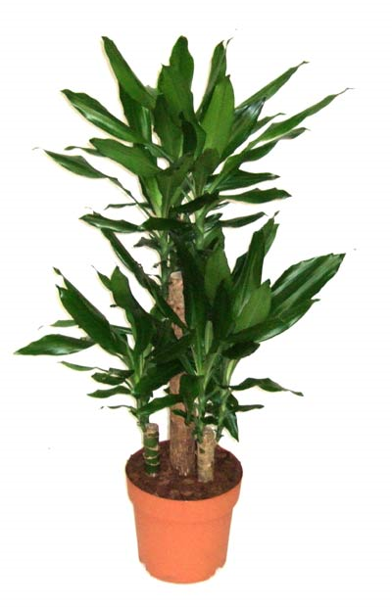
Examples
Nicotine
Atropine

Slide 4
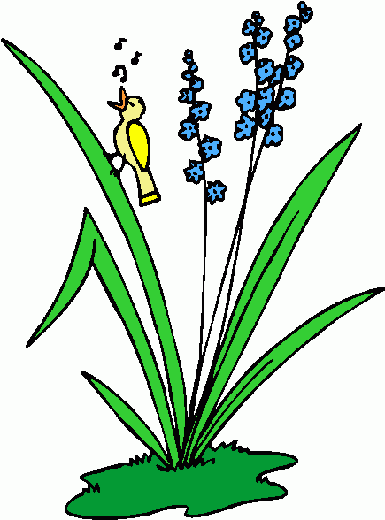
Functions of alkaloids in plants
The possible functions of alkaloids in plants are
1. They are poisonous agents that protect
the plants against insect and herbivores.
2. Alkaloids are reserve substances capable
of supplying nitrogen or other necessary elements to the
plants.
3. They are regulatory growth factors.
4. Alkaloids are the end product of detoxification reaction
representing a metabolic locking up of compounds
otherwise harmful to the plant.

Slide 5
Properties of alkaloids
Most alkaloids are well defined crystalline substances and unite with acids to form salts. In the plants they may exists in the free state or as salts.
The alkaloids are usually insoluble or sparingly soluble in water but their salts with acids are freely soluble.
The free alkaloids are soluble in ether, chloroform or other non-polar solvents in which the alkaloidal salts are insoluble.
This property permits a ready means for the isolation and purification of alkaloids.
The alkaloids usually possess a bitter taste

Slide 6
General properties
They are complex chemical compounds of plant origin.
In addition to Carbon and Hydrogen they all contain Nitrogen and generally also Oxygen.
The Nitrogen atom usually exists in a heterocyclic ring.
Most of the alkaloids are crystalline solids, though a few are amorphous (Exceptions: Coniine, Nicotine and Sparteine are liquid)
Alkaloids are usually colorless compounds (Exceptions: Betaine is red, Berberine is yellow)
Alkaloids are either insoluble or sparingly soluble in water, but their salts with acids are freely soluble in water. They are soluble in organic solvents.
Most of them are precipitated by Dragendorff’s, Mayer’s, Wagner’s and Hager’s reagent.
In plants, alkaloids usually exist in the form of salts of simple organic acids, such as Lactic, Malic, Tartaric or Citric acids (Exceptions: Some alkaloids exist as glycoside e.g. Solanine, Tomatine etc.)
The alkaloids usually possess a bitter taste.
Amino acids are used as the precursor for the biosynthesis of alkaloids.
They are usually basic in nature.

Slide 7
Pharmacological action
The alkaloids have a wide range of pharmacological action. For example:
Analgesic and narcotic Morphine, Codeine
CNS stimulant Strychnine
Mydriatic Atropine
Myotic Pilocarpine
Hypertensive Ephedrine
Antihypertensive Reserpine
Antineoplastic / Anticancer Vinblastine, Vincristine
Emetic Emetine, Sanguinarine
Oxytocic Ergonovine
Skeletal muscle relaxant (+)-Tubocurarine
Cardiac arrhythmia Quinidine

Slide 8
Naming of alkaloids
Based on the Genus: Atropine (Atropa), lobeline (Lobelia), ephedrine (Ephedra)
Based on Species: Cocaine (Erythroxyllum coca), belladonnine (Atropa belladonna)
Based on common Sources: Ergotamine (Ergot)
Based on Pharmacological actions: Emetine (emetic)
Based on the Discoverer: Pelletierine (Pelletier)

Slide 9
Tests for alkaloids
Most alkaloids are precipitated from neutral or slightly acid
solution by various reagents. The precipitate may be
amorphous or crystalline and are of various colors. Such as
Reagent Color of ppt.
Mayer’s reagent Cream
(Potassium mercuric iodide solution)
Wagner’s reagent Reddish brown
(Solution of I₂ in KI)
Dragendorff’s reagent Reddish brown
(Solution of potassium bismuth iodide)
Hager’s reagent Yellow
(Saturated solution of picric acid)

Slide 10
Chemical Tests For Alkaloids
The qualitative chemical tests used for detection of alkaloids are depend on the character of alkaloids to give precipitate as salts of organic acids or with compound of heavy metals like Hg, Au, Pt, etc.
Test by Dragendorff reagent (Potassium-bismuth-iodide solution) : - Alkaloids give reddish-brown precipitate with this reagent.
Test by Mayer reagent (Potassium-mercuric-iodide solution): - Alkaloids give cream colour precipitate with this reagent.

Slide 11
Chemical Tests For Alkaloids…
Test by Wagner reagent (iodine-potassium-iodide solution): - Alkaloids give Brown colour precipitate with this reagent.
Test by Hager reagent (Saturated solution of picric acid): -Alkaloids give yellow colour precipitate with this reagent.
Test by Tannic acid: -Alkaloids gives buff colour precipitate with this acid
Test by Picrolonic acid: -Alkaloids give yellow colour precipitate with this acid.

Slide 12
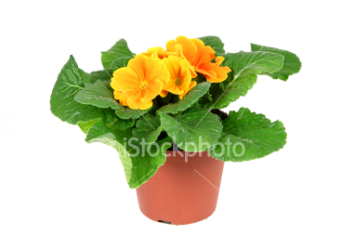
Classification
Alkaloids may be classified in a number of ways.
For example: they may be classified
1. According to source,
2. Chemical structure, or
3. Pharmacological action.
Each system has its own advantages and disadvantages.

Slide 13
Alkaloids can be classified in another way
Types | Features | Examples
True alkaloids | Contain nitrogen in a heterocyclic ring, derived from amino acids and normally occur in plants | Colchicine, quinine, morphine, emetine etc.
Amino / Proto alkaloids | Relatively simple amine in which the amino acid nitrogen is not in a heterocyclic ring | Mescaline and ephedrine
Pseudoalkaloids | Not derived from amino acid precursors and are usually basic in nature | Conessine and caffeine

Slide 14
Classification
Usually they are classified on the basis of the ring structure or nucleus of the alkaloids as follows:
  Pyridine-piperidine group
  Tropane group
  Quinoline group
  Isoquinoline group
  Indole group
  Imidazole group
  Steriodal group
  Alkaloidal amino group
  Lupinane group
  Purine group

Slide 15
  Pyridine - piperidine group
  The alkaloids in this group contain pyridine or piperidine in the molecule. The important alkaloids in this group are nicotine, coniine, arecoline, lobeline etc.
  pyridine piperidine
  Example:
  nicotine coniine

Slide 16
  Tropane group
  Tropane is a dicyclic compound where both pyrrolidine
  and piperidine ring system are present.
  pyrrolidine piperidine tropane
  Example:
  Atropine

Slide 17
Natural sources:
Plants of Solanaceae family are the major sources of tropane alkaloids
Different genus of the family Solanaceae e.g. Atropa, Datura, Hyoscyamus, Scopolia, Duboisia etc.
Besides Solnaceae, they are also found in many species of Erythroxylum (Family: Erythroxylaceae)
The principal alkaloids of therapeutic interest are hyoscyamine, atropine, and hyoscine

Slide 18
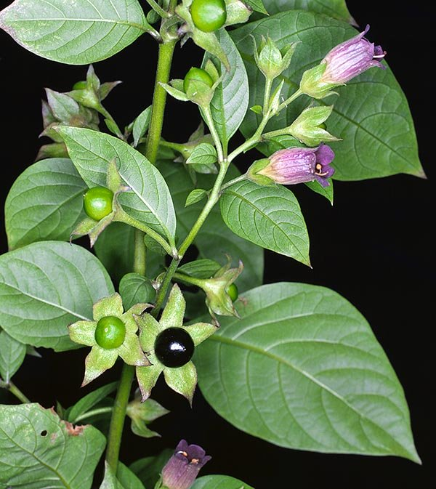
Belladonna (Deadly nightshade)
Biological source:
Belladonna leaf consists of dried leaf and flowering or fruiting tops of Atropa belladonna Linn or its variety acuminata of Solanaceae family.
Belladonna root consists of dried roots of Atropa belladonna Linn.
Family: Solanaceae
The plant is a perennial herb that grows to 1m in height.
“Belladonna” is from two Italian words “bella” meaning beautiful and “donna” meaning lady.
This probably refers to the fact that, juice of the berry of plant when placed in the eyes causes dilation of the pupils giving an outstanding appearance.
Atropa belladonna

Slide 19
Chemical constituents:
  Contains predominantly hyoscyamine
  Other components include atropine, apoatropine, asparagine, choline, chrysatropic acid, volatile bases such as pyridine, atroscine, leucatropic acid, phytosterols, N-methylpyrrolidine, scopoletin, calcium oxalate, 14% soluble acid soluble ash, and 4% inslouble ash
  Uses:
  It is used as anticholinergic, narcotic, sedative, diuretic & mydriatics
  It relieves spasm of gut or respiratory tract
  Consumption of Belladonna reduces excessive perspiration of patients suffering from tuberculosis
  It is also used to treat peptic ulcer disease, histaminic reaction, and motion sickness.
Hyoscyamine

Slide 20
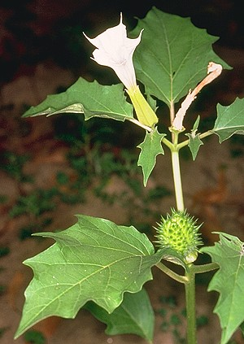
Stramonium (Thorn apple/Jimson weed/Jamestown weed / Devil’s apple)
Biological source
It consists of dried leaf and flowering or fruiting tops (with branches) of Datura stramonium Linn or its variety Tatula torrey of Solanaceae family.
The plant is an annual herb that attains height of about 2m.
Location: Widely found in Europe, Asia, and America. Cultivated in Germany, France, Hungary, and S. America
Datura stramonium

Slide 21
Chemical constituents:
  Contains hyoscyamine and hyoscine
  Other alkaloids include tiglodine, metelodine, 3,6 dihydroxy tropane, norhyoscyamine, noratropine, hygroline, norhyoscine, littorine, acetoxytropane, valtropine, tropine, pseudotropine, cuscohygrine
Hyoscyamine
  Uses:
  It is used as a narcotic, anticholinergic, mydriatic, anthelmentic, anticancer, smooth muscle relaxant & sedative antispasmodic
  Mainly used to relieve the spasm of the bronchioles in asthma
  Also used for the treatment of Parkinsonism
  Fruit juice is used to cure dandruff and falling hair

Slide 22
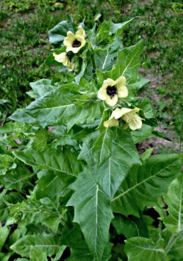
Hyoscyamus (henbane) / Insane root / Hog’s bean / Poison tobacco / Black henbane / Folia hyoscyamus / Khurasani-ajvayan
Biological source
Hyoscyamus or henbane is the dried leaf with or without the flowering or fruiting top of Hyoscyamus niger Linn of Solanaceae family.
Constituents
The drug contains about 0.05 – 0.15% alkaloids (no less than 0.04%). Alkaloids include
Hyoscyamine
Scopolamine
Hyoscyamus niger

Slide 23
Chemical constituents:
  Contains hyoscyamine and hysocine
  Also contains hyoscipicrine, choline, metelodine, tiglodine, acetoxytropane
Hyoscyamine
Hyoscine
  Uses:
  It is used as a narcotic, mydriatic, antiseptic, purgative (Laxative), smooth muscle relaxant, sedative antispasmodic (relieve spasm of involuntary muscle) & CNS stimulant
  Used to treat asthma and whooping cough

Slide 24
  Quinoline group
  Alkaloids containing the quinoline ring as the principal nucleus are quinine, quinidine, cinchonine and cinchonidine.
  Quinoline
  quinine
  Natural sources:
  Different species of the family Rubiaceae such as Cinchona succirubra, Cinchona calisaya, Cinchona ledgereiana, C. officinalis, Remija pedun-culata, R. purdieana etc

Slide 25
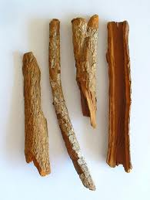
Cinchona / Cinchona Bark / Peruvian bark
Synonyms: Peruvian bark, Cinchona, Calisaya bark, Jesuit’s bark etc
Source: Dried bark of stem or the root of Cinchona succirubra, Cinchona calisaya, Cinchona ledgereiana or C. officinalis
Family: Rubiaceae
Geographical source: South America. Cultivated in Indonesia, Java, Zaire, India, Guatemala, and Bolivia.

Slide 26
Chemical Constituents:
  It contains predominantly quinine (70%), quinidine, and cinchonine
  Other constituents include quinovin, red coloring oxidase, calcium oxalate, and starch
Quinine (R1 = OCH₃, R2 =α-H)
Quinidine (R1 = OCH₃, R2 = β-H
Cinchonidine (R1= H, R2 = α-H)
Cinchonine (R1= H, R2 = β-H)

Slide 27
Uses:
  It has antimalerial, antipyretic, and analgesic properties
  Quinidine is used as prophylactic (intended to prevent disease) for treatment of cardiac arrhythmias
  Bark and other preparations are used in treating intermittent fever
  Act as antiseptic
Side effects
  Large doses of quinine cause loss of hearing, impaired sight, weakening of heart & restlessness
  Cause CNS disturbance, spasm, convulsion, abdominal pains, paralysis of limbs, albuminuria etc.

Slide 28
  Isoquinoline group
  The isoquinoline ring occurs in a number of alkaloids in widely separated plant families. For example:
  papaverine, morphine, emetine etc.
  Isoquinoline
  papaverine
Natural sources:
  Ipecac, Opium, Berberis, Curare, and Sanguinaria

Slide 29
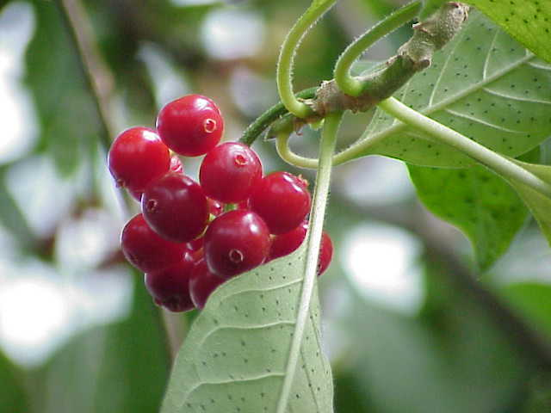
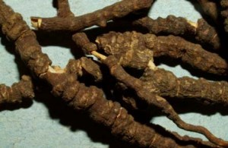
Ipecac
Synonyms: Ipicacuanha, Brazilian or Johor Ipeac, Hippo, Ipicacuanha root
Source: Dried root or rhizome of Cephaelis ipicacuanha or C. acuminata
Family: Rubiaceae
Geographical source: Indigenous to Brazil, and also found in Colombia, Nicargua, Malaya, Burma, Panama, and India

Slide 30
Chemical Constituents:
  It contains predominantly emetine (30-75%)
  Other alkaloids include cephaeline, psychotrine methyl ether, protoemetine, and emetamine
  Other compounds include ipecacuanhin, ipicoside, traces of ipecamine and hydroipecamine, malic acid, citric acid, saponins, starch, calcium oxalate and resin
Uses:
  It is emetic and used as an expectorant
  It is used in the treatment of amoebic dysentery
Emetin (R = CH₃)
Cephaeline (R = H)

Slide 31
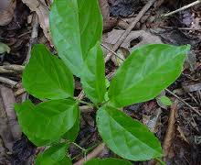
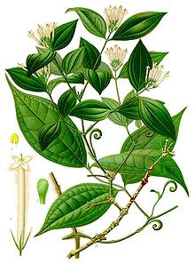
Curare / (South American Arrow Poison)
Synonyms: Ourari, Urari, Woorari, S. American arrow poison, Wourara
Source: Dried extract from the bark and stems of Strychons castelnaei, S. toxifera, S. crevauxii, S. jobertiana & C. microphylla
Family: Loganiaceae and Menispermaceae
Geographical source: It is generally found in Southern America

Slide 32
Chemical Constituents:
  It contains several alkaloids and quaternary compounds
  Most important compound is d-tubocurarine which is quaternary compound
  C. microphylla possesses one quaternary base (+)-bebeerine while (-)-bebeerine has been isolated from C. tomentosum
  Menispermaceous Curare has (+)-tubocurarine, (+)-isochondrodendrine, isochondrodendrine methyl ether, curine and (+)-chondrocurine
  Loganiaceous curare contains 12 crystalline quaternary alkaloids, toxiferines I-XII
Bebeerine

Slide 33
Uses:
  Curare is used as source of alkaloids
  Tubocurarine chloride has muscular relaxation effect in surgery and is used to control convulsions of strychnine poisoning and of tetanus

Slide 34
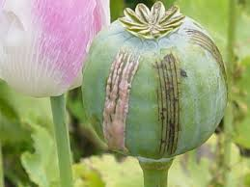
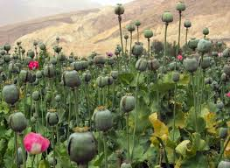
Opium
Synonyms: Crude Opium, Raw Opium, Gum Opium, Afim
Source: It is obtained by incision from the unripe capsules of Papaver somniferum
Family: Papaveraceae
Geographical source: Turkey, Russia, Yugoslavia, Tasmania, India, pakistan, Iran, Afganistan, China, Myanmer, Thiland, Laos and India

Slide 35
Chemical Constituents:
  Opium contains about 25 alkaloids, predominantly morphine (10-16%)
  The alkaloids are combined with meconic acid
  Different alkaloids are:
  Morphine type: Morphine, codeine, neopine, pseudo-or oxymorphine, thebaine and porphyroxine
  Phthalide isoquinoline type: Hydrocotarnine, narcotoline, L-narcotine, noscapine, oxynarcotine, and narceine
  Benzyl isoquinoline type: Papaverine, xanthaline, D-L-laudanine, laudanidine, codamine, and laudanosine
  Cryptopine type: Protopine, cryptopine
  Unknown types: Aporeine, rhodeadine, meconidine, papaveramine and lanthopine
  The drug also contains sugars, sulphates, albuminous compounds, coloring matter, anisaldehyde, vanillin, vanillic acid, p-hydroxystyrene, fumaric acid, lactic acid, benzyl alcohol, phthalic acid, hemipinic acid, meconin and some odorous compounds

Slide 36
Morphine (R1 = R2 = H)
Codeine (R1 = CH₃ R2 = H)
Meconic acid
Papaverine
Narcotine
Thebaine
Narceine

Slide 37
Uses:
  Opium and morphine have narcotic, analgesic, and sedative action which are commonly used to reduce pain, diarrhea, dysentery and cough
  Poppy capsules are astringent, somniferous, sedative, and narcotic
  Opium is first stimulant, then narcotic, anodyne, antispasmodic, hypnotic, intoxicant, cerebral depressant, astringent and myotic
  As astringent opium checks haemorrhages, lessens bodily secretions and restrains tissue changes
  Codeine is mild sedative and employed in cough mixtures
  Nosocapine is non-narcotic and also has cough suppressant action acting as a central antitussive drug
  Papaverine has smooth muscle relaxant action and used to cure muscular spasms
  Opium, morphine, and diacetyl morphine (heroin), cause drug addiction

Slide 38
Indole alkaloids
These drugs contain indole nucleus in their structure
Indole
The major sources of indole alkaloids are Ergot, Nux vomica, Physostigma, Vinca etc

Slide 39
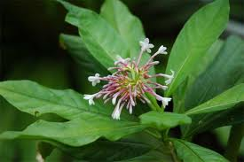
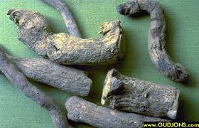
Rauwolfia
Synonyms: Sarpagandha, Chandrika, Chootachand, Indian snake root
Source: It is the dried roots of Rauwolfia serpentina.
Family: Apocyanaceae
Geographical source: Native to India. Also found in Thailand, Philippines, Indonesia, Pakistan, Malaysia, and Bangladesh

Slide 40
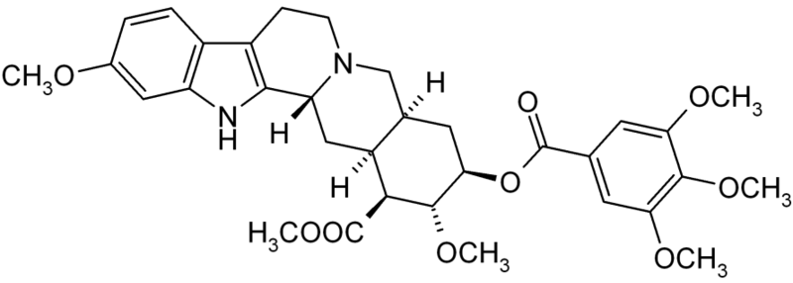
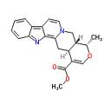
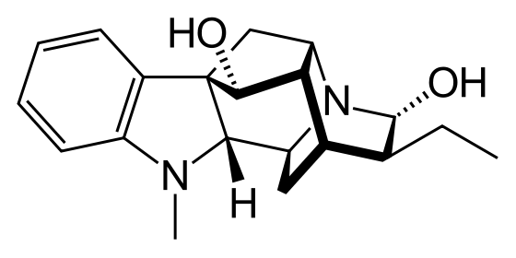
Chemical Constituents:
  It contains about 0.7-2.4% of total alkaloidal bases from which more than 80 alkaloids have been isolated
  The prominent alkaloids include reserpine, rescinnamine, γ-resepine, rescidine, raunescine and deserpidine
  The other alkaloidal compounds include ajmalinine, ajmaline, ajmalicine, serpentine, serpentinine, tetrahydroreserpine, raubasine, reserpinine, isoajamaline, rauwolfinine and alstonine
  Other substances include phytosterols, fatty acids, unsaturated alcohols and sugar
Reserpine
Ajmaline
Serpentine

Slide 41
Uses:
  It is used as hypnotic, sedative, and antihypertensive
  It reduces blood pressure, and cures pain
  It is employed in labors to increase uterine contractions and in certain neuropsychiatric disorders

Slide 42
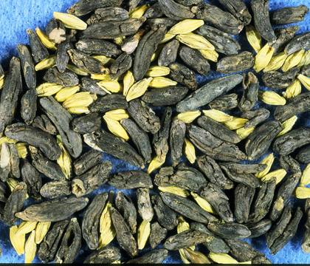
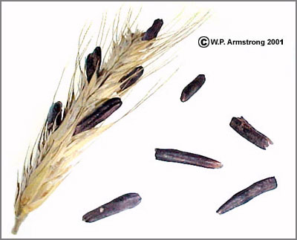
Ergot
Synonyms: Ergot, Rye ergot, Scale cornutum, Ergota, Ergot of rye
Source: Dried sclerotium of a fungus, Claviceps purpurea, developing in the ovary of rye plant, Secale cereale.
Family: Clavicipitaceae
Geographical source: Czechoslovkia, Hungary, Switzerland, Germany, France, Yugoslovia, Spain, Russia and India

Slide 43
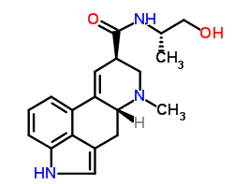
Chemical Constituents:
  A large number of alkaloids have been isolated of which important alkaloids are ergonovine and ergotamine
  Ergot alkaloids are classified as three groups:
    Ergometrine group (Water soluble): Ergometrine, ergometrinine
    Ergotamine group (Water insoluble): Ergotamine, ergotaminine, ergosine and ergosinine
    Ergotoxine group ( water insoluble): Ergocristine, ergocristinine, ergocryptine, ergocryptinine, ergocornine, and ergocorninine
  Other chemicals include histamine, tyramine, putrescine, cadaverine, agmatine, amino acids, acetylcholine, coloring matters, ergosterol, fungisterols, elymoclavine, sclereythrin, erggonovine, ergothioneine, clavicepsin, betaine, clavine, fat, mannitol, lactic acid and succinic acid
Ergometrine

Slide 44
Uses:
  Ergot is oxytocic & vasoconstrictor
  Ergot is used to assist delivery and to reduce postpartum hemorrhage
  Also used to treat migraine

Slide 45
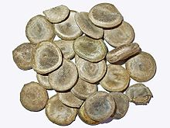
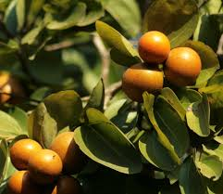
Nux vomica
Synonyms: Nux vomica seeds, Kuchla, Quaker buttons, Bachelor’s buttons, Posion nut
Source: It is the ripe, dried seed of Strychons nux-vomica
Family: Loganiaceae
Geographical source: Native to East India and forest of Srilanka, Malabar coast, and N. Australia.

Slide 46
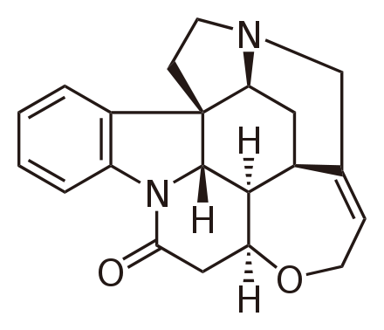
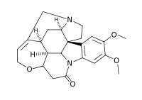
Chemical Constituents:
  Important alkaloids are strychnine and brucine
  Other alkaloids include α-colubrine, β-colubrine, icajine, 3-methoxyicajine, protostrychnine, vomicine, novacine, N-oxystrychnine, pseudostrychnine, and isostrychnine
  Other compounds include chlorgenic acid, loganin, secologanin, fixed oil (3%), and proteins
Strychnine
Brucine

Slide 47
Uses:
  Strychnine is used as circulatory stimulant and bitter tonic
  It increase the tone of intestine
  Strychnine improves the appetite and digestion
  It is a powerful poison at large doses, producing tetanic convulsion and death

Slide 48
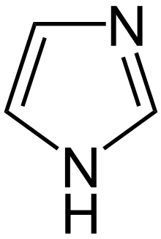
Imidazole alkaloids
These drugs contain imidazole nucleus in their structure
Imidazole
The major sources of imidazole alkaloids are Pilocarbus jaborandi, P. pinnatifolius, P. microphyllus and P. racemous

Slide 49
Pilocarpus
Source: Pilocarpus jaborandi or P. microphyllus (Fam: Rutaceae)
Properties:
  Principle alkaloids are Pilocarpine and isopilocarpine
  Other alkaloids are Pilocarpidine, Pilosine etc.
Uses:
    Has parasympathomimetic activity
    It is used in the treatment of glaucoma
    Pilocarpine

Slide 50
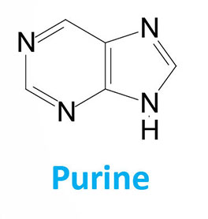
Purine alkaloids
These drugs contain purine base in their structure
Pharmaceutically important bases of this group are methylated derivatives of 2,6-dioxypurine (Xanthine)
Caffaine or 1,3,7-trimethyl xanthine
Theophylline or 1,3-dimethyl xanthine
Theobromine or 3,7-dimethyl xanthine

Slide 51
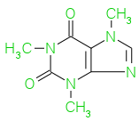
Coffea
Biological source:
It is the dried, ripe seeds of Coffea Arabica or C. liberica
Family: Rubiaceae
Geographical source:
It is indigenous to Ethiopia and other parts of Eastern Africa and is widely cultivated in tropical countries like Indonesia and Sri Lanka and central and South America.
Constituents:
It contains-
Caffeine (1-2%)
Trigonelline (0.25%)
Tannin (3-5%)
Sugar (15%)
Fatty oil (10-13%)
Protein (10-13%)
Use:
  Caffeine is the main principle which is CNS stimulant
  It reduces physical fatigue and restores alertness when drowsiness occurs
  It produces increased wakefulness, faster and clearer flow of thought, increased focus, and better general body coordination
  It is a diuretic
Caffaine

Slide 52
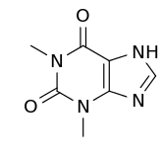
Tea/Thea
Biological source:
Tea is the prepared leaves or leaf buds of Camelia sinensis
Family: Theaceae
Geographical source:
It is indigenous to Eastern Asia. It is extensively cultivated in Bangladesh, China, Japan, India and Indonesia.
Constituents:
Tea contains-
Caffeine (1-4%)
Adenine
Theobromine
Theophylline
Xanthine
gallotannic acid
volatile oil etc.
Use:
As beverage
Stimulant & Diuretic
Theophylline

Slide 53
  Steroidal group
  The steroidal alkaloids are characterized by the cyclopentanoperhydrophenanthrene nucleus. The important alkaloids are protoveratrine A and B, Aconitine, conessine etc.
  Example:
  Cyclopenteno-perhydro-phenanthrene
  Conessine

Slide 54
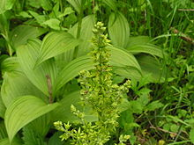
Veratrum viride (green hellebore)
Biological source
It is dried rhizome and roots of Veratrum viride
Family: Liliaceae
It is a perennial herb attaining 0.7 to 2 m height.
Constituents
It contains a large number of alkaloids as follows-
Esters of alkamines (steroidal bases): Germidine, germitrine, cevadine, protoveratrine etc.
Glucosides of alkamines: Pseudojervine, veratrosine.
The alkamines: Jervine, rubijervine, germine etc.
Among them germidine and germitrine are most important therapeutically.
Use
It possesses hypotensive, cardiac depressant and sedative properties.
It is used in the treatment of hypertension.
As insecticide.

Slide 55
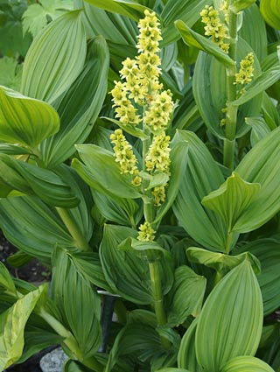
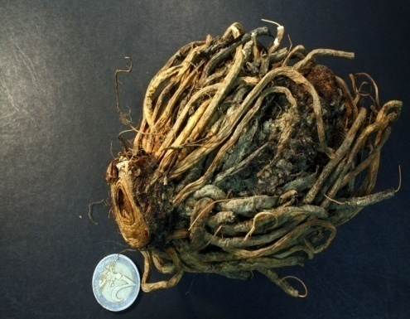
Veratrum album (white hellebore)
Biological source
It is dried rhizomes of Veratrum album. It is also a perennial herb but the external color is lighter compare to V. viride.
Family: Liliaceae
Constituents
Similar to V. viride. Two ester alkaloids protoveratrine A and B are most active.
Use
It has hypotensive properties
As insecticides

Slide 56
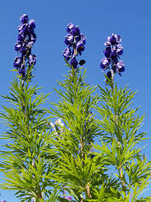
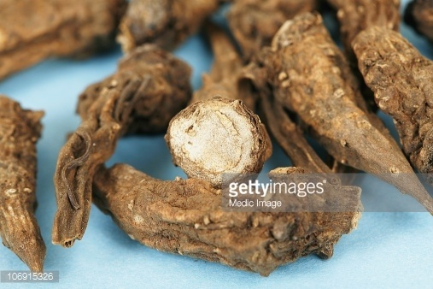
Aconite napellus
Biological source
It is dried tuberous roots of Aconitum napellus. The plant is perennial herb.
Family: Renunculaceae
Constituents
It contains aconitine, aconine and aconitic acid etc.
Use
Has cardiac effect but
Principally used as local analgesic in liniments

Slide 57
  Lupinane group
  The alkaloids in this group contain a dicyclic lupinane ring. For example , Sparteine, lupinine etc.
  Lupinane
  Example:
  Lupinine

Slide 58
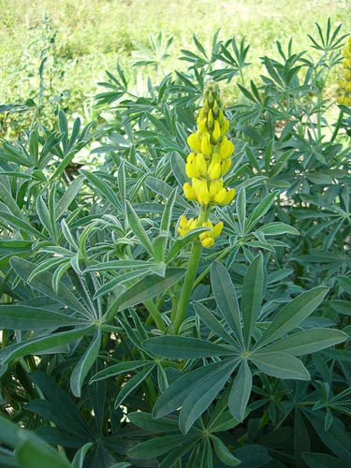
Lupinus luteous
Biological source
Lupinus is obtained from Lupinus luteus.
The plant is an annual herb and cultivated as ornamental plant.
Family: Fabaceae
Constituents
Important constituents is Lupinine.
Use
Not medicinally important.

Slide 59
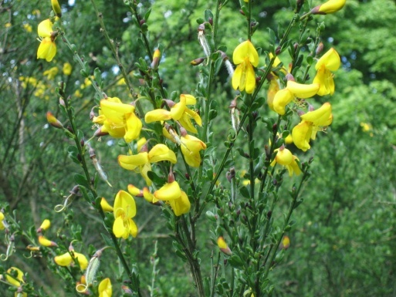
Cytisus scoparius
Botanical Source
It is the dried tops of Cytisus scoparius.
Family: Leguminosae
Constituents
Its main constituents are Lupinane alkaloids including Sparteine and flavonoids.
Use
It is an oxytocic and is used in the treatment of uterine inertia.

Slide 60
  Alkaloidal amine group
  The alkaloids in this group do not contain heterocyclic nitrogen atoms. For example, Colchicine. Some are simple derivative of phenylalanine like ephedrine, mescaline etc.
  Example:
  Colchicine
  Phenylethylamine Ephedrine

Slide 61
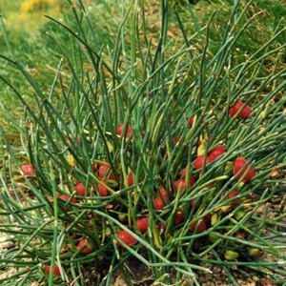
Ephedra sinica (Ma huang)
Biological source
It is the entire plant or the overground portion of Ephedra sinica.
The plant is a low, dioecious (male and female reproductive organs on different plants) practically leafless shrub that attain 60-90 cm. height.
Family: Gnetaceae
Constituents
The important constituent is ephedrine. It may also contain pseudoephedrine and some other related compounds.
Use
Ephedrine is a potent sympathomimetic (excites the sympathetic nervous system).
It raises blood pressure and causes mydriasis and act as bronchodilator.

Slide 62
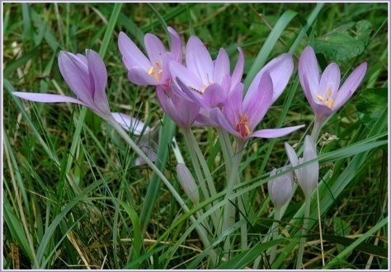
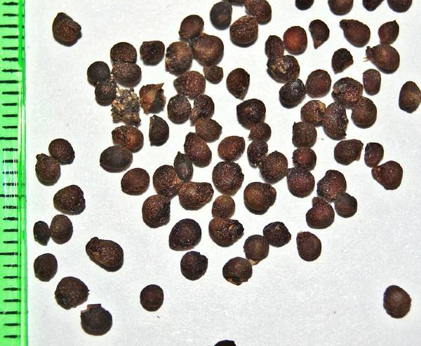
Colchicum autumnale
Biological source
It is dried, ripe seed (or corn) of Colchicum autumnale.
Two to six flowers with long perianth (outer part of a flower) tube develop from the underground plant. The arabs had recommended the use of colchicum in the treatment of gout.
Family: Liliaceae
Constituents
It contains colchicine, colchicine like alkaloids, resin, fixed oil and reducing sugars. The seed contains upto 0.8% colchicine (corn contains 0.6% colchicine).
Use
It is used in the treatment of gout.

Slide 63
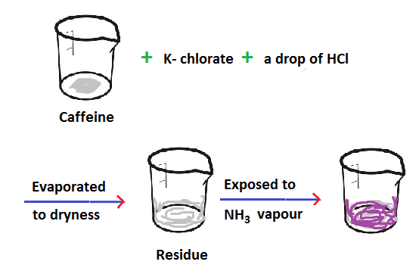
Detection of purine alkaloids:
Purine alkaloids do not respond to the normal tests of alkaloids. These alkaloids are detected using Murexide test.
In the Murexide test the sample of alkaloid is taken in a beaker and small amount of potassium chlorate (KClO₃) and a drop of conc. HCl were added. Then the content of the beaker was evaporated to dryness. The beaker was then exposed to NH₃ vapor. A purple/pink color indicates the presence of purine alkaloids.

Slide 64
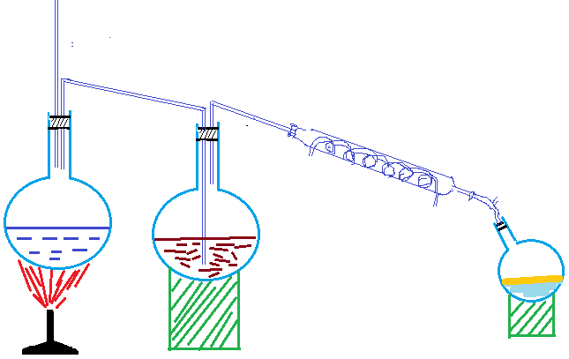
Extraction of alkaloids

Slide 65
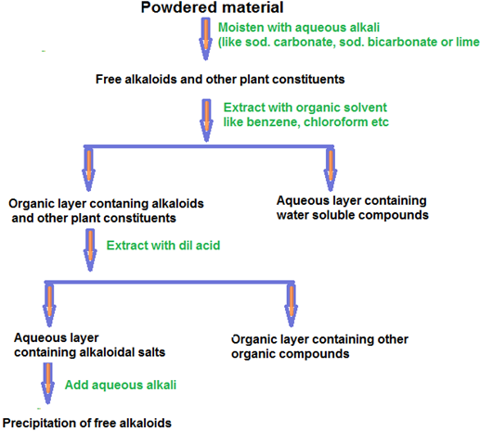
Extraction of alkaloids
Process I

Slide 66
Description
The powdered material is moistened with aqueous alkali [water and mixed with lime which combines with acids, tannins and other phenolic substances and sets free the alkaloids (if they exist in the plant as salts)].
The alkaloids are set free with other plant constituents.
Extraction is then carried out with organic solvents such as Benzene or chloroform (either or petroleum spirit).
The concentrated organic liquid which contains alkaloids and other plant constituents is then extracted with dilute acid (aqueous acid) and allowed to separate.
Alkaloid salts are now in the aqueous liquid, while many impurities remain behind in the organic liquid.
Aqueous alkali is added to the aqueous layer giving precipitation of free alkaloids.

Slide 67
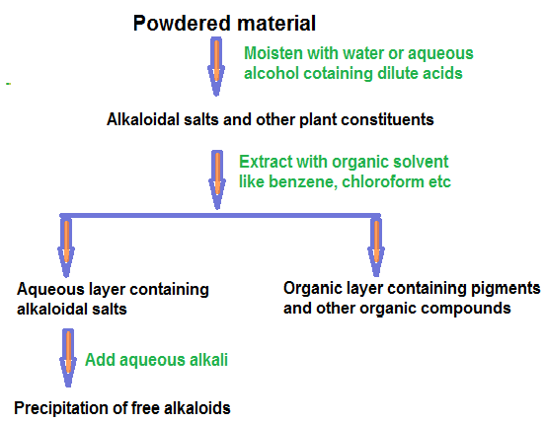
Process II

Slide 68
Description
The powdered material is extracted with water of aqueous alcohol containing dilute acid.
We get alkaloidal salts and other plant constituents.
Pigments and other unwanted materials are removed by shaking with chloroform or other organic solvents.
Then we get aqueous layer containing alkaloidal salts.
The free alkaloids are then precipitated by the addition of aqueous alkali (excess sodium bicarbonate or ammonia) and separated by filtration or by extraction with organic solvents.

Slide 69
Biosynthesis of Tropane alkaloids
Tropane is formed by the condensation of pyrrolidine compound with 3 acetate derived carbon atoms.
The pyrrolidine ring is formed from amino acid ornithine.
The remaining 3 carbon atoms are derived from acetate and methylation results in the completion of the tropine nucleus.
The 3-hydroxy derivative of tropane is called tropine.
On the other hand from phenylalanine tropic acid is formed via rearrangement and other reactions.
Esterification of tropine and tropic acid results in the formation of Hyoscyamine and thus other Tropane alkaloids are synthesized.

Slide 71
Biosynthesis of Tropane Alkaloid

Slide 73
Biosynthesis of Cocaine

Slide 74
Biosynthesis of Quinoline Alkaloids
The precursor of quinine and other Quinoline alkaloids is Tryptophan.
Its biosynthesis in plant is not fully understood but in microorganisms it is obtained via shikimic acid pathway.
In this pathway, shikimic acid through a series phosphorylation reaction yields chorismic acid.
Chorismic acid is an important branch point where one branch leads to prephenic acid and then to aromatic amino acids like tyrosine, phenylalanine where the other branch lead to anthralinic acid and then to Tryptophan.
Tryptophan and corynanthe like monoterpene form corynantheine which yield quinine.

Slide 75
Biosynthesis of Tryptophan in Microorganism

Slide 77
Biosynthesis of Isoquinoline Alkaloids
From phenylalanine of tyrosine Phenylethylamine derivatives and phenylacetaldehyde derivatives are obtained which are condensed to give Isoquinoline alkaloids.
Morphine (and codeine, thebaine) is also formed from tyrosine (2 molecules) and in the biosynthetic pathway Norlaudanosoline is a key intermediate.

Slide 79
Biosynthesis of Indole Alkaloids
The precursor of indole alkaloids is tryptophan and monoterpenoid skeleton.
Alkaloids like reserpine, serpentine are synthesized from tryptamine and corynanthe monoterpenoid precursor.
The ergot alkaloids are synthesized by alkylation of Tryptophan by DMAPP (Dimethyl allyl pyrophosphate)as illustrated below:

