Slide 1
Glycosides
BPH-122

Slide 2
Glycosides
Glycosides are compound that yield, upon hydrolysis, one or more sugars and a compound which is not sugar among the product of hydrolysis. The most frequently occurring sugar is β-D glucose although rhamnose, digitoxose, cymarose and other sugars are found as components of glycosides.
The bond by sugar molecules attached to non-sugar molecule is called glycosidic bond.

Slide 3
Glycoside is composed of two parts-
a. Sugar part known as glycone
Responsible for the pharmacokinetic properties of the drug. Such as- ADME (absorption, distribution, metabolism and excretion).
Sugar helps in the solubilization of non-sugar, for increasing the bioavailability of the drug.
The most frequently occurring sugar is β-D-glucose, although rhamnose, digitoxose, cymarose and other sugars are the components of glycosides.
b. Non-sugar part known as aglycone or genin
It is the active part of glycoside which is responsible for the pharmacological properties. Aglycone part may be alcohol, phenol, cyanohydrin or heterocyclic poly-hydroxy compounds.

Slide 5
Chemistry of Glycosides
In chemistry, a glycoside is a molecule in which a sugar is bound to another functional group via a glycosidic bond.
The sugar group is then known as the glycone and the non-sugar group as the aglycone or genin part of the glycoside. The glycone can consist of a single sugar group (monosaccharide) or several sugar groups (oligosaccharide).

Slide 6
Biosynthesis
Involves 2 processes:
Uridine triphosphate (UTP) [pyrimidine nucleoside triphosphate] is an activator of metabolic reactions which produces UDP-sugar & inorganic phosphate by uridylyl transferase enzyme [isolated from animal, plant and microbial sources].
Transfer of sugar from UDP to aglycone by glycosyl transferase enzyme [found in Golgi apparatus and Endoplasmic reticulum] .
UTP + sugar
UDP-sugar + PP(i) [Inorganic pyrophosphate]
UDP-sugar + Aglycone
Aglycone-Sugar + UDP

Slide 7
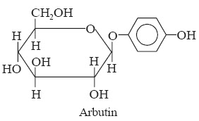
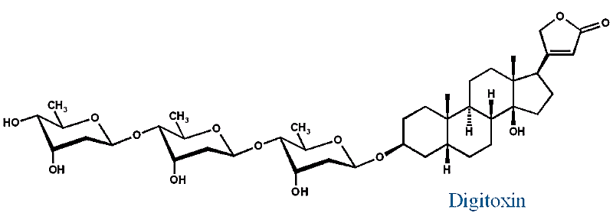
All glucosides are glycoside, but all glycosides are not glucoside.
Glucoside= glucose + non-sugar part
Ex: Arbutin = Glucose + Hydroquinone
It’s used as diuretic & urinary antiseptic.
Glycoside= sugar part + non-sugar part
Ex: Digitoxin = Digitoxose + Digitoxinogen
It’s used in the treatment of cardiac problems.

Slide 8
Classification of Glycosides
On the basis of linkage of sugar molecule to aglycone
On the basis of chemical nature of aglycones
On the basis of types of sugar attached
On the basis pharmacological effects

Slide 9
On the basis of linkage of sugar molecule to aglycone
  O-glycosides: sugar is combined with alcoholic or phenolic -OH group e.g. digitoxin
  N-glycoside: Nitrogen of amino group (-NH2/-NH-) is condensed with a sugar e.g. nucleoside
  S-glycoside: sugar moiety attached to S of the aglycone e.g. isothiocyanate glycosides
  C-glycosides: Condensation of sugar directly to a carbon atom gives rise to C-glycosides. e.g. aloin
Limitations:
Biological activities are ignored here.
Number of aglycones are ignored.
Linkage of sugar molecules with aglycones never indicate the pharmaceutical activities of the glycosides.

Slide 10
On the basis of chemical nature of aglycones
  Steroidal/Cardioactive glycosides: Contains sterol as an aglycone e.g. digitalis, strophanthus etc.
  Flavonoid glycoside: Contains flavonoid as aglycone e.g. rutin
  Anthracene glycosides: Sugar moiety attached to an anthracene aglycone e.g. aloin
  Cyanogenic glycoside: Cyanogen is the aglycone part e.g. prunasin
  Alcohol glycoside: alcohol compounds attached to sugar e.g. salicin
  Lactone glycosides: e.g. hydroxy coumarin
  Isothiocyanate: e.g. sinalbin
  Saponin glycosides: e.g. dioscin

Slide 11
On the basis of types of sugar attached / Glycone part
Glucose - glucoside group like in Sennoside.
Rhamnose - Rhamnoside like in frangullin.
Digitoxose - Digitoxoside like in digoxin.
Glucose and Rhammnose - Glucorhamnoside _ glucofrangulin.
Rhamnose and glucose - Rhamnoglucoside _ Rutin.
Limitation:
It is unable to comprise all the glycosides, only a few sugars are known.
Gives no information about the biological activity of the glycoside.
One can’t be concerned about the chemistry of aglycone molecules here.

Slide 12
On the basis pharmacological effects/Therapeutic effects
CHF and cardiac muscles stimulators such as:
Digitalis glycosides: digoxin, digitoxin, gitoxin (Fox glove leaves).
Ouabain: Strophanthus gratus seeds.
K-strophanthin -Strophanthus kombe seeds.
Scillaren A,B which isolated from red and white Squill bulbs.
Laxative group of glycosides:
Sennoside A, B, C, D (Senna leaves and fruits).
Cascaroside A,B (Cascara bark).
Frangulin and glucofrangulin (Frangula bark).
Aloin and barbaloin (Aloe vera and Aloe barbadensis juice).
Local irritant group:
Sinigrin (Black mustered seeds_Brassica nigra)
Sinalbin (White mustered seeds_Brasica alba)

Slide 13
Analgesics and antipyretics: Salicin
Keeping elasticity of blood vessels like:
Rutin - Rutoside (Bitter orange peels, Lemon peels)
Anti-inflammatory group:
Aloin for acne and peptic ulcer
Glycyrrhizin
Limitations:
Biologically inactive glycosides are out of consideration.
Ignores many chemically important & unique glycosides.

Slide 14
Functions of glycosides
In plant:
Protective function
Regulatory function
In animal (Pharmacology related):
Cardiac diseases: Digitalis and Strophanthus contain cardiac glycosides and used as cardiac stimulant, e.g.: Digitoxin.
Laxatives: Anthraquinone glycosides present in Senna, Cascara, Rhuhburb and Aloe, are used as laxatives
Tonic: Picrorhiza roots and rhizomes possess picroside glycoside and are utilized as tonic to protect damaged liver
Expectorant: Wild Cherry bark glycosides have expectorant properties
Analgesic: Gaultherin from Wintergreen is used as analgesic

Slide 15
In pharmaceutical aid:
Flavoring agent: Vanillin, Coumarin
Coloring agent: Saffran
As a vehicle: Wild cherry

Slide 16
Cardiac
Glycosides

Slide 17
What are cardiac glycosides?
Cardiac glycosides are organic compounds that act on the contractile force of the cardiac muscle.
Chemically they are steroidal. Thus they are called steroidal glycosides but, another type of steroidal glycosides (saponins) exists. Saponins aren’t cardio-active.
Historically cardiac glycosides have been used to assassinate people, they were ingredient of arrow poisons.
Cardiac glycosides have similar structure and basic action on heart, such as :-
Increase the force of contraction (Inotropic effect)
Decrease heart rate
Maintain an effective circulation

Slide 18
Source of cardiac glycosides
Plant source | Active glycosides | Aglycone part | Glycone part
Digitalis purpurea (leaf) | Digitoxin | Digitoxigenin | Digitoxose
 | Gitoxin | Gitoxigenin | Digitoxose
Digitalis lanata (leaf) | Digitoxin | Digitoxigenin | Digitoxose
 | Digoxin | Digoxigenin | Digitoxose
Strophanthus gratus | G. strophanthin | Ouabagenin | Rhamnose
Strophanthus kombe | Strophanthin | Strophanthidin | Cymarose

Slide 19
Chemical nature and structure
The basic structure of the aglycone of cardiac glycoside contains a steroidal nucleus/skeleton.
All the glycosides posses –OH group at the C-3 & C-14 positions.
–OH group at C-3 position should be β oriented and Sugars are attached to the hydroxyl group at C-3 position.
Glycone part may contain 1-4 sugar molecules. Different types of sugar molecules such as glucose, rhamnose, antiarose, digitalose, thevetose, digitoxose, cyamarose etc can be attached to the aglycone

Slide 20
A 5 or 6 numbered unsaturated lactone ring is attached to the steroidal ring via C-17.
the lactone ring must be unsaturated for the biological activity of cardiac glycosides.
Based on the type of lactone ring cardiac glycosides are of two types:
Cardenolides: Contains 5 numbered lactone ring
Bufanolides/bufadienolides: Contains 6 numbered lactone ring
Cardenolides
Bufadienolides

Slide 21
Some glycosides have same aglycone but different sugar e.g. lanatoside A and purpurea glycoside A. In contrast, some glycosides have same sugar but different aglycone e.g. digitoxin and gitoxin.
In addition, CH₃, CHO, CH₂OH groups are attached to the ring in specific position that varies with the particular aglycone.

Slide 22
Structural features of cardiac glycosides
Steroidal nucleus must be present.
3β-OH group involved in glycosidic linkage.
14β-OH group at C-14.
A/B ring junction cis
B/C ring junction trans
C/D ring junction cis
Additional OH groups at C-5, C-11 and C-16 may be present.
The presence of lactone ring:
Cardenolides: Contains 5 numbered lactone ring
Bufanolides/bufadienolides: Contains 6 numbered lactone ring

Slide 23
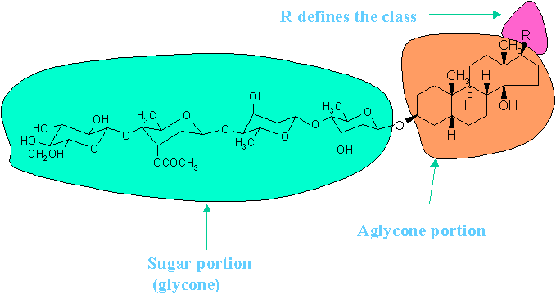
Fig: Structure of a cardiac glycoside

Slide 24
Importance of non-sugar part in cardiac glycoside
Aglycone part of the cardiac glycosides is mainly responsible for pharmacological activity. It consists of 3 parts:
Steroid nucleus: causes immediate but brief action on the force of contraction of the heart .
Lactone ring: responsible for the prolonged cardiotonic action. Opening or saturation of the ring may cause the inactivity of the glycoside.
Hydroxil group: responsible for prolonged cardiotonic action. It also determines solubility, absorption and protein binding.

Slide 25
Importance of sugar part in cardiac glycoside
Aglycones are less active than intact glycosides indicating that the sugar moieties are important functional part of the glycosides.
Sugar part is responsible for the pharmacokinetic properties of drug, such as: absorption in blood, half-life, metabolism, water solubility, distribution in cardiac tissues and elimination.
Attachment of sugar moiety increases the potency and duration of action of the drug.
This part also prevents the enzymatic reaction of aglycone part which may change the steric configuration of the glycoside and inactivate it.

Slide 26
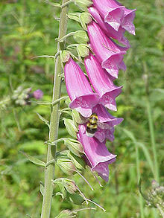
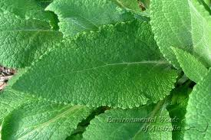
Digitalis
Synonyms:
  Foxglove, Digifortis, Folia Digitalis, Digitalis Folium
Source:
  Digitalis is the dried leaves of Digitalis purpurea belongs to the family Plantaginaceae
  Leaves should be dried gently & rapidly after collection at 60⁰C and they must contain less than 5% moisture.
  The dried leaves must be stored in an air tight and light protected container.
  Otherwise, it will absorb moisture and lose their pharmacological activity.
Geographical sources:
  England, Germany, Holland, France, USA, India etc

Slide 27
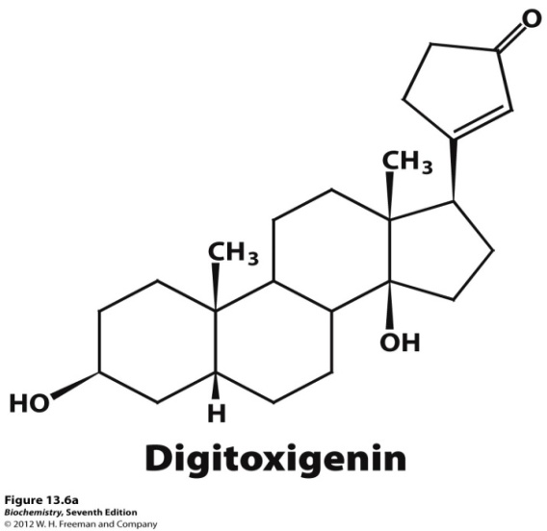
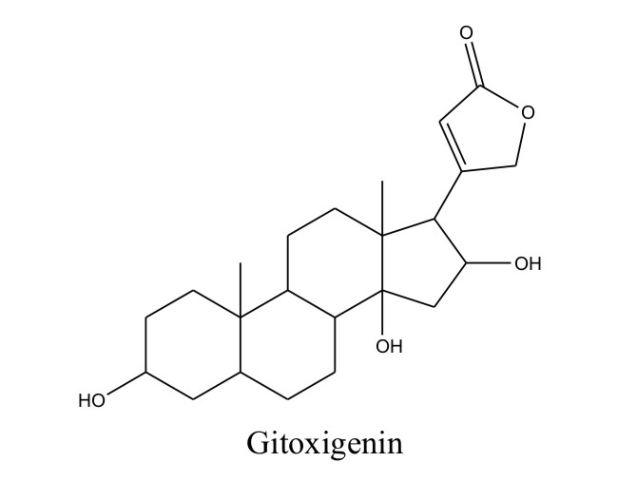
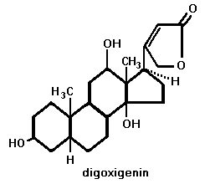
Chemical constituents:
  It contains about 35 cardiac glycosides.
  Among them digitoxin, gitoxin, digoxin, purpurea glycosides A and B, gitaloxin are the main cardiac glycosides
  In addition, it contains digitalin, gitalin, digitonin, volatile oils, antirrhinic acid, an oxidase enzyme and tannic acid

Slide 28
Uses:
  Used as heart tonic which improves heart function
  It increases the force of contraction of the cardiac muscle and cardiac output
  It increases blood circulation and urine formation which is directly related to improved heart function
  It can be used as diuretic
Dosage:
  Can be given as tablet to the patient. Initial dose usually 1 to 2 g and maintenance dose 100 to 200 mg.

Slide 29
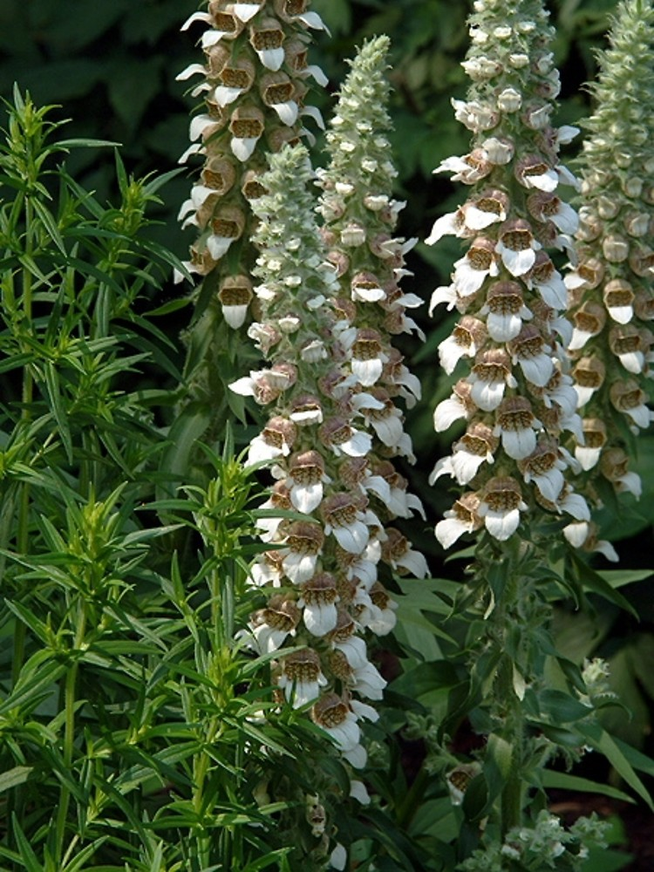
Another source of Digitalis is Digitalis lanata belongs to the family Plantaginaceae
Nearly 70 different glycosides have been detected from the leaves of Digitalis lanata.

Slide 30
Differences between Digitalis and digitalis lanata:
Digitalis purpurea | Digitalis lanata
Derived from D. purpurea. | Derived from D. lanata.
Nearly 35 glycosides have been identified. | Nearly 70 glycosides have been found.
The glycosides are derivatives of 3 aglycones (digitoxigenin, gitoxigenin, gitaloxigenin). | The glycosides are derivatives of 5 different aglycones (digitoxigenin, gitoxigenin, gitaloxigenin, digoxigenin,diginatigenin).
Digoxigenin and diginatigenin glycosides aren’t found. | Digoxigenin and diginatigenin glycosides are principle constituents.
Digitoxin concentration is higher. | Digitoxin concentration is lower.
Primary glycosides do not contain an acetyl group. | Primary glycosides contain an acetyl group.

Slide 31
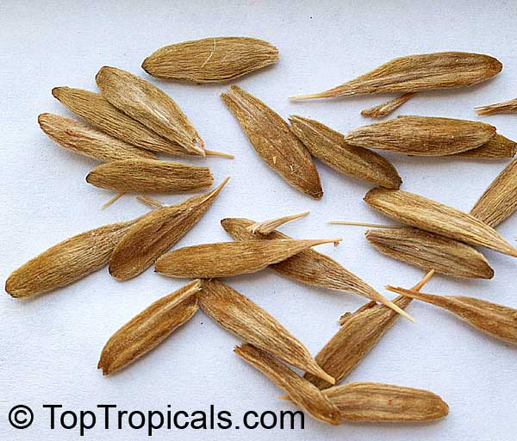
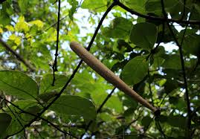
Strophanthus
Synonyms:
  Strophanthus seeds, Semina Strophanthi
Source:
  It is derived from the dried seeds of Stophanthus kombe which belongs to the family Apocyanaceae
Geographical sources:
  Strophanthus is a perennial herb that wildly grown in East and Central Africa

Slide 32
Chemical constituents:
  It contains about 5% cardiac glycosides
  The main cardiac glycosides include strophanthin
  The aglycone of these glycosides is called strophanthidin.
  It also contains kombic acid, trigonelline, choline and 30% essential oil.
Uses:
  Seeds of Strophanthus are used as arrow poison by African tribal
  It is also used as heart tonic like Digitalis
  Increase circulation in case of chronic heart weakness
  Can be used as diuretic
Dose:
  60 mg
Strophanthidin
Samentogenin
Ouabagenin

Slide 33
ANTHRAQUINONE
Glycosides
BPH-122

Slide 34
General properties of anthraquinone glycoside
Must have an anthracene nucleus or it’s derivative
Sugar is attached to aglycone via either oxygen or C- bond
Anthraquinone glycosides are usually orange-red in color.
They are soluble in water and diluted alcohol.
Anthraquinone and related glycosides are cathartics & laxatives.

Slide 35
General properties of anthraquinone glycoside
Anthranol and anthrone:
  They are formed by reduction of anthraquinone
  They can be found as free or glycosidic form
  Anthrones are off white in color & alkali insoluble substances
  Anthranoles are yellowish in color & alkali insoluble substances
Anthrone
Anthranol
Anthraquinone

Slide 36
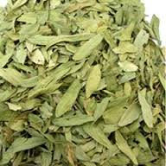
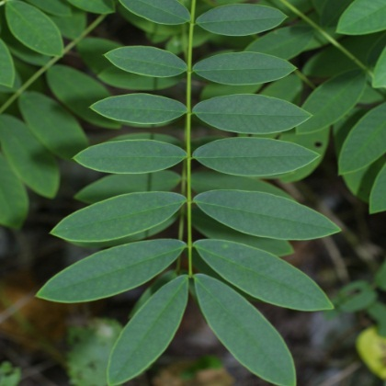
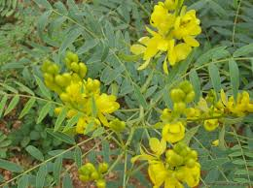
Senna
Synonyms:
  Senna Leaves, Folia Sennae, Golden leaves
Biological source:
  Senna is a leaves-derived herbal medicine. Medicinal Senna is the dried leaflets of Cassia senna and Cassia angustifolia of the family Leguminosae.
Geographical source:
  Egypt, South India, North-East Pakistan

Slide 37
Chemical constituents:
  Senna contains mainly anthraquinone glycosides which include sennosides A, B, C, and D, aloe emodin diathrone-diglycoside etc.
  It also contains sterol, mucilage, calcium oxalate, resin and free anthraquinone.
Uses:
  Senna glycosides, or sennosides, are used in modern medicine as laxatives and cathertics.
  Senna is also used for irritable bowel syndrome (IBS) & hemorrhoids
Dose: Usual dose is 2g.
Sennosides A

Slide 38
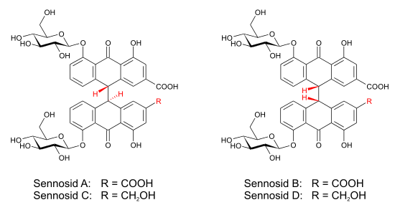

Slide 39
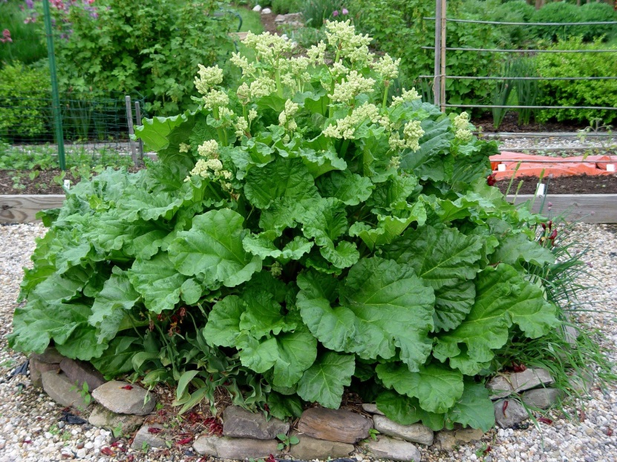
Rhubarb
Synonyms:
  Rhubarb Rhizome, Rhei Radix
Source:
  Rhubarb is a rhizome-derived herbal medicine obtained from Rheum officinale, R. palmatum, and other species of the family Polygonaceae. Rhubarb has characteristics odor with bitter taste.
Geographical source:
  Rhubarb is collected from different species of Rheum cultivated in China, Tibet, Nepal, Middle East, Europe, and America

Slide 40
Chemical constituents:
  It contains many anthraquinone derivatives as both free and glycosidic form.
  Among them, chrysophanol, aloe emodin, rhein and their glycosides are main anthraquinone derivatives.
  In addition, it also contains gallic acid, catechin, rheotannic acid, methyl chrysophanic acid, cinnamic acid and calcium oxalate.
Uses:
  It’s a traditional Chinese medicine which can be used in conditions such as constipation, diarrhea, or upset stomach in doses ranging from 0.1-4.0 grams per day.
Rhein; R = COOH
Chrysophanol; R = CH₃
Aloe emodin; R = CH₂OH

Slide 41
Saponin
Glycosides

Slide 42
General properties
They are high molecular weight chemical substance.
Widely distributed in higher plants.
They are amphipathic glycosides that can produce soap-like foaming when shaken in aqueous solutions.
Bitter/acidic taste.
Capable to destroy red blood cell by hemolysis.
Highly toxic saponin glycosides are sometimes called sapotoxin.
The aglycones of saponin glycosides are called sapogenin and commonly 1-5 sugar moieties are attached to aglycone.
Saponin glycosides are of two types: steroidal glycosides and triterpenoid glycosides. Both glycosides linked to sugar via C-3 carbon.

Slide 43
Liquorice
Synonyms: Licorice, Liquorice Root, Glycyrrhiza, Josthimodhu
Sources: Liquorice is a herbal medicine obtained from the dried rhizome and root of Glycyrrhiza glabra (family: Papilionaceae). Commercially available liquorice is three types:
  Spanish Liquorice: commonly grown in Spain, England, France, Germany, and Italy.
  Russian Liquorice: commonly grown in different parts of Russia.
  Parsian Liquorice: commonly grown in the valley of Euphrates and Tigris rivers.

Slide 44
Chemical Constituents:
  It mainly contains glycyrrhizin (6-14%), a sweetening agent. It is 50 times sweeter than sucrose. It is triterpenoid glycoside and the aglycone is called glycyrrhetinic acid. Glycyrrhizin produces glycyrrhetinic acid and 2 molecules of glucoronic acid upon hydrolysis.
  Besides glycyrrhigic acid, it also contains glycyrrhetinic acid related hydroxyl and deoxytriterpenoid and liquiritic acid.
Uses:
  It has been long used in traditional medicine as tonic, diuretic and laxative.
  It is also employed for the treatment of urinary tract infections, common cold, cough, bronchitis, respiratory infections, and peptic ulcers.
  Besides, it is used as sweetening agent in many formulations such as chewing gum, tobacco, chocolate, cigarette, and medicines.

Slide 45
cyanogenic
Glycosides

Slide 46
General characteristics
Cyanogenic glycosides are those glycosides which contain CN group in their structure and can produce HCN upon hydrolysis.
Manihotoxin is the first cyanogenic glycosides separated from Manihot utilissima root in 1830.
Amygdalin is a cyanogenic glycoside most commonly found in bitter almond, apricot, cherry, peach and plums.
Cyanogenic glycosides are mainly found in Rosaceae family.
They can produce HCN upon hydrolysis.
Most of the cyanogenic glycosides contain N and they are derived from CN. However, glycosidic linkages are formed via -O- linkage. So, they are O-glycosides, not N-glycosides.
Usually 1 or 2 sugars molecule can be linked to aglycone.

Slide 47
Wild Cherry
Sources:
  Wild cherry is obtained from the stem bark of Prunus serotina (Fam. Rosaceae)
Chemical constituents:
  Prunasin (D-mandelonitrile glucoside)
  Prunase, a hydrolytic enzyme
  P-ceramic acid
  Starch
  Benzoic acid etc.
Use:
  As a vehicle in cough preparation.
  Has sedative, expectorant properties.
  Flavoring agent.

Slide 48
Isothyocyanate
Glycosides

Slide 49
Mustard
Sources:
  Dried seed of Brassica nigera( Fam. Cruciferae)
Chemical constituents:
  Principle glycoside is Sinigrin
  Fixed oil (30-35%)
Use:
  Local irritant
  Emetic
  Commercially as a flavoring agent

