Slide 1
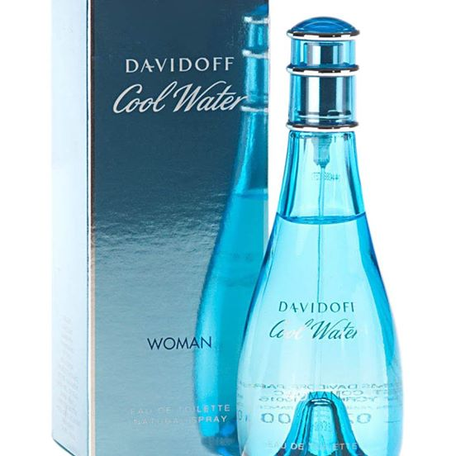
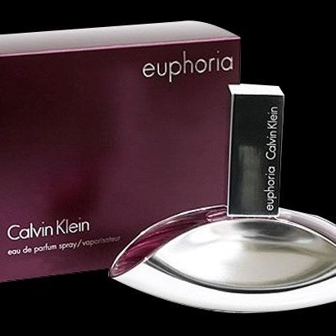
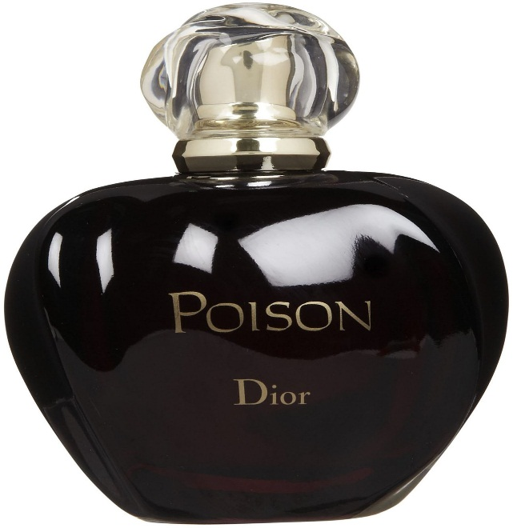
VOLATILE OILS
Arifur Rahman
Lecturer
Department of Pharmacy
BRAC University

Slide 2
Volatile oils
Volatile oils are mono- and sesquiterpenes obtained from (the odorous principle) various plant parts.
They may be formed directly by protoplasm or by decomposition of the resinogenous layer of the cell wall or by hydrolysis of certain glycosides.
Most of the volatile oils are evaporate when they are exposed to the air at ordinary temperature (36-38°).
Volatile oils are sometimes called essential oils because they represent the ‘essence’ or the active constituents of the plants.

Slide 3
Volatile oils are also called ethereal oil due to its ether like behavior, which is they are volatile and evaporates even in room temperature.
Example: peppermint oil, Clove oil.
Fixed oilS:
Fixed oils are esters of long chain fatty acids and glycerols or closely related derivatives. Fixed oils are obtained from either plants or animals. Most fixed oils are liquid at room temp but there are some exceptions. Cocoa butter is solid vegetable oil.
Example: Caster oil, Peanut oil, Olive oil, Coconut oil.

Slide 4
Difference Between Fixed 0il and Volatile Oil
Volatile oil | Fixed oil
Volatile oil can easily vaporize at normal temp. | Fixed oil can’t easily vaporize at normal temp.
Have characteristics odor. | Fixed oils are odorless.
It can be distilled/ extracted from their natural source. | It can’t be distilled/ extracted from their natural source.
On exposure to light and air, they oxidize and resinify | On exposure, become rancid

Slide 5
They don’t contain the glycerol esters and fatty acids. | They contain the glycerol esters and fatty acids.
They cannot be saponified with alkali. | They can be saponified with alkali.
They don’t leave permanent grease spot on Paper | They leave permanent grease spot on Paper.
Low boiling point. | High boiling point.
Low molecular weight. | High molecular weight.
Most of them are optically active | Optically inactive.

Slide 6
Properties Of Volatile Oils:
Physical properties:
They possesses characteristics odor.
They evaporate when they exposed to the air at ordinary temperature.
Most of them are optically active.
They are slightly soluable in water and readily soluable in ether, alcohol and most organic solvent.
Usually colourless.
Reasonably heat stable

Slide 7
Chemical properties:
They may be hydrocarbons, alcohol, aldehyde, ketone, phenol, phenolic ether, oxides and esters.
They can’t be saponified with alkalies.
The volatile oils largely consists terpenes and phenyl propanoids.

Slide 8
Methods of obtaining volatile oils
There are some methods for obtaining volatile oils from crude drugs. These are
1.Distillation: Volatile oils are usually obtained by this method. Distillation is further divided into three methods:
Water distillation
Water and steam distillation
Direct steam distillation

Slide 9
i. Water distillation
It is applied to plant material that is dried and not subject to injury by boiling.
Turpentine oil is obtained by this method.
The crude turpentine oleoresin is introduced into the distilling chamber and subjected to heat until all the volatile matter both oil and water is condensed in the condensing chamber.
Turpentine oil, consisting almost entirely of terpenes, is not affected by this amount of heat.

Slide 10
ii. Water and Steam distillation
It is employed for substances either dried or fresh that may be injured by boiling.
In the case of dried material (cinnamon or clove), the drug is ground and then covered with a layer of water, and steam is passed through the macerated mixture.
Since the oil might be impaired by direct boiling, the steam is generated elsewhere and is piped into the container holding that drug.
The oily layer of the condensed distillate is separated from the aqueous layer, and the oil may be marketed with or without further processing.

Slide 11
iii. Steam distillation
This method is applicable to fresh plant drugs (peppermint, spearmint).
The crop is cut and taken directly to the distilling chamber.
Instead of being allowed to macerate, the drug is suspended on a grid. Since the plant material is still green and contains natural moisture, no maceration is necessary.

Slide 12
Steam is forced through the fresh herb carrying the oil droplets to the condensing chamber.
During steam distillation hydrolysis (volatile component) and decomposition (other constituents) is a major problem. Hydrolysis and decomposition should be kept as minimum as possible

Slide 13
2. Hydrolysis: Glycosidic volatile oils are obtained by the enzymatic hydrolysis of the glycosides. E.g. Mustard oil.
3. Expression: e.g. lemon oil.
4. Ecuelle method: e.g. lemon oil.
5. Enfleurage: e.g. Rose oil.
6. Extraction: Using solvents such as petroleum ether or benzene. E.g. Sandalwood.
7. Destructive distillation: e.g. Eucalyptus oil.

Slide 14
Difference between three types of distillation method
Water distillation | Water and steam distillation | Direct steam distillation
Only dried material can be used. | Both dried and fresh material can be used. | Only fresh material can be used.
Maceration is not needed. | Maceration needed. | Maceration is not needed.
The crude drug is placed in the boiling chamber. | The macerated drugs is placed in a separate container. | Crude drug is hanged from the top of the container.
Temperature should be above 100°c | Temperature should be 60-70°c. i.e. low. | Temperature should be medium (80-85°c)
e.g. Turpentine oil | e.g. Clove oil, Cinnamon oil. | e.g. peppermint oil, spearmint oil.

Slide 15
Importance or uses of volatile oils
Therapeutic /medicinal importance
Carminative (Clove Oil)
Antiseptic (Eucalyptus Oil)
Antispasmodic (Peppermint Oil)
Stimulant (Clove Oil)
Astringent (Nutmeg Oil)
Antibacterial (Pine Oil)
Anti Infective (Camphor Oil)
Anti Fungual (Thymol oil)
Expectorant (Eucalyptus Oil)
Antirheumatic (Wintergreen Oil)

Slide 16
Pharmaceutical importance:
Pharmaceutical aid (flavour)
Perfume and Cosmetic Preparation
Masking bad odor in Pharmaceutical Preparation
Sometimes it is used main constituents of drug preparation
Preservatives
Importance for plants:
Volatile Oils acts as repellent of insects
Thus preventing from destruction of the flowers and leaves
Act as an insect attractant. Thus aiding in cross fertilization of the flowers

Slide 17
DEFINITION OF VOLATILE OILS
Volatile oils are products which are generally complex in composition, consisting of the volatile principles contained in plants, and are more or less modified during the preparation process.
Only 2 procedures may be used to prepare official oils
Steam distillation
Expression
4 Main types of volatile oils
Concretes
Pomades
Resinoids
Absolutes

Slide 18
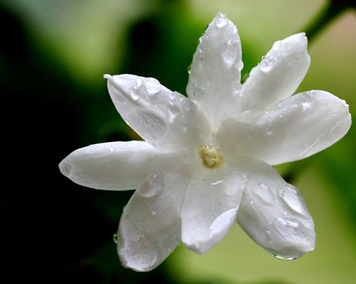
CONCRETES
Prepared from raw materials of vegetable origin (bark, flowers, leafs, roots etc.)
Extracted by HC type solvents, rather than distillation or expression – Becomes necessary when the essential oil is adversely affected by hot water or steam (e.g. jasmine).
Produces a more true-to-nature fragrance.

Slide 19
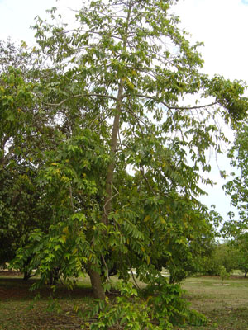
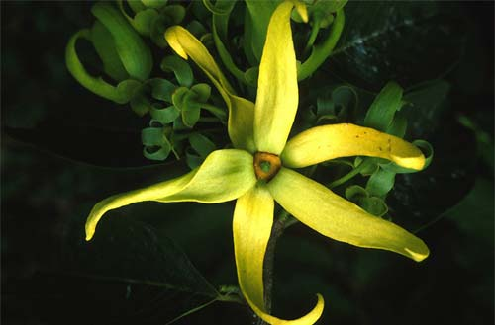
CONCRETES
Concretes contain about 50 % wax and 50 % essential oil (jasmine).
Ylang ylang (concrete volatile) contains 80 % essential oil and 20 % wax.
Advantages of concretes: they are more stable and concentrated than pure essential oils.

Slide 20
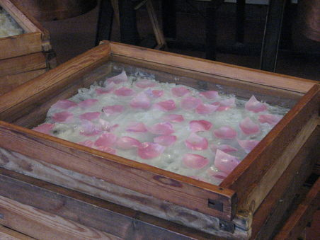
POMADES
True pomades are (volatile oil) products of a process known as enfleurage (hot or cold).
Enfleurage is used for obtaining aromatic materials from flowers containing volatile oils to produce perfume long after they were cut.

Slide 21
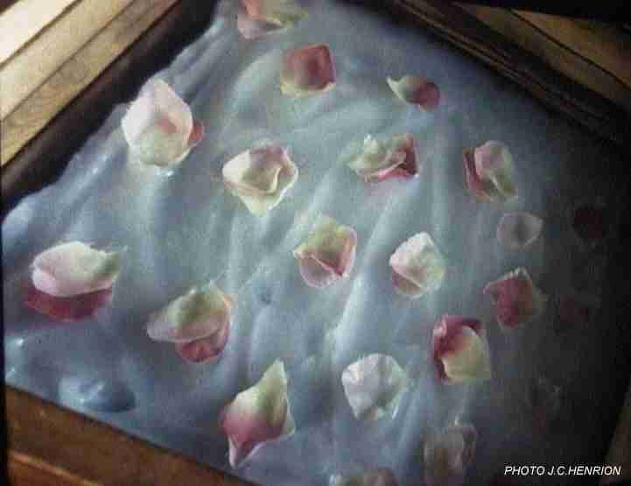
ENFLEURAGE: METHOD
A glass plate is covered with a thin coating of especially prepared and odourless fat (called a chassis).
The freshly cut flowers are individually laid on to the fat which in time becomes saturated with their essential oils. The flowers are renewed with fresh material.
Eventually the fragrance-saturated fat, known as pomade, may be treated with alcohol to extract the oil from the fat.

Slide 22
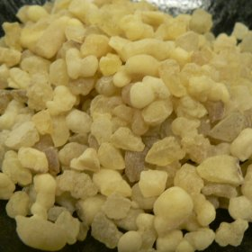
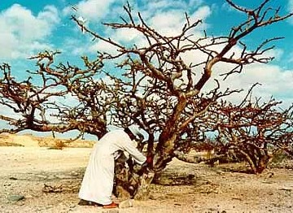
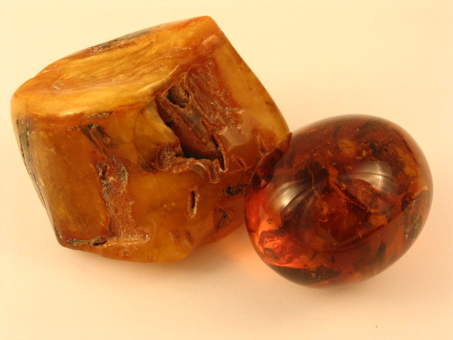
RESINOIDS
Prepared from natural resinous material (dried material) by extraction with a non-aqueous solvent, e.g. Petroleum ether or hexane.
E.g. Balsams – Peru balsam or benzoin; resins (amber or mastic); Oleoresin (copaiba balsam and turpentine); Oleogum resins (frankincense and myrrh)

Slide 23
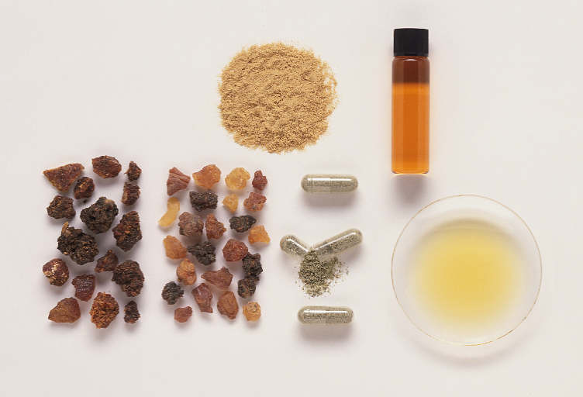
RESINOIDS
Can be viscous liquids, semi-solid or solid.
Usually homogeneous mass of non-crystalline character.
Uses: in perfumery as fixatives to prolong the effect of a fragrance.

Slide 24
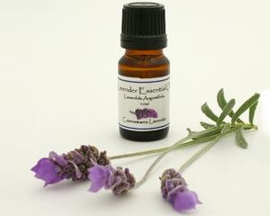
ABSOLUTES
Obtained from a concrete, pomade, or a resinoid by alcoholic extraction.
The extraction process may be repeated.
The ethanol solution is cooled & filtered to eliminate waxes.
The ethanol is then removed by distillation.
They are usually highly concentrated viscous liquids.

Slide 25
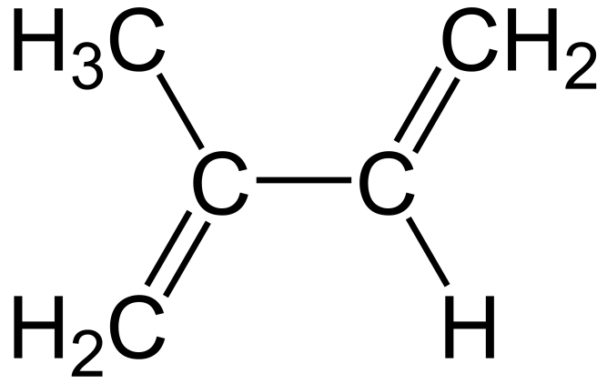
TERPENES
Terpenes, are natural products whose structures may be divided into isoprene units.
isoprene

Slide 26
Classification of terpenes
Terpenes are classified by the number of 5-C atoms they contain.
Hemiterpenes consist of a single isoprene unit. Isoprene itself is considered the only hemiterpene.
10-Carbon terpenes (contain 2 C-5 units) – monoterpenes
15- Carbon terpenes (3 C-5 units) are called sesquiterpenes.
20-carbon terpenes (4 C-5 units) are diterpenes.
Larger terpenes (30 carbons) are called triterpenes (triterpenoids),
40 Carbons - called tetraterpenes and polyterpenoids.

Slide 27
TERPENOIDS
When terpenes are modified chemically, such as by oxidation or rearrangement of the carbon skeleton, the resulting compounds are generally referred to as terpenoids.
Terpenoids contain only the most volatile terpenes (i.e. molecular weight is not too high) → mono and sesquiterpenes

Slide 28
Major classes of Volatile oils
Hydrocarbon Volatile Oils
Alcohol Volatile Oils
Aldehyde Volatile Oils
Ketone Volatile Oils
Phenol Volatile Oils
Phenolic Ether Volatile Oils
Oxide Volatile Oils
Ester Volatile Oils

Slide 29
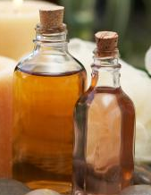
1. Hydrocarbon Volatile Oils
Turpentine oil
Botanical source:
Pinus palustris
Family: Pinaceae
Constituents:
65 % α pinene
30 % β pinene
3% other terpines
Rectified turpentine oil : It is the turpentile oil rectified by distillation from aqueous solution of sodium hydroxide.

Slide 30
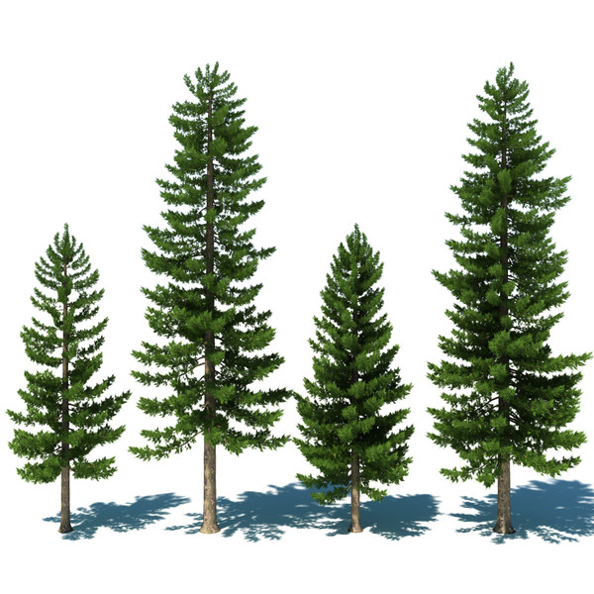
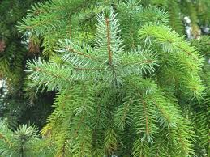

Slide 31
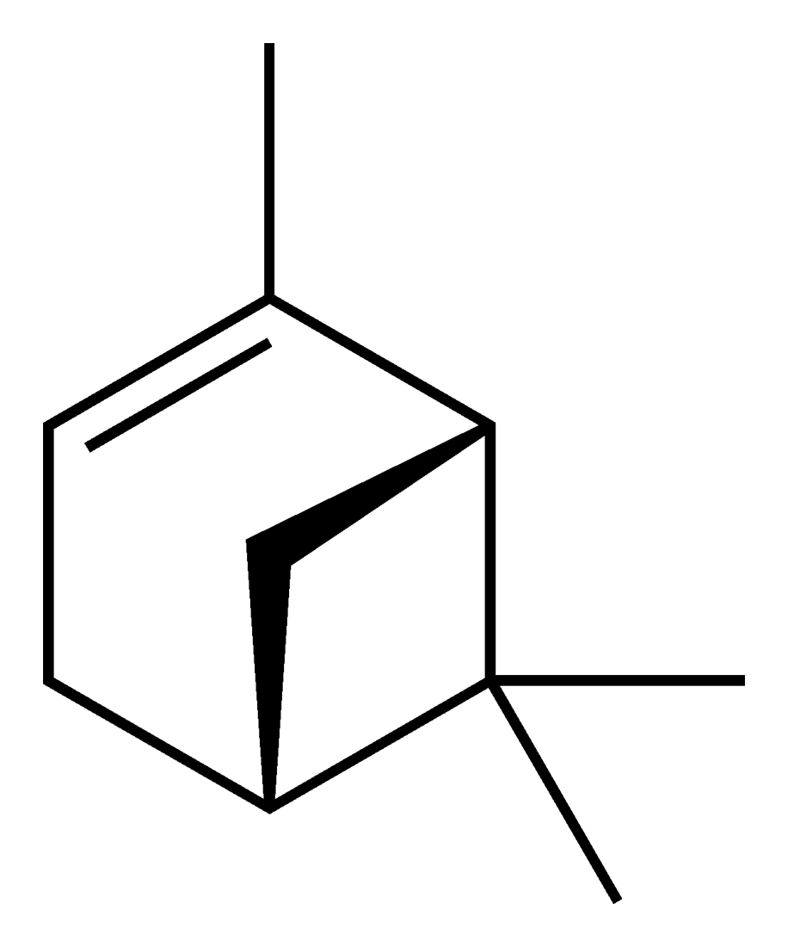
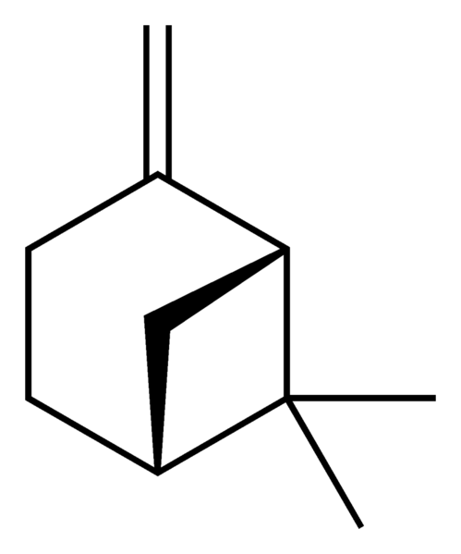
α pinene and β pinene
α pinene β pinene

Slide 32
Use:
Local irritant
Mild antiseptic
rubefacient
Industrial use:
Insecticides
Solvent
In the production of synthetic camphor
Furniture polish
Pharmacological use:
Carminative
Tonic
Diuretic
Expectorant

Slide 33
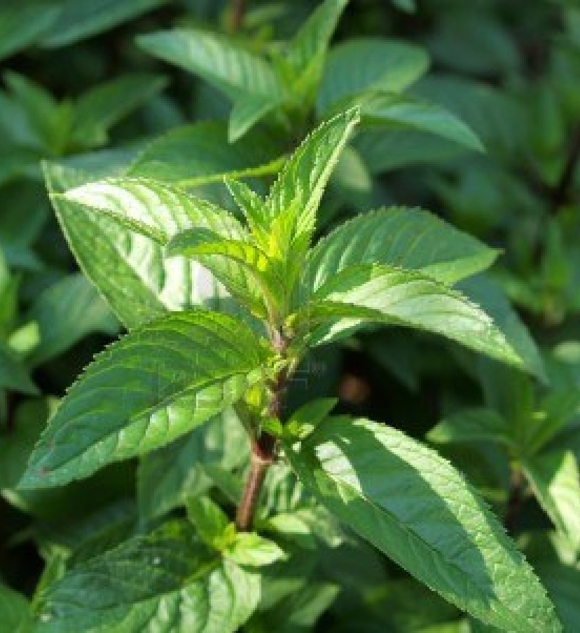
2. Alcohol Volatile Oils
Peppermint oil :
Botanical source:
It is obtained from dried leaf and flowering top of Mentha piperita
Family: Labiatae

Slide 34
Geographical source: It is indigenous to Europe, Northern United States and Canada.
Constituents:
1) 50-78 % of free menthol
2) 5-20 % acetate
3) Mentone
4) Cineole

Slide 35
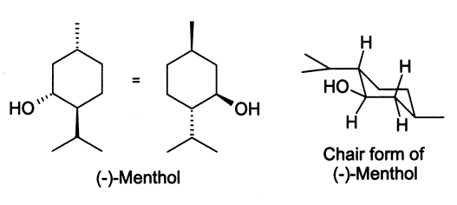
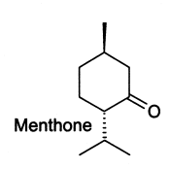

Slide 36
Peppermint oil
Use:
1. flavour
2. carminative
3. stimulant
4. mild antiseptic
Commercial use:
1. Flavour for chewing gum
2. Flavouring agent in candy, toothpaste, jellies

Slide 37
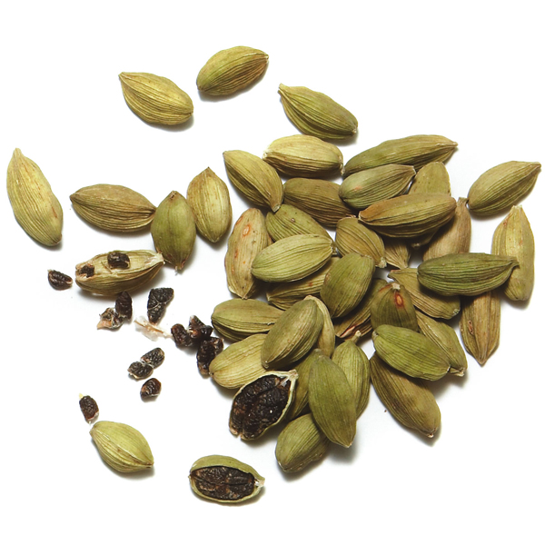
Cardamon oil/ Cardamom oil
Botanical source:
Elettaria cardamom
Family: Zingibereraceae
Geographical source :
India, Srilanka, Guatemala

Slide 38
Constituent:
26-40 % cineole
28-34 %Terpinyl acetate
2-14 % limonene
3-5 % sabinene
2-8 % linalyl acetate
Use:
Flavour
Carminative
stimulant

Slide 39
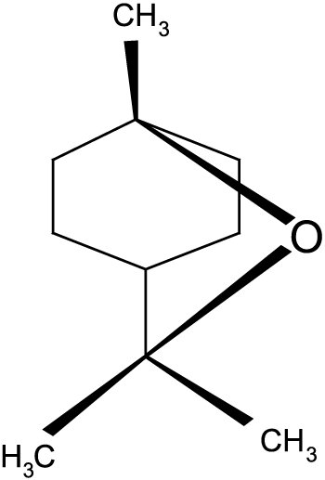
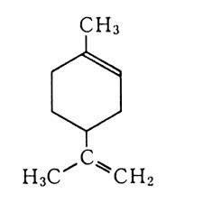
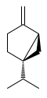
Cineole, Limonene and Sabinene
Cineole Limonene Sabinene

Slide 40
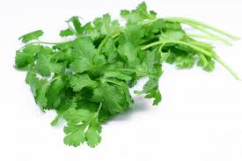
Coriander oil :
Botanical source: Coriandrum sativum
Family: Umbelliferae
Geographical source :
India, Morocco, Eastern
Europe, Mexico,
United States, Argentina

Slide 41
Constituent:
60-70% linalool
Limonene
α pinene
Geraniol
Cymene
Camphor
Use:
Flavour
Carminative
spice in cooking

Slide 42

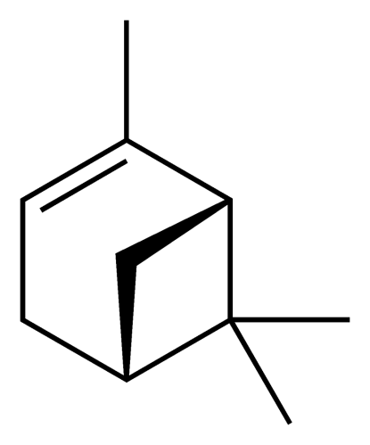
Limonene
α pinene

Slide 43
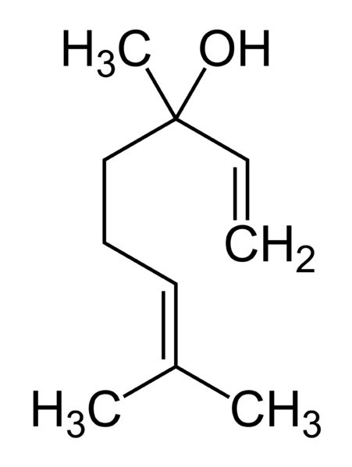
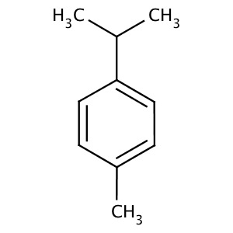
Linalool
Cymene

Slide 44
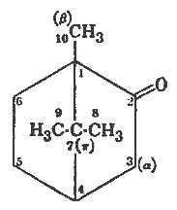
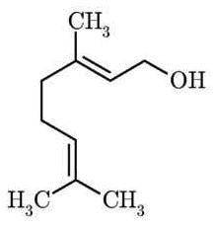
Geraniol
Camphor

Slide 45
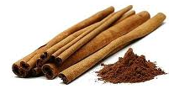
3. Aldehyde Volatile Oils
Cinnamon oil:
It is the dried bark of Cinnamomum loureirii
Family: Lauraceae
Geographical source:
Srilanka, China, Vietnam, West Indies.

Slide 46
Constituent:
60-70% cinnamaldehyde
5-10% eugenol
Benzaldehyde
Cuminaldehyde
Pinene
cymene
Use:
Antiseptic
Carminative
Stimulant
Flavor
Condiments

Slide 47
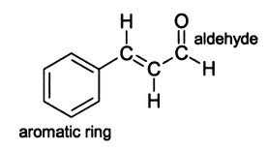
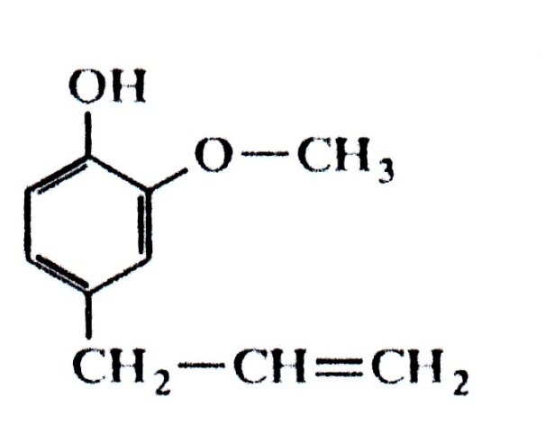
Cinnamaldehyde Eugenol

Slide 48
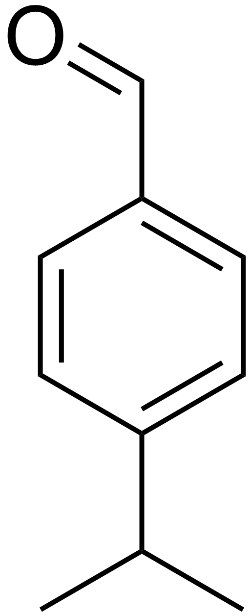
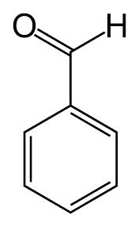
Benzaldehyde
Cuminaldehyde

Slide 49
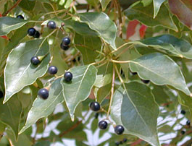
4. Ketone Volatile Oils
Camphor oil:
Botanical source: Cinnamomum camphore
Family: Lauraceae
Geographical source: Japan, China, Srilanka, Africa, Egypt, Brazil

Slide 50
Constituent:
1. Safrole (Used in making perfume and soap)
2. Camphor(as a liniment and treatment for colds)
3. Eugenol
4. Cineole
5. d-pinene
6. Eucalypt0l

Slide 51
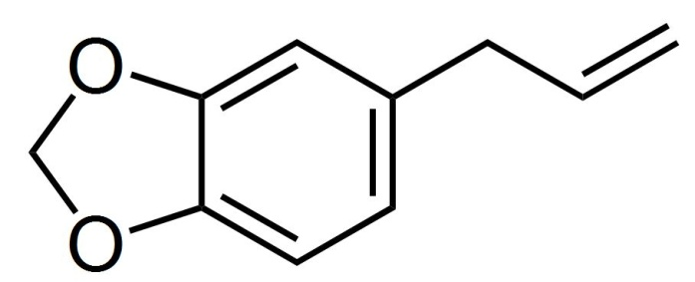
Safrole
Cineole

Slide 52
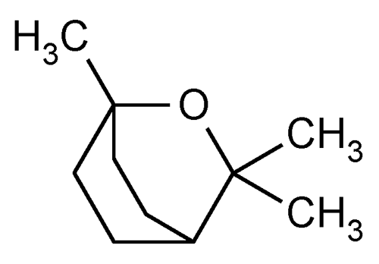
Eugenol
Eucalyptol

Slide 53
Use :
1. Rubefacient
2. Counter irritant
3. Flavor in toothpowder,
soaps and cosmetic
products.
Camphor

Slide 54
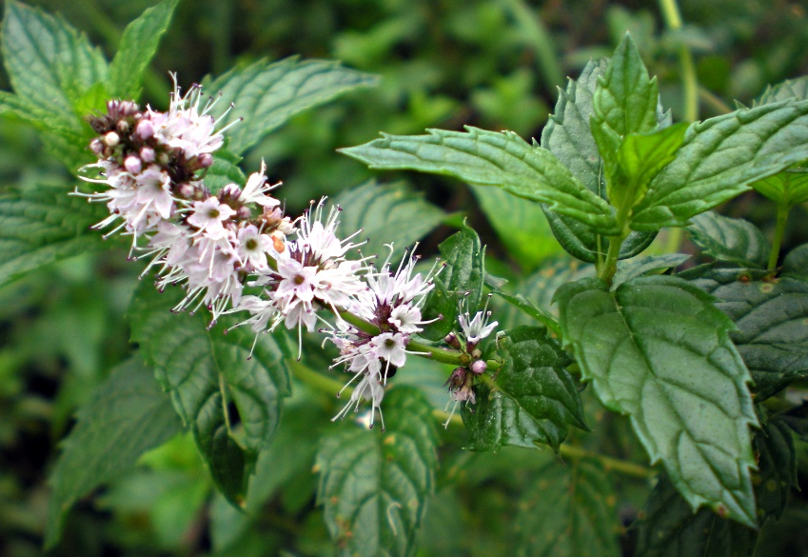
Spearmint oil:
Botanical source: Mentha spicata
Family: Labiatae
Geographical source:
North America, Washington, India, Michigan.
Constituent:
45-60 % Carvone
6-zo% alcohols
4-20% esters, terpenes mainly limonene, cineole

Slide 55
Limonene
Cineole

Slide 56
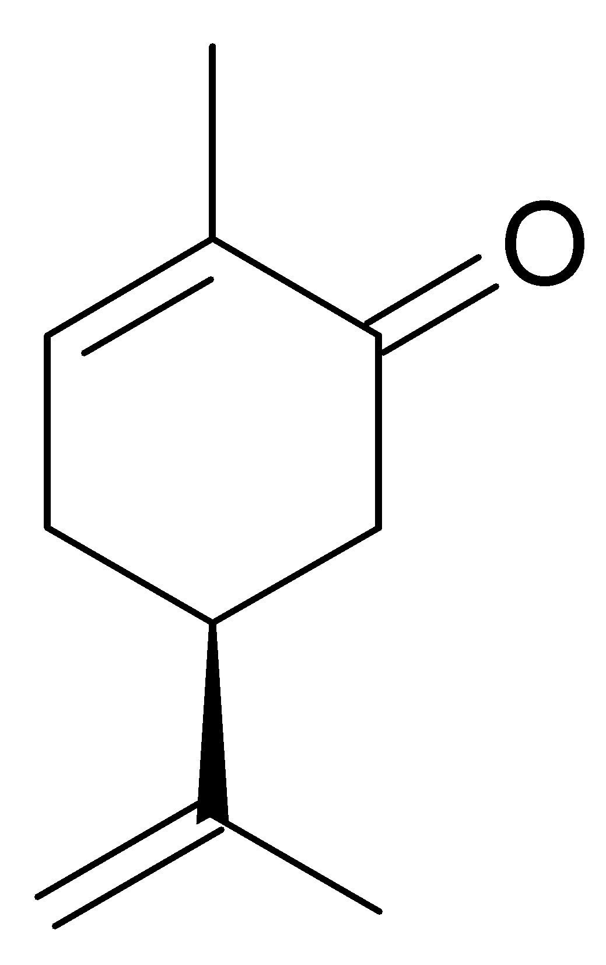
Use:
1. Flavoring
2. Carminative
3. Chewing gum industry
4. Mouthwash
Carvone

Slide 57
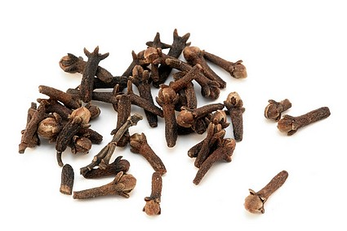
5. Phenol Volatile Oils
Clove oil:
Botanical source: Eugenia caryophyllus
Family: Myrtaceae
Geographical source:
Penang, Ambon, Pemba, Sumatra

Slide 58
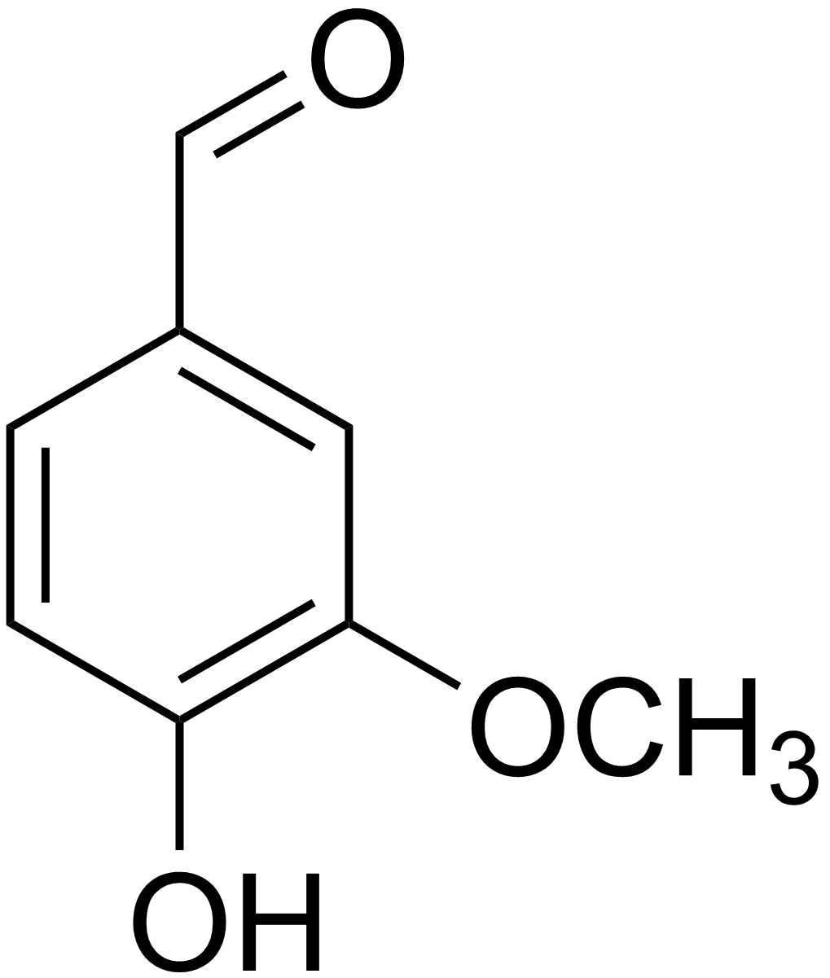
Constituent:
85-90% eugenol
Acetyl eugenol 3 %
Tannins
Oleanolic acid
Carbinol
Vanillin
Dirnethyl furfural
Vanillin

Slide 59
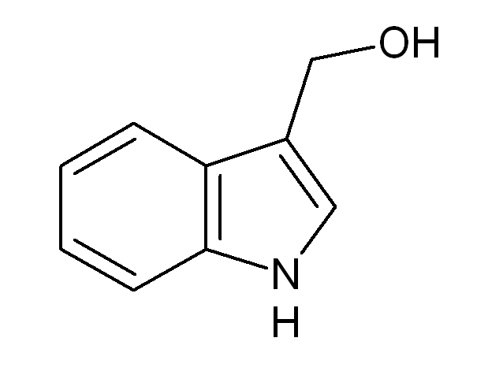
Eugenol
Carbinol

Slide 60
Use
Carminative
Flavor
Counter irritant
Antispasmodic
Local analgesic and antiseptic in dentistry
In preparation of vanillin

Slide 61
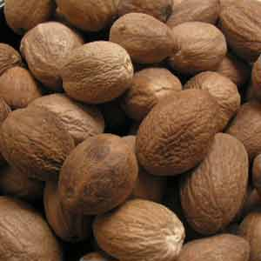
6. Phenolic Ether Volatile Oils
Nutmeg :
Botanical source:
Dried kernels of Myristica fragrans
Family: Myristicaceae
Geographical source:
it is native to Indonesia It is cultivated in Malay, Sumatra, Java, Srilanka, West Indies

Slide 62
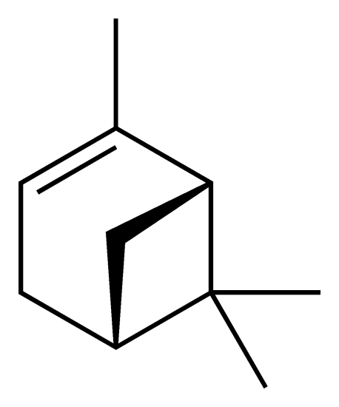
Constituent:
Safrole
Myristicin
Methoxyeugenol
Camphene
Alpha and beta pinene
Palmitic, oleitic and lauric acids.
Safrole
α pinene

Slide 63
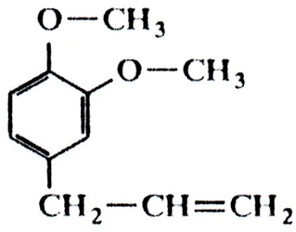
Limonene
Methoxyeugenol

Slide 64
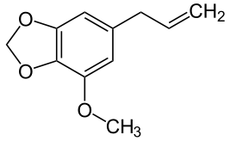
β pinene
Myristicin

Slide 65
Use:
• Carminative
• Astringent
• Nausea
• Useful for controlling dirrhoea
• Vomiting
• Antibacterial activity
• Flavoring agent
• The Fat (nutmeg butter ) is used in soap industries
• The fat is used in the treatment of rheumatism

Slide 66
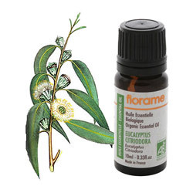
7. Oxide Volatile Oils
Eucalyptus oil :
Botanical source:
Dried leaf of Eucalyptus globulus
Family: Myrtaceae
Geographical source :
E.globulus is native to Australia and Tasmania.
Now it is cultivated in South France, Spain, Portugal, Brazil and India.

Slide 67

Constituents
Cineole 76-85 %
Camphor
Cuminaldehyde
Pinene
P-coumaric acid
dihydroflavonol

Slide 68
Cuminaldehyde
Cineole
Camphor

Slide 69
Use :
• Antiseptic
• Expectorant
• Diuretic
• Flavoring agent
• It increases the flow of saliva and helps in appetite and digestion
• It increases the heart rate

