Slide 1
The Integumentary System

Slide 2
Integumentary system
Integument is skin
Integumentary system is the skin and the organs derived from it (hair, glands, nails)
One of the largest organs
surface area of between - 1.5-2.0 square meters ,
total average weight :10-11 lbs.
Largest sense organ in the body
The study of the skin is Dermatology

Slide 3
Functions of skin
1.Covers and protects the body from
Pathogens
Injury
Ultra-violet radiation
2. Regulate body temperature through
Sweating
Dilatation/constriction of blood vessels
3. Excretes Waste as
- Urea
- sweat
4. Reduces water loss - Keeps the body from drying out
5. Houses sensory receptors

Slide 4
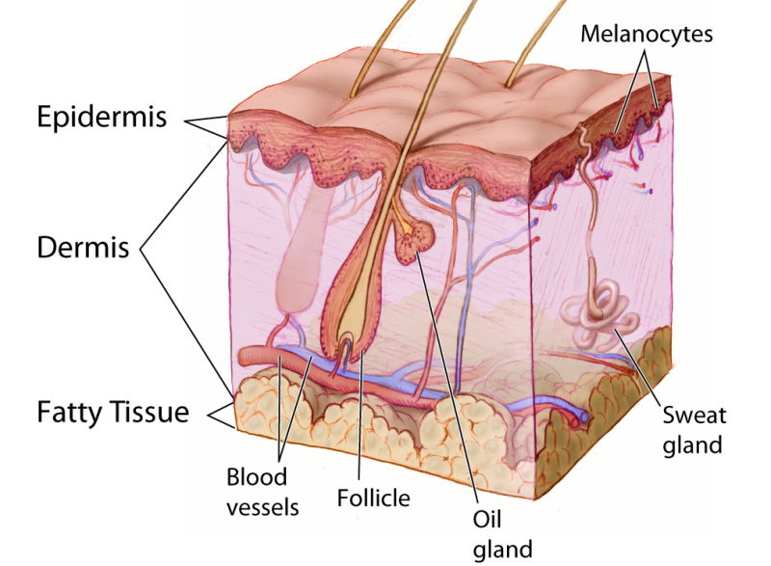
Anatomy of skin

Slide 5
Anatomy of skin
Epidermis
Dermis
Subcutaneous layer or hypodermis

Slide 6
Epidermis
Stratified squamous epithelium
– Avascular (contains no blood vessels)
Most of the cells in the epidermis are keratinocytes.
Inner part is composed of living cells
Outer part is composed of dead cells

Slide 7
Epidermis- Four types of cells
1. Keratinocytes
produce the protein keratin, which helps to protect the skin and underlying tissue from heat, microbes, and chemicals
Produce lamellar granules, which release a waterproof sealant.
2. Melanocytes
produce the pigment melanin which contributes to skin color and absorbs damaging ultraviolet (UV) light.
Help in the production of Vitamin D

Slide 8
Epidermis- Four types of cells
3. Langerhans cells (Dendritic cells)
derived from bone marrow (star shaped cells)
participate in immune response
play a role in the development of skin allergies
4. Merkel cells
contact a sensory structure called a tactile (Merkel) disc that helps in the sensation of touch

Slide 9
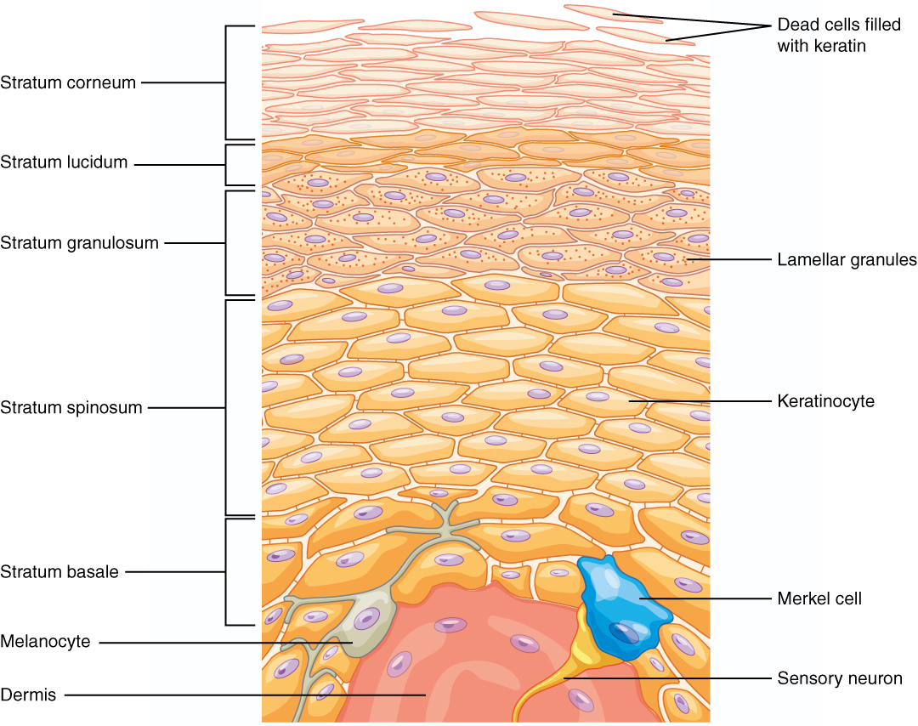
Layers and cells of epidermis

Slide 10
Layers (from deep to superficial)
5 layers:
Stratum basale (stratum germinativum)
Stratum spinosum
Stratum granulosum
Stratum lucidum (only in palms and soles)
Stratum corneum

Slide 11
Layers (from deep to superficial)
Stratum basale or germinativum – single row of cells attached to dermis; youngest cells
Stratum spinosum – provides strength and flexibility to the skin, 8 to 10 cell layers are held together by desmosomes.
Stratum granulosum – layers of flattened keratinocytes, producing keratin (hair and nails made of it also)
Stratum lucidum (only on palms and soles)
Stratum corneum – horny layer (cells dead, many layers thick)

Slide 12
Dermis
The dermis is the middle layer of skin
composed of dense irregular connective tissue - collagen & elastic fibers, fibroblasts, macrophages & fat cells.
Contains hair follicles, glands, nerves & blood vessels.
Two major regions of dermis
- Papillary region
- Reticular region

Slide 13
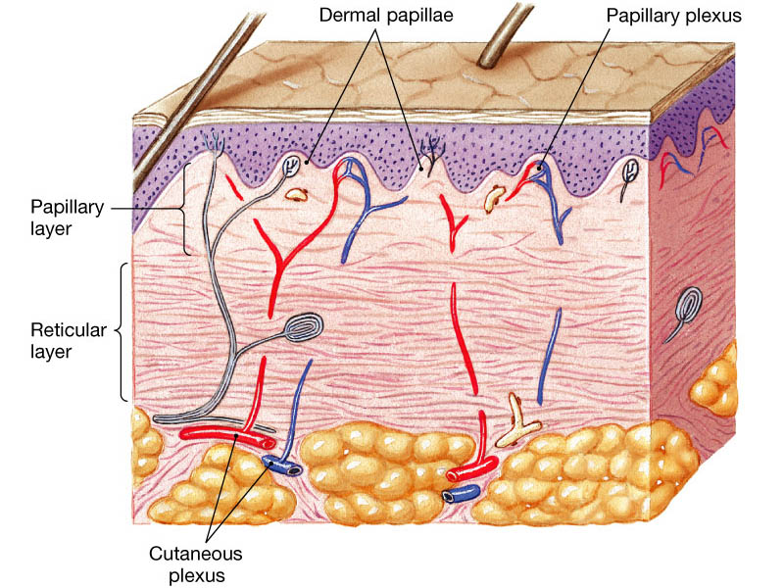
Dermis

Slide 14
Dermis
Dermis - Papillary Region
Top 20% of dermis
Finger like projections are called dermal papillae
– anchors epidermis to dermis
– contains capillaries that feed epidermis
– contains Meissner’s corpuscles (a sensory nerve ending that is sensitive to mechanical stimuli like touch) & free nerve endings for sensations of heat, cold, pain, tickle, and itch

Slide 15
Dermis
Dermis - Reticular Region
Dense irregular connective tissue
Contains interlacing collagen and elastic fibers
Packed with oil glands, sweat gland ducts, fat & hair follicles
Provides strength, extensibility & elasticity to skin
– Stretch marks are dermal tears from extreme stretching
Epidermal ridges form in fetus
– Fingerprints are left by sweat glands open on ridges
– Increase grip of hand

Slide 16
Hypodermis
Hypodermis (Gk) = below the skin
“Subcutaneous” (Latin) = below the skin
Also called “superficial fascia”
“fascia” (Latin) =band; in anatomy: sheet of connective tissue
Fatty tissue which stores fat and anchors skin
Attaches the reticular layer to the underlying organs
It contains larger blood vessels and nerves than those found in the dermis.

Slide 17
Hypodermis

Slide 18
Hypodermis
It is essentially composed of a type of cells specialised in accumulating and storing fats, known as adipocytes.
These cells are grouped together in lobules separated by connective tissue - collagen and elastin fibres
The number of adipocytes varies among different areas of the body, while their size varies according to the body's nutritional state.
It acts as energy reserve
provides some minor thermoregulation via insulation

Slide 19
Summery………
Integumentary system
Definition
Characteristics
Functions
Layers
Epidermis
Charecteristics
Cells of epidermis
Layers of epidermis
Dermis
Characteristics
Functions
Figure
Subcutaneous
Characteristics
Functions
Figure

Slide 20
summery…….
Skin layer:
Dermis
Characteristics
Functions
Figure
Subcutaneous
Characteristics
Functions
Figure

