Slide 1
ISOMERISM

Slide 2
Isomerism
Molecules which have the same molecular formula, but differ in the arrangement of their atoms, are called isomers.
Constitutional (or structural) isomers differ in their bonding sequence.
Stereoisomers differ only in the arrangement of the atoms in space. A particular three-dimensional arrangement is called a configuration. Stereoisomers differ in configuration.

Slide 3
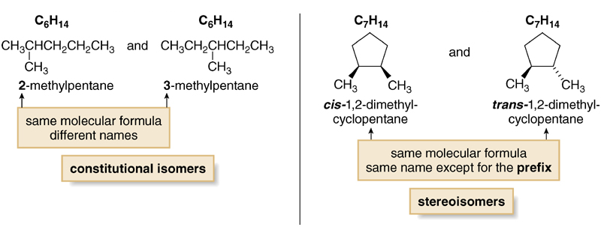
Figure 5.3
A comparison of consitutional
isomers and stereoisomers

Slide 4
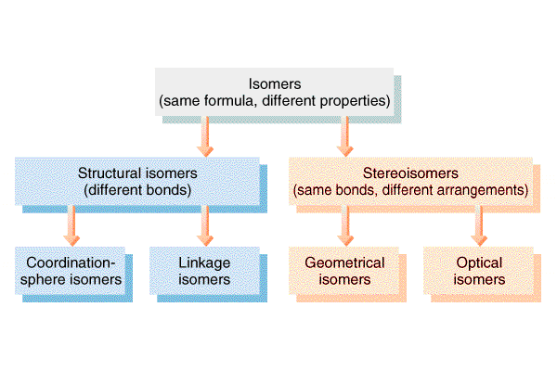
Isomerism
Chain isomers
Positional Isomers
Enantiomers
(Chiral:
Non-superimposable
Mirror Images)
Diastereomers
(Chiral:
Non-superimposable
Non-Mirror Images;
multiple chiral centers)
Functional isomrs

Slide 5
There are two types of isomerism common in organic chemistry:
1. structural isomerism
Which have the atoms of their molecules linked in a different order.
This can come about in one of three ways:

Slide 6
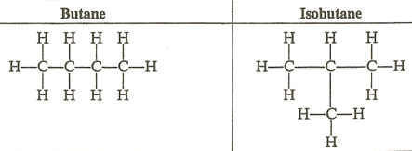
a.Chain Isomerism
Chain isomers have different carbon chain (carbon skeletons differ). The same compound are very similar.
There may be small difference in physical properties such as melting or boiling point due to different strengths of intermolecular bonding.
Their chemistry is likely to be identical.

Slide 7
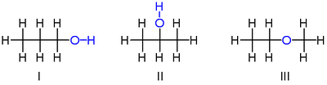
b.Positional Isomers
Positional isomers have a substituent group in different positions in the same carbon “skeleton” and also usually similar.
There are slight physical differences, but the chemical properties are usually very similar.
However, occasionally, positional isomers can have quite different properties

Slide 8
b.Positional Isomers
A simple example of isomerism is given by propanol:
it has the formula C₃H₈O (or C₃H₇OH) and two isomers propan-1-ol (n-propyl alcohol; I) and propan-2-ol (isopropyl alcohol; II)
Note that the position of the oxygen atom differs between the two: it is attached to an end carbon in the first isomer, and to the center carbon in the second.
The number of possible isomers increases rapidly as the number of atoms increases; for example the next largest alcohol, named butanol (C₄H₁₀O), has four different structural isomers.

Slide 9
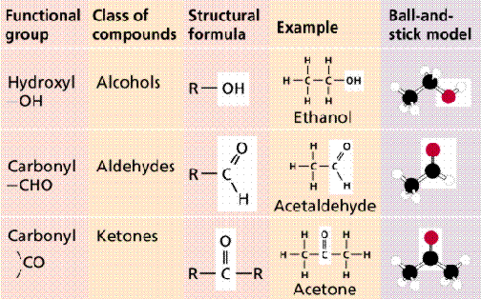
c.Functional Group Isomers
Functional group isomers are likely to be both physically and chemically dissimilar and have different functional group.
Eg: An aldehyde and a ketone, Propanal-CH₃CH₂CHO, propanone-CH₃COCH₃
_{Eg:} An alcohol and an ether. Ethanol-C₂H₅OH ,Dimethyl ether---CH₃OCH₃

Slide 10
Stereoisomer-
Have same molecular formula and structural formula. But difference is the arrangement of the bond in space.
Enantiomers are chiral: i.e. They are non-superimposable mirror images.
Enantiomers are “optical isomers.” eg. (+) and (-)
Most physical and chemical properties of enantiomers are identical.
Therefore, enantiomers are very difficult to separate eg. Tartaric acid…
Enantiomers can have very different physiological effects: eg. (+) and (-)

Slide 11
Enantiomers are important in the pharmaceutical industry
Two enantiomers of a drug may have different effects
Usually only one isomer is biologically active
Differing effects of enantiomers demonstrate that organisms are sensitive to even subtle variations in molecules

Slide 12
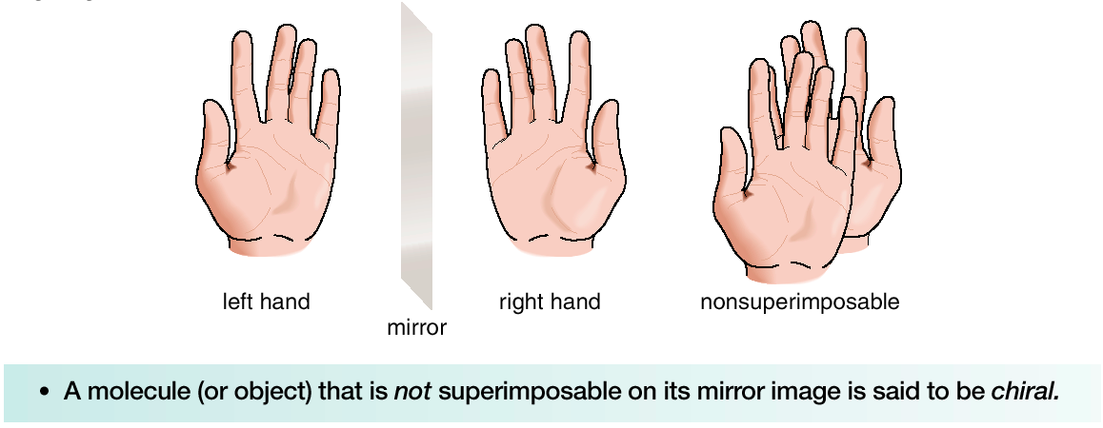
Chiral and Achiral Molecules
Although everything has a mirror image, mirror images may or may not be superimposable.
Some molecules are like hands. Left and right hands are mirror images, but they are not identical, or superimposable.

Slide 13
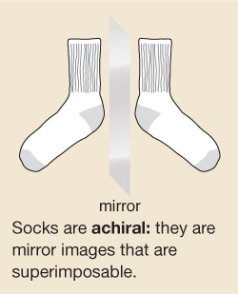
Other molecules are like socks. Two socks from a pair are mirror images that are superimposable. A sock and its mirror image are identical.
A molecule or object that is superimposable on its mirror image is said to be achiral.
A molecule or object that is not superimposable on its mirror image is said to be chiral.

Slide 14
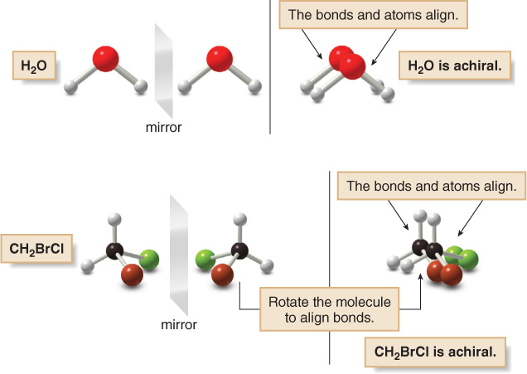
We can now consider several molecules to determine whether or not they are chiral.

Slide 15
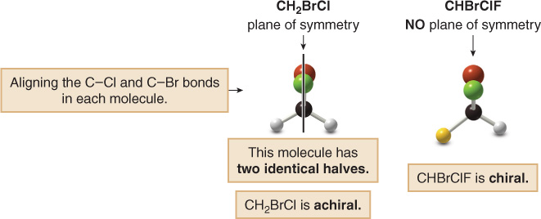

Slide 16
Geometric Isomerism
cis – or same side
trans – or across
cis-trans isomers are geometric isomers.
Restriction of rotation about a C=C double bond gives rise to cis-trans isomerism.
They do not have the same physical and chemical properties.
They differ in melting temperature, solubility etc.
.

Slide 17
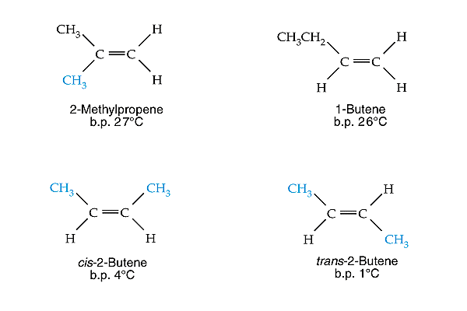
Geometric Isomerism
No cis-trans isomers in top two isomers, only the bottom two.

Slide 18
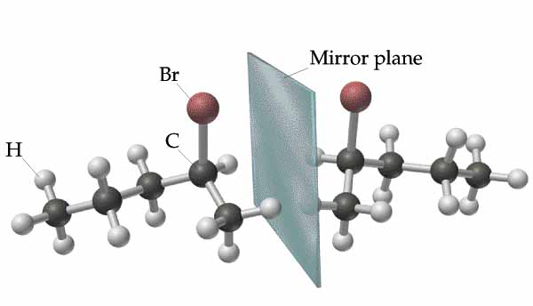
Enantiomers of 2-bromobutane
Notes:
Carbon 2 in 2-bromobutane has four different groups attached to it, making it chiral. It is not possible to superimpose the molecules by rotating them in the plane of the paper. Nonsuperimposable mirror images are called enantiomers. Enantiomers have identical physical properties and identical chemical properties when they react with achiral reagents. They exhibit different properties in chiral environments.

Slide 19
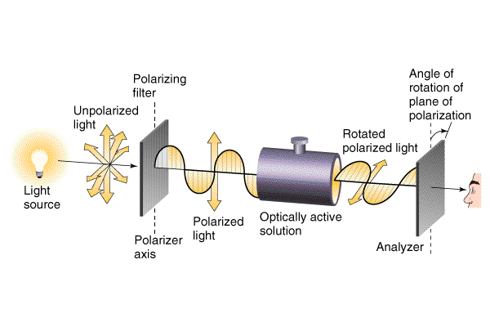
Optical Activity
(+) dextrorotatory
(-) levorotatory

Slide 20
If a beam of light is passed through a nicol prism or a piece of polaroid, the emergent light vibrates in a single plane.
It is said to be plane-polariside.
Certain substances, either in crystalline form or in solution, have the ability to rotate the plane polarized light, they are called optically active.
Polarimeter is used to measure this effect.
.

