Slide 1
DIETHYL ETHER

Slide 2
INTRODUCTION:
Diethyl Ether is one of the most important member of Ether family.
It is also known as Ethyl Ether or Ethoxy Ethene.
It is an organic compound.
It is a colorless,highly volatile flammable liquid with a characteristics odor.
It is an important solvent in the production of cellulose acetate.
It was used an general anesthetic.

Slide 3
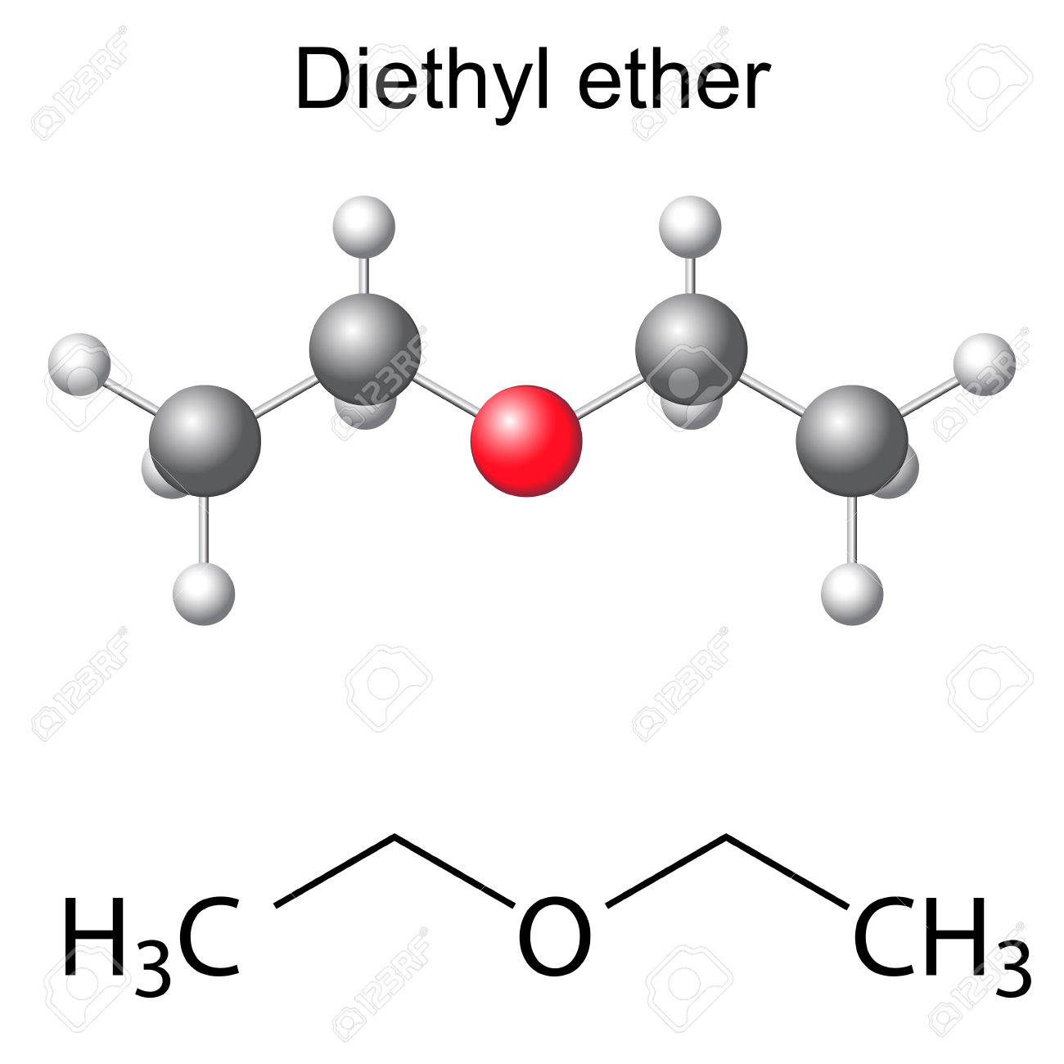
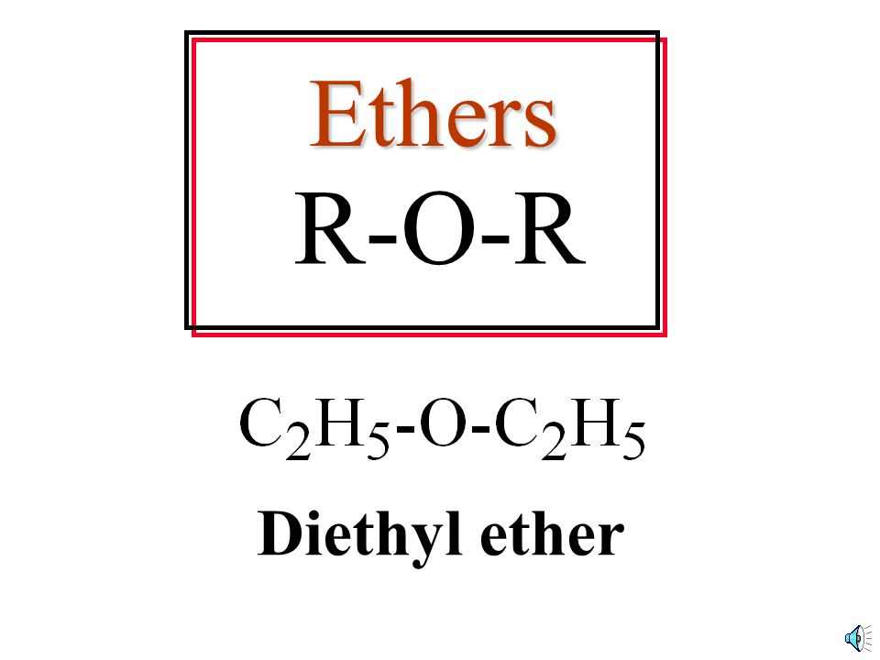
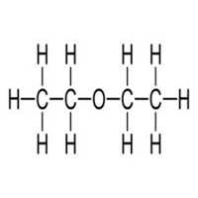
DIETHYL ETHER

Slide 4
STRUCTURE
Diethyl ether is a highly volatile flammable liquid used as anesthetic and as a solvent for waxes,fats,oils,alkaloids and gums. It is mildly irritating to skin and mucous membrane.
Chemical Name: Diethyl ether,Ethyl ether, Dether,
Ethoxyethane,Diethyl oxide
Molecular Formula: C₄H₁₀ or (C₂H₅)₂O or CH₃CH₂OCH₂CH_{3 .}
Molecular Weight: 74.123 g/mol
Drug Information: Therapeutic uses, FDA UNII.
Safety Summary: Laboratory Chemical Safety Summary (LCSS)

Slide 5
PHYSICAL PROPERTY OF DIETHYL ETHER:
Melting point : -116 °C
Boiling point : 34.6 °C(lit.)
Density : 0.714
Vapor density : 2.6 (vs air)
Vapor pressure : 28.69 psi ( 55 °C)
Fp : -40 °F
Form : Liquid
Color : max. 10
Water Solubility : 69 g/L (20 ºC)
FreezingPoint : -116.3℃
Merck : 14,3806
Stability : Stable

Slide 6
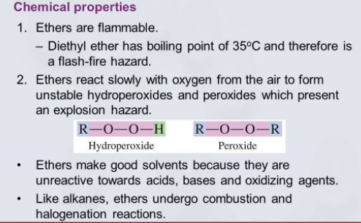
CHEMICAL PROPERTY OF DIETHYL ETHER:

Slide 7
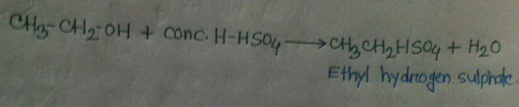
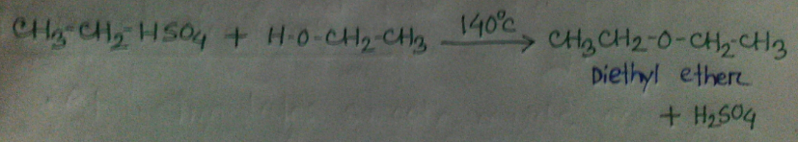
REACTION OF DIETHYL ETHER:
Diethyl ether is prepared in the laboratory by the reaction of ethanol with cnc. H₂SO₄ at 140℃
The reaction take place in the following steps: Ethyl alcohol reacts with conc. H2SO4 at 110℃ to give ethyl hydrogen sulphate.
Ethyl hydrogen sulphate again reacts with ethanol to give diethyl ether at 140℃

Slide 8
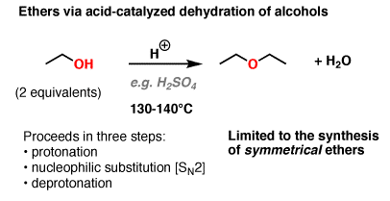
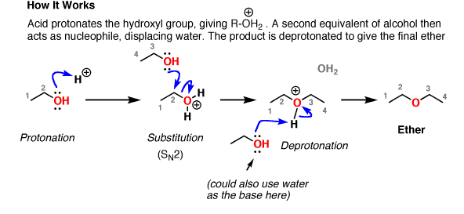
SYNTHESIS OF DIETHYL ETHER:

Slide 9
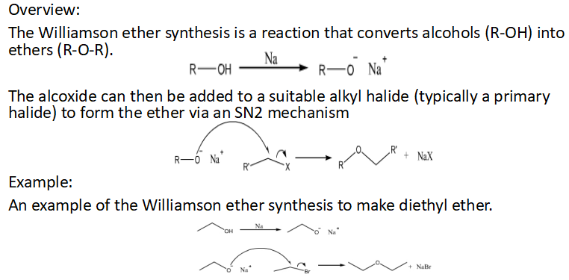
Williamson Ether synthesis:

Slide 10
Synthesis Of Diethyl Ether From Ethanol:
Diethyl ether can be prepared both in laboratories and on an industrial scale by the acid ether synthesis. Ethanol is mixed with a strong acid, typically sulfuric acid, H₂SO₄. The acid dissociates in the aqueous environment producing hydronium ions, H3O⁺. A hydrogen ion protonates the electronegative oxygen atom of the ethanol, giving the ethanol molecule a positive charge:
CH₃CH₂OH + H₃O⁺ → CH₃CH₂OH₂+ + H₂O
A nucleophilic oxygen atom of unprotonated ethanol displaces a water molecule from the protonated (electrophilic) ethanol molecule, producing water, a hydrogen ion and diethyl ether.
CH₃CH₂OH₂+ + CH₃CH₂OH → H₂O + H⁺ + CH₃CH₂OCH₂CH₃

Slide 11
USE OF DIETHYL ETHER:
Laboratory Use: Diethyl ether is a common laboratory aprotic solvent.
Anesthetic Use: Diethyl ether could also be mixed with other anesthetic agents such as chloroform to make C.E. mixture, or chloroform and alcohol to make A.C.E. mixture.
Medical Use: One of the first anesthetics used in surgery.
Fuel: The diethyl ether (DEE) is a renewable oxygenated fuel, which has favorable characteristics to be used as a fuel additive for the diesel engines
Recreational Use: recreational use is quite uncommon, diethyl ether has been used recreationally both orally (liquid) and inhaled (gas).

Slide 12
TOXICITY OF DIETHYL ETHER:
Diethyl Ether is low acute toxicity. In high concentration Diethyl Ether has anesthetic effects. At such high concentration diethyl ether causes mucosal irritation. Diethyl Ether has no clear systemic effects in animal studies.

Slide 13
CONCLUSION:
Significantly, diethyl ether allowed surgeons to perform painful operations on patients rendered unconscious. However, diethyl ether is very flammable, especially in the presence of enriched oxygen mixture.

