Slide 1
Palmitic Acid

Slide 2
History Of Palmitic Acid:
Palmitic acid was discovered by Edmond Frémy in 1840, in saponified palm oil. This remains the primary industrial route for its production, with the triglycerides in Palm oil being hydrolysed by high temperature water, and the resulting mixture fractionally distilled to give the pure product.
Definition:
A solid satured fatty acid obtained from palm oil and other vegetable and animal fats.

Slide 3
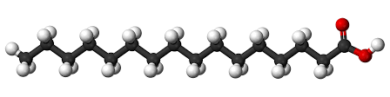
Chemical formula and others:
Palmitic acid, or hexadecanoic acid in IUPAC nomenclature, is the most common saturated fatty acid found in animals, plants and microorganisms. Its chemical formula is CH₃(CH₂)₁₄COOH, and its C:D is 16:0. As its name indicates, it is a major component of the oil from the fruit of oil palms. Palmitic acid can also be found in meats, cheeses, butter, and dairy products. Palmitate is the salts and esters of palmitic Acid

Slide 4
Sources of Palmitic Acid:
Excess carbohydrates in the body are converted to palmitic acid. Palmitic acid is the first fatty acid produced during fatty acid synthesis and is the precursor to longer fatty acids. As a consequence, palmitic acid is a major body component of animals. In humans, one analysis found it to make up 21–30% of human depot fat, and it is a major, but highly variable, lipid component of human breast milk. It is naturally present in:
Meats
Dairy
Palm oil and other plant oils
Butter
Cheese

Slide 5
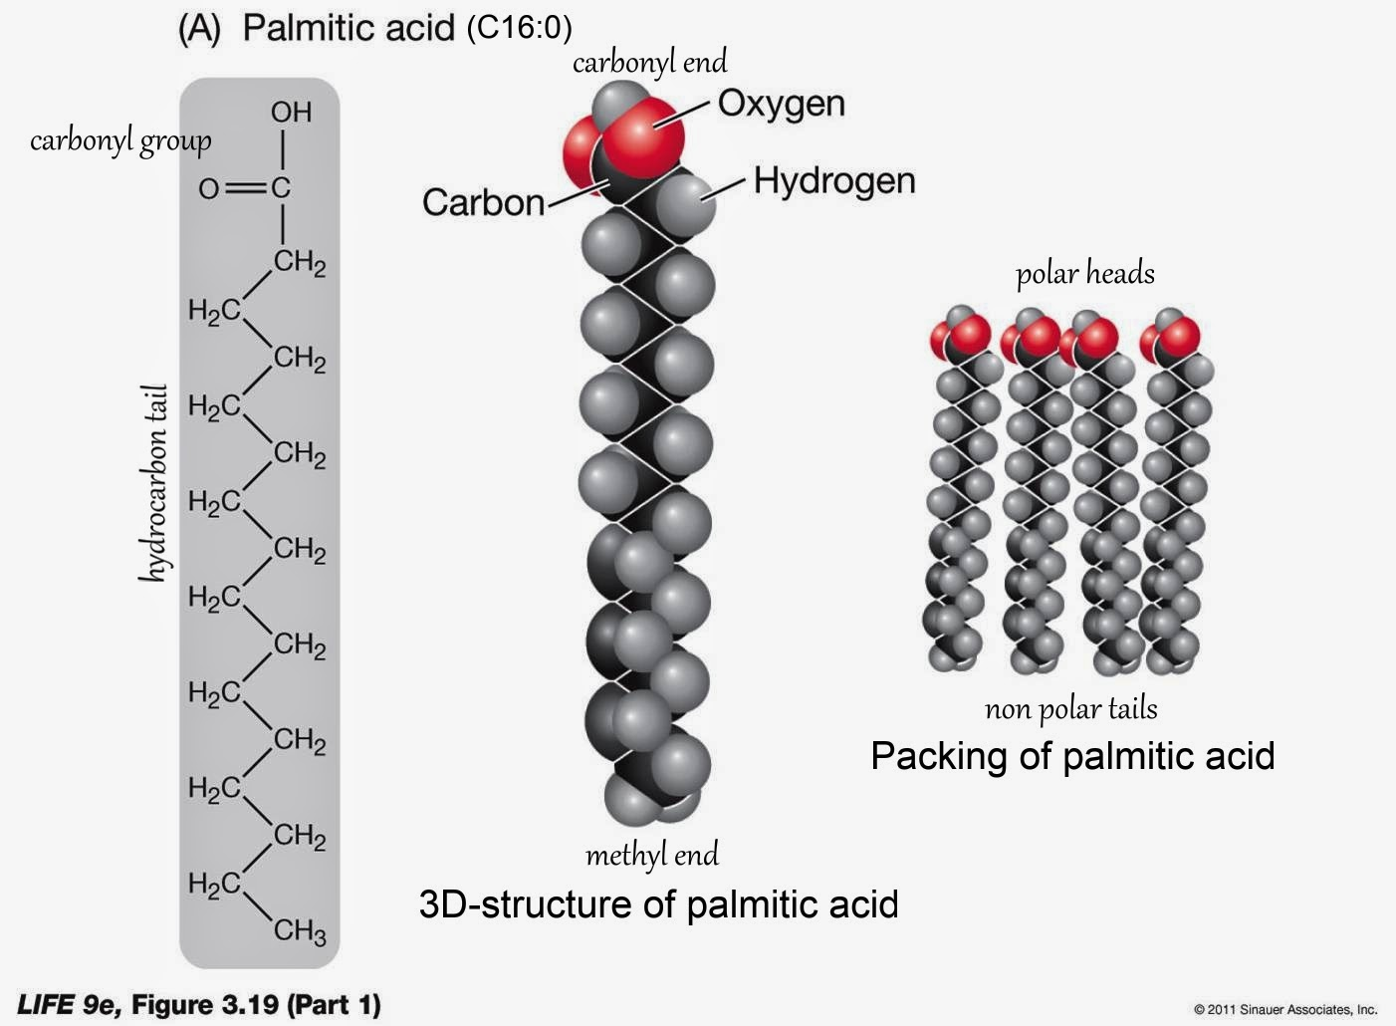
Structure of Palmitic Acid

Slide 6
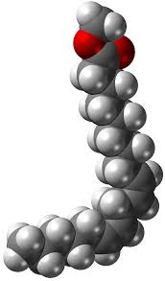
Properties of Palmitic Acid:
Physical properties:
Physical properties are used to observe and describe matter.
Chemical Properties:
Chemical properties means a property or characteristic of a substance that is observed during a reaction in which the chemical composition or identity of the substance is changed: Combustibility is an important chemical property to consider when choosing building materials.

Slide 7
Physical properties:
        Solubility: It is soluble in amyl acetate, alcohol, CCl₄, C₆H₆, very soluble in CHCl₃
        Solubility in water is 0.46 mg/L
    Melting Point - 62.9 °C
    Boiling Point - 271.5 °C
    Pressure – 10 mm/Hg
    Appearance – Cristal white

Slide 8
2. Chemical properties:
Molecular formula - C₁₆H₃₂O₂
Chemical name - Hexadecanoic acid
Other names - Palmitic acid
C16:0 (Lipid numbers)
Molecular weight - 256.43 g·mol⁻¹
Mass percentage - C- 74.94%
H- 12.57%
O- 12.47%

Slide 9
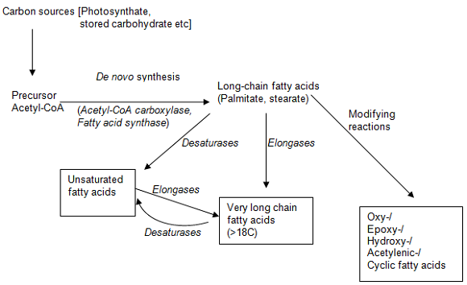
Synthesis of Palmitic Acid:
1. De novo synthesis

Slide 10
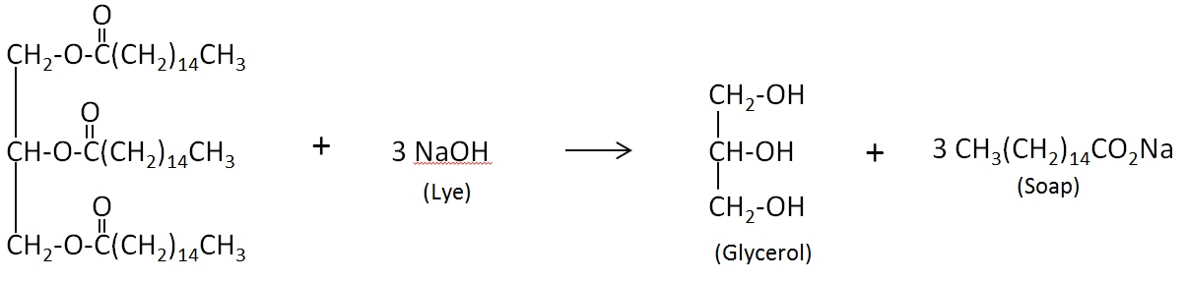
2. Saponification of palmitic acid to produce soap and glycerol
Ester linkage between large molecule of
triglyceride is broken

Slide 11
Uses of palmitic acid:
Palmitic acid is used to produce soaps, cosmetics, and industrial mold release agents.
These applications use sodium palmitate, which is commonly obtained by saponification of palm oil.
To this end, palm oil, rendered from palm tree (species Elaeis guineensis), is treated with sodium hydroxide, which causes hydrolysis of the ester groups, yielding glycerol and sodium palmitate.
Because it is inexpensive and adds texture and "mouth feel" to processed foods, palmitic acid and its sodium salt find wide use in foodstuffs.
Sodium palmitate is permitted as a natural additive in organic products.
The aluminium salt is used as a thickening agent of napalm used in military actions.

Slide 12
Hydrogenation of palmitic acid yields cetyl alcohol, which is used to produce detergents and cosmetics.
Recently, a long-acting antipsychotic medication, paliperidone palmitate , used in the treatment of schizophrenia, has been synthesized using the oily palmitate ester as a long-acting release carrier medium when injected intramuscularly.
The underlying method of drug delivery is similar to that used with decanoic acid to deliver long-acting depot medication, in particular, neuroleptics such as haloperidol decanoate.

Slide 13
Health hazards
Develop the risk of cardio vascular disease
Strongly boosts metastasis in mouse which is the model of human oral cancer

Slide 14
Storage condition:
Keep it tightly closed container
Store in cool, dry area
Protect against physical damage
Isolate from incompatiable substances

