Slide 1
Acetic acid

Slide 2
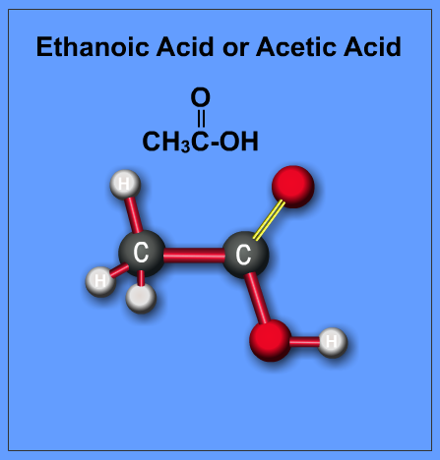
What is Acetic acid?
The acid most commonly associated with vinegar. Acetic acid is a two-carbon carboxylic acid. Its formula is: CH3COOH. It is the most commercially important organic acid and is used in the manufacture of a broad range of chemical products.

Slide 3
Physical properties
Formula: CH₃COOH
Molar mass: 60.05 g/mol
Density: 1.05 g/cm³
Boiling point: 244.6°F (118.1°C)
IUPAC ID: Acetic acid
Properties: Liquid or Solid
Color: Colorless
Odor: Having a pungent characteristic odor
Taste: When diluted in water an acidic taste

Slide 4
What are the properties of acetic acid?
Acidic character
When dissolved in water, acetic acid undergoes dissociation to form hydrogen (H⁺) ion. Because of the release of a proton, acetic acid has an acidic character. It turns blue litmus paper red, indicating that it is acidic in nature. However, it is a weak acid because it does not dissociate completely in aqueous solution.
Reaction with sodium bicarbonate
acid reacts with sodium bicarbonate to produce carbon dioxide.

Slide 5
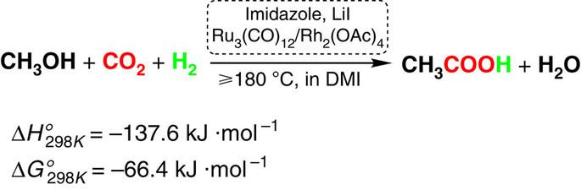
Chemical Synthesis

Slide 6

Why would humans need acetic acid in space?
It would help future colonies produce a variety of lightweight instruments for daily use from plastic or keep food fresh for a long time by fermenting it. It’s very useful in space, considering there isn’t a good climate to grow crops.

Slide 7
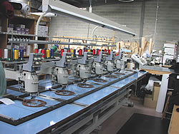
What equipment is needed to produce acetic acid?
To produce acetic acid on a large scale, you would need to use: Filters, desalting machinery, evaporation machines and distillation equipment. It is a bit expensive, but worth it. I think it should be the one to travel to space and help humans in their daily life.

Slide 8

What is the reaction of acetic acid in water?
When acetic acid is added to water, due to electronegativity differences of oxygen and hydrogen in —OH group of acetic acid and dipole interaction with water molecule, the acetic acid is transformed into acetate ion and H+ ion which furthur combines with water to form hydronium ion. The reaction is —
The mechanism can be represented as —

Slide 9
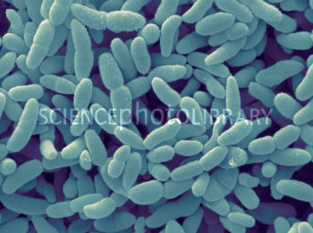
Acetic acid production process
Acetic acid is made by the process of fermenting various substances: starchy solutions, sugar solutions or wine with Acetobacter bacteria.

Slide 10
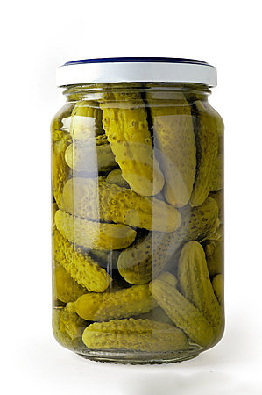
Common uses of acetic acid:
Acetic acid is used as coagulant in the manufacture of rubber.
It is used in the manufacture of various dye stuffs and perfumes.
It is used in the manufacture of rayon fibre.
It is used as a solvent.
used as an ingredient in plastic, vinegar, lacquers and is a preservative itself.

Slide 11

Why is acetic acid so important?
Acetic acid can produce vinegar and is a fermenting substance itself. It can help future colonies to keep their food fresh and healthy for a long time without rotting. Acetic acid is also an ingredient in plastic, which is very useful in making different gadgets and tools.

Slide 12
Toxicities
The patient survived the intoxication by use of hemodialysis and intensive care therapy. Acetic acid has shown no evidence of mutagenic activity with or without metabolic activation. It was harmful to aquatic life. High concentrations produced oxidizing bacteria, inhibiting oxygen demand.

Slide 13
Conclusion
Acetic acid is one of the simplest carboxylic acids. It is an important chemical reagent and industrial chemical that is used in the production of plastic soft drink bottles, photographic film as well as many synthetic fibres and fabrics. It is also a component of the vaginal lubrication of humans and other primates, where appears to serve as a mild antibacterial agent.

