Slide 1
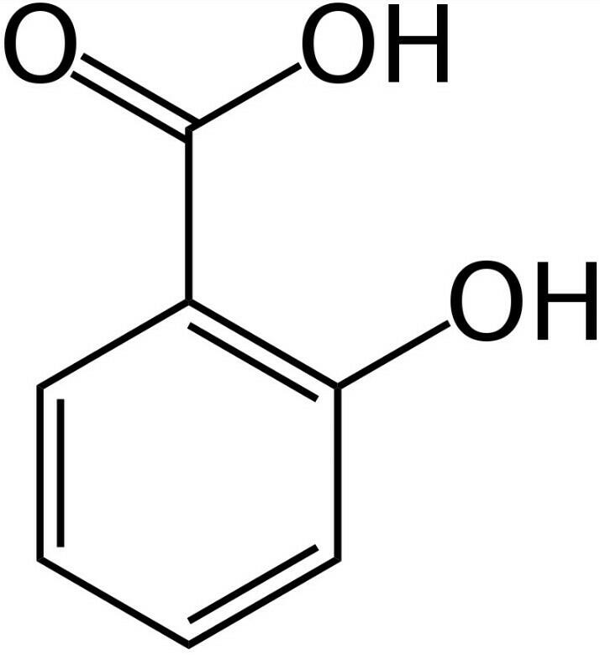
Salicylic acid
Salicylic acid is a lipophillic monohydroxybenzoic acid, a type of phenolic acid, and a beta hydroxy acid(BHA). It has the formula C₇H₆O₃. This colorless crystalline organic acid is widely used in organic synthesis and functions as a plant hormone. It is derived from the metabolism of salicin.
Preferred IUPAC name:2-Hydroxybenzoic acid￼￼

Slide 2
Chemical properties
Properties
Chemical formula | C₇H₆O₃
Molar mass | 138.12 g·mol⁻¹
Appearance | colorless to white crystals
Odor | odorless
Density | 1.443 g/cm³ (20 °C)^{[2]}
Melting point | 158.6 °C (317.5 °F; 431.8 K)
Boiling point | 200 °C (392 °F; 473 K) decomposes^{[3]} 211 °C (412 °F; 484 K) at 20 mmHg^{[2]}

Slide 3
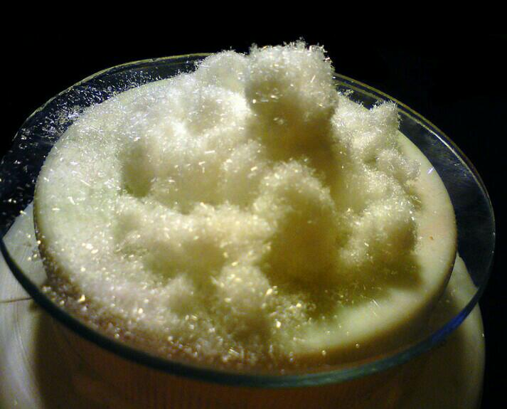
Physical properties
State: Solid
Color: colorless or White crystals
Odor: odorless
Flammability: Luminious smoky flame
Solubility: Insoluble in water but In NAOH

Slide 4
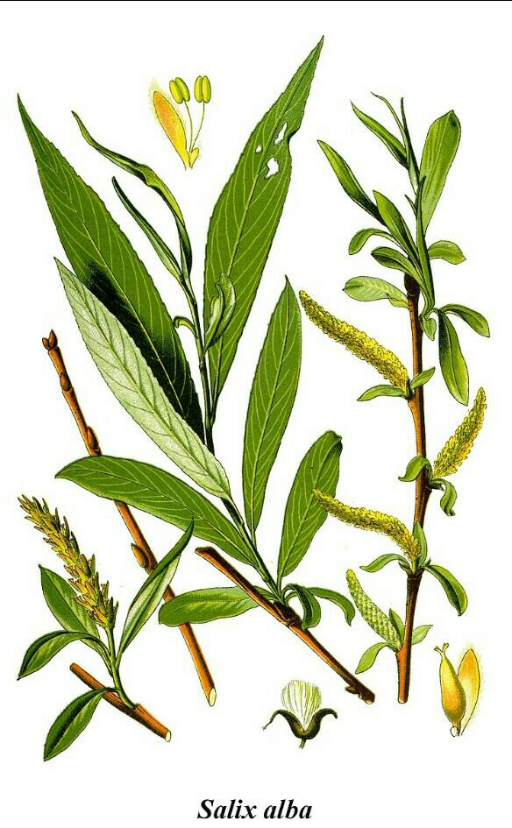
History
Salicylic acid is found naturally in the bark of the willow tree. It has been used for centuries to relieve a variety of ailments. It has also been developed in a variety of products in the areas of skin care, cosmetics and stomach relief. Salicylic acid is a wonder drug.
White willow (Salix alba) is a natural source of salicylic acid.

Slide 5
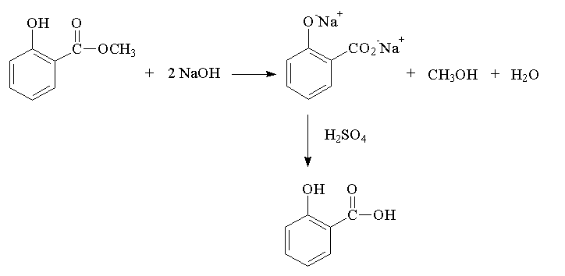
Reaction of Salicylic Acid

Slide 6
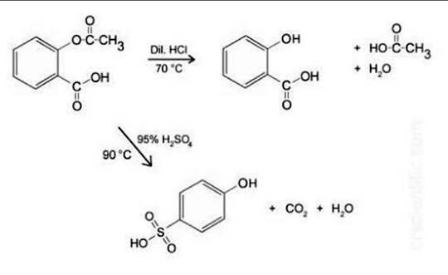
Reaction of Salicylic Acid

Slide 7
Pharmaceutical Use of Salicylic Acid
This medication is used on the skin to treat common skin and foot (plantar) warts. Salicylic acid helps cause the wart to gradually peel off. This medication is also used to help remove corns and calluses. This product should not be used on the face or on moles, birthmarks, warts with hair growing from them.
Salicylic acid is used as a food preservative, a bactericidal and an antiseptic

Slide 8
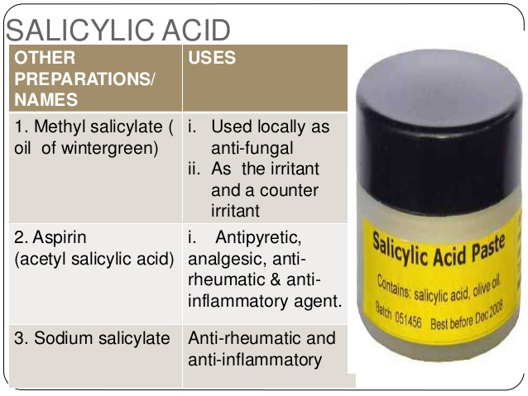

Slide 9

Synthesis
Salicylic acid is biosynthesized from the amino acid phenylalanine.
Sodium salicylate is commercially prepared by treating sodium￼phenolate￼with carbon dioxide.
Acidification of the product with sulfuric acid gives salicylic acid.
It can also be prepared by the hydrolysis of aspirin (acetylsalicylic acid) or methyl salicylate with a strong acid or base.

Slide 10
Toxicity
Overdose￼
Salicylic acid overdose can lead to people sick.which often presents clinically in a state of metabolic acidosis with compensatory respiratory￼￼￼￼￼￼￼￼￼alkalosis. In patients presenting with an acute overdose, a 16% morbidity rate and a 1% mortality rate are observed.
Allergy
Some people are hypersensitive to salicylic acid and related compounds.
Sun exposure
The United States recommends the use of sun protection when using skincare products containing salicylic acid on sun-exposed skin area.

Slide 11
Hazard
Health Hazard
Inhalation of dust irritates nose and throat. Vomiting may occur spontaneously if large amounts are swallowed. Contact with eyes causes irritation, marked pain, and corneal injury which should hezard.
Explosion Hazard
Finely dispersed particles form explosive mixtures in air.

Slide 12
Fire Potential.
Skin, Eye, and Respiratory Irritations
A facial cosmetic cream containing 1.5% salicylic acid.

