Slide 1
Phylogenetic Tree
Lecture – 11
Department of CSE, DIU

Slide 2
CONTENTS
1. Phylogenetic Analysis and MSA
- Evolution
- Phylogenetic Tree Basics
Phylogenetic Tree Types
- Rooted and Unrooted Tree
Phylogenetic Tree Approaches
- Parsimony
- Distance
-Maximum Likelihood

Slide 3
1. Phylogenetic Analysis and MSA
How are these sequences related?

Slide 4
Phylogenetic Analysis and MSA
Similarity searches and multiple alignments of sequences naturally lead to the question:
“How are these sequences related?”
and more generally:
“How are the organisms (from which these sequences come) related?”
Phylogenetic systematics is a method of taxonomic classification based on their evolutionary history

Slide 5
Evolution
Recall that DNA encodes blue print of life
Living things pass DNA info to their children
Due to mutations, DNA is changed a little bit
After a long time, different species would evolve
Phylogenetics studies genetic relationship between different species

Slide 6
Phylogenetic Tree Basics
leaves represent things (genes, species, individuals/strains) being compared
the term taxon (taxa plural) is used to refer to these when they represent species and broader classifications of organisms
internal nodes are hypothetical ancestral units
in a rooted tree, path from root to a node represents an evolutionary path
the root represents the common ancestor
an unrooted tree specifies relationships among things, but not evolutionary paths

Slide 7
Genetic Analysis of Lice Supports Direct Contact between Modern and Archaic Humans
D. Reed et al., PLoS Biology 2(11), Nov 2004.
inferred phylogeny of lice species closely parallels accepted phylogeny of their hosts
can phylogeny of lice tell us something about evolution of hosts?

Slide 8
Data for Building Trees
Trees can be constructed from various types of data
distance-based: measures of distance between species/genes
character-based: morphological features (e.g.
# legs), DNA/protein sequences
gene-order: linear order of orthologous genes in given genomes

Slide 9
2. Phylogenetic Tree Types
Rooted and Unrooted

Slide 10
Rooted vs. Unrooted Trees

Slide 11
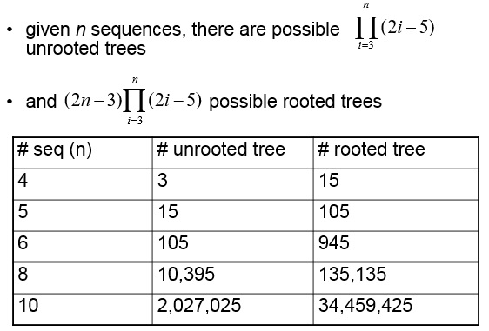
Number of Possible Trees

Slide 12
3. Phylogenetic Tree Approaches
Parsimony, Distance, Maximum Likelihood

Slide 13
Phylogenetic Tree Approaches
Three general types of methods
parsimony: find the tree that requires minimum number of changes to explain the data
distance: find tree that accounts for estimated evolutionary distances
maximum likelihood: find the tree that maximizes the likelihood of the data

Slide 14
Parsimony Based Approaches
given: character-based data
do: find tree that explains the data with a minimal number of changes
focus is on finding the right tree topology, not on estimating branch lengths

Slide 15
Parsimony Example
there are various trees that could explain the phylogeny of the sequences AAG, AAA, GGA, AGA including these two:
parsimony prefers the first tree because it requires fewer substitution events

Slide 16
Parsimony
For parsimony analysis, positions in a sequence alignment fall into one of two categories:
informative and
uninformative.
Only 3 possible unrooted trees you can make…

Slide 17
Parsimony
Which one is our target tree?

Slide 18
Parsimony
Invariant positions – contain NO INFORMATION→uninformative

Slide 19
Parsimony
Equally uninformative – need one mutation in each tree

Slide 20
Parsimony
Also uninformative – need two mutations in each tree

Slide 21
Parsimony
Also uninformative – need three mutations in each tree

Slide 22
Parsimony
Informative! – need only one mutation in one tree but two In the other trees!

Slide 23
Parsimony
So to be Informative, need at least 2 different nucleotides
And each has to be present at least twice.
Every tree is considered for every site, maintaining a running score of the number of mutations required. The tree with the smallest number of invoked mutations is the most parsimonious

