Slide 1
Global and National Power Sector Overview And Energy Resources

Slide 2
Importance of energy
Energy is an important parameter for socio-economic development
Poverty alleviation is a global challenge and access to modern energy to all is one of the necessary conditions to achieve this goal
About 1.4 billion people do not have access to electricity and 2.6 billion people rely on traditional biomass
Access to modern energy helps to improve the conditions to achieve global development goals
(Sources: MoWIE, 2012 and 2013; G.T. Tucho et al., 2104)
Notes:
The measure of development in any society of today is synonymous with the level of energy consumption
Energy is therefore recognized as a critical input parameter for national economic development
Energy demands are still met largely (80%) from fossil fuels such as coal, oil and natural gas
About 41% of total CO₂ emission comes from power generation based on fossil fuels
A warming of about 0.2°C per decade is projected by IPCC for a range of emission scenarios

Slide 3
General/background on Energy: Global (cont.)
If the current rate of energy consumption continues, the limited reserves of coal, oil and natural gas may only last 118, 46 and 59 years, respectively
About 78% of total GHG emissions related to energy activities and 41% of total CO₂ emissions come from power generation based on fossil fuels
Global warming of about 0.2°C per decade is projected by IPCC for a range of emission scenarios
(Sources:, BP, 2012; EIA, 2014; IPCC, 2007 and 2014)
Notes:
Therefore, the sustainable development issue is more than ever raised, stimulating the need to search for sustainable development paths

Slide 4
General/background on Energy: Global
Energy is recognized as a critical input parameter for national economic development
Total energy demands are still met largely by fossil fuels such as coal, oil and natural gas (80%)
About 69% power generation from fossil fuels
In the next 20 years, expected demand for electricity would require the installation of the same power generation capacity that was installed over the entire 20th century
(Sources: WEO, 2010; ; EIA, 2014; Lior, 2012)
Notes:
The measure of development in any society of today is synonymous with the level of energy consumption
Energy is therefore recognized as a critical input parameter for national economic development
Impact of climate change on agriculture sector (from review paper)
we have seen the impacts of climate change on agriculture is huge.

Slide 5
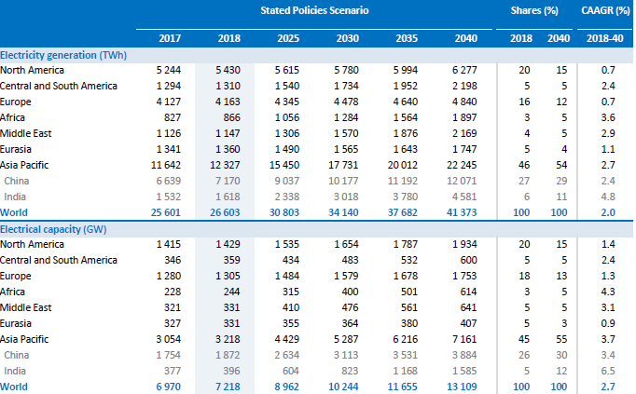
Global Power Sector Overview
18 TWh
18 TWh
(Source: WEO, 2019)
Notes:
The measure of development in any society of today is synonymous with the level of energy consumption
Energy is therefore recognized as a critical input parameter for national economic development
Impact of climate change on agriculture sector (from review paper)
we have seen the impacts of climate change on agriculture is huge.

Slide 6
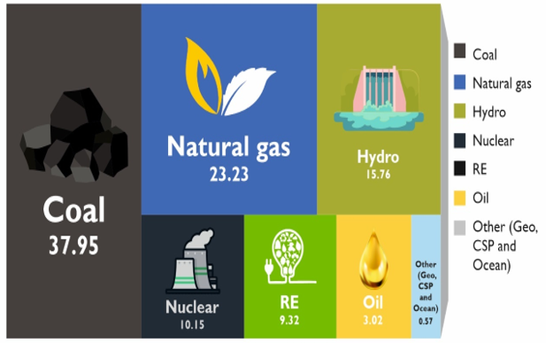
World Electricity Generation Share by Fuel
(Source: IRENA, 2019 and REN21, 2019)
Notes:
The measure of development in any society of today is synonymous with the level of energy consumption
Energy is therefore recognized as a critical input parameter for national economic development
Impact of climate change on agriculture sector (from review paper)
we have seen the impacts of climate change on agriculture is huge.

Slide 7
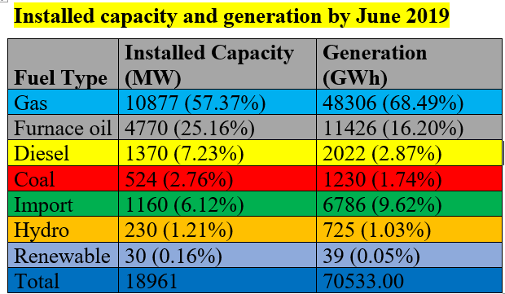
Bangladesh Power Generation Overview: Energy-mix for power generation in 2020
(Source: BDB 2019 and SREDA 2020)
Notes:
The measure of development in any society of today is synonymous with the level of energy consumption
Energy is therefore recognized as a critical input parameter for national economic development
Impact of climate change on agriculture sector (from review paper)
we have seen the impacts of climate change on agriculture is huge.

Slide 8
Bangladesh Power Generation Overview: Installation Capacity Share (Total 19922 MW)
(Source: BDB 2019 and SREDA 2020)
Notes:
The measure of development in any society of today is synonymous with the level of energy consumption
Energy is therefore recognized as a critical input parameter for national economic development
Impact of climate change on agriculture sector (from review paper)
we have seen the impacts of climate change on agriculture is huge.

Slide 9
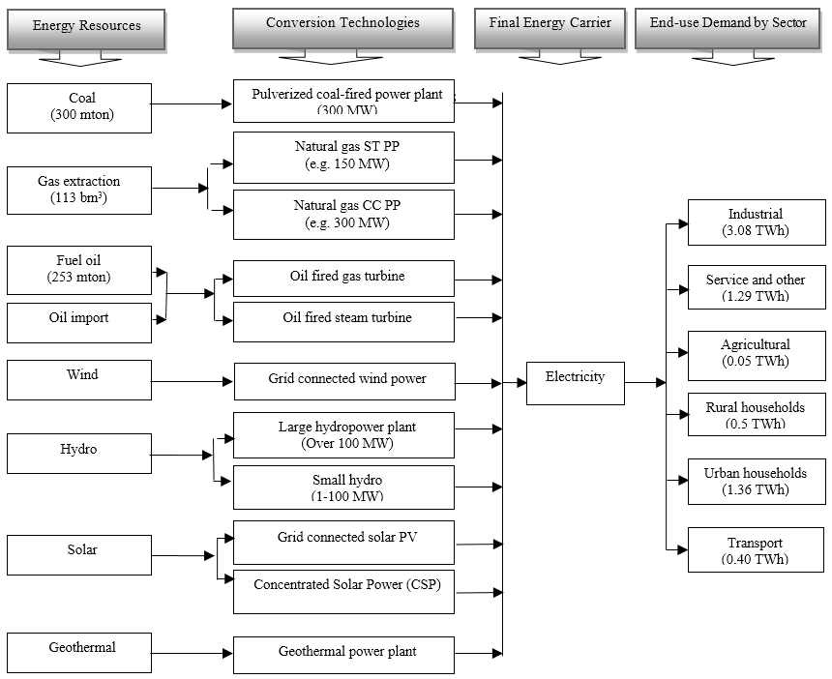
Energy system
Notes:
The reference energy system represents the activities and technologies of an energy system, depicting energy (flows from the source of origin to the end use) demands, energy conversion technologies, fuel mixes, and the resources required to satisfy the energy demand
Technology learning effects on cost
Growth bound and resource availability

Slide 10
Results
Introduction/methodology
16 times
11 times
Renewable potential
7.5 times
Demand projection
18 TWh
MARKAL- Bangladesh
Conclusions/remarks
Notes:
1) Total electricity consumption was about 18 TWh in 2005 and is projected to increase 7.5 times to 132 TWh by 2035 in the LG scenario .
2) In the AG and HG scenarios, the demand in 2035 shows an increase that is about 11 and 16 times the base-year value, respectively

Slide 11
Results/carbon tax scenarios
Introduction/methodology
Renewable potential
Demand projection
MARKAL- Bangladesh
Conclusions/remarks
Power generation capacity mix in 2035
Notes:
To summarize the results generated for each different tax scenario by the MARKAL-Bangladesh model, the power generation capacity mix in 2035 is selected as the principal metric . This provides a good indication of the types of technology choices made by the model to meet the various carbon taxes applied.
The colored bars (except yellow) give the breakdown of generation capacity (GW) by technology.
The low tax scenario allows a reduction in imported coal use of about 10 %, contributing only 0.34 % increase in system costs during 2005-2035. Import dependency reduces by 65 %, 84 % and 85 % in the medium, medium-high and high tax scenarios, respectively compared to the base scenario, but contributes to increase in the total system costs of 12 %, 24 % and 63 %, respectively.
The power generation capacity level in 2035 varies from 95 GW to 99 GW in the medium, medium-high and high tax scenarios, i.e., is roughly double the 2035 capacity level in the base and low-tax scenarios.
Gas-based simple cycle, steam turbine and biomass-based power plant capacity levels slightly decrease when taxes increase.
On the other hand, generation from renewable technologies increases from 210 TWh (5.8 %) in the base scenario to 1363 TWh (37.4 %) in the medium to high tax scenarios, consecutively between 2005 and 2035.

Slide 12
Importance of electrical energy
Electrical energy is superior to all other forms of energy due to the following reasons
Convenient form.
Easy control
Greater flexibility
Cheapness
Cleanness
High transmission efficiency

Slide 13
Energy sources
(i) The Sun
(ii) The Wind
(iii) Water
(iv) Fossil Fuels?
(v) Nuclear energy

Slide 14
Electricity generation
The conversion of energy available in different forms in nature into electrical energy is known as generation of electrical energy
What are the available different forms of energy?
Conventional Energy?
Non-conventional Energy?
Energy is available in various forms from different natural sources
These forms of energy can be converted into electrical energy by use of suitable arrangements
The arrangement essentially employs an alternator coupled to a prime mover

Slide 15
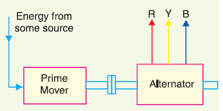
Electricity generation
The prime mover is driven by the energy obtained from various sources
The steam is fed to a prime mover which may be a steam engine or a steam turbine
The turbine converts heat energy of steam into mechanical energy
Further converted into electrical energy by the alternator

Slide 16
Relationship among energy units
Electrical and Mechanical
1 kWh = 1 kW x 1 hr
= 1000 watts x 3600 seconds = 36 x 10⁵ watt-sec. or Joules
1 kWh = 36 × 10⁵ Joules
Heat and Mechanical
It may be seen that heat energy can be expressed in Joules instead of thermal units viz. calorie, B.Th.U.
(Principles of Power System, V.K .Mehta)

Slide 17
Comparison of energy sources and efficiency
Parameter Hydro Fossil-fuels Nuclear Renewable
Initial cost High Low Highest High
Running cost Less High Least Less
Réservés Permanent Exhaustable Inexhaustible Unlimited
Cleanliness Cleanest Dirtiest Clean Clean
Simplicity Simplest Complex Most complex Simplest
Reliability Most reliable Less reliable More reliable Most reliable
Efficiency = Output energy/Input energy
Efficiency???

Slide 18
An Example
Mechanical energy is supplied to a DC generator at the rate of 4200 J/s. The generator delivers 32·2 A at 120 V.
(i) What is the percentage efficiency of the generator ?
(ii) How much energy is lost per minute of operation ?

Slide 19
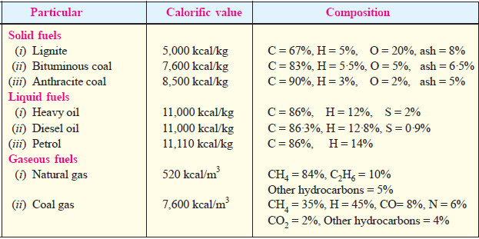
Calorific value of fuels
The amount of heat produced by the complete combustion of a unit weight of fuel is known as its calorific value.
Calorific value indicates the amount of heat available from a fuel. The greater the calorific value of fuel, the larger is its ability to produce heat.

Slide 20
Advantages of liquid fuels over solid fuels
The handling of liquid fuels is easier and they require less storage space.
The combustion of liquid fuels is uniform.
The solid fuels have higher percentage of moisture and consequently they burn with great difficulty. However, liquid fuels can be burnt with a fair degree of ease and attain high temperature very quickly compared to solid fuels.
The waste product of solid fuels is a large quantity of ash and its disposal becomes a problem. However, liquid fuels leave no or very little ash after burning.
The firing of liquid fuels can be easily controlled. This permits to meet the variation in load demand easily.

Slide 21
Advantages of solid fuels over liquid fuels
In case of liquid fuels, there is a danger of explosion.
Liquids fuels are costlier as compared to solid fuels.
Sometimes liquid fuels give unpleasant odours during burning.
Liquid fuels require special types of burners for burning.
Liquid fuels pose problems in cold climates since the oil stored in the tanks is to be heated in order to avoid the stoppage of oil flow.

Slide 22
Thank You
Contact: dralam.eee@diu.edu.bd

