Slide 1
Steam Power Plant

Slide 2
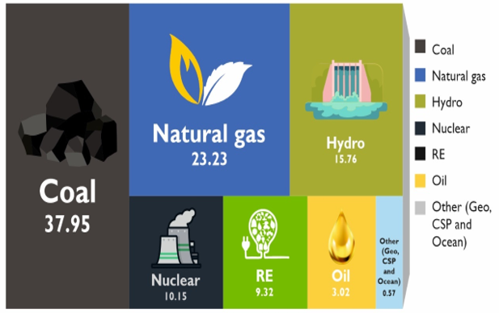
World Electricity Generation Share by Fuel
(Source: IRENA, 2019 and REN21, 2019)
Notes:
The measure of development in any society of today is synonymous with the level of energy consumption
Energy is therefore recognized as a critical input parameter for national economic development
Impact of climate change on agriculture sector (from review paper)
we have seen the impacts of climate change on agriculture is huge.

Slide 3
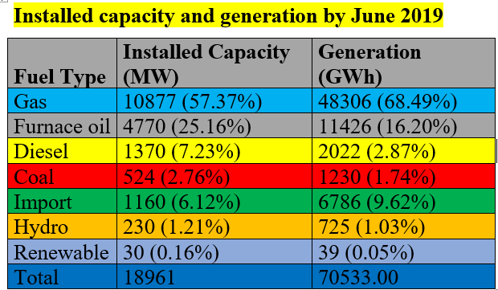
Bangladesh Power Generation Overview: Energy-mix for power generation in 2020
(Source: BDB 2019 and SREDA 2020)
Notes:
The measure of development in any society of today is synonymous with the level of energy consumption
Energy is therefore recognized as a critical input parameter for national economic development
Impact of climate change on agriculture sector (from review paper)
we have seen the impacts of climate change on agriculture is huge.

Slide 4
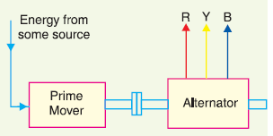
Electricity generation
The prime mover is driven by the energy obtained from various sources
The steam is fed to a prime mover which may be a steam engine or a steam turbine
The turbine converts heat energy of steam into mechanical energy
Further converted into electrical energy by the alternator

Slide 5
Power generation stations
Bulk electric power is produced by special plants known as generating stations or power plants:
A generating station essentially employs a prime mover coupled to an alternator for the production of electric power. The prime mover (turbine) converts energy from some other form into mechanical energy. The alternator converts mechanical energy of the prime mover into electrical energy.
Generating stations are classified as under :
Steam power stations
Hydroelectric power stations
Diesel power stations
Nuclear power stations

Slide 6
Steam power plant (thermal plant)
A generating station which converts heat energy of fossil fuel (coal, oil, natural gas) combustion into electrical energy is known as a steam power plant:
A steam power station basically works on the Rankine cycle:
Steam is produced in the boiler by utilizing the heat of fossil fuel combustion.
The steam is then expanded in the prime mover (steam turbine) and is condensed in a condenser to be fed into the boiler again.
The steam turbine drives the alternator which converts mechanical energy of the turbine into electrical energy.

Slide 7
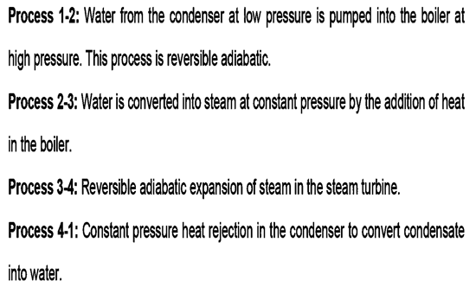
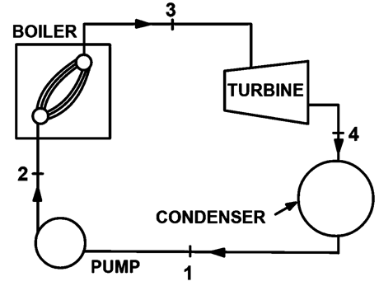
Steam power plant (thermal plant)
Rankine cycle

Slide 8
Pros and cons of coal power plant
Advantages
(i) The fuel (i.e., coal) used is quite cheap.
(ii) Less initial cost as compared to other generating stations.
(iii) It can be installed at any place irrespective of the existence of coal. The coal can be transported to the site of the plant by rail or road.
(iv) It requires less space as compared to the hydroelectric power station.
(v) The cost of generation is lesser than that of the diesel power station.
Disadvantages
(i) It pollutes the atmosphere due to the production of large amount of smoke and fumes.
(ii) It is costlier in running cost as compared to hydroelectric plant.

Slide 9
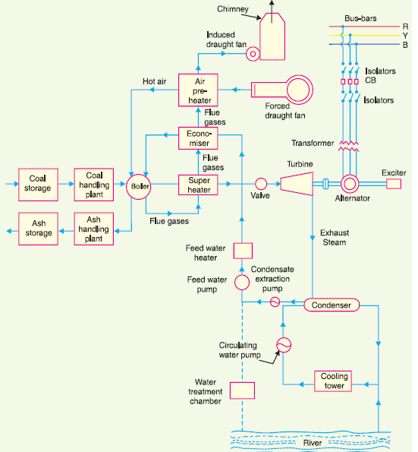
Schematic Arrangement of Coal Power Station (Thermal)

Slide 10
Main components of coal Power Station
The whole schematic arrangement of coal power plant can be divided into the following stages for simplicity:
Coal and ash handling arrangement
Steam generating plant
Steam turbine
Alternator
Feed water
Cooling arrangement

Slide 11
Main components of coal Power Station
Coal and ash handling arrangement
The coal is transported to the power station by road or rail and is stored in the coal storage plant
Then coal is delivered to the coal handling plant where it is pulverized (i.e., crushed into small pieces) in order to increase its surface exposure, thus promoting rapid combustion without using large quantity of excess air
The pulverized coal is fed to the boiler by belt conveyors. The coal is burnt in the boiler and the ash produced after the complete combustion of coal is removed to the ash handling plant and then delivered to the ash storage plant for disposal
The removal of the ash from the boiler furnace is necessary for proper burning of coal

Slide 12
Main components of coal Power Station
2. Steam generating plant
The steam generating plant consists of a boiler for the production of
steam and other auxiliary equipment for the utilization of flue gases:
Boiler
Superheater
Economiser
Air preheater.
(i) Boiler: The heat of combustion of coal in the boiler is utilized to convert water into steam at high temperature and pressure. The flue gases from the boiler make their journey through superheater, economiser, air pre-heater and are finally exhausted to atmosphere through the chimney.

Slide 13
Main components of coal Power Station
(ii) Superheater: The steam produced in the boiler is wet and is passed through a superheater where it is dried and superheated.
Superheating provides two principal benefits:
Firstly, the overall efficiency is increased.
Secondly, too much condensation in the last stages of turbine (which would cause blade corrosion) is avoided.
The superheated steam from the superheater is fed to steam turbine through the main valve.

Slide 14
Main components of coal Power Station
(iii) Economiser: An economiser is essentially a feed water heater and derives heat from the flue gases for this purpose. The feed water is fed to the economiser before supplying to the boiler. The economiser extracts a part of heat of flue gases to increase the feed water temperature.
(iv) Air preheater: An air preheater increases the temperature of the air supplied for coal burning by deriving heat from flue gases. Air is drawn from the atmosphere by a forced draught fan and is passed through air preheater before supplying to the boiler furnace.
Principal benefits of preheating the air are: increased thermal efficiency and increased steam capacity per square meter of boiler surface.

Slide 15
Main components of coal Power Station
3. Steam turbine
The dry and superheated steam from the superheater is fed to the steam
turbine through main valve. The heat energy of steam when passing over the blades of turbine is converted into mechanical energy.
4. Alternator
The steam turbine is coupled to an alternator. The alternator converts mechanical energy of turbine into electrical energy. The electrical output from the alternator is delivered to the bus bars through transformer, circuit breakers and isolators.
5. Feed water
The condensate from the condenser is used as feed water to the boiler.

Slide 16
Main components of coal Power Station
6. Cooling arrangement
In order to improve the efficiency of the plant, the steam exhausted
from the turbine is condensed by means of a condenser. Water is drawn from a natural source of supply such as a river, canal or lake and is circulated through the condenser.
The circulating water takes up the heat of the exhausted steam and itself becomes hot. This hot water coming out from the condenser is discharged at a suitable location down the river.

Slide 17
Choice of Power Station Site
In order to achieve overall economy, the following points should be considered while selecting a site for a steam power station :
Supply of fuel. The steam power station should be located near the coal mines so that transportation cost of fuel is minimum.
Availability of water. As huge amount of water is required for the condenser, therefore, such a plant should be located at the bank of a river or near a canal to ensure the continuous supply of water.
Transportation facilities. A modern steam power station often requires the transportation of material and machinery.
Cost and type of land
Nearness to load centers
Distance from populated area

Slide 18
Thermal efficiency of steam power plant
Thermal efficiency: The ratio of heat equivalent of mechanical energy transmitted to the turbine shaft to the heat of combustion of coal is known as thermal efficiency of steam power station.
Thermal efficiency of a modern steam power station is about 30%. It may be important to note that more than 50% of total heat of combustion is lost in the condenser. The other heat losses occur in flue gases, radiation, ash etc.

Slide 19
Overall efficiency of steam power plant
Overall efficiency: The ratio of heat equivalent of electrical output to the heat of combustion of coal is known as overall efficiency of steam power station.
Overall efficiency = Thermal efficiency × Electrical efficiency

Slide 20
Equipment of steam power plant
The most important equipment of a steam power station are:
Steam generating equipment
Condenser
Prime mover
Water treatment plant
Electrical equipment

Slide 21
1) Steam generating equipment
Steam generating equipment. This is an important part of steam power station. It is concerned with the generation of superheated steam and includes such items as 1) boiler, 2) boiler furnace, 3) superheater, 4) economiser, 5) air pre-heater and 6) other heat reclaiming devices
Boiler: A boiler is closed vessel in which water is converted into steam by utilizing the heat of coal combustion. Steam boilers are broadly classified into the following two types:
a) Water tube boilers
(b) Fire tube boilers

Slide 22
1) Steam generating equipment (cont.)
(2) Boiler furnace: A boiler furnace is a chamber in which fuel is burnt to liberate the heat energy. In addition, it provides support and enclosure for the combustion equipment i.e., burners.
There are following three types of construction of furnace walls :
(a) Plain refractory walls
(b) Hollow refractory walls with an arrangement for air cooling
(c) Water walls

Slide 23
1) Steam generating equipment (Cont.)
(3) Superheater
Superheater is a device which superheats the steam i.e., it raises the temperature of steam above boiling point of water. Superheaters are mainly classified into two types:
Radiant superheater
Convection superheater

Slide 24
1) Steam generating equipment (Cont.)
Radiant superheater is placed in the furnace between the water walls and receives heat from the burning fuel through radiation process. Disadvantages:
due to high furnace temperature, it may get overheated and requires a careful design and
the temperature of superheater falls with increase in steam output.
Convection superheater (commonly used) is placed in the boiler tube bank and receives heat from flue gases entirely through the convection process. It has the advantage that temperature of superheater increases with the increase in steam output.

Slide 25
1) Steam generating equipment (Cont.)
(4) Economiser: It is a device which heats the feed water on its way to boiler by deriving heat from the flue gases.
(An economiser consists of a large number of closely spaced parallel steel tubes connected by headers of drums. The feed water flows through these tubes and the flue gases flow outside. A part of the heat of flue gases is transferred to feed water, thus raising the temperature of the latter.)
(5) Air Pre-heater. Superheaters and economisers generally cannot fully extract the heat from flue gases. Therefore, pre-heaters are employed which recover some of the heat in the escaping gases.

Slide 26
1) Steam generating equipment (Cont.)
Depending upon the method of transfer of heat from flue gases to air,
air pre-heaters are divided into the following two classes:
Recuperative type
Regenerative type
Recuperative type air-heater consists of a group of steel tubes. The flue gases are passed through the tubes while the air flows externally to the tubes. Thus heat of flue gases is transferred to air.
Regenerative type air pre-heater consists of slowly moving drum made of corrugated metal plates. The flue gases flow continuously on one side of the drum and air on the other side.

Slide 27
2) Condenser
A condenser is a device which condenses the steam at the exhaust of turbine. It serves two important functions:
1) It creates a very low pressure at the exhaust of turbine, thus
permitting expansion of the steam in the prime mover to a very low pressure. This helps in converting heat energy of steam into mechanical energy in the prime mover.
2) The condensed steam can be used as feed water to the boiler.
There are two types of condensers:
(i) Jet condenser
(ii) Surface condenser

Slide 28
2) Condenser (Cont.)
In a jet condenser, cooling water and exhausted steam are mixed together. Therefore, the temperature of cooling water and condensate is the same when leaving the condenser.
Advantages of this type of condenser are: low initial cost, less floor area required, less cooling water required and low maintenance charges.
Disadvantages: condensate is wasted and high power is required for pumping water.
In a surface condenser, there is no direct contact between cooling water and exhausted steam. It consists of a bank of horizontal tubes enclosed in a cast iron shell.
Advantages of this type of condenser are: condensate can be used as feed water, less pumping power required and creation of better vacuum at the turbine exhaust.

Slide 29
3) Prime movers
The prime mover converts steam energy into mechanical energy.
Two types of steam prime:
steam engines and
2) steam turbines.
A steam turbine has several advantages over a steam engine. Therefore, all modern steam power stations employ steam turbines as prime movers.
Steam turbines are generally classified into two types according to the action of steam on moving blades : (i) Impulse turbines and (ii) Reactions turbines

Slide 30
3) Prime movers
In an impulse turbine, the steam expands completely in the stationary nozzles (or fixed blades), the pressure over the moving blades remaining constant. The steam attains a high velocity and impinges against the moving blades. This results in the impulsive force on the moving blades which sets the rotor rotating.
In a reaction turbine, the steam is partially expanded in the stationary nozzles, the remaining expansion takes place during its flow over the moving blades. The result is that the momentum of the steam causes a reaction force on the moving blades which sets the rotor in motion.

Slide 31
4) Water treatment plant
Boilers require clean and soft water for longer life and better efficiency. However, the source of boiler feed water is generally a river or lake which may contain suspended and dissolved impurities, dissolved gases etc. Therefore, it is very important that water is first purified and softened by chemical treatment and then delivered to the boiler.
The water from the source of supply is stored in storage tanks. The suspended impurities are removed through sedimentation, coagulation and filtration. Dissolved gases are removed by aeration and degasification. The water is then ‘softened’ by removing temporary and permanent hardness through different chemical processes. The pure and soft water thus available is fed to the boiler for steam generation.

Slide 32
5) Electrical equipment
A modern power plant contains many electrical equipment. The most important items are:
Alternators: Each alternator is coupled to a steam turbine and converts mechanical energy of the turbine into electrical energy.
Transformers: A generating station has different types of transformers:
main step-up transformers which step-up the generation voltage
station transformers which are used for general service (e.g., lighting)
auxiliary transformers which supply to individual unit-auxiliaries.
Switchgear: It houses such equipment which locates the fault on the system and isolate the faulty part from the healthy section. It contains circuit breakers, relays, switches and other control devices.

Slide 33
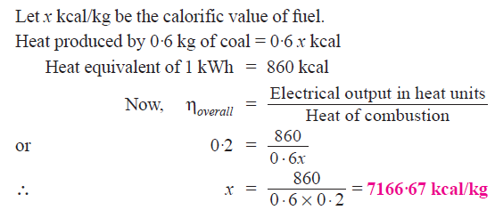
Examples: coal (thermal) power plant
Example 2.1. A steam power station has an overall efficiency of 20% and 0·6 kg of coal is burnt per kWh of electrical energy generated. Calculate the calorific value of fuel.

Slide 34
Examples: coal (thermal) power plant

Slide 35
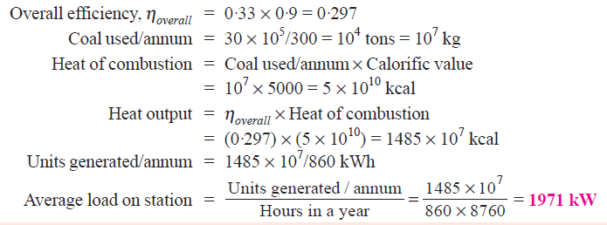
Examples: coal (thermal) power plant
Example 2.3. A steam power station spends BDT30 lakhs per annum for coal used in the station. The coal has a calorific value of 5000 kcal/kg and costs Rs. 300 per ton. If the station has thermal efficiency of 33% and electrical efficiency of 90%, find the average load on the station.

Slide 36
Examples: coal (thermal) power plant

Slide 37
Examples: coal (thermal) power plant

Slide 38
Thank You
Contact: dralam.eee@diu.edu.bd

