Slide 1
General Adaptation, Cell Injury & Cell Death
Mashiur Rahman
Lecturer
Department of Pharmacy
Daffodil International University

Slide 2
Diseases
Modern pathology is based on the theory of Rudolph Virchow who states that, all diseases starts with the molecular and functional changes to the cells.

Slide 3
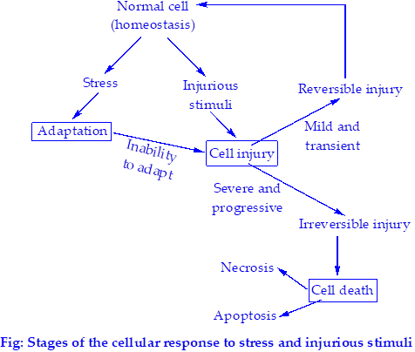

Slide 4
Cell adaptation
Definition:
Adaptation is the reversible structural and functional change of the cell due to some pathologic stimuli or severe physiologic stress and the cell can continue to survive and function by achieving new steady state.
The adaptive responses are - change to the number, size, phenotype, metabolic activity or functions of cell. These changes cause –
- Modulation of functioning of cells
- Increase viability of cells
When the stress is removed, the cell can return to the original steady state without any harmful consequences

Slide 5
Types of Cell Adaptation
1. Physiologic adaptations: Responses of cell to normal stimulation usually by hormones or other endogenous ligands. Cells must constantly adapt to changes in their environment, even under normal conditions.
2. Pathologic adaptations: Responses of cell to abnormal/noxious stimulation that provide the ability to survive in the changed environment and perhaps avoid injury

Slide 6
Forms of Adaptation
Adaptation may occur in several distinct forms –
Hyperplasia
Hepertrophy
Atrophy
Metaplasia
Dystrophy:
Dysplasia: Disorderly proliferation of cells where cells have lost uniformity and architectural orientation in tissue. This is not cancer.

Slide 7
Hyperplasia

Slide 8
Why hyperplasia occurs?
Increased workload
Increased physiologic requirements
For wound healing
Types:
1. Physiologic hyperplasia
Hormonal hyperplasia
Compensatory hyperplasia
2. Pathologic hyperplasia
Excessive stimulation
Failure of regulation

Slide 9
Mechanism of hyperplasia
Hyperplasia occurs usually due to combined effects of following –
Increased local production of growth factor
Increased production of growth factor receptor (GFR) in responding cell
Activation of intracellular pathway of transcription factor synthesis.
Hyperplasia is mainly caused by growth factor-driven proliferation or by increased cell production from the tissue stem cells (unipotent). For example, in liver regeneration, the process is mostly paracrine signaled growth factor-driven proliferation.

Slide 10
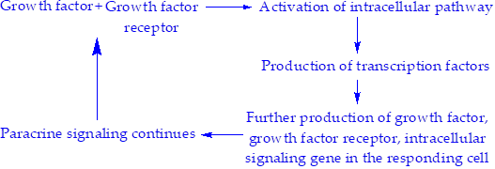
Hyperplasia is a controlled process in the sense that when the stimuli are removed the cell returns to normal state. This is true for even pathologic hyperplasia. On the other hand, in cancer, the growth can’t be controlled. Hence, hyperplasia is different from cancer but hyperplasia may give support to cancerous proliferation (patients with endometrial hyperplasia are at risk of endometrial cancer

Slide 11
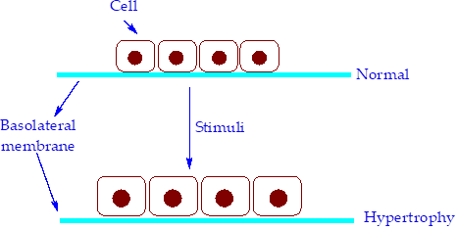
Hypertrophy
Definition:
It is the adaptive process in which the size of cell is increased in response to stimuli resulting in increase of the organ/tissue.

Slide 12
Why hypertrophy occurs?
Hypertrophy is triggered by
Mechanical stress/workload (e.g. in cardiac and skeletal muscle)
Trophic factors such as increased nutritional supply, vasoactive agents (endothelin-1, angiotensin II, α-adrenergic agonists) and growth factors (e.g. Insulin like growth factor, IGF-1; TGF-β Fibroblast growth factors), .

Slide 13
Types of Hypertrophy
Hypertrophy is of two types –
Physiologic hypertrophy: This is physiologic growth of cells to meet increased functional demand. E.g. estrogen induced growth of uterus during pregnancy, bulging of muscles of bodybuilders etc.
Pathologic hypertrophy: Pathologic condition causes increased functional demand which result in hypertrophy. E.g. hypertrophy of heart due to chronic hemodynamic overload. The chronic hemodynamic overload is due to hypertension or faulty heart valves. Here, the myofilaments are increased in number, hence each myocyte is enlarged. So each myocyte can generate more force resulting in greater work capacity of muscle. If the demand surpasses the capacity of muscle to enlarge then, cardiac failure ensues

Slide 14
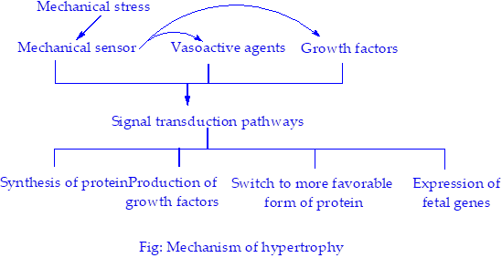
Mechanism of hypertrophy

Slide 15
Mechanism of hypertrophy
hypertrophy is caused by mechanical stress, growth factors and vasoactive agents. These stimuli work together to
Increase muscle protein synthesis. Mainly two biochemical processes are involved – phosphoinositid-3-kinase/Akt pathway (important in physiologic hypertrophy) and GPCR downstream effect (important in pathologic pathway).
Also contractile proteins may be switched between adult and fetal/neonatal forms. Exemplary, α-myosin heavy chain is switched to β-myosin heavy chain which gives slower and energetically economical contraction.
In addition, some genes which are only expressed in fetal/neonatal stage, is expressed again. Exemplary, ANF gene is expressed in atrium and ventricle of embryonic heart but not after birth. During hypertrophy it is expressed again. ANF (Atrial Natriuretic Factor) causes decreased blood volume and pressure hence decrease hemodynamic load

Slide 16
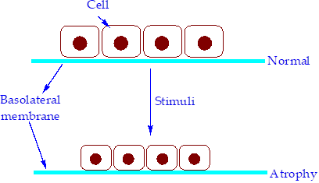
Atrophy
Definition:
It is the adaptive process of cell to a stimulus where are cell shrink in size by loss of cellular substances.
Atrophy is the reduced size of an organ or tissue due to decrease in cell size and number.

Slide 17
Why atrophy occurs?
Decreased workload
Loss of innervation
Diminished blood supply
Inadequate nutrition
Loss of endocrine stimulation
Pressure: Pressure can cause atrophy
Aging

Slide 18
Types of Atrophy
Atrophy is also of two types –
Physiologic atrophy: e.g. decrease in size of uterus after parturition, atrophy of the notochord and some other embryonic structures during fetal development. Such atrophy is normal physiologic process and not due to any disease conditions.
Pathologic atrophy: This may be localized or generalized. Example include, muscle atrophy in marasmus.

Slide 19
Mechanism of atrophy
The main reason for atrophy is protein degradation. If the degradation rate increased and synthesis is decreased atrophy will occur. Followings are possible protein degradation paths –
1. Lysosomes: It contains proteolytic enzymes. For example acid hydrolase – cathepsins. These enzymes degrade extracellular protein (when endocytosed) as well as cytosolic proteins.
2. Ubiquitin-proteasome pathway: This pathway is thought to be responsible for the accelerated proteolysis seen in a variety of catabolic conditions.
Hormones e.g. (glucocorticoids and thyroid hormone) and cytokines (TNF) stimulate this mechanism while insulin opposes it.
3. Autophagic vacuoles: When nutrient shortage occurs, the intracellular organelles and portion of cytosol are first sequestered in vacuoles which are then bound to membrane. Eventually the vacuoles are fused with lysosome forming lysophagosome. Thus the cellular components are digested and used as nutrients

Slide 20
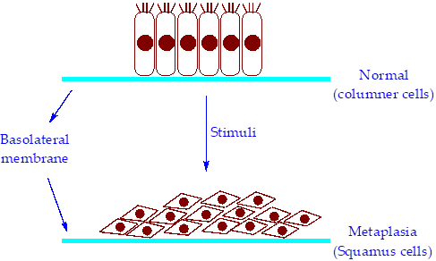
Metaplasia
Definition:
Metaplasia is a reversible change in which one adult cell type is replaced by another adult cell type.
In this manner, the cells which are more susceptible to the stress is replaced by cells which are less susceptible in an attempt to adapt to the stress.

Slide 21
Causes of metaplasia
Changes in the environment: e.g. stones in excretory ducts of salivary glands, pancreas or bile duct may cause columner cells being replaced by stratified squamus cells.
Irritation or inflammation: In chronic irritation e.g. habitual cigarette smokers, the columner epithelial cells respiratory tract are replaced by stratified squamus epithelial cells.
Nutritional: Vitamin A (retinoic acid) deficiency causes squamus metaplasia in respiratory tract.

Slide 22
Mechanism of metaplasia
The adult (differentiated) cells come from stem cells (undifferentiated). Stimuli responsible for metaplasia cause these stems cells to undergo differentiation in a new pathway. For example, retinoic acid controls expression of genes and thus differentiation through nuclear retinoid receptors. If vitamin A is deficient, then this regulation is lost and cell divides in another path.
Consequences of metaplasia:
Most of the time, epithelial metaplasia is detrimental. Cancer can also form around the area of metaplasia. Thus epithelial metaplasia is a double edged sword.

Slide 23
Cell injury
Definition:
Cell injury is the state of cell when cell is stressed so severely that it can’t adapt to the stress.
Such stress can result from extrinsic factors or intrinsic abnormalities or inherently damaging agents. Injury may progress through reversible stage and culminate in cell death

Slide 24
Types of cell injury
Injury is of two types –
Reversible injury: If injurious stimulus is mild and short-lasting then the cell can return to normal state. Such injury is termed reversible injury.
Irreversible injury: When the injurious stimulus is severe and also continuous, the cell can’t recover and eventually dies. This type of injury is termed irreversible injury.

Slide 25
Causes of cell injury
Oxygen deprivation
Physical agents
Chemical agents and drugs
Infectious agents:
Immunologic reactions
Genetic derangement
Nutritional imbalances

Slide 26
Mechanism of cell injury

Slide 27
Factors affecting cell injury:
Type, duration and severity of injury. These determine the cellular response.
Type, state and adaptability of the responding cell.
The biochemical pathways affected.
Common targets affected by injurious stimuli:
ATP production
Plasma membrane integrity which control ionic and osmotic homeostasis of cell and its organelles.
Cytoskeleton
Protein synthesis
The integrity of the genetic apparatus of the cell

Slide 28
Cell death
Introduction:
Cell death is the most crucial event in the development of disease. It is the end result of progressive injury. It results from diverse causes e.g.
Ischemia
Infection
Toxins etc.
Cell death is a normal and essential process in –
Embryogenesis
Development of organs
Maintenance of homeostasis.
Two principle path of cellular death are necrosis and apoptosis.

Slide 29
Necrosis
Simply necrosis is the pathologic death of cells
The mechanism and path of necrosis differs from cell type to cell type. But the process –
Is always pathological
Culminates irreversible injury
Cell swelling occurs
Nuclear change occurs
Inflammation is possible

Slide 30
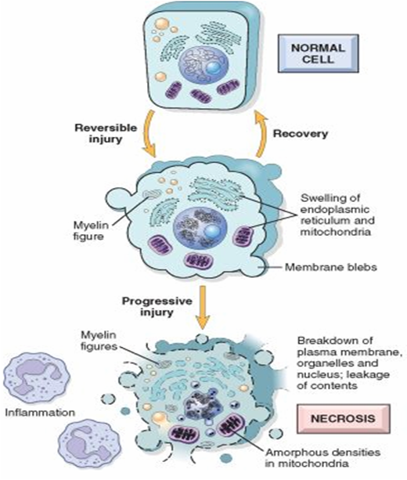
Mechanism of Necrosis

Slide 31
Patterns of necrosis
Coagulative necrosis: In such case, the architecture of the dead tissue is preserved in the necrotic area for a long time. This is probably due to denaturation of the proteolytic enzymes.
Liquefactive necrosis: The cellular contents are digested by enzymes to form a liquid mass.
Caseous necrosis: Here the contents of lysed cells are enclosed in a specific inflammatory border. This is encountered most commonly in tuberculosis.

Slide 32
Apoptosis
Introduction:
Apoptosis is defined as the programmed death of cells.
It is a normal phenomenon used to eliminate unnecessary or incorrect cells. It is also used to remove cells which are injured beyond repair. Thus apoptosis can be physiologic or pathologic

Slide 33
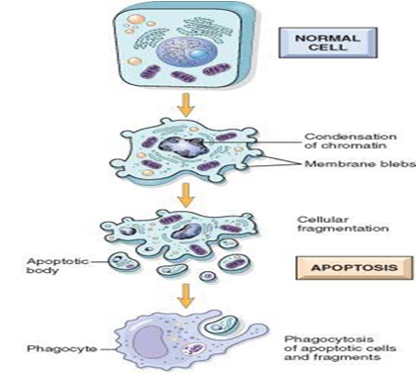
Mechanism of apoptosis

Slide 34
Differences between necrosis and apoptosis
Feature | Necrosis | Apoptosis
Control | Uncontrolled pathological death of cells. | Controlled death of cells. May be physiologic or pathologic.
Cell size | Enlarged. | Reduced/shrinkage.
Cell lysis | Yes. | No. fragmentation into apoptic bodies.
Cellular content | Enzymatic digestion. Leakage | Intact. Present in apoptic bodies.
Nucleus |  | Fragmentation into nucleosome-sized fragments.
Enzyme participation | Phospholipase and proteases are important. | Caspases are activated.
Inflammation | Frequent. | Completely absent.
Phagocytic clearance | Usually no. | Yes.

Slide 35
Pathologic calcification
Definition:
Pathologic calcification is the abnormal (macroscopic) deposition of calcium salts along iron, magnesium and other mineral salts in the tissue.
The calcium salts are deposited as fine, gritty, white granules or clumps. The main deposit is crystalline calcium phosphate in the form of an apatite similar to hydroxyapatite of bone.
This deposition may be intracellular, extracellular or both.

Slide 36
Types
Dystrophic calcification | Metastatic calcification
Occurs locally in dying tissues. | Occurs in normal tissues.
May occur at normal serum level of Ca. | Results from hypercalcemia or problems of calcium metabolism.

Slide 37
Thank You

