Slide 1

Md. Sakhawat Hossain
Lecturer
Department of Pharmacy
Daffodil International University

Slide 2
Edema
60% of lean body weight is water; 2/3 is intracellular, and the remainder is the extracellular space, mostly as interstitial fluid
Only about 5% of the total body water is in blood plasma
Increased fluid in the interstitial spaces (e.g. hydrothorax, anasarca)

Slide 3
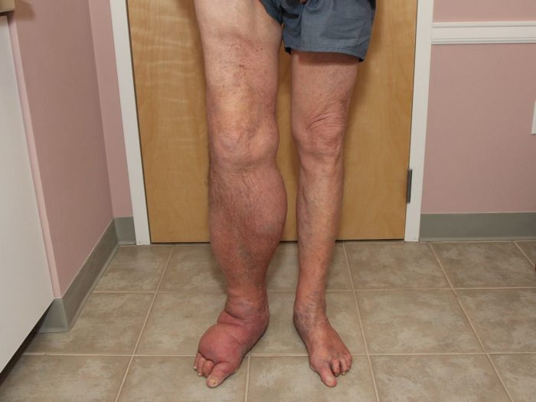
Edema
Edema is swelling that is caused by fluid trapped in your body’s tissues. Edema happens most often in the feet, ankles, and legs, but can affect other parts of the body, such as the face, hands, and abdomen. It can also involve the entire body.

Slide 4
Causes of edema
Increased capillary pressure
Decreased plasma proteins
  Excessive kidney retention of salt and water
High venous pressure and venous constriction
Decreased arteriolar resistance
Loss of proteins in urine or G.I.T
Loss of protein from denuded skin areas
Failure to produce proteins
Liver disease

Slide 5
Causes of edema
Increased capillary permeability
Blockage of lymph return
  Toxins
  Bacterial infections (Cellulites)
  Vitamin deficiency, especially vitamin C
  Prolonged ischemia
  Burns
  Cancer
  Infections
  Surgery
  Congenital absence or abnormality of lymphatic vessels

Slide 6
Types of edema
1) According to pathophysiological mechanism:
a) Transudate (low protein content)
b) Exudate (high protein content)
2) According to location:
a) Localized
b) Generalized
3) According to clinical finding:
a) Pitting
b) Non-pitting

Slide 7
Types of edema
Localized edema:-
Generalized edema:-
Venous edema
Lymphatic edema
Allergy
Inflammatory
Cardiac edema
Hepatic edema
Renal edema
Endocrine edema

Slide 8
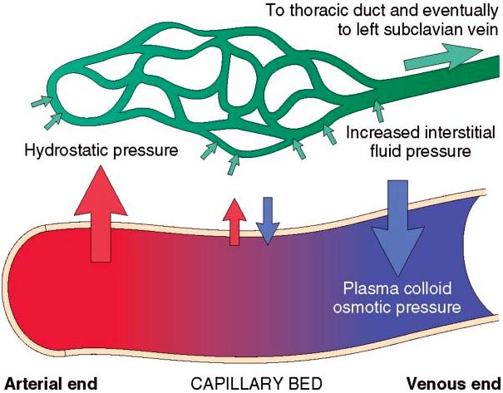
Pathophysiology

Slide 9
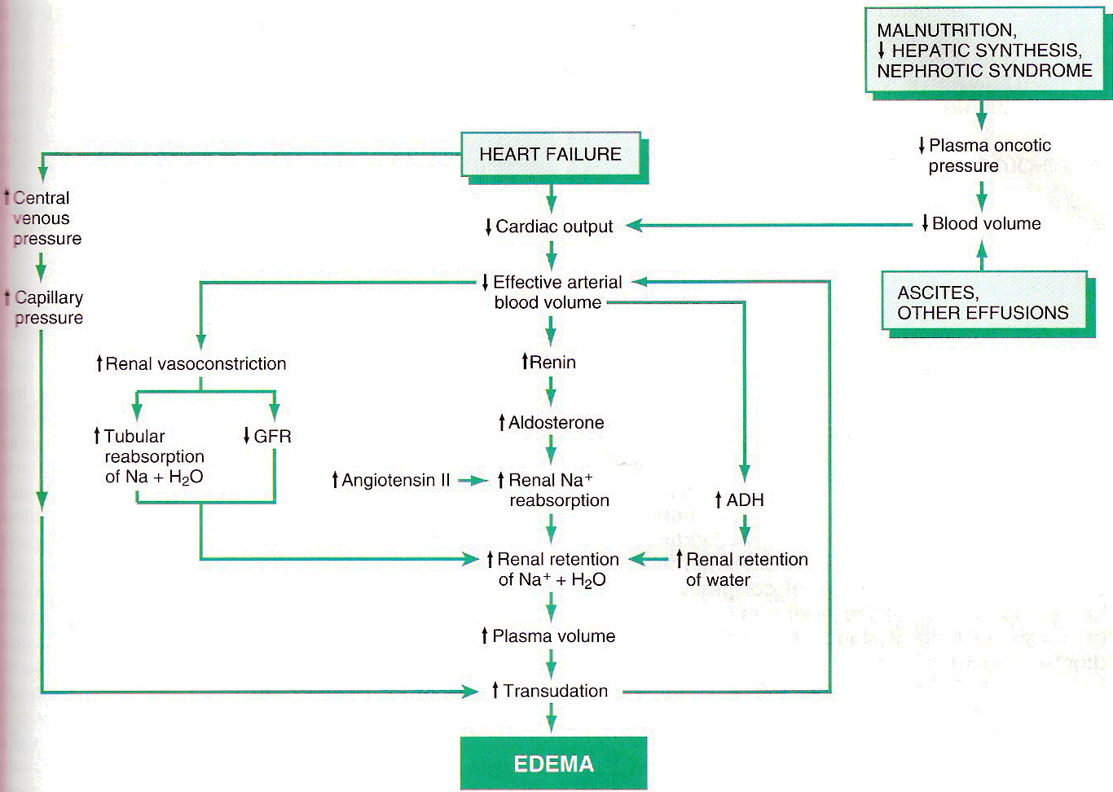

Slide 10
Sign-Symptoms
The affected area is swollen.
The skin over the swollen area might look stretched and shiny.
Pushing in gently on the swollen area with your finger for at least 5 seconds and then removing your finger will leave a dimple in the skin.
You may have trouble walking if your legs are swollen.
You may be coughing or have trouble breathing if you have edema in the lungs.

Slide 11
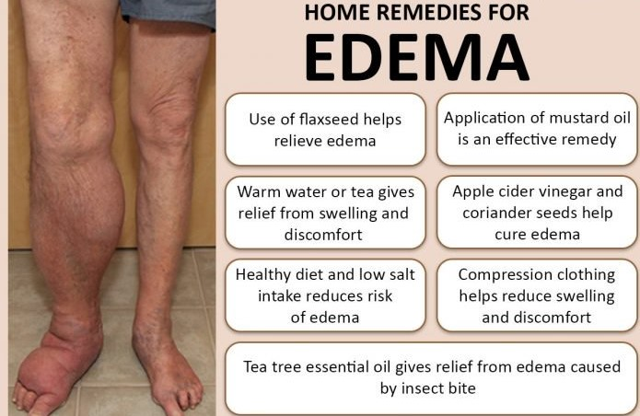
Treatment

Slide 12
Treatment
Medication:-
Furosemide
Temasemide
Morphine sulfate

Slide 13
Shock
Shock is basically failure of circulatory system to supply blood to tissue. At this type situation because of poor blood circulation our body tissue can’t get enough or require nutrient and oxygen and also body can’t remove the metabolic wastes from the affected tissue.
Shock is basically cause by hemorrhage and overwhelming infection. For this the patient who have shocked are reduce blood presser and also show some other symptoms.

Slide 14
Causes of shock
Severe allergic reaction
Significant blood lose
Blood infection
Heart failure

Slide 15
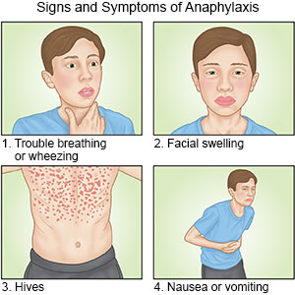
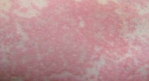
Causes of shock
Severe allergic reaction
  Anaphylaxis
    Breathing and ultimate shock
    Low pulse
    Difficulty to swallowing

Slide 16
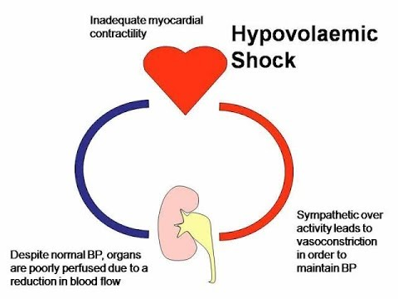
Causes of shock
Significant blood lose
  Hypovolemia
    loss 20% blood of total volume.
    bleeding from serious cuts or wounds
    significant vaginal bleeding
    Bleeding form the digestive tract
    internal bleeding from abdominal organs
    Difficult for heart to pump sufficient
    amount of blood

Slide 17
Cause of shock
Blood infection
  Sepsis (septic shock)
    Trigger by local infection
      Pneumonia (lung infection)
      Infected wound
      Urinary tract infection
    Cause by bacteria release toxic in blood
    Symptom:
      Reduce blood presser
      Difficulty to caring O₂
      Failure of kidney, heart, lung
Heart failure

Slide 18
Types of Shock
Respiratory shock
Trauma to the respiratory tract (trachea, lungs) that causes a reduction of oxygen and carbon dioxide exchange. Body cells cannot receive enough oxygen.
Neurogenic Shock
injury or trauma to the nervous system (spinal cord, brain). Nerve impulse to blood vessels impaired, blood vessels remain dilated and blood pressure decreases.

Slide 19
Types of Shock
Cardiogenic Shock
Myocardial Infarction with damage to heart muscle; heart unable to pump effectively. Inadequate cardiac output. Body cells do not receive enough oxygen.
Hemorrhagic Shock
Severe bleeding or loss of body fluid from trauma, burns, surgery, or dehydration from severe
nausea and vomiting. Blood pressure decreases, thus blood flow is reduced to cells, tissue, and organs.

Slide 20
Types of Shock
Anaphylactic Shock
Results from reaction to substance to which patient is hypersensitive or allergic (allergen extracts, bee sting, medication, food). Outpouring of histamine results in dilation of blood vessels throughout the body.
Metabolic Shock
Body's homeostasis impaired; acid-base balance disturbed (diabetic coma or insulin shock); body fluids unbalanced.

Slide 21
Types of Shock
Psychogenic Shock
Shock caused by overwhelming emotional factors. Sudden dilation of blood vessels results in fainting because of lack of blood supply to the brain.
Septic Shock
An acute infection, usually systemic, that overwhelms the body (toxic shock syndrome). Poisonous substances accumulate in bloodstream and blood pressure decreases, impairing blood flow to cells, tissues, and organs.

Slide 22
Sign-symptoms
  Hypovolemic Shock
  Hypovolemia is a direct loss of effective circulating blood volume leading to-
Rapid heart rate (rapid pulse)
Rapid breathing
Dilated pupils
Pale, cool skin
Sweating (diaphoresis)

Slide 23
  2. Distributive Shock
  Anaphylaxis symptoms include:
  • Hives
  • Itching
  • Swelling, particularly of the face
  • Trouble breathing
  • Skin redness
  • Rapid heart rate
  Sepsis symptoms include:
  • Fever (not always)
  • Flush, red skin
  • Dry mouth
  • Poor skin elasticity (turgor), which means if you pinch the skin it stays pinched and returns slowly back to normal, if at all.

Slide 24
Treatment
Usually IV fluids are administered in addition to medications that raise blood

Slide 25
Embolism
An embolus is a particle that moves about in our blood vessels, either in the veins or arteries. Most emboli are composed of clotted blood cells. A blood clot is called a thrombus and a moving blood clot is called a thromboembolus.
As an embolus moves through the body's blood vessels, it's likely to come to a passage it can't fit through. It lodges there, backing up blood behind it. The cells that normally get their blood supply via this passage are starved of oxygen (ischemia) and die. This condition is called an embolism.

Slide 26
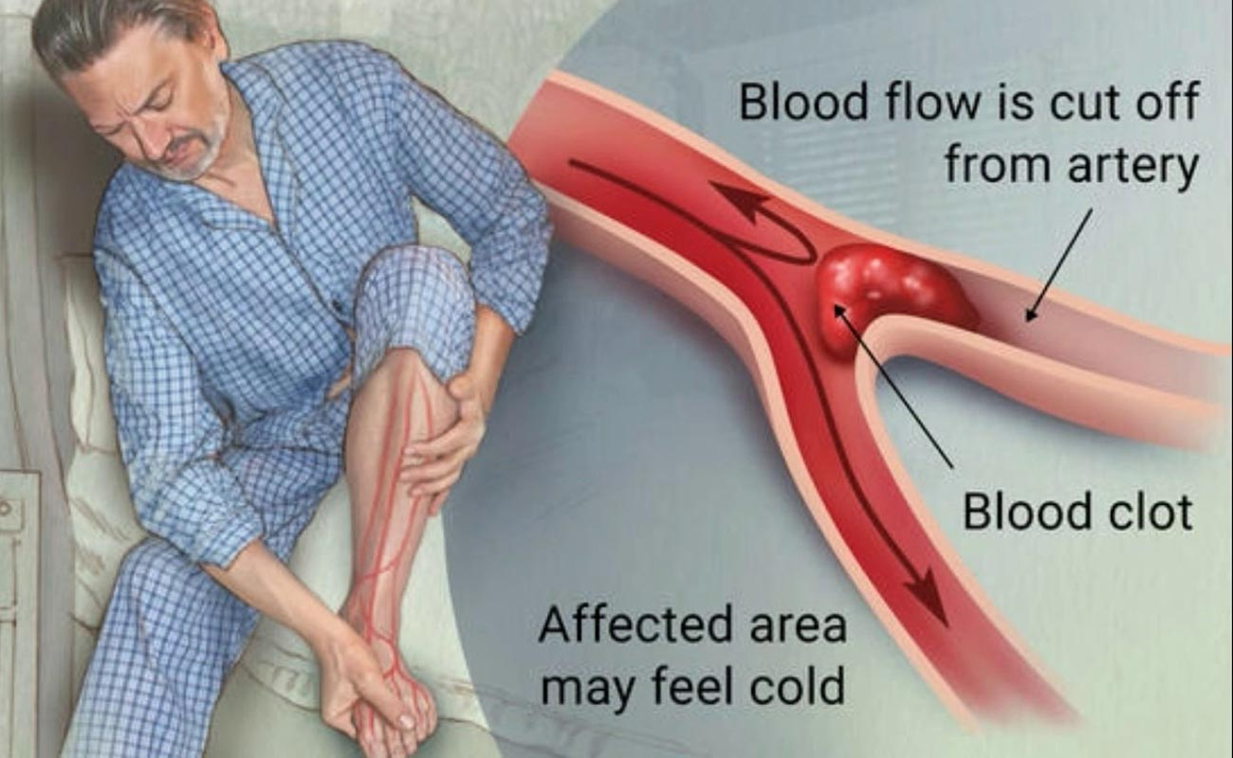
Embolism

Slide 27
Types of embolism
Pulmonary embolism: An embolus, usually formed in the leg (sometimes known as a deep vein thrombosis or DVT), lodges in one of the arteries of the lungs. Many emboli are broken down by the body and go away by themselves however, serious pulmonary embolism may cause death.
Brain embolism: If a blood clot travels to the brain, this causes an ischemic stroke or TIA (transient ischemic attack).
Retinal embolism: Small clots that wouldn't block a major artery can block the smaller blood vessels feeding the retina at the back of the eye. The result is usually sudden blindness in one eye.

Slide 28
Types of embolism
Septic embolism: This occurs when particles created by infection in the body reach the bloodstream and block blood vessels.
Amniotic embolism: Not all emboli are made of clotted blood. In pregnancy, the womb is filled with amniotic fluid, which protects the fetus. Amniotic fluid can embolize and reach the mother's lungs, causing pulmonary amniotic embolism.
Air embolism: Scuba divers who rise to the surface too rapidly can generate air embolism, bubbles in the blood that can block arterial blood flow.
Fat embolism: If fat or bone marrow particles are introduced into the blood circulation, they may block blood vessels the way a blood clot or air bubble can.

Slide 29
Causes
Most embolisms happen to people who have risk factors for blood clot formation such as smoking and heart disease. Other risk factors for other types of emboli include high blood pressure, atherosclerosis and high cholesterol.
The primary cause of most pulmonary embolisms is deep vein thrombosis (DVT)

Slide 30
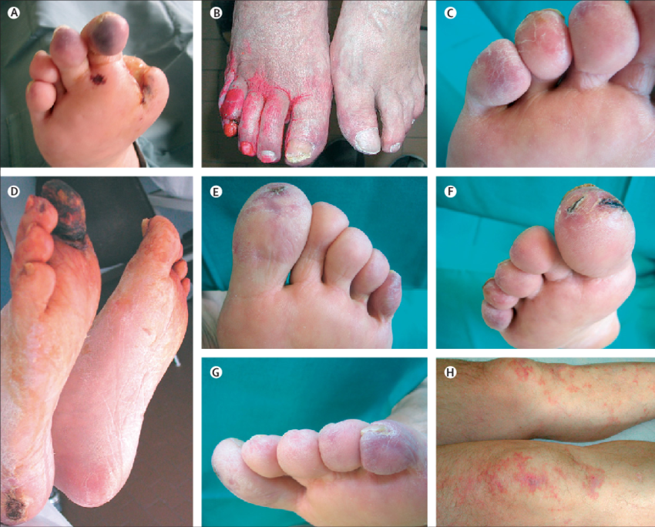
Symptoms of Embolism
Symptoms of pulmonary embolism appear suddenly and include:
shortness of breath,
rapid breathing or wheezing
bloody sputum
Cough
Lightheadedness
dizziness
sharp chest pain or back pain

Slide 31
Treatment and Prevention
Anticoagulants, such as heparin or warfarin
Thrombolytics such as alteplase and streptokinase help the body to dissolve the original clot.
Non-medication methods to help prevent DVT include using compression devices and compression stockings
For instance by quitting smoking and controlling your blood pressure.

Slide 32
HEMORRHAGE
Bleeding or the abnormal flow of blood.
Loss of blood or blood escape from the circulatory system
Bleeding into the spleen or liver are examples of internal hemorrhage.
Can bleed from mouth, ear, nose, anus etc

Slide 33
Causes
Trauma
Cerebral aneurysm
High blood pressure
Blood vessel abnormalities
Blood or bleeding disorders
Liver diseases
Brain tumor and drug abuse

Slide 34
Types
1.Intracranial hemorrhage
2.Cerebral hemorrhage
3.Intracerebral hemorrhage
4.Subconjunctival hemorrhage
5.Hematemesis
6.Hemoptysis etc

Slide 35
Pathophysiology
There are many types of hemorrhage. Hemorrhagic stroke is one of them. Pathophysiology of hemorrhagic stroke is-
Blood pressure increase
Rupture the blood vessels in brain
Clot the blood in the brain
Hemorrhagic stroke occurs

Slide 36
Treatment
Depending on the severity of hemorrhage, surgery may be necessary to repair the blood vessel and remove excess blood.
Doctors may prescribe preventative medications after the bleeding has stopped.
More recently, doctors have begun to administer very high doses of complexes and compounds that stimulates clotting.

Slide 37
Hemostasis and thrombosis
Home work

