Slide 1
Data type modifiers in C

Slide 2
Data type modifiers in C
In c language Data Type Modifiers are keywords used to change the properties of current properties of data type. Data type modifiers are classified into following types.
long
short
unsigned
Signed
Modifiers are prefixed with basic data types to modify (either increase or decrease) the amount of storage space allocated to a variable.
For example, storage space for int data type is 4 byte for 32 bit processor.
We can increase the range by using long int which is 8 byte.
We can decrease the range by using short int which is 2 byte.

Slide 3
long
This can be used to increased size of the current data type to 2 more bytes, which can be applied on int or double data types. For example int occupy 4 byte of memory if we use long with integer variable then it occupy 6 byte of memory.

Slide 4
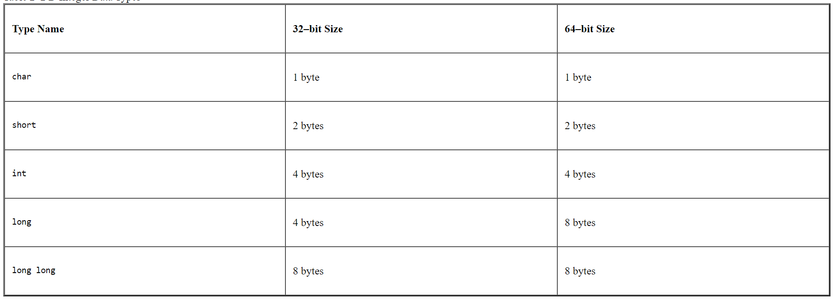
short
In general to allocate fixed memory space short keyword can be used. It decreases 2 bytes of memory.

Slide 5
unsigned
This keyword can be used to make the accepting values of a data type is positive data type.
This declaration allows the a variable to store only positive values. An immediate effect is that the range changes from (-32768 to 32767) to (0 to 65536)

Slide 6
Signed
This keyword accepts both negative or positive value and this is default properties or data type modifiers for every data type.
Note: in real time no need to write signed keyword explicitly for any data type.

