Slide 1
Database Architecture
Presented By
Rubaiya Hafiz
rubaiya.cse@diu.edu.bd

Slide 2
এই Lesson এ কি শিখব?
Database Architecture?
Two tier Architecture?
Three tier Architecture?

Slide 3
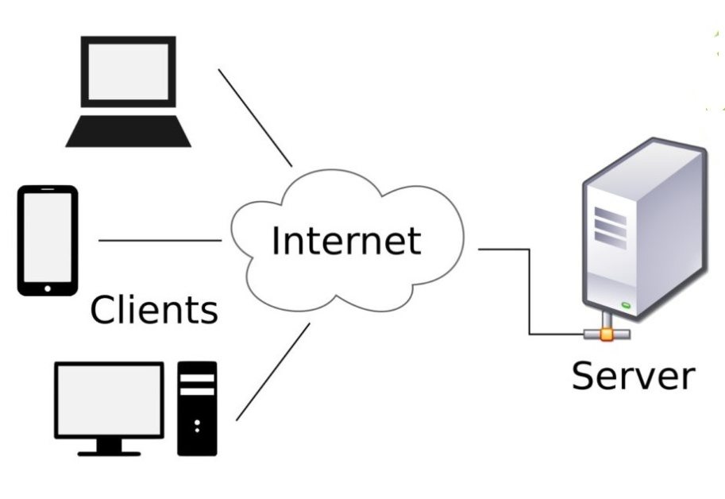
Client and Server Model
Client: When we talk the word Client, it mean to talk of a person or an organization using a particular service. Similarly in the digital world a Client is a computer (Host) i.e. capable of receiving information or using a particular service from the service providers (Servers).
Servers: Similarly, when we talk the word Servers, It mean a person or medium that serves something. Similarly in this digital world a Server is a remote computer which provides information (data) or access to particular services.

Slide 4
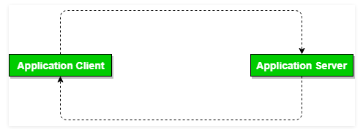
Two Tier Architecture
Two tier architecture is similar to a basic client-server model.
The application at the client end directly communicates with the database at the server side.
API’s like ODBC,JDBC are used for this interaction.
The server side is responsible for providing query processing and transaction management functionalities. On the client side, the user interfaces and application programs are run.

Slide 5
Advantage of Two Tier Architecture
The application on the client side establishes a connection with the server side in order to communicate with the DBMS.
An advantage of this type is that maintenance and understanding is easier, compatible with existing systems. However this model gives poor performance when there are a large number of users.

Slide 6
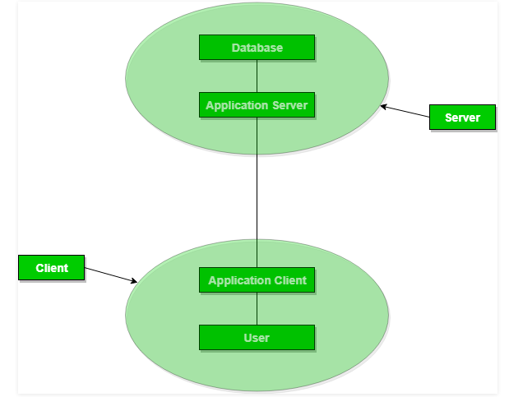
Three Tier Architecture
In this type, there is another layer between the client and the server. The client does not directly communicate with the server.
Instead, it interacts with an application server which further communicates with the database system and then the query processing and transaction management takes place.

Slide 7
Three Tier Architecture (Cont’d)
This intermediate layer acts as a medium for exchange of partially processed data between server and client. This type of architecture is used in case of large web applications.

Slide 8
Advantage of Three Tier Architecture
Enhanced scalability due to distributed deployment of application servers. Now, individual connections need not be made between client and server.
Data Integrity is maintained. Since there is a middle layer between client and server, data corruption can be avoided/removed.
Security is improved. This type of model prevents direct interaction of the client with the server thereby reducing access to unauthorized data.

Slide 9
Disadvantage of Three Tier Architecture
Increased complexity of implementation and communication. It becomes difficult for this sort of interaction to take place due to presence of middle layers.

Slide 10
“It is during our darkest moments that we must focus to see the light.”
– Aristotle Onassis

