Slide 1

CSE 311
Transactions

Slide 2

Outline
Transaction Definition
Transaction Boundaries
Committing a transaction
Rolling Back transaction
Transaction Control
  Savepoint
An Example

Slide 3
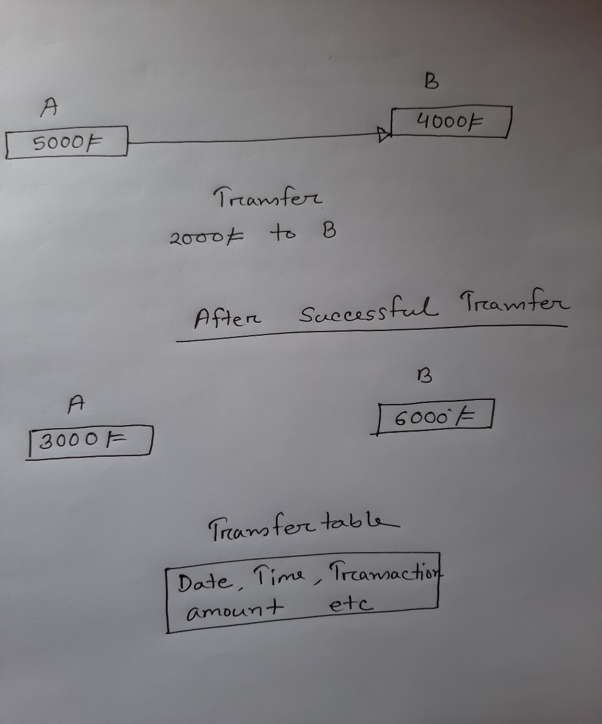

Slide 4
Transactions
Transaction is a series of one or more SQL statements that are logically related or a series of operations performed on Oracle table data.
Transactions are a means to break programming code into manageable units.
A successfully executed SQL statement and a committed transaction are not same. Even if an SQL statement is executed successfully, unless the transaction containing the statement is committed, it can be rolled back and all changes made by the statement(s) can be undone.

Slide 5
Transaction Boundaries
A transaction has a beginning and an end.
A transaction begins when one of the following events take place:
  When the first SQL statement is executed after connecting to the database.
  At each new SQL statement issued after a transaction is completed.

Slide 6
Transaction Boundaries (Cont..)
A transaction ends when one of the following events take place:
  A COMMIT or a ROLLBACK statement is issued.
    COMMIT makes events within a transaction permanent.
    ROLLBACK erases events within a transaction.
  A DDL statement, like CREATE TABLE statement, is issued; because in that case a COMMIT is automatically performed.
  The system crashes.

Slide 7
Committing a Transaction
A transaction is made permanent by issuing the SQL command COMMIT.
The general syntax for the COMMIT command is:
Commit;
When a COMMIT statement is issued to the database, the following results are true:
  All work done by the transaction becomes permanent.
  Other users can see changes in data made by the transaction.
  Any locks acquired by the transaction are released.

Slide 8
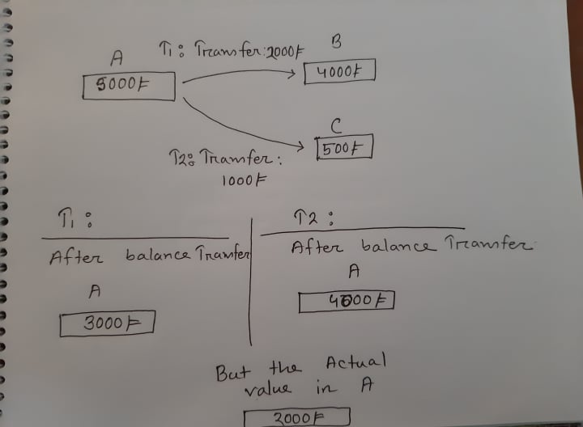

Slide 9
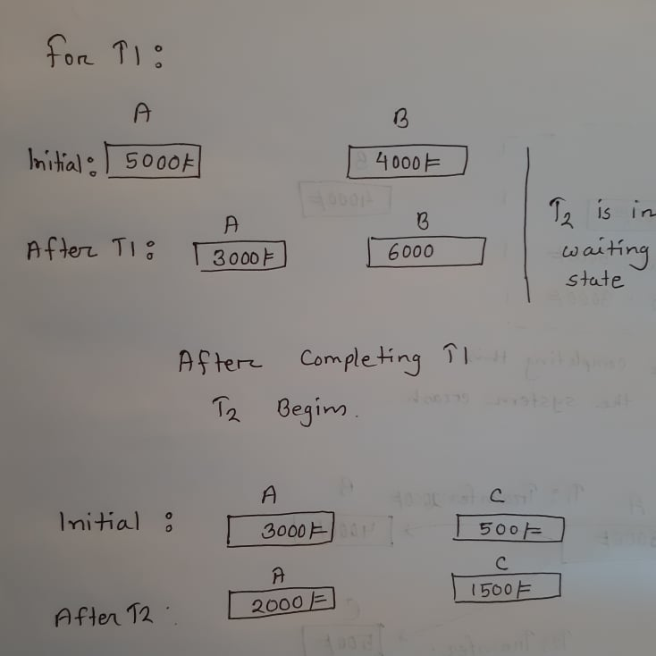

Slide 10
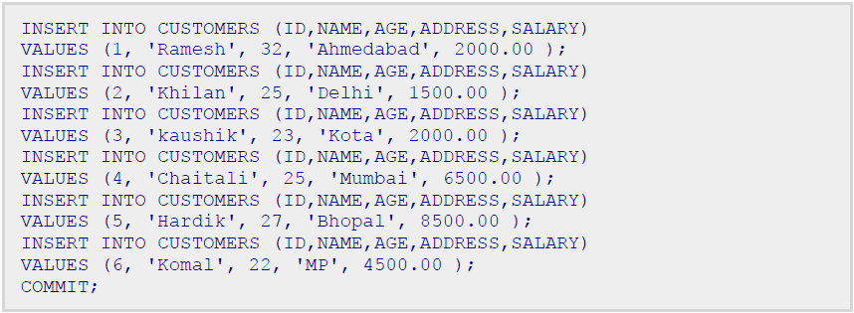
Example of Commit

Slide 11
Rolling Back Transactions
Changes made to the database without COMMIT could be undone using the ROLLBACK command.
The general syntax for the ROLLBACK command is:
ROLLBACK [TO SAVEPOINT < savepoint_name>];
If you are not using savepoint, then simply use the following statement to rollback all the changes:
ROLLBACK;
When a ROLLBACK statement is issued to the database, the following results are true:
  All work done by the transaction is undone.
  Any locks acquired by the transaction are released.

Slide 12
Transaction Control
Savepoints:
  Savepoints are sort of markers that help in splitting a long transaction into smaller units by setting some checkpoints.
  By setting savepoints within a long transaction, you can roll back to a checkpoint if required.
  This is done by issuing the SAVEPOINT command.
  The general syntax for the SAVEPOINT command is:
SAVEPOINT < savepoint_name >;

Slide 13
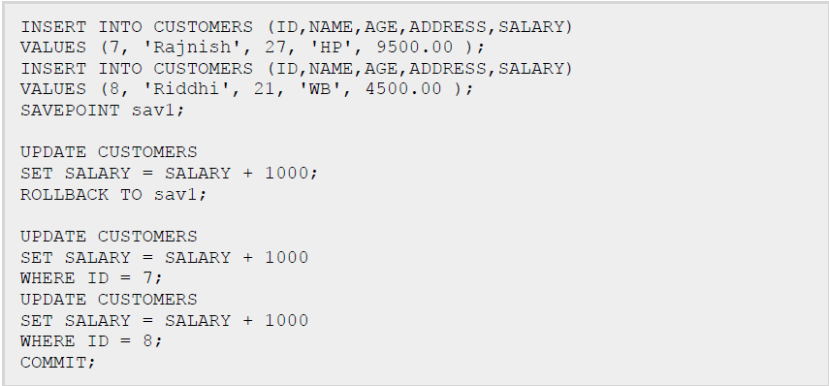
Example of Rollback and Savepoint
Here, ROLLBACK TO sav1; statement rolls back the changes up to the point, where you had marked savepoint sav1 and after that new changes will start.

Slide 14
Advantages of COMMIT and ROLLBACK
With COMMIT and ROLLBACK statements, you can:
  Ensure data consistency
  Preview data changes before making changes permanent
  Group logically related operations

