Slide 1
Transaction
Part 2
Rubaiya Hafiz
710001433

Slide 2
ACID Properties
A transaction is a very small unit of a program and it may contain several low level tasks. A transaction in a database system must maintain Atomicity, Consistency, Isolation, and Durability − commonly known as ACID properties − in order to ensure accuracy, completeness, and data integrity.
Atomicity − This property states that a transaction must be treated as an atomic unit, that is, either all of its operations are executed or none. There must be no state in a database where a transaction is left partially completed. States should be defined either before the execution of the transaction or after the execution/abortion/failure of the transaction.
Consistency − The database must remain in a consistent state after any transaction. No transaction should have any adverse effect on the data residing in the database. If the database was in a consistent state before the execution of a transaction, it must remain consistent after the execution of the transaction as well.

Slide 3
ACID Properties
Durability − The database should be durable enough to hold all its latest updates even if the system fails or restarts. If a transaction updates a chunk of data in a database and commits, then the database will hold the modified data. If a transaction commits but the system fails before the data could be written on to the disk, then that data will be updated once the system springs back into action.
Isolation − In a database system where more than one transaction are being executed simultaneously and in parallel, the property of isolation states that all the transactions will be carried out and executed as if it is the only transaction in the system. No transaction will affect the existence of any other transaction.

Slide 4
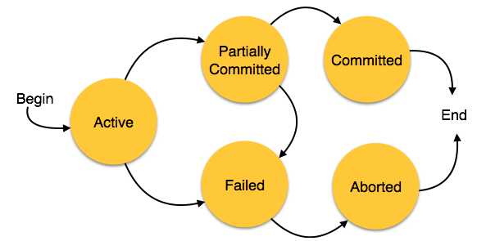
States of Transactions
A transaction in a database can be in one of the following states −

Slide 5
States of Transactions
Active − In this state, the transaction is being executed. This is the initial state of every transaction.
Partially Committed − When a transaction executes its final operation, it is said to be in a partially committed state.
Failed − A transaction is said to be in a failed state if any of the checks made by the database recovery system fails. A failed transaction can no longer proceed further.

Slide 6
States of Transactions
Aborted − If any of the checks fails and the transaction has reached a failed state, then the recovery manager rolls back all its write operations on the database to bring the database back to its original state where it was prior to the execution of the transaction. Transactions in this state are called aborted. The database recovery module can select one of the two operations after a transaction aborts −
  Re-start the transaction
  Kill the transaction
Committed − If a transaction executes all its operations successfully, it is said to be committed. All its effects are now permanently established on the database system.

Slide 7
Dead Lock
In a multi-process system, deadlock is an unwanted situation that arises in a shared resource environment, where a process indefinitely waits for a resource that is held by another process.
Deadlocks are not healthy for a system. In case a system is stuck in a deadlock, the transactions involved in the deadlock are either rolled back or restarted.

Slide 8
Dead Lock
Suppose, Transaction T1 holds a lock on some rows in the Students table and needs to update some rows in the Grades table. Simultaneously, Transaction T2 holds locks on those very rows (Which T1 needs to update) in the Grades table but needs to update the rows in the Student table held by Transaction T1.
Now, the main problem arises. Transaction T1 will wait for transaction T2 to give up lock, and similarly transaction T2 will wait for transaction T1 to give up lock. As a consequence, All activity comes to a halt and remains at a standstill forever unless the DBMS detects the deadlock and aborts one of the transactions.

Slide 9
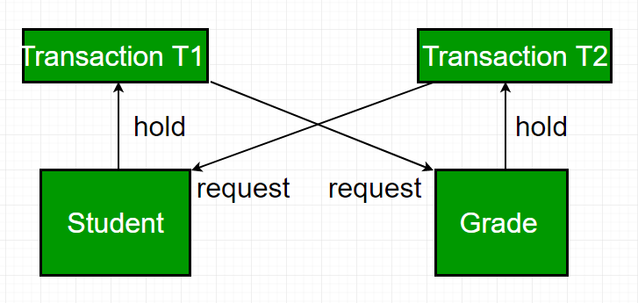
Dead Lock

Slide 10
Deadlock Prevention
To prevent any deadlock situation in the system, the DBMS aggressively inspects all the operations, where transactions are about to execute. The DBMS inspects the operations and analyzes if they can create a deadlock situation. If it finds that a deadlock situation might occur, then that transaction is never allowed to be executed.
There are deadlock prevention schemes that use timestamp ordering mechanism of transactions in order to predetermine a deadlock situation.

Slide 11
Deadlock Prevention: Wait-Die Scheme
In this scheme, if a transaction requests to lock a resource (data item), which is already held with a conflicting lock by another transaction, then one of the two possibilities may occur −
  If TS(T_{i}) < TS(T_{j}) − that is T_{i}, which is requesting a conflicting lock, is older than T_{j} − then T_{i} is allowed to wait until the data-item is available.
  If TS(T_{i}) > TS(t_{j}) − that is T_{i} is younger than T_{j} − then T_{i} dies. T_{i} is restarted later with a random delay but with the same timestamp.
This scheme allows the older transaction to wait but kills the younger one.

Slide 12
Deadlock Prevention: Wound-Wait Scheme
In this scheme, if a transaction requests to lock a resource (data item), which is already held with conflicting lock by some another transaction, one of the two possibilities may occur −
  If TS(T_{i}) < TS(T_{j}), then T_{i} forces T_{j} to be rolled back − that is T_{i} wounds T_{j}. T_{j} is restarted later with a random delay but with the same timestamp.
  If TS(T_{i}) > TS(T_{j}), then T_{i} is forced to wait until the resource is available.
This scheme, allows the younger transaction to wait; but when an older transaction requests an item held by a younger one, the older transaction forces the younger one to abort and release the item.

Slide 13
Deadlock Avoidance
Aborting a transaction is not always a practical approach. Instead, deadlock avoidance mechanisms can be used to detect any deadlock situation in advance. Methods like "wait-for graph" are available but they are suitable for only those systems where transactions are lightweight having fewer instances of resource. In a bulky system, deadlock prevention techniques may work well.

Slide 14
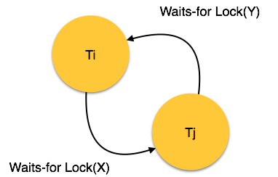
Wait-for Graph
This is a simple method available to track if any deadlock situation may arise. For each transaction entering into the system, a node is created. When a transaction T_{i} requests for a lock on an item, say X, which is held by some other transaction T_{j}, a directed edge is created from T_{i} to T_{j}. If T_{j} releases item X, the edge between them is dropped and T_{i} locks the data item.
The system maintains this wait-for graph for every transaction waiting for some data items held by others. The system keeps checking if there's any cycle in the graph.

Slide 15
Wait-for Graph

Slide 16
Wait-for Graph
Here, we can use any of the two following approaches
  First, do not allow any request for an item, which is already locked by another transaction. This is not always feasible and may cause starvation, where a transaction indefinitely waits for a data item and can never acquire it.
  The second option is to roll back one of the transactions. It is not always feasible to roll back the younger transaction, as it may be important than the older one. With the help of some relative algorithm, a transaction is chosen, which is to be aborted. This transaction is known as the victim and the process is known as victim selection.

