Slide 1
Entity Relationship (ER) Model in DBMS
Presented By
Md. Zahid Hasan
Zahid.cse@diu.edu.bd

Slide 2
এই Lesson এ কি শিখব?
Entity Relationship Model?
Symbols for Entity Type
Relationship Type and Relationship Set

Slide 3
E-R MODEL
An entity–relationship model (or ER model) describes interrelated things of interest in a specific domain of knowledge.
A basic ER model is composed of entity types (which classify the things of interest) and specifies relationships that can exist between entities (instances of those entity types).
ER MODEL
Entity
Attribute
Relationship
Weak Entity
Key
Composite
One to Many
Multivalued
Many to One
Derived
Many to Many

Slide 4
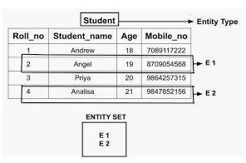
ENTITY
An entity is an object that exists and is distinguishable from other objects.
Example: specific person, company, event, plant
Entities have attributes
Example: people have names and addresses
An entity type defines a collection of entities that have the same attributes.
Each entity type is described by its name and attributes.
An entity set is a set of entities of the same type that share the same properties.
Example: set of all persons, companies, trees, holidays

Slide 5

ATTRIBUTE
Attributes are the properties which define the entity type.
Example: Roll_No, Name, DOB, Age, Address, Mobile_No are the attributes which defines entity type Student
In ER diagram, attribute is represented by an oval.

Slide 6

KEY ATTRIBUTE
The attribute which uniquely identifies each entity in the entity set is called key attribute.
Example: Roll_No will be unique for each student
In ER diagram, key attribute is represented by an oval with underlying lines.

Slide 7
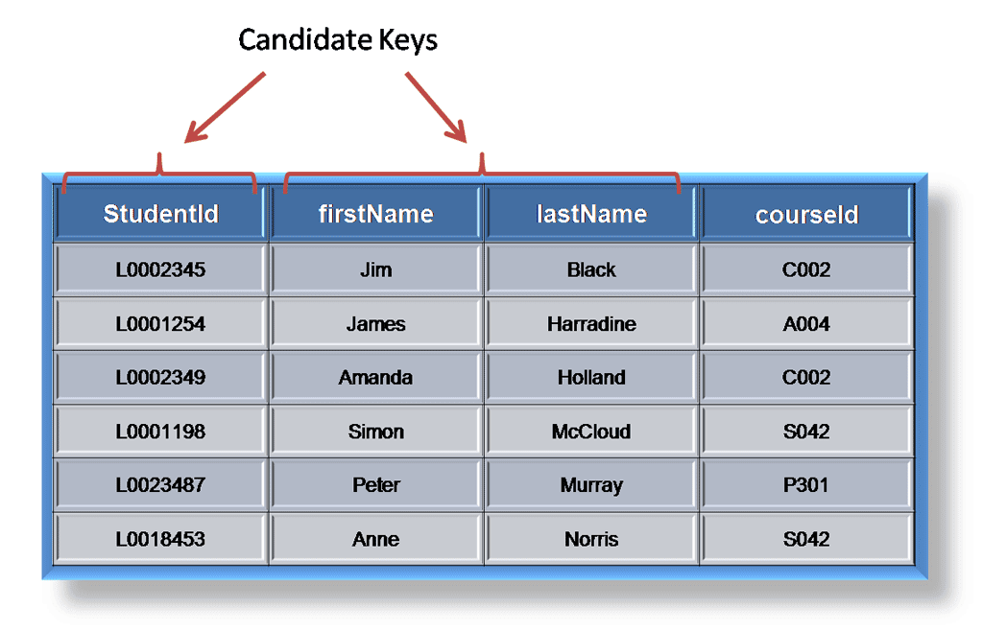
DIFFERENT TYPES OF KEYS
A candidate key of an entity set is a minimal super key.
ID is candidate key of instructor
course_id is candidate key of course

Slide 8
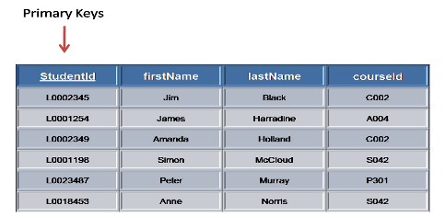
PRIMARY KEY
The primary key must contain unique values, must never be null and uniquely identify each record in the table

Slide 9
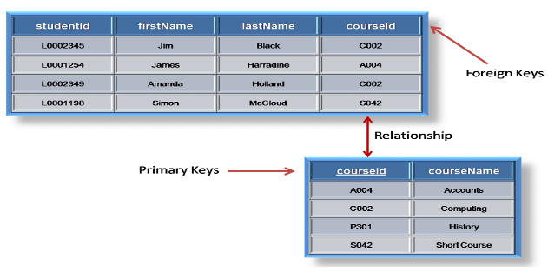
FOREIGN KEY
A foreign key is generally a primary key from one table that appears as a field in another where the first table has a relationship to the second.

Slide 10
DIFFERENT TYPES OF KEYS
A super key of an entity set is a set of one or more attributes whose values uniquely determine each entity.
Example:
{Student ID,FirstName }
{Student ID, LastName }
{Student ID,FirstName,LastName}

Slide 11
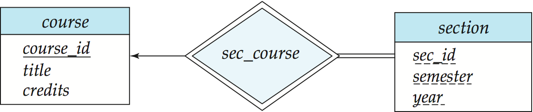
WEAK ENTITY SETS
An entity set that does not have a primary key is referred to as a weak entity set
We underline the discriminator of a weak entity set with a dashed line.
We put the identifying relationship of a weak entity in a double diamond.
Primary key for section – (course_id, sec_id, semester, year)

Slide 12
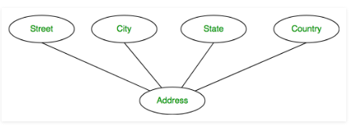
COMPOSITE ATTRIBUTE
An attribute composed of many other attribute is called as composite attribute.
Example: Address attribute of student Entity type consists of Street, City, State, and Country.
In ER diagram, composite attribute is represented by an oval comprising of ovals.

Slide 13
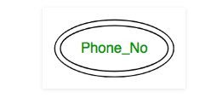
MULTIVALUED ATTRIBUTE
An attribute consisting more than one value for a given entity.
Example: Phone_No (can be more than one for a given student).
In ER diagram, multivalued attribute is represented by double oval.

Slide 14
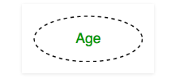
DERIVED ATTRIBUTE
An attribute which can be derived from other attributes of the entity type is known as derived attribute.
Example: Age (can be derived from DOB)
In ER diagram, derived attribute is represented by dashed oval.

Slide 15
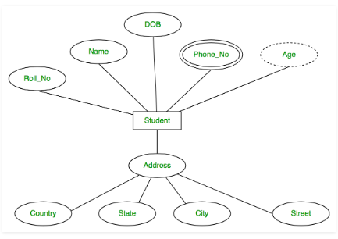
ATTRIBUTE(CONT’D)
The complete entity type Student with its attributes can be represented as:

Slide 16
ENTITY-RELATIONSHIP DIAGRAMS
Representing entities
we represent an entity by a named rectangle
use a singular noun, or adjective + noun
refer to one instance in naming
CUSTOMER
PART TIME EMPLOYEE

Slide 17
ENTITY-RELATIONSHIP DIAGRAMS
Representing relationship
DEPT.
EMPLOYS
EMPLOYEE

Slide 18
ENTITY-RELATIONSHIP DIAGRAMS
Types of Relationships
Three types of relationships can exist between entities
One-to-one relationship One-to-one relationship (1:1): One instance in an entity (parent) refers to one and only one instance in the related entity (child).
One-to-many relationship One-to-many relationship (1:M): One instance in an entity (parent) refers to one or more instances in the related entity (child)
Many-to-many relationship Many-to-many relationship (M:N): exists when one instance of the first entity (parent) can relate to many instances of the second entity (child), and one instance of the second entity can relate to many instances of the first entity.

Slide 19
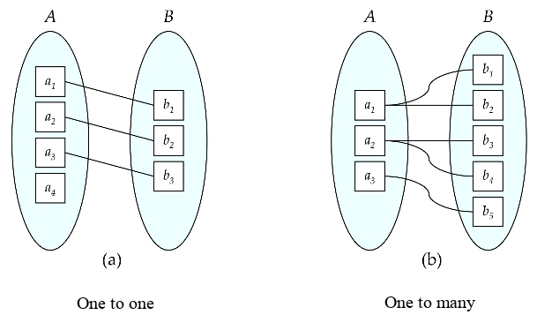
ENTITY-RELATIONSHIP DIAGRAMS(CONT’D)

Slide 20
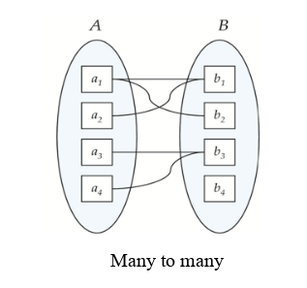
ENTITY-RELATIONSHIP DIAGRAMS(CONT’D)
Types of Relationships
Many-to-many relationship Many-to-many relationship (M:N): exists when one instance of the first entity (parent) can relate to many instances of the second entity (child), and one instance of the second entity can relate to many instances of the first entity.

Slide 21
ENTITY-RELATIONSHIP DIAGRAMS(CONT’D)
Crow’s foot notation: A type of cardinality notation. It is called crow's foot notation because of the shapes, which include circles, bars, and symbols, that indicate various possibilities.

Slide 22
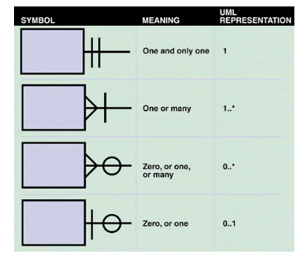
ENTITY-RELATIONSHIP DIAGRAMS(CONT’D)
Crow's foot notation is a common method of indicating cardinality. The four examples show how
you can use various symbols to describe the relationships between entities.

Slide 23
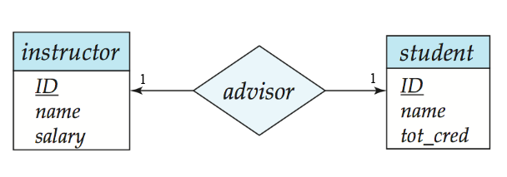
CARDINALITY CONSTRAINTS
We express cardinality constraints by drawing either a directed line (→),signifying “one,” or an undirected line (—), signifying “many,” between the relationship set and the entity set.
Or, by numbering each entity. * or, m for many.
One-to-one relationship:
A student is associated with at most one instructor via the relationship advisor
A student is associated with at most one department via stud_dept

Slide 24
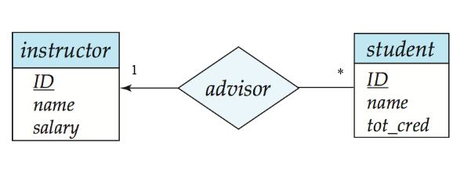
ONE-TO-MANY RELATIONSHIP
one-to-many relationship between an instructor and a student
an instructor is associated with several (including 0) students via advisor
a student is associated with at most one instructor via advisor,

Slide 25
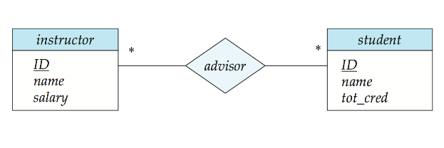
MANY-TO-MANY RELATIONSHIP
An instructor is associated with several (possibly 0) students via advisor
A student is associated with several (possibly 0) instructors via advisor

Slide 26
PARTICIPATION CONSTRAINT
Participation Constraint is applied on the entity participating in the relationship set.
Total Participation – Each entity in the entity set must participate in the relationship. If each student must enroll in a course, the participation of student will be total. Total participation is shown by double line in ER diagram.
Partial Participation – The entity in the entity set may or may NOT participate in the relationship. If some courses are not enrolled by any of the student, the participation of course will be partial.The diagram depicts the ‘Enrolled in’ relationship set with Student Entity set having total participation and Course Entity set having partial participation.

Slide 27
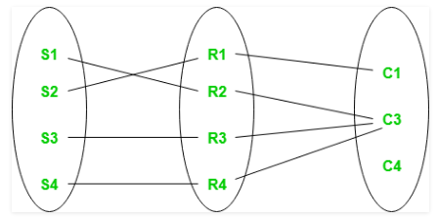
PARTICIPATION CONSTRAINT(CONT’D)
Using set, it can be represented as
Every student in Student Entity set is participating in relationship but there exists a course C4 which is not taking part in the relationship.

Slide 28
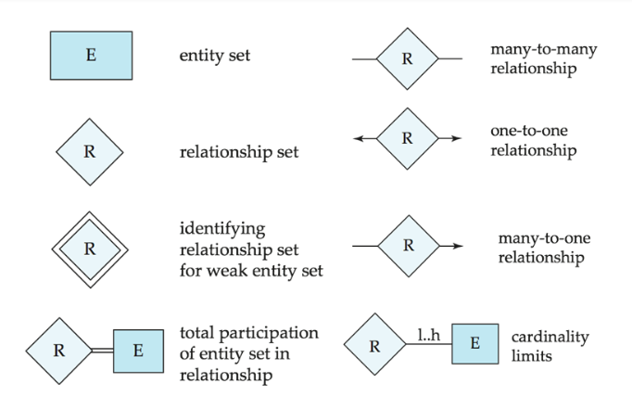
SUMMARY OF SYMBOLS USED IN E-R NOTATION

Slide 29
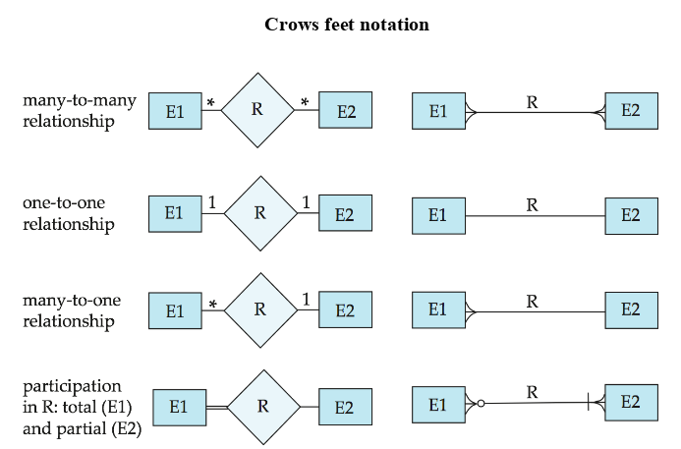
SUMMARY OF SYMBOLS USED IN E-R NOTATION(CONT’D)

Slide 30
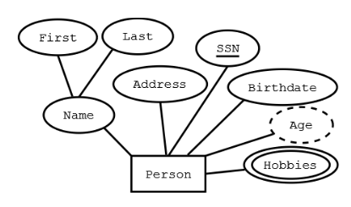
SUMMARY OF SYMBOLS USED IN E-R NOTATION(CONT’D)
Representing attributes:
Rectangle – Entity
Ellipses -- Attribute (underlined attributes are [part of] the primary key)
Double ellipses -- multi-valued attribute
Dashed ellipses-- derived attribute,
Example: age is derivable from birthdate and current
date.

Slide 31
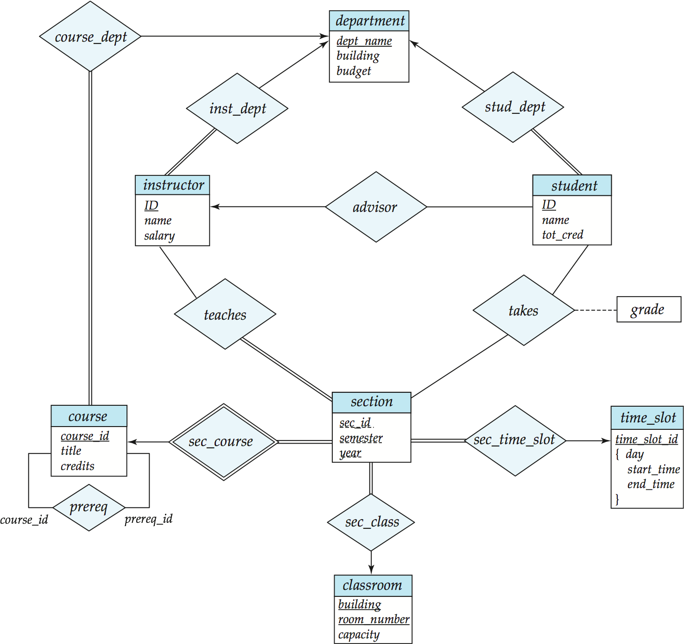
E-R DIAGRAM FOR A UNIVERSITY

Slide 32
“If opportunity doesn’t knock, build a door.”
– -Milton Berle

