Slide 1
Lab-1
Fahmida Afrin

Slide 2
Teacher Table
ID | Name | Dept | Salary
1 | Black | CSE | 350000
2 | Green | SWE | 400000
3 | White | EEE | 500000
4 | Brown | CSE | 300000

Slide 3
Create Database and Create Table
SQL 1 : CREATE DATABASE university;
SQL 2 :
CREATE TABLE Teacher
(
ID int,
Name Varchar(20),
Dept varchar(20),
Salary int,
PRIMARY KEY (ID)
);

Slide 4
Insert Sql
INSERT INTO teacher VALUES (1, "Black", "CSE", 350000)

Slide 5
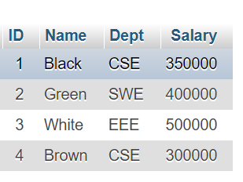
Select and From
SELECT *
FROM teacher

Slide 6
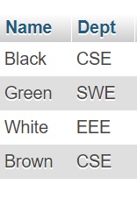
Select and From
SELECT Name, Dept FROM teacher

Slide 7
Task -1
Find The Salary from Teacher Table.

Slide 8
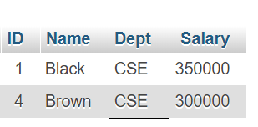
Where
SELECT * FROM teacher WHERE Dept = "CSE"

Slide 9
Where
SELECT Name
FROM teacher
WHERE Dept = "CSE"

Slide 10
And in Where Condition
SELECT Name
FROM teacher
WHERE Dept = "CSE" AND Salary= 350000

Slide 11
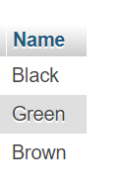
Between
SELECT Name
FROM teacher
WHERE Salary BETWEEN 300000 AND 400000

