Slide 1
SQL (Nested Subqueries)
Fahmida Afrin

Slide 2
Bank Scheme

Slide 3
Nested Subqueries
SQL provides a mechanism for the nesting of subqueries.
A subquery is a select-from-where expression that is nested within another query

Slide 4
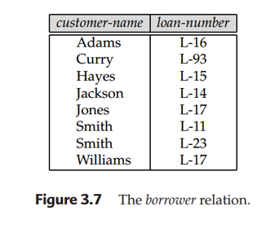
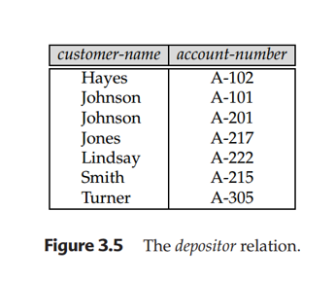
Example Query
Find all customers who have both an account and a loan at the bank.
select distinct customer-name
from borrower
where customer-nameany (select customer-name
From depositor)

Slide 5
Example Query
Find all customers who have a loan at the bank but do not have an account at the bank.
(select distinct customer-name
from borrower
where customer-name) not in (select customer-name
From depositor)

Slide 6
ANY and ALL Operators
The ANY and ALL operators are used with a WHERE or HAVING clause.
The ANY operator returns true if any of the subquery values meet the condition.
The ALL operator returns true if all of the subquery values meet the condition.
The operator must be a standard comparison operator (=, <>, !=, >, >=, <, or <=).

Slide 7
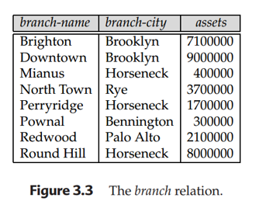
Example Query
Find all branches that have greater assets than some branch located in Brooklyn.
select branch-name
from branch
where assets > all (select assets
from branch
where branch-city = ‘Brooklyn’)

Slide 8
Example Query
Find the names of all branches that have greater assets than all
branches located in Brooklyn.
select branch-name
from branch
where assets > all (select assets
from branch
where branch-city = ‘Brooklyn’)

Slide 9
Practice Query
Student Table
1. Display the name of the student whose marks less than
75 or 65 or 86.
Select Sname
From Student
Where marks<Any/All (75,86,65)
2. Display the name of the student whose marks less than
75 and 65 and 86.
Sid | Sname | marks
101 | Jhon | 78
102 | Ria | 79
103 | Monica | 85
104 | Chang | 76
105 | Joy | 87
106 | Rehana | 65

Slide 10
Practice Query
Employee Table
Eid | Ename | Dept | Salary
1 | Jhon | HR | 20000
2 | Ria | MRKT | 10000
3 | Monica | HR | 30000
4 | Chang | MRKT | 60000
5 | Joy | IT | 50000
6 | Rehana | IT | 40000
1. Find the name of all employee who get salary greater than any of employee who work in HR dept..
2. Find the name of any employee who get salary greater than any employee of IT.

Slide 11
Thank You

