Slide 1
Synchronous Generator
Md. Zakir Hasan

Slide 2
Introduction
Synchronous generators or alternntors are synchronous machines used to convert mechanical power to ac electric power.
In a synchronous generator, a dc current is applied to the rotor winding, which produces a rotor magnetic field. The rotor of the generator is then turned by a prime mover, producing a rotating magnetic field within the machine. This rotating magnetic field induces a three-phase set of voltages within the stator windings of the generator.

Slide 3
Introduction
Two terms commonly used to describe the windings on a machine are
(i)field windings and
(ii) armature windings.
In general, the term "field windings" applies to the windings that produce the main magnetic field in a machine, and the term "armature windings" applies to the windings where the main voltage is induced.
For synchronous machines, the field windings are on the rotor, so the terms "rotor windings" and " field windings" are used interchangeably. Similarly, the terms "stator windings" and "armature windings" are used interchangeably.

Slide 4
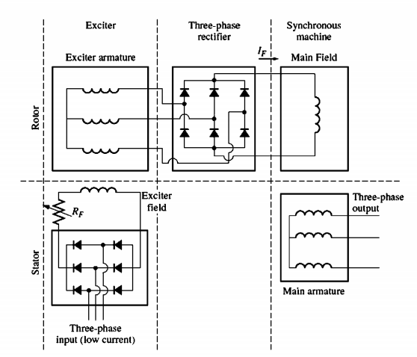
Excitation systems
The figure shows, A brush less exciter circuit. A small three-phase current is rectified
and used to supply the field circuit of the exciter.
which is located on the stator. The output of the armature circuit of the exciter (on the rotor) is then rectified and used to supply the field current of the main machine.

Slide 5

THE SPEED OF ROTATION OF A SYNCHRONOUS GENERATOR
Synchronous generators are by defination synchronous, meaning that the electrical frequency produced is locked in or synchronized with the mechanical rate of rotation of the generator.
A synchronous generator's rotor consists of an electromagnet to which direct current is supplied. The rotor's magnetic field points in whatever direction the rotor is turned. Now, the rate of rotation of the magnetic fields in the machine is related to the stator electrical frequency by Equation given below:
Where, fe = electrical frequency, in Hz
nm = mechanical speed of magnetic field, in r/min
(equals speed of rotor for synchronous machines)
P = number of poles

Slide 6
THE EQUIVALENT CIRCUIT OF A SYNCHRONOUS GENERATOR
The voltage EA is the internal generated voltage produced in one phase of a synchronous generator. However, this voltage EA is not usually the voltage that appears at the terminals of the generator.
In fact, the only time the internal voltage EA is the same as the output voltage
Vø of a phase is when there is no armature current flowing in the machine.
Why is the output voltage Vø from a phase not equal to EA , and what is
the relationship between the two voltages?
The answer to these questions yields the model of a synchronous generator.

Slide 7
THE EQUIVALENT CIRCUIT OF A SYNCHRONOUS GENERATOR
There are a number of factors that cause the difference between EA and Vø:
1.The distortion of the air-gap magnetic field by the current flowing in the stator, called armature reaction.
2. The self-inductance of the armature coils.
3. The resistance of the armature coils.
4. The effect of salient-pole rotor shapes.

Slide 8
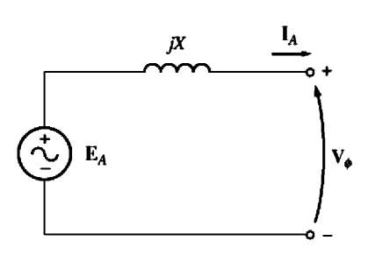
THE EQUIVALENT CIRCUIT OF A SYNCHRONOUS GENERATOR
Look at the circuit shown in Figure 1.1, The Kirchhoff's voltage law equation for this circuit is
Vø=EA – jXIA
This is exactly the same equation as the one describing the armature reaction voltage. Therefore, the armature reaction voltage can be modeled as an inductor in series with the internal generated voltage.
Fig1.1:A simple circuit

Slide 9


THE EQUIVALENT CIRCUIT OF A SYNCHRONOUS GENERATOR
In addition to the effects of armature reaction, the stator coils have a self inductance and a resistance.
If the stator self-inductance is called LA (and its corresponding reactance is called XA) while the stator resistance is called RA , then the total difference between EA and Vø is given by
The armature reaction effects and the self-inductance in the machine are both represented by reactances , and it is customary to combine them into a single reactance, called the synchronous reactance of the machine:
Xs=X + XA
Therefore, the final equation describing Vø is

Slide 10
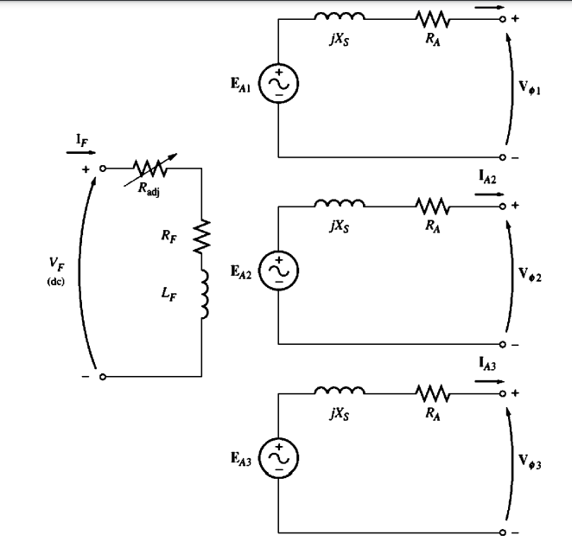
THE EQUIVALENT CIRCUIT OF A SYNCHRONOUS GENERATOR
Figure 1.2: The full equivalent circuit of a three-phase synchronous generator.

