Slide 1
Synchronous Generator
EEE-313
Md. Zakir Hasan

Slide 2
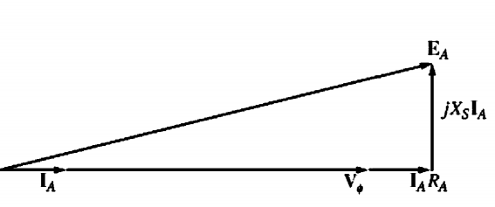
THE PHASOR DIAGRAM OF A SYNCHRONOUS GENERATOR
Figure 1 shows these relationships when the generator is supplying a load at unity power factor (a purely resistive load).The total voltage EA, differs from the terminal voltage of the phase Vø by the resistive and inductive voltage drops. All voltages and currents are referenced to Vø which is arbitrarily assumed to be at an angle of 0°.
This phasor diagram can be compared to the phasor diagrams of generators operating at lagging and leading power factors.
Fig 1: The phasor diagram of a synchronous generator at unity power factor.

Slide 3
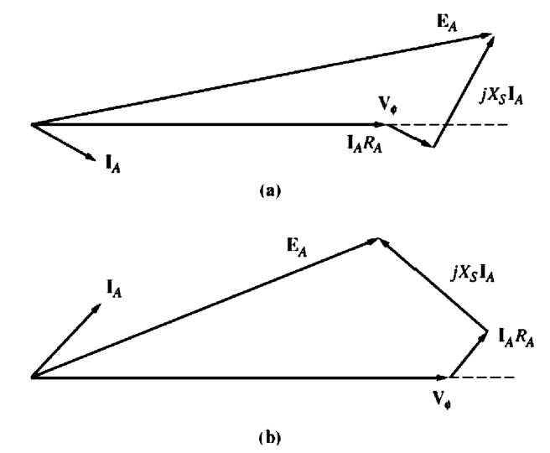
THE PHASOR DIAGRAM OF A SYNCHRONOUS GENERATOR
In Figure 2. Notice that, for a given phase voltage and armature current, a larger internal generated voltage EA is needed for lagging loads than for leading loads. Therefore, a larger field current is needed with lagging loads to get the same terminal voltage, because
EA=køѠ
And Ѡ must be constant to keep a constant frequency.
Alternatively, for a given field current and magnitude of load current, the terminal voltage is lower for lagging loads and higher for leading loads.
Fig 2: The phasor diagram of a synchronous generator at (3) lagging and (b) leading power factor.

Slide 4
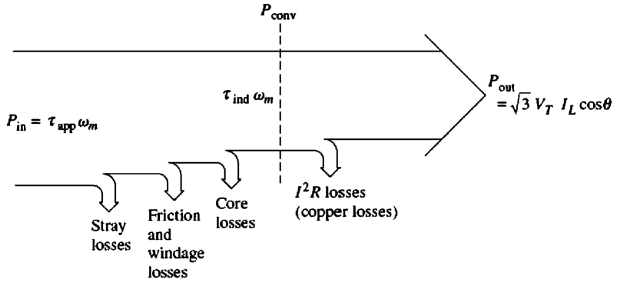
POWER AND TORQUE IN SYNCHRONOUS GENERATORS
Fig1:The power-flow diagram of a synchronous generator.
The input mechanical power is the shaft power in the generator Pin=$τ$appѠm
while the power converted from mechanical to electrical form internally is given by
Pconv = $τ$indѠm
= 3EAIA cos$γ$
Where $γ$ is the angle between EA and IA.

Slide 5
POWER AND TORQUE IN SYNCHRONOUS GENERATORS
The difference between the input power to the generator and the power converted in the generator represents the mechanical, core, and stray losses of the machine.
The real electrical output power of the synchronous generator can be expressed in line quantities as
Pout = $√3$ VTLT cos$θ$
and in phase quantities as
Pout = 3VøIA cos$θ$
The reactive power output can be expressed in line quantities as
Qout = $√3$ VTLT sin$θ$
or in phase quantities as
Qout = 3VøIA sin$θ$

Slide 6
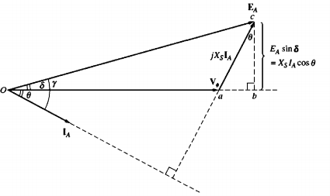
POWER AND TORQUE IN SYNCHRONOUS GENERATORS
If the armature resistance RA is ignored (since Xs»RA), then a very useful equation can be derived to approximate the output power of the generator. To derive this equation, examine the phasor diagram in Figure 2.It shows a simplified phasor diagram of a generator with the stator resistance ignored. Notice that the vertical segment be can be expressed as either EA sin$δ$ or XsIA cos$θ$
Therefore,
Now, we have,
Fig2:Simplified phasor diagram with armature resistance ignored.

Slide 7
POWER AND TORQUE IN SYNCHRONOUS GENERATORS
The equation shows that the power produced by a synchronous generator depends on the angle $δ$ between Vø and EA. The angle $δ$ is known as the torque angle of the machine .
Notice also that the maximum power that the generator can supply occurs when $δ$= 900. At $δ$ = 90°, sin $δ$ = 1, and
An alternative expression for the induced torque in a synchronous generator can be derived from previous equation. Because Pconv = $τ$indѠm, the induced torque can be expressed as

Slide 8
THE SYNCHRONOUS GENERATOR OPERATING ALONE
Fig 1: A single generator supplying a load.
The behavior of a synchronous generator under load varies greatly depending on the power factor of the load and on whether the generator is operating alone or in parallel with other synchronous generators.
Here, the effect of RA is ignored.The speed of the generators will be assumed constant, and all terminal characteristics are drawn assuming constant.
speed. Also, the rotor flux in the generators is assumed constant unless their field current is explicitly changed.

Slide 9
Voltage Regulation
A convenient way to compare the voltage behavior of two generators is by their voltage regulation. The voltage regulation (VR) of a generator is defined by the equation.
where Vn1 is the no-load voltage of the generator and Vf1 is the full-load voltage of the generator. A synchronous generator operating at a lagging power factor has a fairly large positive voltage regulation, a synchronous generator operating at a unity power factor has a small positive voltage regulation, and a synchronous generator operating at a leading power factor often has a negative voltage regulation.

