Slide 1
SYNCHRONOUS MOTORS
Md. Zakir Hasan

Slide 2
Introduction
Synchronous motors are synchronous machines used to convert electrical power to mechanical power.
Since a synchronous motor is the same physical machine as a synchronous generator, all of the basic speed, power, and torque equations of synchronous generator apply to synchronous motors also.

Slide 3
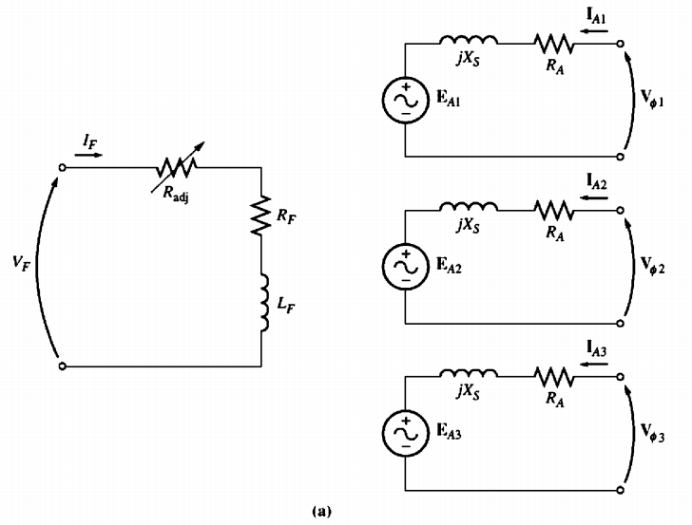
The Equivalent Circuit of a Synchronous Motor
Fig 1: (a) The full equivalent circuit of a three-phase synchronous motor.

Slide 4
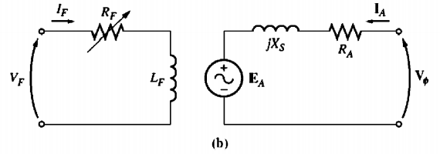
The Equivalent Circuit of a Synchronous Motor
Fig 1: (b) The per-phase equivalent circuit.
A synchronous motor is the same in all respects as a synchronous generator, except that the direction of power flow is reversed. Since the direction of power flow in the machine is reversed, the direction of current flow in the stator of the motor may be expected to reverse also. Therefore, the equivalent circuit of a synchronous motor is exactly the same as the equivalent circuit of a synchronous generator, except that the reference direction of IA is reversed.

Slide 5
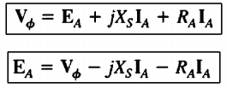
The Equivalent Circuit of a Synchronous Motor
Because of the change in direction of lA , the Kirchhoff's voltage law equation for the equivalent circuit changes too. Writing a Kirchhoff's voltage law equation for the new equivalent circuit yields
This is exactly the same as the equation for a generator, except that the sign on the current term has been reversed.

Slide 6
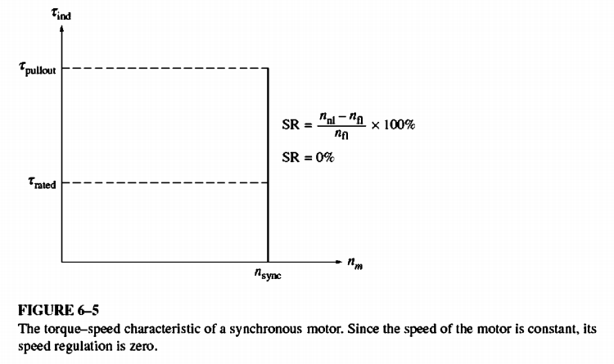
The Synchronous Motor Torque-Speed
Characteristic Curve
Synchronous motors supply power to loads that are basically constant-speed devices. They are usually connected to power systems very much larger than the individual motors, so the power systems appear as infinite buses to the motors. This means that the terminal voltage and the system frequency will be constant regardless of the amount of power drawn by the motor. The speed of rotation of the motor is locked to the applied electrical frequency, so the speed of the motor will be constant regardless of the load.

Slide 7
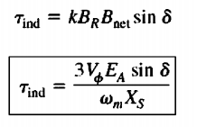
The Synchronous Motor Torque-Speed
Characteristic Curve
The steady-state speed of the motor is constant from no load all the way up to the maximum torque that the motor can supply (called the pullout torque),
so the speed regulation of this motor is 0 percent. The torque equation is
The maximum or pullout torque occurs when $δ$= 900. Normal full-load torques are much less than that, however. In fact, the pullout torque may typically be 3 times the full-load torque of the machine.

Slide 8
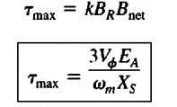
The Synchronous Motor Torque-Speed
Characteristic Curve
When the torque on the shaft of a synchronous motor exceeds the pullout torque, the rotor can no longer remain locked to the stator and net magnetic fields. Instead, the rotor starts to slip behind them. As the rotor slows down, the stator magnetic field "laps" it repeatedly, and the direction of the induced torque in the rotor reverses with each pass. The resulting huge torque surges, first one way and then the other way, cause the whole motor to vibrate severely. The loss of synchronization after the pullout torque is exceeded is known as slipping poles. The maximum or pullout torque of the motor is given by
These equations indicate that the larger the field current (and hence EA), the greater the maximum torque of the motor. There is therefore a stability advantage in operating the motor with a large field current or a large EA.

