Slide 1
Synchronous Motor
Md. Zakir Hasan

Slide 2
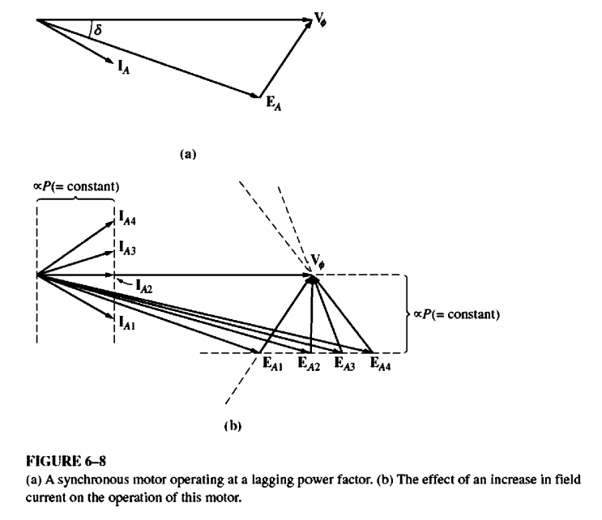
The Effect of Field Current Changes on a Synchronous Motor
There is one other quantity on a synchronous motor that can be readily adjusted- its field current.
What effect does a change in field current have on a synchronous motor ?
To find out, look at Figure 6--8.Figure 6--8a shows a synchronous motor initially operating at a lagging power factor. Now, increase its field current and see what happens to the motor.

Slide 3
The Effect of Field Current Changes on a Synchronous Motor
Note that an increase in field current increases the magnitude of EA but does not affect the real power supplied by the motor.
The power supplied by the motor changes only when the shaft load torque changes. Since a change in IF does not affect the shaft speed nm , and since the load attached to the shaft is unchanged, the real power supplied is unchanged. Of course, VT is also constant, since it is kept constant by the power source supplying the motor.
The distances proportional to power on the phasor diagram (EA sin $δ$ and IA cosƟ) must therefore be constant. When the field current is increased, EA must increase, but it can only do so by sliding out along the line of constant power. The is effect is shown in Figure 6--8b.

Slide 4
The Effect of Field Current Changes on a Synchronous Motor
Notice that as the value of EA increases, the magnitude of the armature current IA first decreases and then increases again. At low EA, the armature current is lagging, and the motor is an inductive load. It is acting like an inductor-resistor combination, consuming reactive power Q. As the field current is increased, the armature current eventually lines up with V$ø$ , and the motor looks purely resistive.
As the field current is increased further, the armature current becomes leading, and the motor becomes a capacitive load. It is now acting like a capacitor-resistor combination, consuming negative reactive power -Q or, alternatively, supplying reactive power Q to the system.

Slide 5
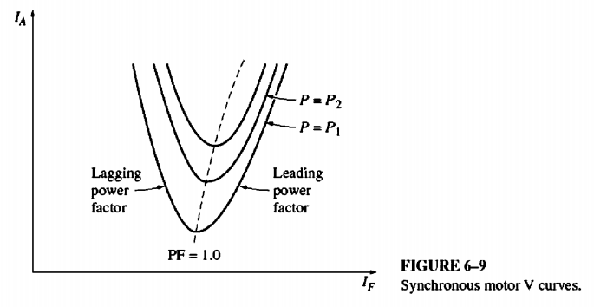
The Effect of Field Current Changes on a Synchronous Motor
A plot of IA versus IF for a synchronous motor is shown in Figure 6- 9. Such a plot is called a synchronous motor V curve, for the obvious reason that it is shaped like the letter V. There are several V curves drawn, corresponding to different real power levels. For each curve, the minimum armature current occurs at unity power factor, when only real power is being supplied to the motor. At any other point on the curve, some reactive power is being supplied to or by the motor as well.
For field currents less than the value giving minimum lA, the armature current is lagging, consuming Q. For field currents greater than the value giving the minimum lA, the armature current is leading, supplying Q to the power system as a capacitor would. Therefore, by controlling the field current of a synchronous motor, the reactive power supplied to or consumed by the power system can be controlled.

Slide 6
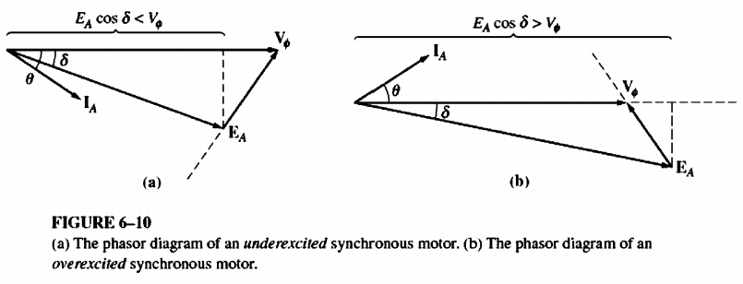
The Effect of Field Current Changes on a Synchronous Motor
When the projection of the phasor EA onto V$ø$ (EA cos $δ$ ) is shorter than V$ø$ itself, a synchronous motor has a lagging current and consumes Q. Since the field current is small in this situation, the motor is said to be underexcited.
On the other hand, when the projection of EA onto V$ø$ is longer than V$ø$ itself, a synchronous motor has a leading current and supplies Q to the power system. Since the field current is large in this situation, the motor is said to be overexcited.

Slide 7
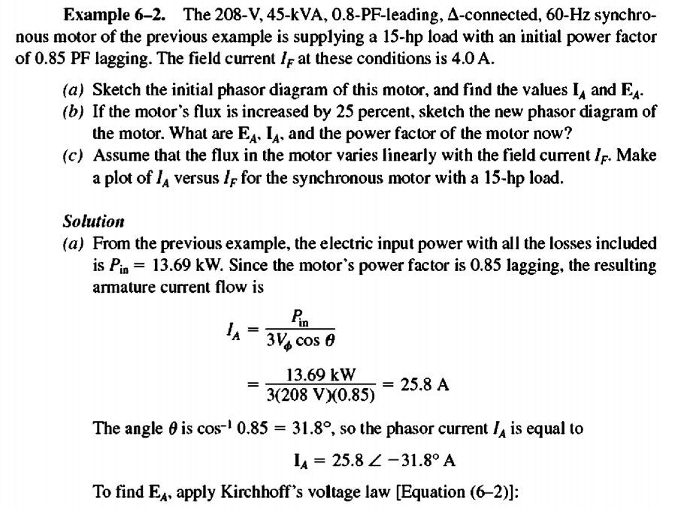
Mathematical Problem

Slide 8
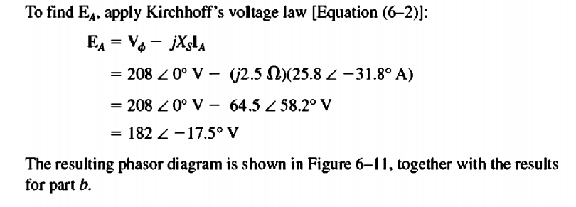
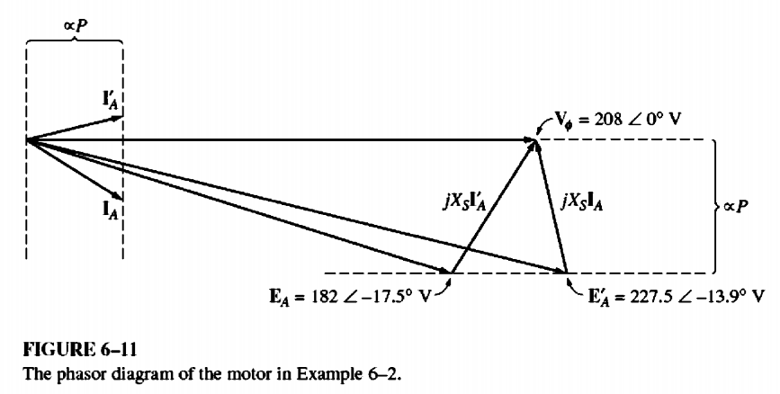
Mathematical Problem

Slide 9
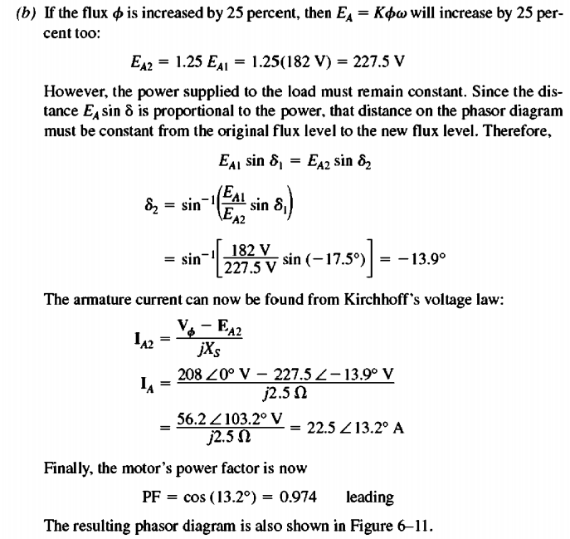
Mathematical Problem

Slide 10
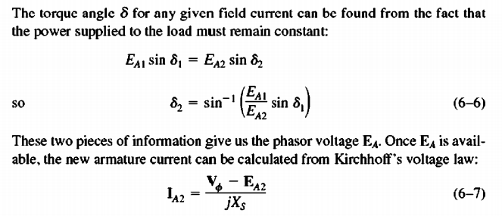
Mathematical Problem

