Slide 1
DC Generator

Slide 2
A DC generator is an electrical machine which converts mechanical energy into direct current electricity. This energy conversion is based on the principle of production of dynamically induced emf. This article outlines basic construction and working of a DC generator.

Slide 3
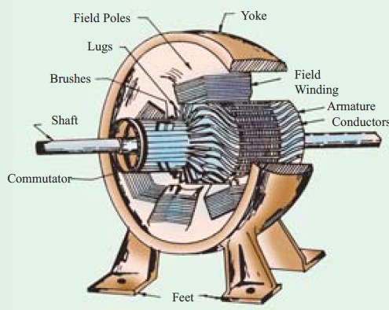
Construction

Slide 4
Construction

Slide 6
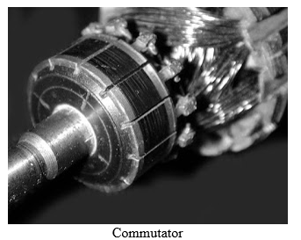

Slide 7
Commutation

Slide 8
Commutation

Slide 9
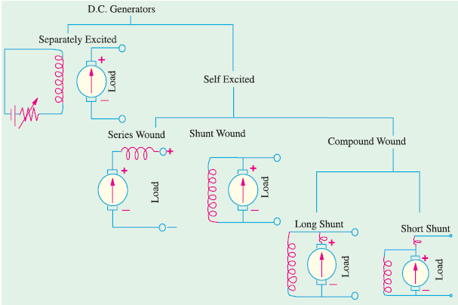
Types of DC generator

Slide 10
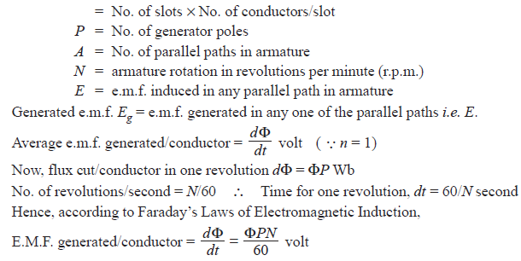
EMF Equation

Slide 11
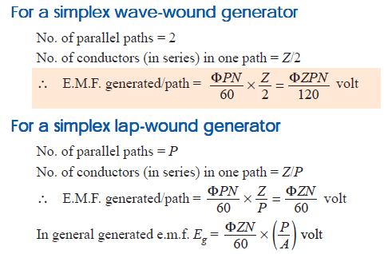
EMF Equation

Slide 12
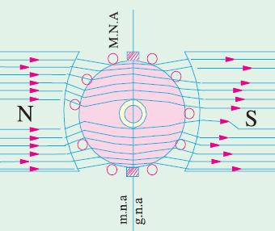
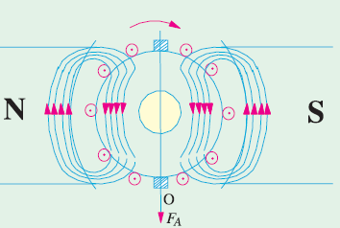
Armature Reaction

