Slide 1
DC Generator

Slide 2

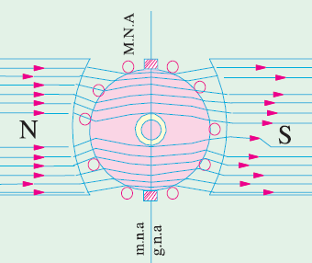
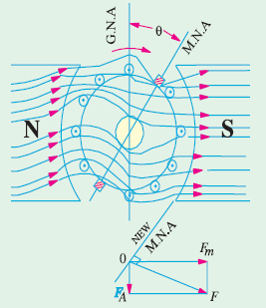
Armature reaction

Slide 3
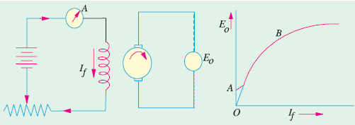
Generator characteristics
No load characteristics

Slide 4
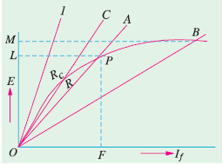
Critical resistance

Slide 5


Slide 6
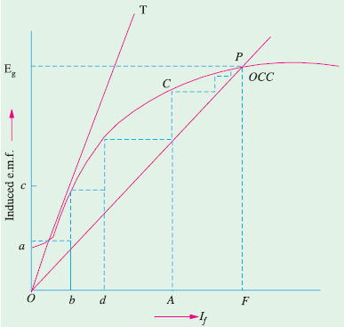
Voltage buildup characteristics

Slide 7

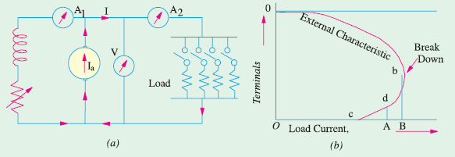
External characteristics

