Slide 1
DC Motor

Slide 2
What is DC Motor ?
The electric motor operated by dc is called dc motor. This is a device that converts DC electrical energy into a mechanical energy.

Slide 3
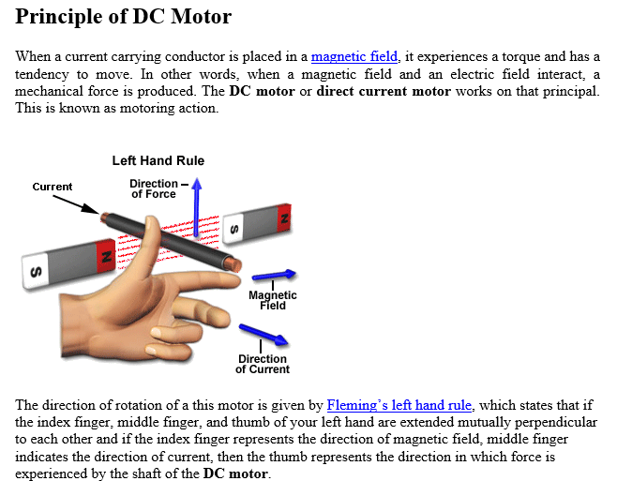

Slide 4
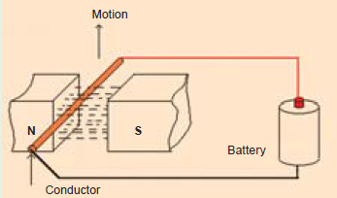
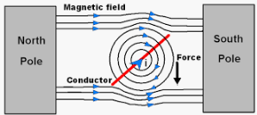
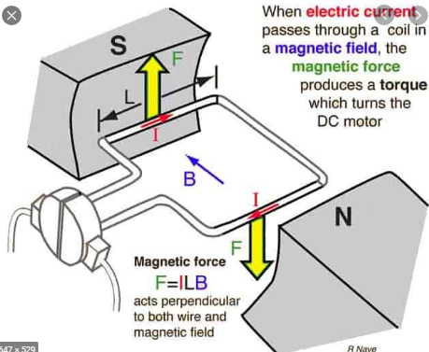

Slide 5
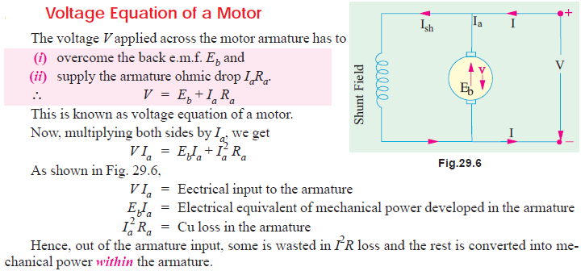


Slide 6

Significance of the Back e.m.f.

Slide 7
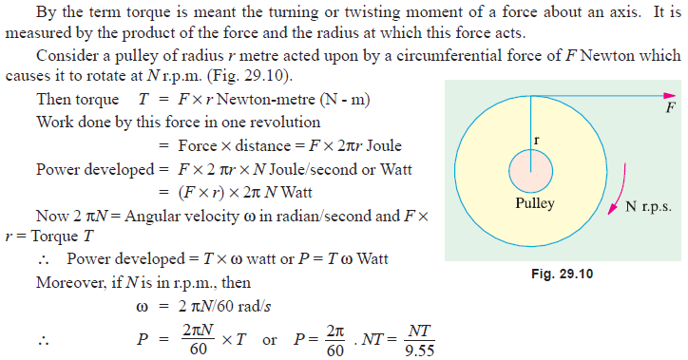
Torque

Slide 8


Slide 9
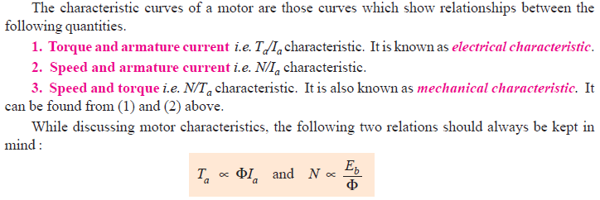
Motor Characteristics

Slide 10
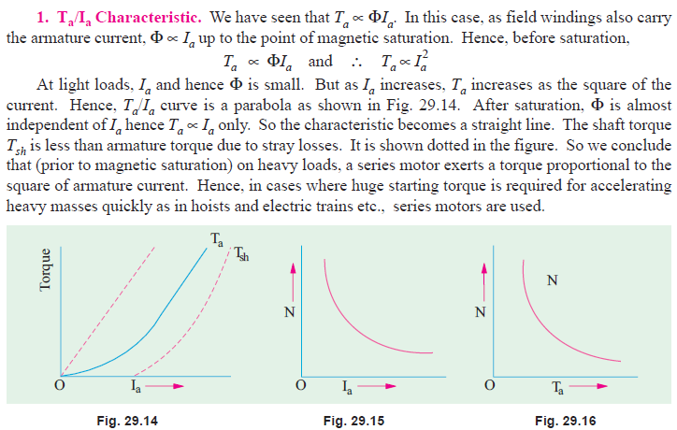
Series Motor characteristics

Slide 11
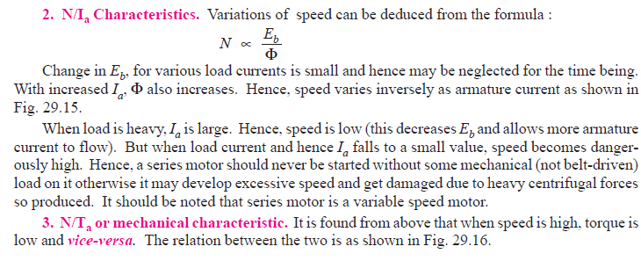

Slide 12
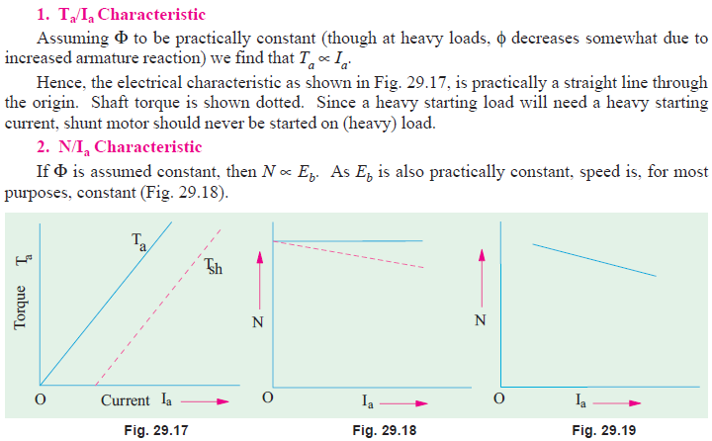
Shunt Motor characteristics
T_{a}

Slide 13


Slide 14
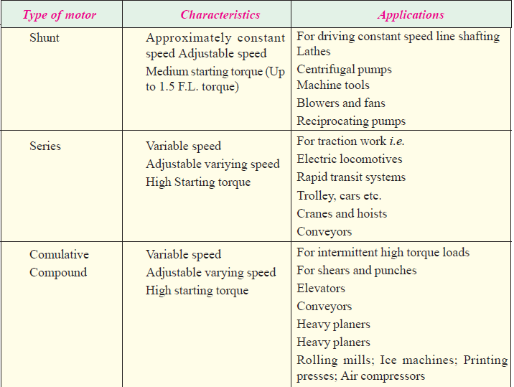

Slide 15

Speed Control

Slide 16
