Slide 1
Basic SQL Queries
Presented By
Md. Zahid Hasan
Zahid.cse@diu.edu.bd

Slide 2
এই Lesson এ কি শিখব?
Create and Delete Database
Create and Delete Table
Insert records Into Table
Delete records into Table
Update or Modify records into Table
Read records from Table
Where and Order By Clause
Group By Clause

Slide 3
Create and Delete Database
Create database online_event
Delete database online_event
online_event

Slide 4
Create Table
CREATE TABLE MyGuests (
id INT(6) UNSIGNED AUTO_INCREMENT PRIMARY KEY,
firstname VARCHAR(30) NOT NULL,
lastname VARCHAR(30) NOT NULL,
email VARCHAR(50),
reg_date TIMESTAMP DEFAULT CURRENT_TIMESTAMP ON UPDATE CURRENT_TIMESTAMP
)
MyGuests
id | firstname | lastname | email | reg_date

Slide 5
Delete Table
drop table MyGuests
MyGuests
id | firstname | lastname | email | reg_date

Slide 6
Insert records Into Table
INSERT INTO MyGuests (firstname, lastname, email)
VALUES
('John', 'Doe', 'john@example.com')
(‘zahid', hasan', ‘hasan@gmail.com')
MyGuests
id | firstname | lastname | email | reg_date
1 | John | Doe | john@example.com | 04-26-2020
2 | zahid | hasan | hasan.ice@gmail.com | 04-26-2020

Slide 7
Delete records Into Table
delete * from MyGuests
MyGuests
id | firstname | lastname | email | reg_date
1 | John | Doe | john@example.com | 04-26-2020
2 | zahid | hasan | hasan.ice@gmail.com | 04-26-2020

Slide 8
‘Where’ Clause
The WHERE clause is used to extract only those records that fulfill a specified condition.

Slide 9
Update or Modify records into Table
UPDATE MyGuests SET lastname=‘Abraham' id=1
WHERE
MyGuests
id | firstname | lastname | email | reg_date
1 | John | Abraham | john@example.com | 04-26-2020
2 | zahid | hasan | hasan.ice@gmail.com | 04-26-2020

Slide 10
Read records from Table
SELECT id, firstname, lastname FROM MyGuests
MyGuests
id | firstname | lastname
email | reg_date
1 | John | Abraham
john@example.com | 04-26-2020
2 | zahid | hasan
hasan.ice@gmail.com | 04-26-2020

Slide 11
Read Specific records from Table
SELECT * FROM MyGuests WHERE lastname='Abraham'
MyGuests
id | firstname | lastname
email | reg_date
1 | John | Abraham
john@example.com | 04-26-2020
2 | zahid | hasan | hasan.ice@gmail.com | 04-26-2020

Slide 12
Order By Clause
The ORDER BY clause is used to sort the result-set in ascending or descending order.
The ORDER BY clause sorts the records in ascending order by default. To sort the records in descending order, use the DESC keyword.
SELECT id, firstname, lastname
FROM MyGuests ORDER BY lastname
SELECT id, firstname, lastname
FROM MyGuests ORDER BY lastname
desc
MyGuests
MyGuests
id | firstname | lastname
id | firstname | lastname
1 | John | Abraham
2 | zahid | hasan
2 | zahid | hasan
1 | John | Abraham

Slide 13
Group By Clause
The GROUP BY statement groups rows that have the same values into summary rows, like "find the number of customers in each country".
The GROUP BY statement is often used with aggregate functions (COUNT, MAX, MIN, SUM, AVG) to group the result-set by one or more columns.

Slide 14
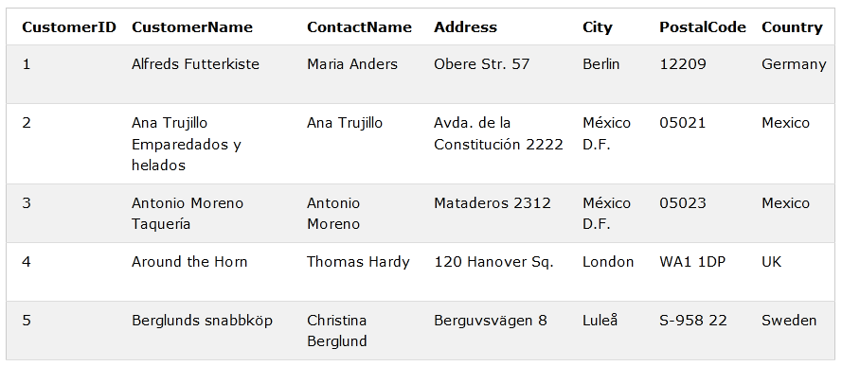
Group By Clause
Number | Country
1 | Germany
2 | Mexico
1 | UK
SELECT COUNT(CustomerID) as Number, Country FROM Customers
GROUP BY Country;

Slide 15
AGGREGATE FUNCTIONS

Slide 16
AGGREGATE FUNCTIONS
Five (5) aggregate functions namely:
COUNT
SUM
AVG
MIN
MAX

Slide 17
Why use aggregate functions
From a business perspective, different organization levels have different information requirements. Top levels managers are usually interested in knowing whole figures and not necessary the individual details.
>Aggregate functions allow us to easily produce summarized data from our database.
For instance, from our test database , management may require following reports
  > Least rented movies.
  > Most rented movies.
  > Average number that each movie is rented out in a month.

Slide 18
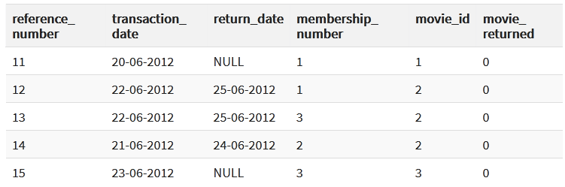
COUNT Function
movierentals
The COUNT function returns the total number of values in the specified field.
It works on both numeric and non-numeric data types.
Let's suppose that we want to get the number of times that the movie with id 2 has been rented out
SELECT COUNT(`movie_id`) FROM `movierentals` WHERE `movie_id` = 2;
Output: 3

Slide 19
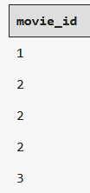

DISTINCT Keyword
movierentals
The DISTINCT keyword that allows us to omit duplicates from our results.
SELECT `movie_id` FROM `movierentals`;
SELECT DISTINCT `movie_id` FROM `movierentals`;

Slide 20
MIN function
Movies
The MIN function returns the smallest value in the specified table field.
Movie_Name | year_released
Sharlock holmes | 2003
Quarentine | 2005
As an example, let's suppose we want to know the year in which the oldest movie in our library was released
SELECT MIN(`year_released`) FROM `movies`;
Output: 2003

Slide 21
MAX function
Movies
The MAX function returns the highest value in the specified table field.
Movie_Name | year_released
Sharlock holmes | 2003
Quarentine | 2020
As an example, let's suppose we want to know the year in which the recent movie in our library was released
SELECT MAX(`year_released`) FROM `movies`;
Output: 2020

Slide 22
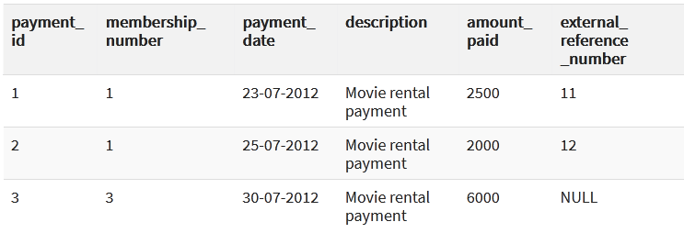
SUM function
payments
SUM function which returns the sum of all the values in the specified column.
SELECT SUM(`amount_paid`) FROM `payments`;
Output: 10500

Slide 23
AVG function
payments
AVG function returns the average of the values in a specified column.
SELECT AVG(`amount_paid`) FROM `payments`;
Output: 3500

Slide 24
Mysql Aliases
payments
MySQL aliases are used to give a table, or a column in a table, a temporary name.
Aliases are often used to make column names more readable.
An alias only exists for the duration of the query.
SELECT AVG(`amount_paid`) as Average FROM `payments`;
Average
3500

Slide 25
‘Between’ and ‘AND’
Select name from instructor where salary between 8000 and 12000;
instructor
instructor
Name | salary
Zahid | 1000
Morium | 6000
Bob | 15000
Sobuj | 8000
Moin | 11000
Name | salary
Sobuj | 8000
Moin | 11000

Slide 26
“Success comes from having dreams that are bigger than your fears.”
– Bobby Unser

