Slide 1
Basic SQL Queries
Presented By
Md. Zahid Hasan
Zahid.cse@diu.edu.bd

Slide 2
এই Lesson এ কি শিখব?
Rename Operation
Order By
Set Operations
Nested Query Using Set Operation

Slide 3

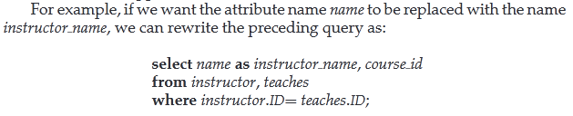
Rename Operation
Rewrite the Query

Slide 4

Rename Operation
Rewrite the Query

Slide 5

Rename Operation
“Find the names of all instructors whose salary is greater than at least one instructor in the Biology department.”We can write the SQL expression:

Slide 6


Ordering the Display of Tuples
To list in alphabetic order all instructors in the Physicsdepartment, we write:
We wish to list the entire instructor relation in descending order of salary. If several
instructors have the same salary, we order them in ascending order by name. We express this query in SQL as follows:

Slide 7
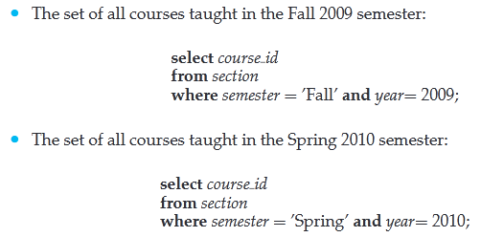
Set Operations
The SQL operations union, intersect, and except operate on relations and correspond to the mathematical set-theory operations ∪,∩, and −.

Slide 8
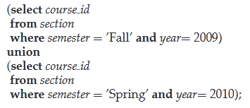
The Union Operation
To find the set of all courses taught either in Fall 2009 or in Spring 2010, or both, we write

Slide 9
The Union Operation
To find the set of all courses taught either in Fall 2009 or in Spring 2010, or both, we write

Slide 10
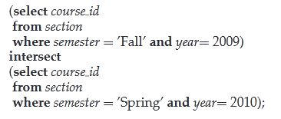
The Intersect Operation
To find the set of all courses taught in the Fall 2009 as well as in Spring 2010 we write:

Slide 11
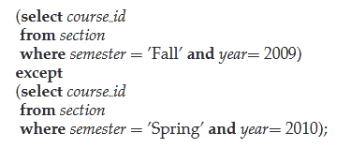
The Except Operation
To find all courses taught in the Fall 2009 semester but not in the Spring 2010 semester, we write:

Slide 12

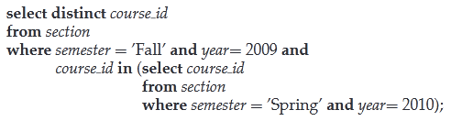
Nested Query using Set Operation
We begin by finding all courses taught in Spring 2010, and we write the subquery
We then need to find those courses that were taught in the Fall 2009 and that appear in the set of courses obtained in the subquery.

Slide 13
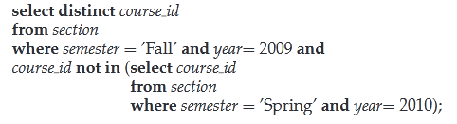
Nested Query using Set Operation
We use the not in construct in a way similar to the in construct.
For example, to find all the courses taught in the Fall 2009 semester but not in the Spring 2010semester, we can write:

Slide 14

Nested Query using Set Operation
The following query selects the names of instructors whose names are neither “Mozart” nor “Einstein”.

Slide 15
“Never do tomorrow what you can do today. Procrastination is the thief of time.”
– Charles Dickens

