Slide 1
Relational Model in DBMS
Presented By
Md. Zahid Hasan
Zahid.cse@diu.edu.bd

Slide 2
এই Lesson এ কি শিখব?
Relational Model?
Relational Model Concepts
Relational Integrity Constraints
Operation in Relational Model

Slide 3
What is Relational Model?
RELATIONAL MODEL (RM) represents the database as a collection of relations. A relation is nothing but a table of values. Every row in the table represents a collection of related data values. These rows in the table denote a real-world entity or relationship.
Some popular Relational Database management systems are:
DB2 and Informix Dynamic Server - IBM
Oracle and RDB – Oracle
SQL Server and Access - Microsoft

Slide 4
Relational Model Concepts
Attribute: Each column in a Table. Attributes are the properties which define a relation. e.g., Student_Rollno, NAME,etc.
Tables – In the Relational model the, relations are saved in the table format. It is stored along with its entities. A table has two properties rows and columns. Rows represent records and columns represent attributes.
Tuple – It is nothing but a single row of a table, which contains a single record.
Relation Schema: A relation schema represents the name of the relation with its attributes.

Slide 5
Relational Model Concepts
Degree: The total number of attributes which in the relation is called the degree of the relation.
Cardinality: Total number of rows present in the Table.
Column: The column represents the set of values for a specific attribute.
Relation instance – Relation instance is a finite set of tuples in the RDBMS system. Relation instances never have duplicate tuples.
Relation key - Every row has one, two or multiple attributes, which is called relation key.
Attribute domain – Every attribute has some pre-defined value and scope which is known as attribute domain

Slide 6
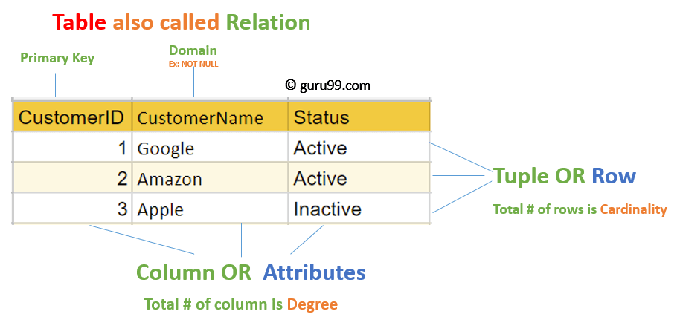
Relational Model Concepts

Slide 7
Relational Integrity constraints
Relational Integrity constraints is referred to conditions which must be present for a valid relation.
There are many types of integrity constraints. Constraints on the Relational database management system is mostly divided into three main categories are:
Domain constraints
Key constraints
Referential integrity constraints

Slide 8
Domain Constraints
Domain constraints can be violated if an attribute value is not appearing in the corresponding domain or it is not of the appropriate data type.
This is specified as data types which include standard data types integers, real numbers, characters, Booleans, variable length strings, etc.
Domain constraints
Key constraints
Referential integrity constraints

Slide 9
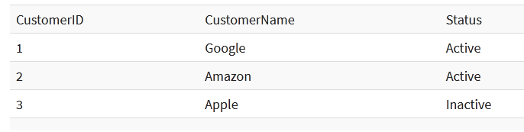
Key constraints
An attribute that can uniquely identify a tuple in a relation is called the key of the table.
In the given table, CustomerID is a key attribute of Customer Table. It is most likely to have a single key for one customer, CustomerID =1 is only for the CustomerName =" Google".

Slide 10
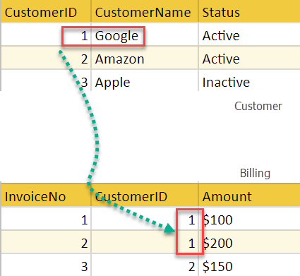
Referential integrity constraints
Referential integrity constraints is base on the concept of Foreign Keys.
A foreign key is an important attribute of a relation which should be referred to in other relationships.

Slide 11
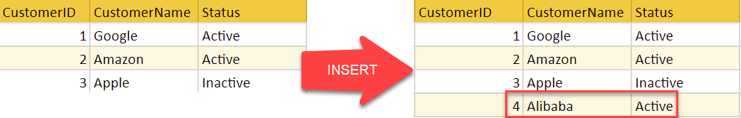
Insert Operation
The insert operation gives values of the attribute for a new tuple which should be inserted into a relation.

Slide 12
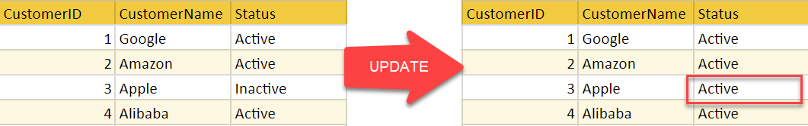
Update Operation
You can see that in the below-given relation table CustomerName= 'Apple' is updated from Inactive to Active.

Slide 13
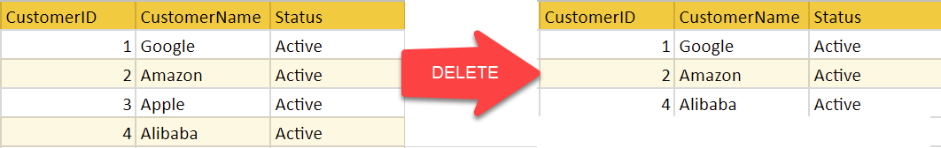
Delete Operation
You can see that in the below-given relation table CustomerName= 'Apple' is updated from Inactive to Active.

Slide 14
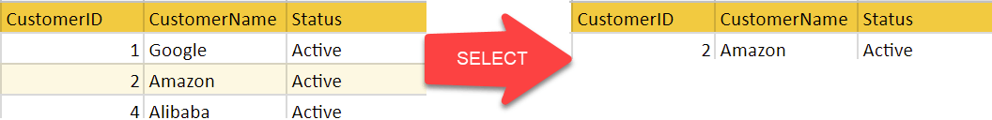
Select Operation
You can see that in the below-given relation table CustomerName= 'Apple' is updated from Inactive to Active.

Slide 15
“Perfection is boring. Getting better is where all the fun is.”
– Dragos Roua

