Slide 1
Demographic transition
Dostogir Harun
Assistant Professor
Department of Public Health, DIU
Email: dostogirharun@gmail.com
Cell: 01556 636 545

Slide 2
Demographic transition
Demographic transition (DT) refers to the transition from high birth and death rates to low birth and death rates as a country develops from a pre-industrial to an industrialized economic system.

Slide 3
The demographic transition
The demographic transition consists of several stages:
Pre-industrial stage: high death rates and high birth rates
Transitional stage: death rates fall due to rising food production and better medical care. Birth rates remain high, so population surges.

Slide 4
The demographic transition
Industrial stage: birth rates fall, as women are employed and as children become less economically useful in an urban setting. Population growth rate declines
Post-industrial stage: birth and death rates remain low and stable; society enjoys fruits of industrialization without threat of runaway population growth.

Slide 5
Demographic transition theory
Demographic transition = model of economic and cultural change to explain declining death rates, declining birth rates, and rising life expectancies in Western nations as they became industrialized
Proposed by F. Notestein in the 1940s-1950s

Slide 6
Demographic Transition Model
The Demographic Transition Model (DTM) shows how birth and death rates change as country goes through different stages of development.
The theory is based on an interpretation of demographic history developed in 1929 by the American demographer Warren Thompson (1887–1973)
The model has five stages

Slide 7
Demographic transition model
How countries pass through different stages of population growth as shown in the five stages of the Demographic Transition Model (birth rate, death rate and natural population changes) and how it changes population structure
The impact of increasing urbanisation, agricultural change, education and the emancipation of women on the rate of population growth
A lot of countries have similar patterns of population change over time so they devised the Demographic Transition Model.
Demographic- is to do with population or people
Transition- means change
A model is a simplified version of something that happens in real life
The model has worked quite well for countries that have gone from a rural, poorly educated society to an urban, industrial, well-educated one. So it fits what happened in the UK, the rest of Europe, and other richer countries like Japan and the USA. But poorer countries might not follow the same pattern.

Slide 8
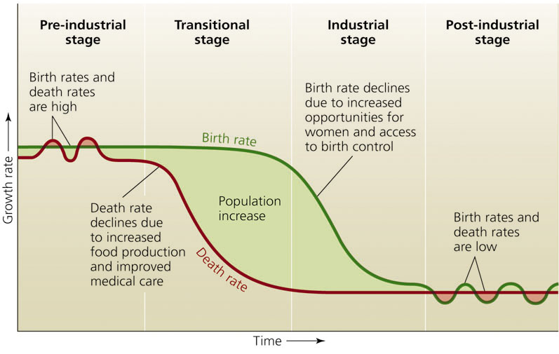
Demographic transition: Stages

Slide 9
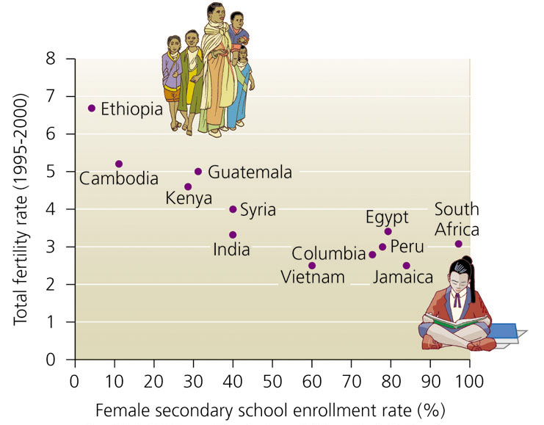
A Proven Solution: Female Education
Female literacy and school enrollment are correlated with total fertility rate:
**More education fewer children

Slide 10
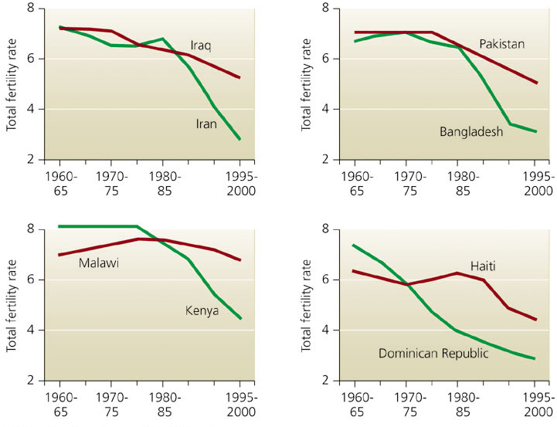
Family planning and Fertility Rate
Nations that invested in family planning (green) reduced TFRs more than similar nations that did not (red)

Slide 11
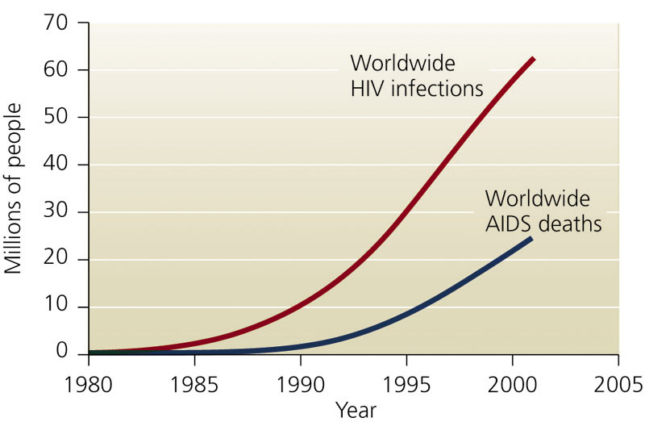
HIV/AIDS and human population
AIDS cases are increasing rapidly worldwide

Slide 12
QUESTION: Interpreting Graphs and Data
What happens during the “transitional stage” of the demographic transition? a. Birth rates rise; death rates drop; population increases
b. Birth rates drop; death rates drop; population decreases
c. Death rates drop; birth rates are stable; population increases
Notes:
Answer = c

Slide 13
Limiting Factors
Limiting Factor: anything that restricts the growth of a population in a biological community
Density-Dependent: relies on the number of people
Ex. Food/famine, clean water, shelter, build up of trash/toxic waste, pollution, plague/disease, stress, war, etc.
Density-Independent: unrelated to the number of people
Ex. Weather, climate, natural disasters, etc.

Slide 14
The “IPAT” model
Shows how Population, Affluence, and Technology interact to create Impact on our environment.
I = P × A × T
Further factors can be added to the original equation of Holdren and Ehrlich to make it more comprehensive.

Slide 15
Challenges
Rapid population growth in region wise and it is rising by 80 million annually
Large number of people are born into poverty
Rich and poor nations are divided by a “wealth gap.”
Few diseases such as HIV/AIDS, Malaria, TB are taking a heavy toll, especially in Developing countries
Population growth has severe environmental effects and climate change

Slide 16
Solutions
Expanding women’s education rights is crucial to encourage the demographic transition
Health and reproductive education and counseling can reduce fertility rates
Education, vaccine, and policies can lessen the toll of Malaria, TB and HIV/AIDS
Environmental up gradation and “green” technologies can help reduce population growth’s environmental impacts & increase our carrying capacity

Slide 17
QUESTION: Review
Women who are more educated tend to… ?
a. Have higher TFRs.
b. Live in developing nations
c. Have fewer children
d. Contract HIV/AIDS.
Notes:
Answer = c

Slide 18
Demographic transition: Stages
The demographic transition consists of several stages:
Pre-industrial stage: high death rates and high birth rates
Transitional stage: death rates fall due to rising food production and better medical care. Birth rates remain high, so population surges.
Industrial stage: birth rates fall, as women are employed and as children become less economically useful in an urban setting. Population growth rate declines.
Post-industrial stage: birth and death rates remain low and stable; society enjoys fruits of industrialization without threat of runaway population growth.

Slide 19
Stage 1: Pre-industrial stage
At stage 1 the birth and death rates are both high.
So the population remains low and stable.
Rural communities of Bangladesh would be at this stage.
High death rates would be attributed to poor water supply, poor health care, a reliance upon subsistence farming, disease and pests and an unreliable economy.
High birth rates would be attributed to a lack of knowledge of family planning, the need to have large families to help with work, and the women’s traditional role as a mother in these societies.

Slide 20
Stage 2: Transitional stage
At this stage death rate falls but the birth rate remains high.
Natural increase is greater so the population begins to grow rapidly.
Example of a country at this stage would be Sri Lanka or Peru.
The death rates often fall due to medical breakthroughs and new hospital services opening
Improvements may have also been made to accommodation or food and water supply.
Birth rates remain high for religious or cultural purposes and people are still not educated to using contraception.

Slide 21
Stage 3
Birth rates now fall and death rates continue to fall.
Natural increase remains high and population growth is rapid.
An example of a country at this stage would be Chile or China.
The birth rates fall as there is better access to family planning and people have begun to appreciate the fact that families are expensive and that women are able to work.
Death rates continue to fall as medical care, water supply and accommodation are improved.

Slide 22
Stage 4
Birth rates and death rates level out.
The population now stabilises as the natural increase is low.
An example of a country at this stage is Australia.
Birth rates are low as the society is advanced and therefore, women choose for careers and smaller families to ensure that they have a better quality of life.
Death rates remain low

Slide 23
Stage 5
The model was designed to only incorporate four stages, however, in recent years there has been call for a fifth stage to be added to the model.
At this stage the birth rate falls below the death rate and this result in a negative population increase.
An example of a country at this stage is Italy.
Italian women are deciding that a career is more important than a family and many decide to not have children at all by being sterilised.
Death rates remain low and the population begins to rapidly age.

Slide 24
Limitations
However, as with all theoretical models, the DTM does have its limitations and the model has failed to predict several occurrences.
Firstly, the model failed to predict the falling birth rates in many MEDC countries.
Secondly, the model assumes that all countries will pass through the same four stages, however, countries in Africa, for example, will never become industrialised.
And finally, countries such as Australia, USA and Canada, never went through the first stages as their populations grew due to emigration.

Slide 25
The Effects of the Demographic Transition on Economic Growth Implications for Japan- Marie-Lor Sundman
Abstract:
Demographic transition implies severe challenges for high income nations, for instance Japan, as the population decreases due to declines in birth rates as well as the higher rate of elderly population
More women are entering the labor market which affects birth rates. In addition, technological progress has improved health care and standard of living, bringing up life expectancies
However, the elderly population is increasing, elevating the dependency ratio which dampens the economic growth. The changed age structure alters the ratio of labor force negatively relative to population, in spite of the higher female labor participation

Slide 26
The Effects of the Demographic Transition on Economic Growth Implications for Japan- Marie-Lor Sundman
This paper analyzes how the current demographic transition in advanced countries influences economic growth
The paper is focused on Japan that is currently dealing with the consequences from the fastest increase in the percentage share of the elderly population compared to the other high income countries
The empirical analysis is based on a growth accounting model that estimates the impact of demographic factors on growth rates in high income countries
The empirical results indicate that demographic factors such as life expectancy and total dependency ratio have a negative impact on economic growth
The conclusion is that Japan and other rich countries have to make greater efforts in dampening the demographic change by policy making and immigration

Slide 27
Demographic Transitions and Economic Miracles in Emerging Asia-David E. Bloom
Abstract
The demographic transition—a change from high to low rates of mortality and fertility—has been more dramatic in East Asia during the twentieth century than in any other region or historical period
By introducing demographic variables into an empirical model of economic growth, this article shows that this transition has contributed substantially to East Asia's so-called economic miracle
The miracle occurred in part because East Asia's demographic transition resulted in its working-age population growing at a much faster rate than its dependent population during 1965–90, thereby expanding the per capita productive capacity of East Asian economies.

Slide 28
Demographic Transitions and Economic Miracles in Emerging Asia-David E. Bloom
This effect was not inevitable; rather, it occurred because East Asian countries had social, economic, and political institutions and policies that allowed them to realize the growth potential created by the transition
The empirical analyses indicate that population growth has a purely transitional effect on economic growth; this effect operates only when the dependent and working-age populations are growing at different rates
These results imply that future demographic change will tend to depress growth rates in East Asia, while it will promote more rapid economic growth in Southeast and South Asia.

Slide 29
Key learning
Demographic transition theory suggests that populations grow along a predictable five-stage model
In stage 1, pre-industrial society, death rates and birth rates are high and roughly in balance, and population growth is typically very slow and constrained by the available food supply.
In stage 2, that of a developing country, the death rates drop rapidly due to improvements in food supply and sanitation, which increase life spans and reduce disease.

Slide 30
Key learning
In stage 3, birth rates fall due to access to contraception, increases in wages, urbanization, increase in the status and education of women, and increase in investment in education. Population growth begins to level off
In stage 4, birth rates and death rates are both low. The large group born during stage two ages and creates an economic burden on the shrinking working population
In stage 5 (only some theorists acknowledge this stage—others recognize only four), fertility rates transition to either below-replacement or above-replacement.

Slide 31
Thanks!

