Slide 1
Population Dynamics in Bangladesh
Dostogir Harun
Assistant Professor
Department of Public Health, DIU
Email: dostogirharun@gmail.com
Cell: 01556 636 545

Slide 2
World Population & key feature 2020
Current population - 7,795 millions
Average population change rate- 1.1%
Population aged 0-14- 25.4%
Population aged 10-24- 23.7%
Population aged 15-64 65.2%
Population aged 65 and older- 9.3%
Life expectancy 73.7 years
Total fertility rate 2.4/ per woman
MMR (deaths/ 100,000 LB-2017) 211
A
Source: https://www.unfpa.org/data/world-population-dashboard

Slide 3
Population in BD and its characteristics
Current population - 164.7 millions
2.18% of the total world population
8th in the list of countries by population
Population density: 1265 per Km2
35.7 % of the population is urban
Population growth rate: 1.1%
Source: https://www.unfpa.org/data/world-population/BD 2020

Slide 4
Population in BD its characteristics
Crude Birth Rate: 18.7 births/thousand
Crude Death Rate: 5.2 deaths/thousand
Crude Net Migration Rate : -1.948/thousand
Life expectancy (both sexes): 72.7 years
Total Fertility Rate: 2.08 children/woman
Infant Mortality Rate: 26.087 deaths/ 1,000 live births
Source: https://www.unfpa.org/data/world-population/BD 2020, Source: World Population Prospectus: The 2017 Revision

Slide 5
Population growth through year
Source: https://www.unfpa.org/data/world-population/BD 2020, Source: Bangladesh Population census

Slide 6
Population distribution by divisions

Slide 7
Population density by division

Slide 8
Population distribution through density

Slide 9
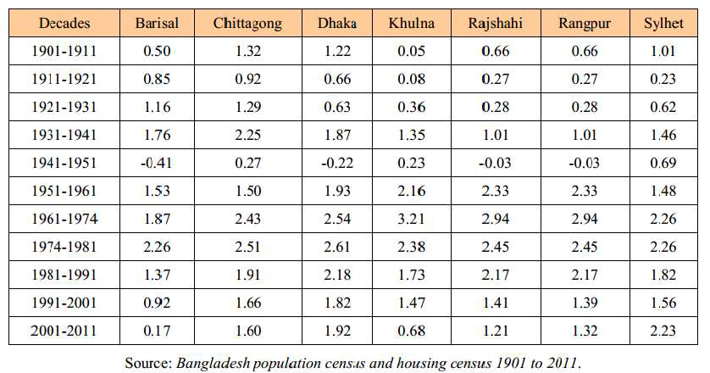
Population distribution through growth

Slide 10
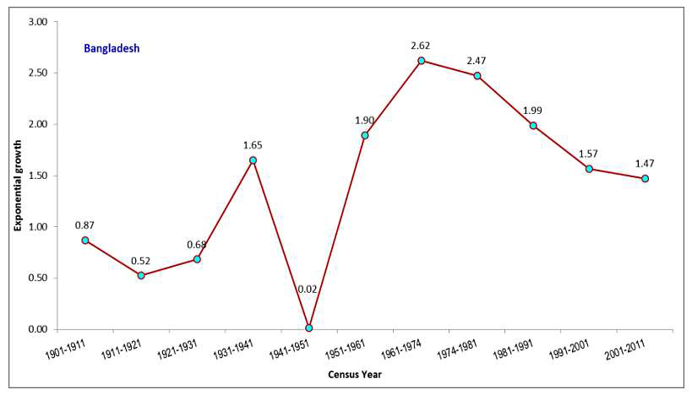
Population distribution through growth

Slide 11
Trend of fertility rate in Bangladesh

Slide 12
Trend of mortality rate in Bangladesh

Slide 13
Trend of migration in Bangladesh

Slide 14
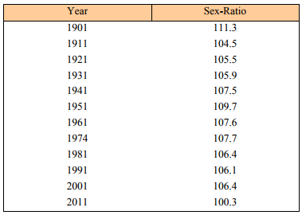
Trend of sex ratio in Bangladesh

Slide 15
Trend of urbanization in Bangladesh

Slide 16
Population pyramid in Bangladesh 2017

Slide 17
Population growth forecast

Slide 18
Over population based challenges

Slide 20
Executive Summary
This study aims to analyze the population trends and impact to provide options for policy makers in Bangladesh. In the last few years Bangladesh is possessing remarkable GDP growth including increased life expectancy and levels of literacy, and an improvement over the maternal and child mortality rates, immunization or vaccination program and even a drastic reduction of poverty rate. Population dynamics is now one of the important factors of this country’s development, planning and success, and projection is one important tool
The population of Bangladesh has been increased rapidly since its independence. This large increase in Bangladesh’s population ,notably from the late 20th century, is mainly due to the improvement of literacy rate, reduction of gender disparity declination of maternal and child mortality rates, better medical technology and immense public health campaigns.

Slide 21
BD population projection and dynamics
This study adopts three realistic scenarios (Scenarios I, II and III) comparing with the trends of various countries, and their socio economic and demographic components based on the adjusted 2011 census population and age-sex distribution.
Scenarios I, II and III could be labeled as high, medium and low variant accordingly. Here the keen interest is on the policy makers’ choices in attaining and implanting different sets of intervention. It is to be recommended that the scenario II is more feasible, whereas scenario III could be preferred for policy implication
In every three different scenarios (I, II and III) has an increased population. In 2061, the population of Bangladesh is estimated to be 251.45 million under high variant fertility assumption (scenario I), 223.39 million under medium variant fertility assumption (scenario II) and 209.42 million under low variant fertility assumption (scenario III)

Slide 22
BD population projection and dynamics
In high variant (scenario I) about 68 percent of population is shown to be increased, ranges from 149 to 251 million. The total population will remain in the range of 209 to 224 millions in 2061 in scenarios II and III
The age structure of projected population shows a curvature pattern for all age groups, there are ups and downs in total numbers and proportion changes. A sharp increase of urbanization has been depicted in all three scenarios
The age-specific projected values show that at the age of 30-34 and onwards, population increases sharply. This indicates movement of the population towards the older age groups. An interesting output of this study is the population projection considering international migration according to scenario II the total population is going to be 219.70 million. For a country like Bangladesh the net migration rates at middle ages are always negative, more people leave the country for work and education than the number that comes in. This fact is also reflected in the estimated

Slide 23
Population Policy of Bangladesh
Population projection and its policy implication have been driven as the foremost national issues in Bangladesh. The population growth was identified as one of the major national problems in the first Five Year Plan (1973 – 1978). A population policy was developed and approved formally in 2004.
The main objective of Bangladesh Population Policy 2004 was to achieve Net Reproductive Rate (NRR) = 1 by 2010 in order to have a stable population by 2060. But it has not been possible to achieve NRR = 1 by 2010 as targeted originally, so it has become a striving need to update the population policy to accelerate the related activities.

Slide 24
Population Policy of Bangladesh
In 2012, an updated version of population policy was proposed. One of the major objectives of the Bangladesh population policy 2012 (BPP) was to lower the TFR to 2.1 by increasing the rate of prevalence of the contraceptive users to 72%, and achieve NRR = 1 by the year 2015
Other important aspects of BPP 2012 was to ensure the availability of family planning methods to the eligible couples by providing easy access to reproduction health services, to reduce infant and maternal mortality, to ensure gender and women’s empowerment.

