Slide 1
Cse312 (L)
Database management system lab
LAB - 2

Slide 2
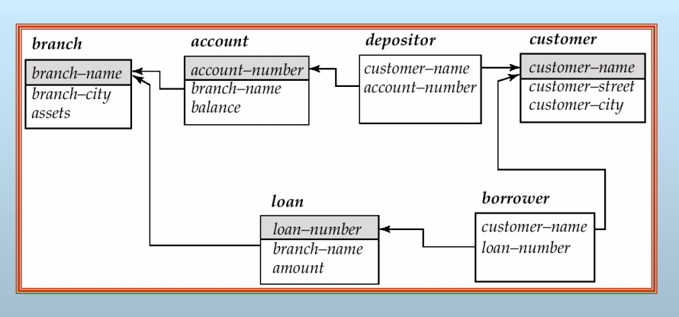
Schema Used in Examples

Slide 3
Table Create :
create table customer
(
Customer-name char(20),
customer-street char(30),
customer-city char(30),
primary key (customer -name)
)
create table branch
(
branch-name char(15),
branch-city char(30),
assets numeric(16,2),
primary key (branch-name)
)

Slide 4
create table account
(
Account-number char(10),
branch-name char(15),
balance numeric(12,2),
primary key (account-number)
)
create table depositor
(
customer-name char(20),
Account-number char(20),
primary key (customer-name, account-number)
)

Slide 5
Basic Structure of SQL Queries
The basic structure of an SQL expression consists of three clauses: select, from, and where.
The select clause corresponds to the projection operation of the relational algebra. It is used to list the attributes desired in the result of a query.
The from clause corresponds to the Cartesian-product operation of the relational algebra. It lists the relations to be scanned in the evaluation of the expression.

Slide 6
The where clause corresponds to the selection predicate of the relational algebra. It consists of a predicate involving attributes of the relations that appear in the from clause. That the term select has different meaning in SQL than in the relational algebra is an unfortunate historical fact.
We emphasize the different interpretations here to minimize potential confusion.
A typical SQL query has the form
select Al, Az,...,An
from T1, T2,...,Tm
where P

Slide 7
The select Clause
Question :
Find the names of all branches in the loan relation":
Answer:
select branch-name
from loan
Question :
Find the names of all customer in the borrower relation":
Answer:
select customer-name
from borrower

Slide 8
The select Clause (Cont.)
In those cases where we want to force the elimination of duplicates, we insert the keyword distinct after select.
We can rewrite the preceding query as
select distinct branch-name
from loan
If we want duplicates removed. SQL allows us to use the keyword all to specify explicitly that duplicates are not removed:
select all branch-name
from loan

Slide 9
The select Clause (Cont.)
An asterisk in the select clause denotes “all attributes”
select * from loan
The select clause may also contain arithmetic expressions involving the operators *, -, *, and / operating on constants or attributes of tuples.
For example, the query
select loan-number, branch-name, amount * 100
from loan

Slide 10
The where Clause:
The where clause specifies conditions that the result must satisfy .
corresponds to the selection predicate of the relational algebra.
Comparison results can be combined using the logical connectives and, or, and not.  Comparisons can be applied to results of arithmetic expressions.

Slide 11
Question :
To find all loan number for loans made at the Perryridge branch with loan amounts greater than $1200.
Answer:
select loan-number from loan where branch-name = ‘Perryridge’ and amount > 1200

Slide 12
Question:
Find the loan number of those loans with loan amounts between $90,000 and $100,000 (that is, ≥$90,000 and ≤$100,000)
Answer :
select loan-number
from loan
where amount between 90000 and 100000

Slide 13
The from Clause
The from clause lists the relations involved in the query
corresponds to the Cartesian product operation of the relational algebra.
Question :
Find the Cartesian product borrower x loan
Answer :
select ∗ from borrower, loan

Slide 14
Question :
Find the name, loan number and loan amount of all customers having a loan at the Perryridge branch.
Answer :
select customer-name, borrower.loan-number, amount
from borrower, loan
where borrower.loan-number = loan.loan-number and branch-name = ‘Perryridge

Slide 15
The Rename Operation
The Rename Operation  The SQL allows renaming relations and attributes using the as clause:
Example: old-name as new-name 
Question :
Find the name, loan number and loan amount of all customers; rename the column name loan-number as loan-id.
Answer:
select customer-name, borrower.loan-number as loan-id, amount from borrower, loan
where borrower.loan-number = loan.loan-number

Slide 16
Tuple Variables
Tuple variables are defined in the from clause via the use of the as clause. 
Question:
Find the customer names and their loan numbers for all customers having a loan at some branch.
Answer:
select customer-name, T.loan-number, S.amount
from borrower as T, loan as S
where T.loan-number = S.loan-number 

Slide 17
Question:
Find the names of all branches that have greater assets than some branch located in Brooklyn.
Answer: select distinct T.branch-name from branch as T, branch as S where T.assets > S.assets and S.branch-city = ‘Brooklyn’

Slide 18
String Operations
String Operations  SQL includes a string-matching operator for comparisons on character strings. Patterns are described using two special characters: + percent (%). The % character matches any substring. + underscore (_). The _ character matches any character. 
Question :
Find the names of all customers whose street includes the substring “Main”.
Answer :
select customer-name from customer
where customer-street like ‘%Main%’


Slide 19
Ordering the Display of Tuples
Question :
Ordering the Display of Tuples  List in alphabetic order the names of all customers having a loan in Perryridge branch.
Answer :
select distinct customer-name
from borrower, loan
where borrower loan-number = loan.loan-number and branch-name = ‘Perryridge’ order by customer-name 
We may specify desc for descending order or asc for ascending order, for each attribute; ascending order is the default. + E.g. order by customer-name desc.

Slide 20
Set Operations
Set Operations  The set operations union, intersect, and except operate on relations and correspond to the relational algebra operations ∪, ∩, −. 
Each of the above operations automatically eliminates duplicates; to retain all duplicates use the corresponding multiset versions union all, intersect all and except all.
Suppose a tuple occurs m times in r and n times in s, then, it occurs:
m + n times in r union all s
min(m,n) times in r intersect all s
max(0, m – n) times in r except all s

Slide 21
Set Operations
Question:
Find all customers who have a loan, an account, or both:
Answer:
(select customer-name from depositor)
union
(select customer-name from borrower) 
Question:
Find all customers who have both a loan and an account.

Slide 22
Answer :
(select customer-name from depositor) intersect (select customer-name from borrower) 
Question:
Find all customers who have an account but no loan.
Answer :
(select customer-name from depositor) except
(select customer-name from borrower)

Slide 23
Aggregate Functions
These functions operate on the multiset of values of a column of a relation, and return a value
avg:average value
min: minimum value
max: maximum value
sum: sum of values
count: number of values

Slide 24
Aggregate Functions (Cont.)
Find the average account balance at the Perryridge branch.
select avg (balance)
from account
where branch-name = ‘Perryridge’ 
Find the number of tuples in the customer relation.
select count (*) from customer
 Find the number of depositors in the bank.
select count (distinct customer-name) from depositor

Slide 25
Aggregate Functions – Group By
Find the number of depositors for each branch.
select branch-name, count (distinct customer-name)
from depositor, account
where depositor.account-number = account.account- number
group by branch-name
Note: Attributes in select clause outside of aggregate functions must appear in group by list

Slide 26
Aggregate Functions – Having Clause
Find the names of all branches where the average account balance is more than $1,200.
select branch-name, avg (balance)
from account group by branch-name
having avg (balance) > 1200
Note: predicates in the having clause are applied after the formation of groups whereas predicates in the where clause are applied before forming groups

Slide 27
Example Query 
Find all customers who have both an account and a loan at the bank.
select distinct customer-name from borrower
where customer-name in (select customer-name from depositor) 
Find all customers who have a loan at the bank but do not have an account at the bank.
select distinct customer-name from borrower
where customer-name not in (select customer-name from depositor)

Slide 28
Example Query
Find all customers who have both an account and a loan at the Perryridge branch .
select distinct customer-name from borrower, loan
where borrower.loan-number = loan.loan-number and branch-name = “Perryridge” and (branch-name, customer-name) in
(select branch-name, customer-name
from depositor, account
where depositor.account-number = account.account-number)
Note: Above query can be written in a much simpler manner. The formulation above is simply to illustrate SQL features. (Schema used in this example)

Slide 29
Set Comparison
Find all branches that have greater assets than some branch located in Brooklyn.
select distinct T.branch-name from branch as T, branch as S
where T.assets > S.assets and S.branch-city = ‘Brooklyn’ 
Same query using > some clause:
select branch-name from branch
where assets > some
(select assets from branch
where branch-city = ‘Brooklyn’)

Slide 30
Example Query
Find the names of all branches that have greater assets than all branches located in Brooklyn.
select branch-name
from branch
where assets > all (select assets
from branch
where branch-city = ‘Brooklyn’)

Slide 31
Example Queries
 A view consisting of branches and their customers
create view all-customer as
(select branch-name, customer-name
from depositor, account
where depositor.account-number = account.account-number)
union
(select branch-name, customer-name
from borrower, loan
where borrower.loan-number = loan.loan-number) 
Find all customers of the Perryridge branch
select customer-name from all-customer
where branch-name = ‘Perryridge’

Slide 32
Modification of the Database – Deletion
Deletion:  Delete all account records at the Perryridge branch.
delete from account
where branch-name = ‘Perryridge’ 
Delete all accounts at every branch located in Needham city.
delete from account
where branch-name in
(select branch-name
from branch
where branch-city = ‘Needham’)
delete from depositor
where account-number in
(select account-number from branch, account
where branch-city = ‘Needham’ and branch.branch-name = account.branch-name)

Slide 33
Example Query
Delete the record of all accounts with balances below the average at the bank.
delete from account
where balance < (select avg (balance) from account)
Problem: as we delete tuples from deposit, the average balance changes
Solution used in SQL:
1. First, compute avg balance and find all tuples to delete
2. Next, delete all tuples found above (without recomputing avg or retesting the tuples)

Slide 34
Modification of the Database – Insertion
Add a new tuple to account:
insert into account values (‘A-9732’, ‘Perryridge’,1200) or equivalently
insert into account (branch-name, balance, account-number)
values (‘Perryridge’, 1200, ‘A-9732’) 
Add a new tuple to account with balance set to null
insert into account
values (‘A-777’,‘Perryridge’, null)

Slide 35
Modification of the Database– Updates
Increase all accounts with balances over $10,000 by 6%, all other accounts receive 5%.
Write two update statements:
update account
set balance = balance ∗ 1.06
where balance > 10000
update account
set balance = balance ∗ 1.05
where balance ≤ 10000
The order is important
Can be done better using the case statement (next slide)

Slide 36


