Slide 1
MMU

Slide 2
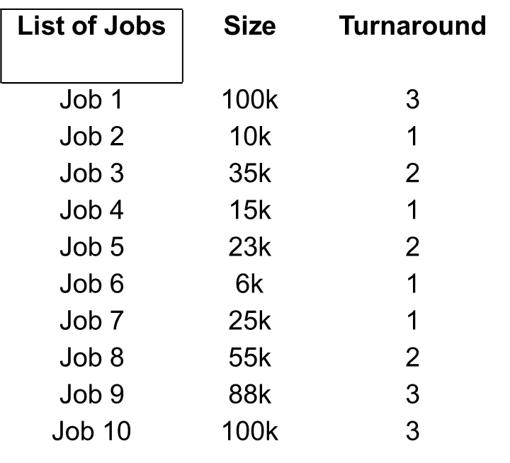
Memory Block Size
Block 1 50k
Block 2 200k
Block 3 70k
Block 4 115k
Block 5 15k

Slide 3
FIRST FIT
HOW!

Slide 4
Memory Block Size
Block 1 50k
Block 2 200k
Block 3 70k
Block 4 115k
Block 5 15k
TURN | BLOCK 1 50k | BLOCK 2 200k | BLOCK 3 70k | BLOCK 4 115k | BLOCK 5 15k
1
2
3
4
5
6
List of Jobs/Process | Size | TAT
p1 | 100k | 3
p2 | 10k | 1
p3 | 35k | 2
p4 | 15k | 1
p5 | 23k | 2
p6 | 6k | 1
p7 | 25k | 1
p8 | 55k | 2
p9 | 88k | 3
p10 | 100k | 3

Slide 5
Memory Block Size
Block 1 50k
Block 2 200k
Block 3 70k
Block 4 115k
Block 5 15k
FIRST FIT
TURN | BLOCK 1 50k | BLOCK 2 200k | BLOCK 3 70k | BLOCK 4 115k | BLOCK 5 15k
1 | p2 | p1 | p3 | p4 | p6
2 | p5 | p1 | p3 | p7
3 | p5 | p1 | p8 | p9
4 |  | p10 | p8 | p9
5 |  | p10 |  | p9
6 |  | p10
List of Jobs/Process | Size | TAT
p1 | 100k | 3
p2 | 10k | 1
p3 | 35k | 2
p4 | 15k | 1
p5 | 23k | 2
p6 | 6k | 1
p7 | 25k | 1
p8 | 55k | 2
p9 | 88k | 3
p10 | 100k | 3

Slide 6
BEST FIT
HOW!

Slide 7
Memory Block Size
Block 1 50k
Block 2 200k
Block 3 70k
Block 4 115k
Block 5 15k
TURN | BLOCK 1 50k | BLOCK 2 200k | BLOCK 3 70k | BLOCK 4 115k | BLOCK 5 15k
1
2
3
4
5
6
List of Jobs/Process | Size | TAT
p1 | 100k | 3
p2 | 10k | 1
p3 | 35k | 2
p4 | 15k | 1
p5 | 23k | 2
p6 | 6k | 1
p7 | 25k | 1
p8 | 55k | 2
p9 | 88k | 3
p10 | 100k | 3

Slide 8
Memory Block Size
Block 1 50k
Block 2 200k
Block 3 70k
Block 4 115k
Block 5 15k
BEST FIT
TURN | BLOCK 1 50k | BLOCK 2 200k | BLOCK 3 70k | BLOCK 4 115k | BLOCK 5 15k
1 | p3 | p5 | p4 | p1 | p2
2 | p3 | p5 | p7 | p1 | p6
3 |  | p9 | p8 | p1
4 |  | p9 | p8 | p10
5 |  | p9 |  | p10
6 |  |  |  | p10
List of Jobs/Process | Size | TAT
p1 | 100k | 3
p2 | 10k | 1
p3 | 35k | 2
p4 | 15k | 1
p5 | 23k | 2
p6 | 6k | 1
p7 | 25k | 1
p8 | 55k | 2
p9 | 88k | 3
p10 | 100k | 3

Slide 9
WORST FIT
HOW!

Slide 10
Memory Block Size
Block 1 50k
Block 2 200k
Block 3 70k
Block 4 115k
Block 5 15k
TURN | BLOCK 1 50k | BLOCK 2 200k | BLOCK 3 70k | BLOCK 4 115k | BLOCK 5 15k
1
2
3
4
5
6
List of Jobs/Process | Size | TAT
p1 | 100k | 3
p2 | 10k | 1
p3 | 35k | 2
p4 | 15k | 1
p5 | 23k | 2
p6 | 6k | 1
p7 | 25k | 1
p8 | 55k | 2
p9 | 88k | 3
p10 | 100k | 3

Slide 11
Memory Block Size
Block 1 50k
Block 2 200k
Block 3 70k
Block 4 115k
Block 5 15k
WORST FIT
TURN | BLOCK 1 50k | BLOCK 2 200k | BLOCK 3 70k | BLOCK 4 115k | BLOCK 5 15k
1 | p4 | p1 | p3 | p2 | p6
2 | p7 | p1 | p3 | p5
3 |  | p1 | p8 | p5
4 |  | p9 | p8 | p10
5 |  | p9 |  | p10
6 |  | p9 |  | p10
List of Jobs/Process | Size | TAT
p1 | 100k | 3
p2 | 10k | 1
p3 | 35k | 2
p4 | 15k | 1
p5 | 23k | 2
p6 | 6k | 1
p7 | 25k | 1
p8 | 55k | 2
p9 | 88k | 3
p10 | 100k | 3

