Slide 1
DATABASE NORMALIZATION

Slide 2
What is Normalization
NORMALIZATION is a database design technique that organizes tables in a manner that reduces redundancy and dependency of data
Normalization divides larger table into smaller tables and links using relationships
The purpose of Normalization is to eliminate redundant data and ensure data is stored logically.
The inventor of the relational model E.F.Codd proposed the theory of Normalization

Slide 3
Redundancy
Row level Redundancy:
If the SID is primary key to each row you can use it to remove duplicates as shown below:
SID | SName | Age
1 | Ann | 21
2 | Tailor | 20
1 | Ann | 21
SID | SName | Age
1 | Ann | 21
2 | Tailor | 20

Slide 4
Redundancy(Cont..)
Column Level Redundancy:
Now Rows are same but in column level because of Sid is primary key but columns are same:
Sid | Sname | Cid | CName | Fid | FName | Salary
1 | AA | C1 | DBMS | F1 | Ann | 30000
2 | BB | C2 | JAVA | F2 | KK | 50000
3 | CC | C1 | DBMS | F1 | Ann | 30000
4 | DD | C1 | DBMS | F1 | Ann | 30000

Slide 5
What is Anomaly
Problems that can occur in poorly planned, unnormalized databases where all the data is stored in one table.
Types of Anomalies:
1.Insert
2. Delete
3. Update

Slide 6
Insertion Anomaly
Table: University
Sid | SName | Cid | CName | Fid | FName | Salary
1 | Ann | C1 | DBMS | F1 | Ahmed | 30000
2 | KK | C2 | JAVA | F2 | Aneel | 28000
3 | Urmila | C3 | DBMS | F1 | Ahmed | 30000
4 | Shourav | C4 | DBMS | F1 | Ahmed | 30000
 |  |  |  | F3 | Arun | 29000
Insertion Anomaly

Slide 7
Delete Anomaly
Sid | SName | Cid | CName | Fid | FName | Salary
1 | Ann | C1 | DBMS | F1 | Ahmed | 30000
2 | KK | Deletion Anomaly
3 | Urmila | C1 | DBMS | F1 | Ahmed | 30000
4 | Shourav | C1 | DBMS | F1 | Ahmed | 30000
SQL:
DELETE FROM University WHERE Sid=2;

Slide 8
Update Anomaly
Sid | SName | Cid | CName | Fid | FName | Salary
1 | Ann | C1 | DBMS | F1 | Ahmed | 30000
2 | KK | C2 | JAVA | F2 | Aneel | 28000
3 | Urmila | C1 | DBMS | F1 | Ahmed | 30000
4 | Shourav | C1 | DBMS | F1 | Ahmed | 30000
SQL:
UPDATE University SET Salary=40000
WHERE Fid=“F1”;

Slide 9
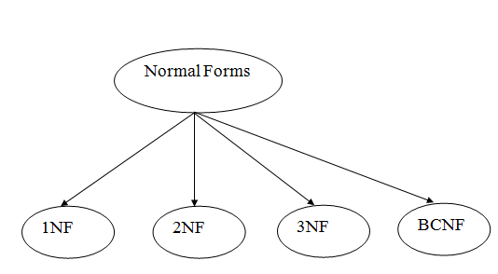
Normal Forms
There are the following four types of normal forms:

Slide 10
First Normal Form(1 NF)
A relation is in 1NF if it contains an atomic value
Example:
The following Course_Content is not in 1NF because the Content attribute contains multiple values:
Course | Content
Programming | Java, C++
Web | HTML, PHP, ASP

Slide 11
1NF Example(Cont..)
The below relation is in 1NF:
Course | Content
Programming | Java,
Programming | C++
Web | HTML
Web | PHP
Web | ASP

Slide 12
Second Normal Forms(2NF)
The table should be in the First Normal Form.
There should be no Partial Dependency

Slide 13
Prime & Non Prime Attributes
Prime Attributes: The attributes which are used to form a candidate key are called Prime Attributes.
Non-Prime Attributes: The attributes which do not form a candidate key are called Non-Prime Attributes.
Roll No. | First Name of Student | Last Name of Student | Course Code
01 | Anik | Ahmed | A100
02 | Anik | Ahmed | B50
03 | Shourav | Hossain | C80
Prime Attribute: Roll No., Course Code
Non-Prime Attribute: First Name of Student, Last Name of Student

Slide 14
Functional Dependency
A dependency FD: X Y means that the values of Y are determined by the values of X. Two tuples sharing the same values of X will necessarily have the same values of Y.
We illustrate this as:
X Y (read as: X determines Y or Y depend on X)

Slide 15
Partial Dependency
If a non-prime attribute can be determined by the part of the candidate key in a relation, it is known as Partial Dependency.
Example: Suppose there is a relation R with attributes A, B & C.
R(A,B,C)
Where,
{AB} is a candidate key.
{C} is a non-prime attribute.
Then,
{A,B} are the prime attributes
A C is a Partial Dependency.
Part of a candidate key
Non-prime attribute

Slide 16
Example of 2NF
CourseID | SemesterID | StudentNo. | CourseName
IT101 | 201301 | 25 | DBMS
IT101 | 201302 | 25 | DBMS
IT102 | 201301 | 30 | Web Prog
IT102 | 201302 | 35 | Web Prog
IT103 | 201401 | 20 | Networking
Primary Key
The Course Name depends on only CourseID, a part of the primary key, not the whole
Primary {CourseID, SemesterID}. It’s called partial dependency.
Solution:
Remove CourseID and Course Name together to create new table.

Slide 17
Example of 2NF(Cont..)
CourseID | SemesterID | StudentNo.
IT101 | 201301 | 25
IT101 | 201302 | 25
IT102 | 201301 | 30
IT102 | 201302 | 35
IT103 | 201401 | 20
CourseID | CourseName
IT101 | DBMS
IT101 | DBMS
IT102 | Web Prog
IT102 | Web Prog
IT103 | Networking
CourseID | CourseName
IT101 | DBMS
IT102 | Web Prog
IT103 | Networking

Slide 18
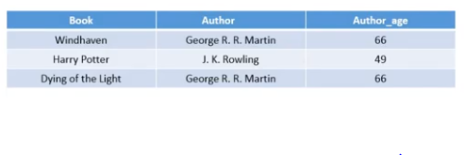
3rd NF:
X Y
Y Z

Slide 19
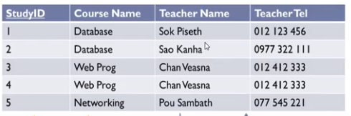

Slide 20
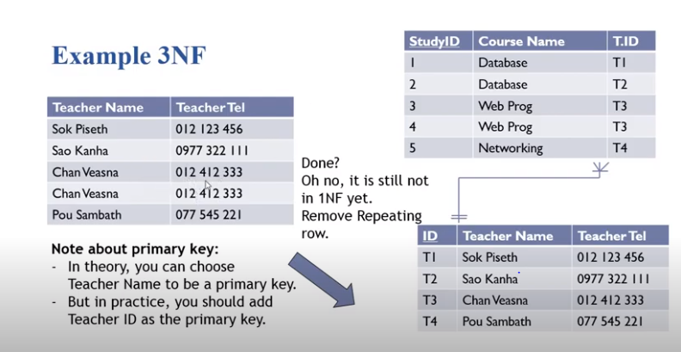

Slide 21
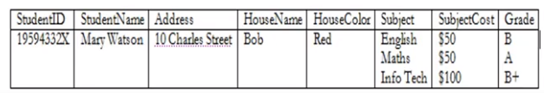
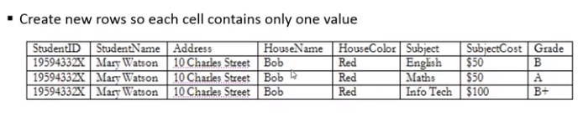

Slide 22
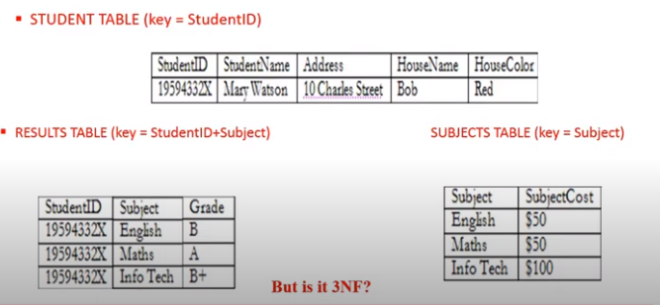

Slide 23
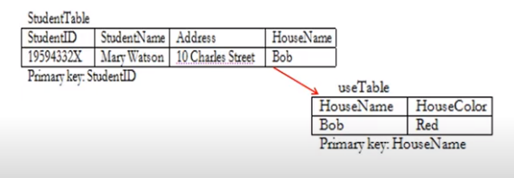

Slide 24
