Slide 1
Synchronous Motor
Md. Zakir Hasan

Slide 2
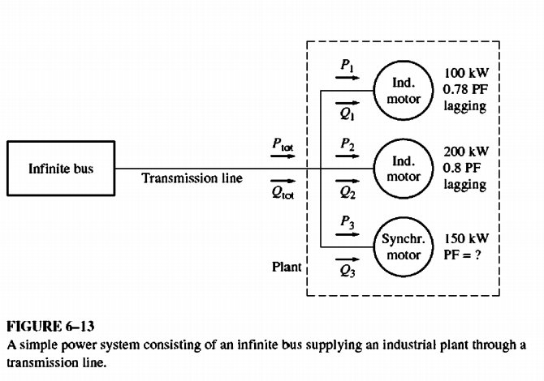
The Synchronous Motor and Power-Factor Correction
Figure 6-13 shows an infinite bus whose output is connected through a transmission line 10 an industrial plant at a distant point. The industrial plant shown consists of three loads. Two of the loads are induction motors with lagging power factors, and the third load is a synchronous motor with a variable power factor.
What does the ability to set the power factor of one of the loads do for the power system?
To find out, examine the following example problem. (Note: A review of the three-phase power equations and their uses is given in Appendix A. Some readers may wish to consult it when studying this problem.

Slide 3
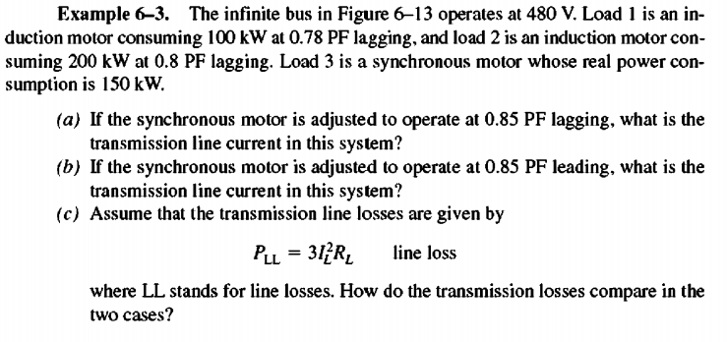
The Synchronous Motor and Power-Factor Correction

Slide 4
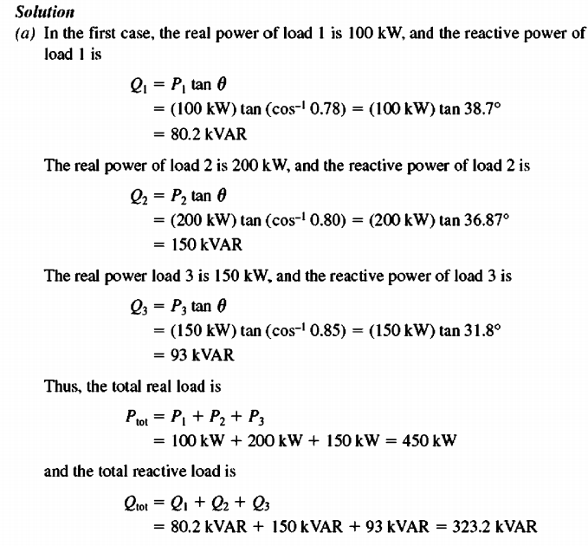
The Synchronous Motor and Power-Factor Correction

Slide 5
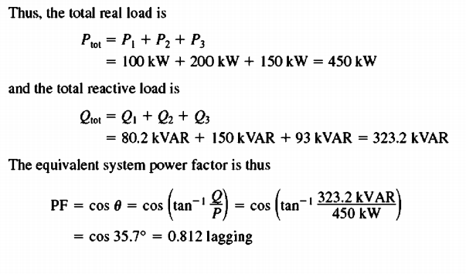
The Synchronous Motor and Power-Factor Correction

Slide 6
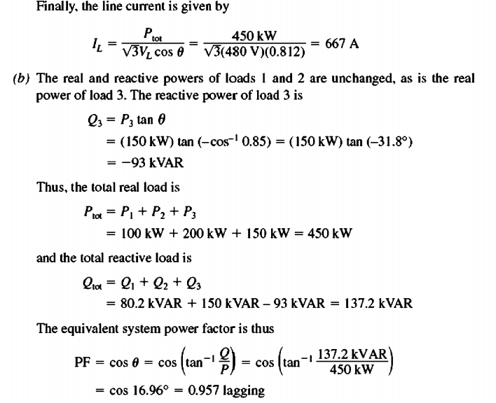
The Synchronous Motor and Power-Factor Correction

Slide 7
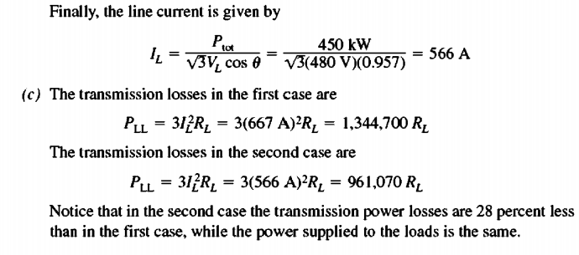
The Synchronous Motor and Power-Factor Correction

Slide 8
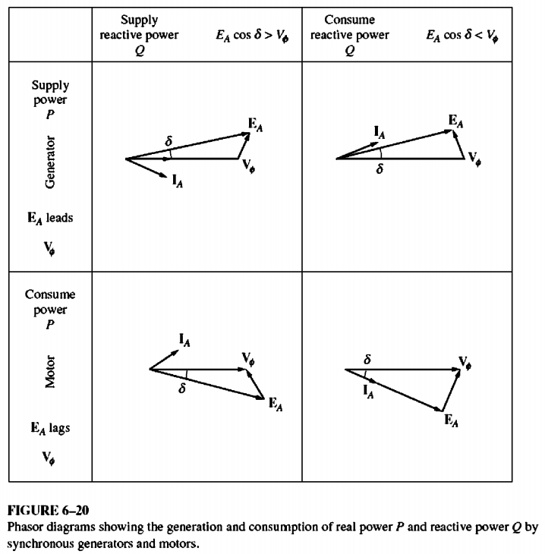
SYNCHRONOUS GENERATORS AND SYNCHRONOUS MOTORS

Slide 9
SYNCHRONOUS GENERATORS AND SYNCHRONOUS MOTORS
A synchronous generator is a synchronous machine that converts mechanical power to electric power, while a synchronous motor is a synchronous machine that converts electric power to mechanical power. In fact, they are both the same physical machine.
A synchronous machine can supply real power to or consume real power from a power system and can supply reactive power to or consume reactive power from a power system. All four combinations of real and reactive power flows are possible, and Figure 6-20 shows the phasor diagrams for these conditions.

Slide 10
SYNCHRONOUS GENERATORS AND SYNCHRONOUS MOTORS
Notice from the figure that
1.The distinguishing characteristic of a synchronous generator (supplying P) is that EA lies ahead V$ø$, while for a motor EA lies behind V$ø$.
2.The distinguishing characteristic of a machine supplying reactive power Q is that EA cos $δ$ >V$ø$, regardless of whether the machine is acting as a generator or as a motor. A machine that is consuming reactive power Q has EA cos $δ$ < V$ø$.

