Slide 1
Database TRIGGER
Presented By
Fahmida Afrin

Slide 2
এই Lesson এ কি শিখব?
What is DB Trigger?
Trigger Syntax
Explanation of Trigger Syntax
Trigger Example

Slide 3
what is trigger??
A trigger is a stored procedure in database which automatically invokes whenever a special event in the database occurs.
Unlike stored procedures and functions , they not explicitly called, but they are activated when a triggering event occurs.
Main purpose is to implement the complex integrity constraints that can not be done with the CREATE TABLE or ALTER TABLE command.
For example, a trigger can be invoked when a row is inserted into a specified table or when certain table columns are being updated.

Slide 4
Trigger timing
BEFORE: Where a trigger will be activated before DML process on table occur.
AFTER: Where a trigger will be activated after DML process on table occur.

Slide 5
Syntax
create trigger[trigger_name]
[before | after]
{insert | update | delete}
on [table_name]
[for each row]
[trigger_body]

Slide 6
Explanation of syntax
create trigger [trigger_name]: Creates or replaces an existing trigger with the trigger_name.
[before | after]: This specifies when the trigger will be executed.
{insert | update | delete}: This specifies the DML operation.
on [table_name]: This specifies the name of the table associated with the trigger.
[for each row]: This specifies a row-level trigger, i.e., the trigger will be executed for each row being affected.
[trigger_body]: This provides the operation to be performed as trigger is fired

Slide 7
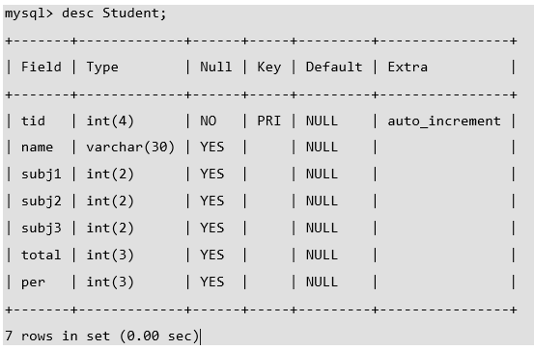
Trigger example - Student Database
Suppose the database Schema –
Given Student Report Database, in which student marks assessment is recorded.
In such schema, create a trigger so that the total and average of specified marks is automatically inserted whenever a record is insert.
Here, as trigger will invoke before record is inserted so, BEFORE Tag can be used

Slide 8
SQL Trigger to problem statement
create trigger stud_marks
before INSERT
on
Student
for each row
set Student.total = Student.subj1 + Student.subj2 + Student.subj3, Student.per = Student.total * 60 / 100;
Above SQL statement will create a trigger in the student database in which whenever subjects marks are entered, before inserting this data into the database, trigger will compute those two values and insert with the entered values.

Slide 9
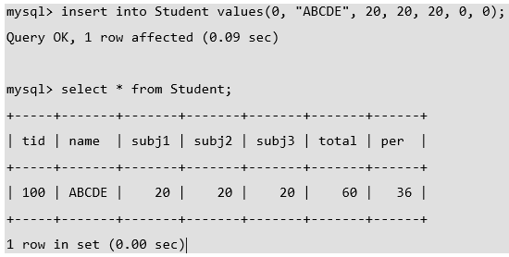
SQL Trigger to problem statement(Cont’d)

Slide 10
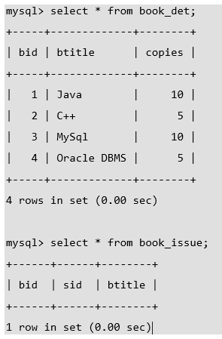
SQL Trigger - Book Management Database
Suppose the schema with some data
For example, given Library Book Management database schema with Student database schema.
In these databases, if any student borrows a book from library then the count of that specified book should be decremented.

Slide 11
Trigger for the system
create trigger book_copies_deducts
after INSERT
on book_issue
for each row
update book_det set copies = copies - 1 where bid = new.bid;
Above trigger, will be activated whenever an insertion operation performed in a book_issue database, it will update the book_det schema setting copies decrements by 1 of current book id(bid)

Slide 12
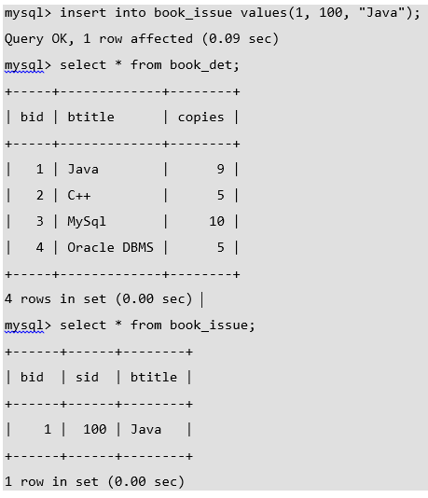
Results
As above results show that as soon as data is inserted, copies of the book deducts from the book schema in the system.

Slide 13
“If you can’t fly, then run.
If you can’t run, then walk.
If you can’t walk, then crawl.
But by all means, keep moving”
– Martin Luther King Jr.

