Slide 1
POPULATION PYRAMIDS
Dostogir Harun
Assistant Professor
Department of Public Health, DIU
Email: dostogirharun@gmail.com
Cell: 01556 636 545

Slide 2
Outline of the lecture
WHAT is a population pyramid?
HOW to read a population pyramid?
Recognize SHAPES of population pyramids.
IMPORTANCE of population pyramids.

Slide 3
What is Population pyramid
The population pyramid represents the breakdown of the population by gender & age at a given point in time
It consists of two histograms, one for each gender where the numbers are shown horizontally and the ages vertically
The numbers by gender and by age depend on interactions between fertility, mortality & migrations
The shape of the pyramid and its variations over the years depend above all on the variations in fertility

Slide 4
What is a population pyramid?
The total population divided into five-year age groups
the percentage of people in each of those age groups
the percentage of males and females in each age group

Slide 5
How do population pyramids help us learn about population and to take decision about the population health?

Slide 6
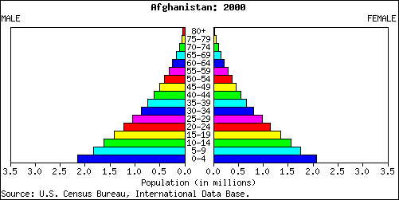
Population pyramids are used to show information about the age and gender of people in a specific country.
Male
Female
There is also a high Death Rate.
In this country there is a high Birth Rate
Population in millions
This population pyramid is typical of countries in poorer parts of the world (LEDCs.)

Slide 7
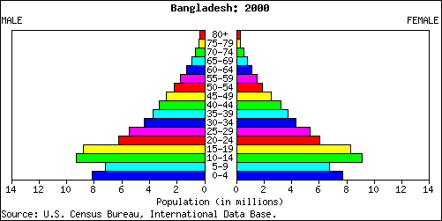
In some LEDCs the government is encouraging couples to have smaller families. This means the birth rate has fallen.

Slide 8
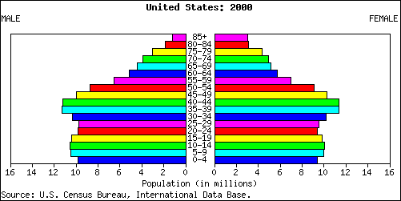
Male
Female
The largest category of people were born about 40 years ago.
In this country the number of people in each age group is about the same.
Population in millions
In this country there is a low Birth Rate and a low Death Rate.
This population pyramid is typical of countries in the richer parts of the world (MEDCs.)

Slide 9
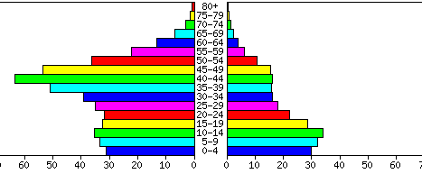
Male
Female
Population in thousands
This country has a large number of temporary workers. These are people who migrate here especially to find a job.

Slide 10
Shape of pyramids is controlled by
births
deaths
migration

Slide 11
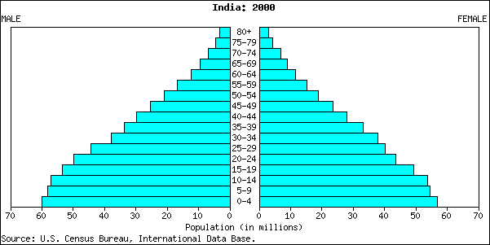
What is a population pyramid?
Vertical Axis - Age Groups
Elderly dependents
Working population
Young dependents
Horizontal Axis – Percentage / number of people

Slide 12
Types of Population Pyramid
There main types of pyramids
Rapid growth-Expansive
Slow growth-Stationary
Negative growth
Shape of rapid
growth - Expansive
Shape of
Slow growth-Stationary
Shape of negative
growth

Slide 13
Triangle
Beehive
Rectangle

Slide 14
Triangle or Rectangle or Beehive

Slide 15
Triangular-shaped Pyramid (Broad-based Pyramid)

Slide 16
Broad-based Pyramid
Example: India, 2000
Shape: Broad Base - high birth rates
Narrow Top - small elderly pop
- high death rate
Proportion: - Large proportion of young
- high young dependency ratio
Sex Ratio: Balance pyramid - Balance sex ratio

Slide 17
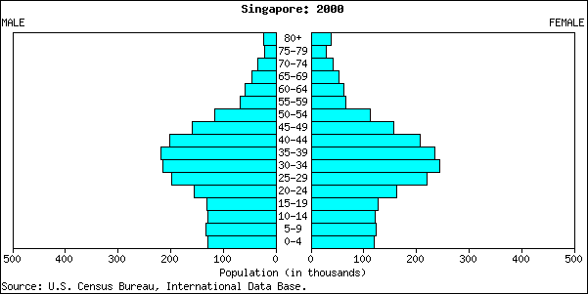
Beehive-shaped Pyramid

Slide 18
Beehive-shaped Pyramid
Example: Singapore, 2000
Shape: Rocket-shaped / Narrow Base
– Low Birth Rates, decreasing pop
Proportion: Large proportion of working
population, 15-59 yr old - large
group of economically active pop
Sex Ratio: Balanced pyramid

Slide 19
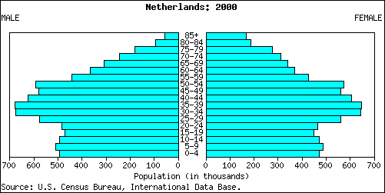
Rectangular-shaped Pyramid

Slide 20
Rectangular Pyramid
Example: Netherlands, 2000
Shape: Rectangular-shaped - Zero Pop Growth
Narrow Base - Low Birth Rates
- Life-expectancy is high e.g. 80+
- Low death rates
Proportion: Bars of equal length - Balance
Proportion
Sex Ratio: Balance pyramid-Balance Sex
Ratio

Slide 21
Bangladesh population pyramid 2019

Slide 22
World population pyramid 2019

Slide 23
Somalia 2019
Italy 2019

Slide 24
Can you Interpret population Pyramids
Six things to comment on
Birth Rate
Death Rate
Infant mortality
Life expectancy
% of dependants to economically active
Migration

Slide 25
Importance of Population Pyramids
Policy Planning
~ future housing estates
~ future schools
~ future jobs
Comparison with other countries
~ developed (US) vs developing (India)

Slide 26
Population pyramids are useful because they show:
Trends in the birth rate, death rate, infant mortality rate and life expectancy - these trends can help a country to plan its future services, e.g. more homes for the elderly if there is an ageing population or fewer schools if there is a declining birth rate
The effects of people migrating into or out of a region or country
The proportion of the population who are economically active and the proportion who are dependent upon them (dependency ratio).

Slide 27
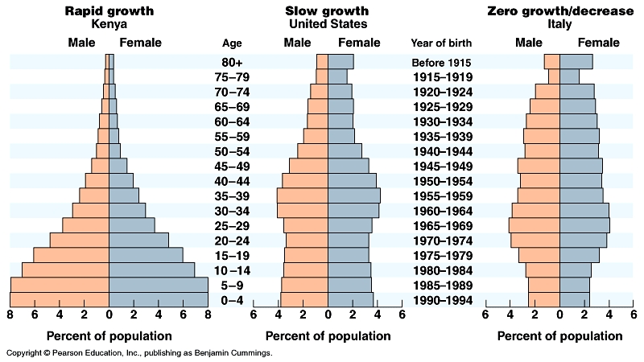
Population Pyramids

Slide 29
4
3
5
2
1

Slide 30
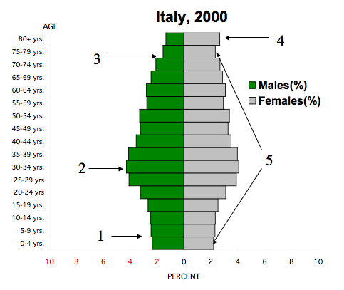
Analysis of Italy’s Population Pyramid
1. Decline in Birth Rate
2. Baby Boom
3. Fewer men due to World War I and II
4. More women due to: a. longer life expectancy and b. World Wars (I and II)
5. More 75-79 yrs than 0-4 yrs. Signs of a future worker shortage and an overall declining population.

Slide 34
Population Pyramids at Different Scales
Country
State
County

Slide 35
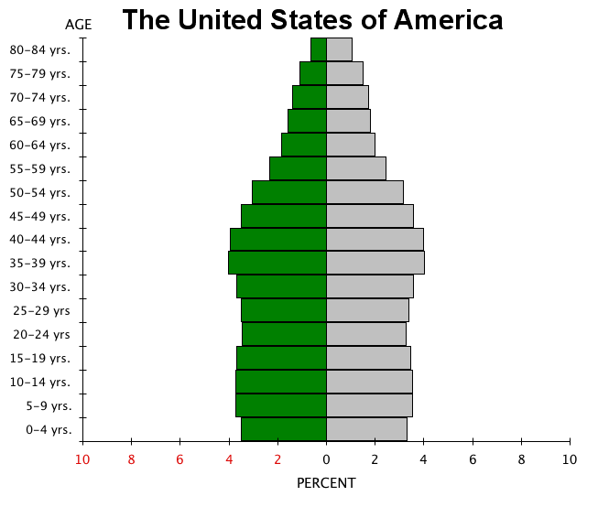

Slide 36
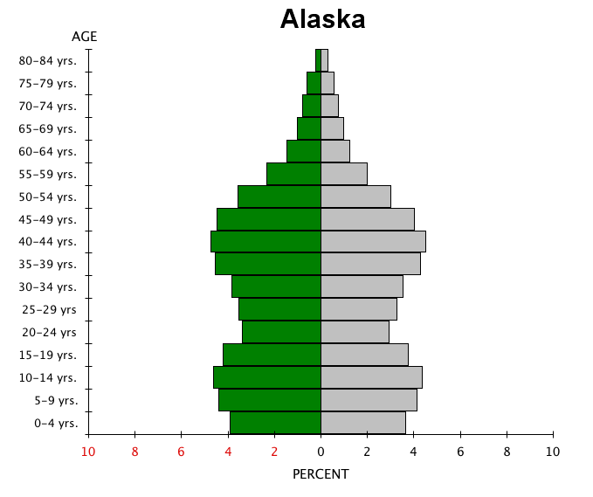

Slide 37
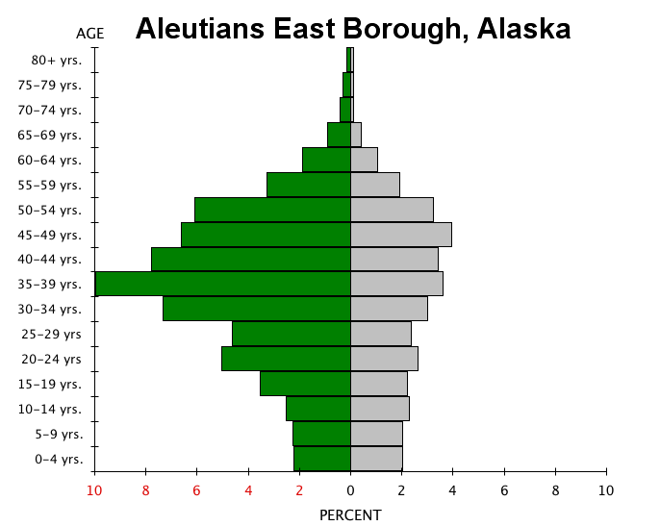

Slide 38
http://www.aleutianseast.org

Slide 39
Summary

Slide 40
Expansive or Expanding Pyramids
Expansive or expanding population pyramids have this classic triangular/pyramid shape. The wide base of this population pyramid indicates a high birth rate & the narrow top indicates a high death rate.
Generally speaking an expanding population is characteristic of a lower standard of living:
high birth rate due to poor access to birth control, lack of education etc.;
high death rate due to poor medical care & nutrition

Slide 41
Stationary or Stable Population
Stationary or Stable population pyramids have a 1/2 elipse shape. The base of this population pyramid is similar in width to the population of the reproductive ages which indicates a stable population.
Generally speaking stable populations are characteristic of a high standard of living due to:
low birth rate due to good family planning, access to birth control, financial planning, education, etc.;
low death rate due to good medical care, nutrition, education etc.

Slide 42
Contractive or Contracting Population
Contractive or contracting population pyramids have a narrower base than the reproductive age population. This indicates a decreasing population trend. The low birth rate is indicative of a well developed country.

Slide 43
Test Yourself
What does the vertical axis on the population pyramid represent?
What type of population pyramid is indicative of a lesser developed country?
What does a narrow base to the population pyramid indicate?
What type of population pyramid has a triangular shape?
What type of population pyramid is wider at the reproductive age than at the pre-reproductive ages.
_?_ are graphs that show the age structure of a population by age & gender.
What type of population pyramid is depicted below? What characteristic of this population pyramid indicate its high death rate?

Slide 46
http://www.gov/population/international/

