Slide 1
MIGRATION
Dostogir Harun
Assistant Professor
Department of Public Health, DIU
Email: dostogirharun@gmail.com
Cell: 01556 636 545
11 December 2020

Slide 2
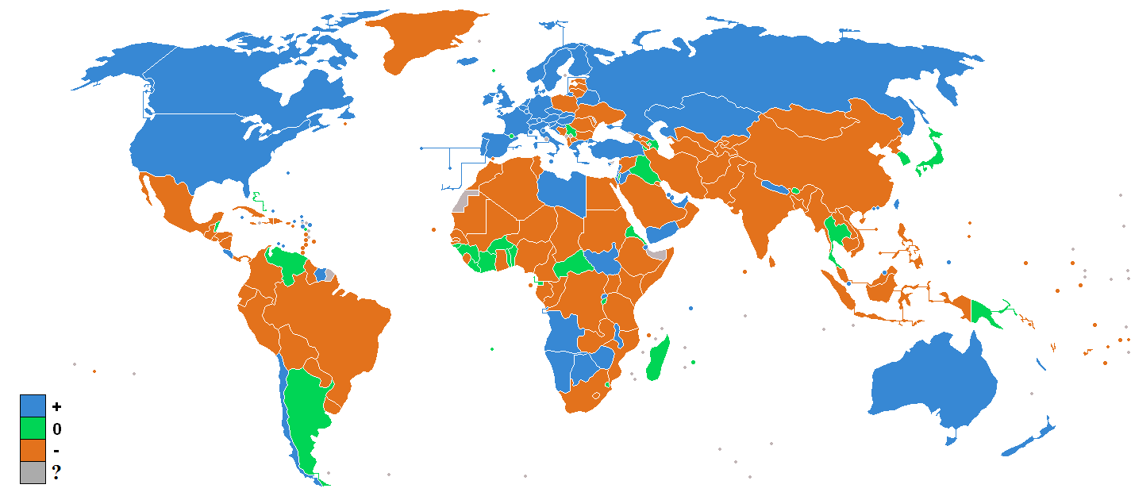

Slide 3
What is globalisation?

Slide 4
Definition
Migration is a form of geographical or spatial mobility involving a change of usual residence between clearly defined geographic units
The term migration has in general usage been restricted to relatively permanent change in residence between specially designated political or statistical areas or between an urban and a rural area

Slide 5
Migrations
Mobility is most generalized term that refers to all types of movements
Journeying each day to work or school
Weekly visits to local shops
Annual trips to visit relatives who live in a different state
Short-term and repetitive acts of mobility are referred to as circulation.
Ex. College students moving to college each fall and returning home each spring

Slide 6
Migrations
A permanent move to a new location constitutes migration
Emigration is migration from a location
Immigration is migration to a location
Place “A” can have individuals migrating away from and to it
Emigrant: Place A → Place B
Immigrant: Place B → Place A
Difference between the number of immigrants and number emigrants is a place’s net migration

Slide 7
Distance and Migrations
Ravenstein’s laws for the distance that migrants typically move
Most migrants relocate a short distance and remain within the same country.
Long-distance migrants to other countries head for major centers of economic activity.
Migration can be divided into two categories.
International Migration- permanent move from one country to another
Voluntary
Forced
Internal Migration- permanent move within the same country
Interregional
Intraregional

Slide 8
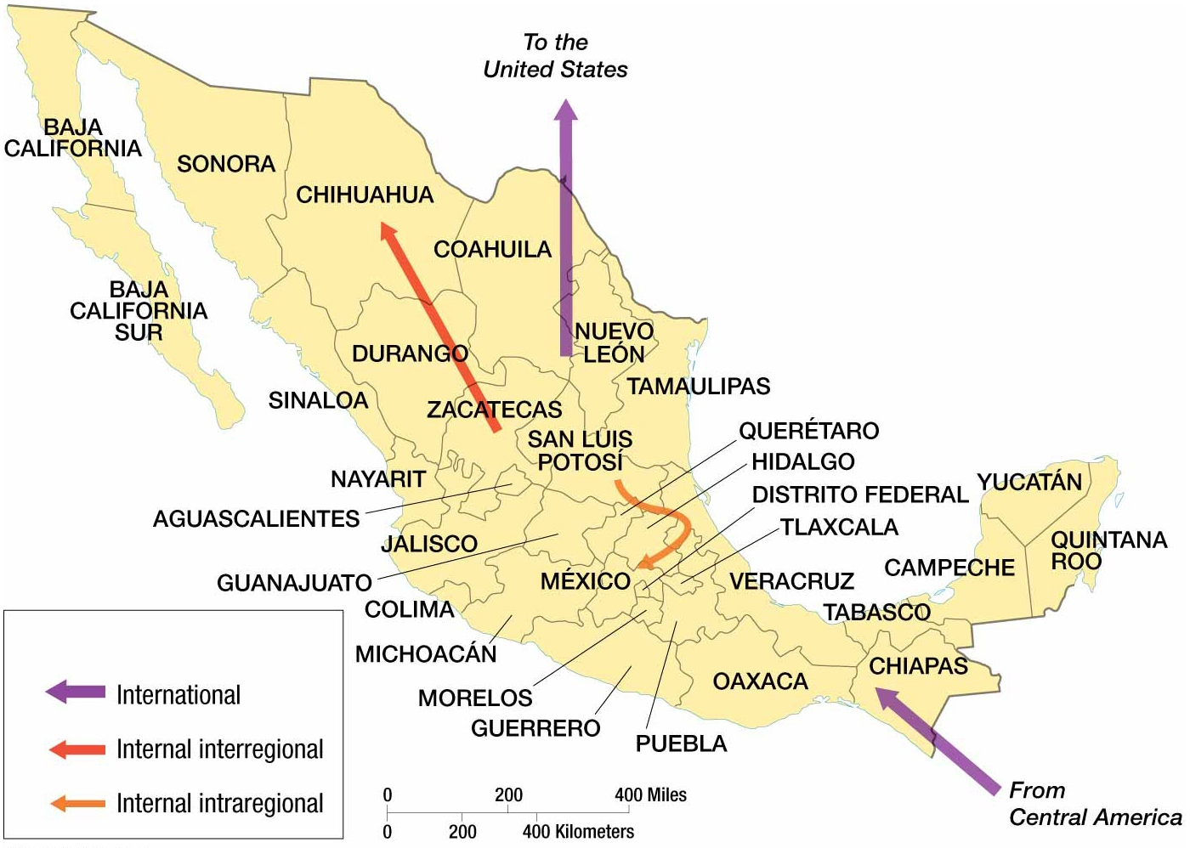

Slide 9
SOME TERMINOLOGIES OF MIGRATION:
Mover: One who moves from his own residence to some other place for any reason whatsoever is called a mover.
Migrant: One who moves from one politico administrative unit to another.
Commuter: One who moves (from one village to another or from one village to a town) for daily earning.
In-migration: Coming from one politico administrative to another politico administrative unit within the same country.
Out-migration: Going from one politico administrative unit to another politico administrative unit within the same country. If the movement is from one country to another country it is called emigration.

Slide 10
Internal migration: If the migration occurs within the same country from one politico administrative to another. Gross migration: Total migration (emigration and immigration) of a country. Net migration: Difference between immigration and emigration. Refugee: If one because of external pressure or reason leaves his place of residence and takes shelter in another place within the same country or in a different country is termed as refugee. Migration Stream: Flow of individuals from rural to urban, urban to urban, urban to rural and rural to urban is called migration stream. International migration: Movement from one country to another country.

Slide 11
Types of Migration
Two broad types of Migration:
International Migration: movement across national boundaries.
Internal Migration: migration within the boundaries of a given nation.

Slide 12
Major reasons in last 20 years
1989 The fall of the Berlin wall
1991 The Soviet Union ceases to exist and Yugoslavia falls apart
1992 War starts in Bosnia-Herzegovina
1971- Temporary migration
1994 Genocide in Rwanda
2017- Rohinga population

Slide 13
Classification of International Migration
Temporary or Permanent movements.
Movement of individuals and families or movement of whole nation.
Movement of citizens or aliens.
Voluntary or forced movements.
Peaceful or non-peaceful movements.
Movements of civilians or military personnel

Slide 14
Sources of data for International Migration statistics:
Land frontier statistics.
Port statistics
Passport statistics.
Population registers statistics.
Population census and survey statistics.
Migration statistics

Slide 15
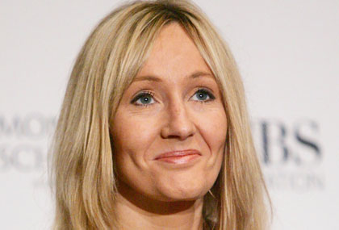
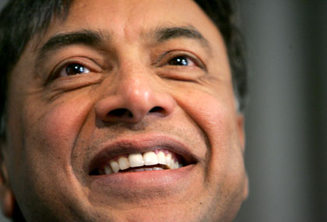
International elites
Elite A minority population group with some combination of: high levels of wealth; social status; political influence; cultural influence. Can migrate easily (e.g. from Brazil to EU) under Highly Skilled Migrants Programme (HSMP)
Examples:
Footballers (330 Premiership players)
Musicians, actors and writers
Financial sector workers and entrepreneurs
High-skilled professionals (surgeons, lawyers, architects, etc.)
Academics (including geographers!)
Politicians
Notes:
Explain Fordism, history of TU (tube drivers, firemen?) whats the min wage?
Describe changing A-levels etc

Slide 16
Story for poor global migrants
The poor are not welcomed into ‘Fortress Europe’ in the same way that elites are
They take great risks (perhaps without knowing)
They are exploited by ‘people-traffickers’ who take their life savings in exchange for passage
Vessels used to cross the Mediterranean from Africa are unsafe, thousands have drowned
Similar stories can be told about poor Mexicans heading for the USA, or Burmese entering Bangladesh

Slide 17
While globalisation has made it easier to move money and goods around the world, it is not true that all people are free to move
It is easier for people with money and skills to migrate than it is for the poor – there is not a ‘level playing field’ for global migrants

Slide 18
States of special concern
Pakistan
Bangladesh
Nigeria
Indonesia
China
Russia
North Korea
Iran
Belarus
Saudi Arabia
Rwanda
Sudan

Slide 19
Asia
North Korea to South Korea
China: internal displacement
South Asia: pressures on the West
Central Asia: pressures on Russia

Slide 20
Migration flows affecting Asia 2027
Considerable internal migration in India
Flows from South Asia to Europe
Flows from South Asia to China and East Asia
Flows from South East Asia to China
Considerable internal migration in China
Less flows from South Asia to West Asia
Flows from West Asia to Europe

Slide 21
Perspectives of Asia
East and SE Asian countries have promoted export-led development w. free trade zones
Increased female rural-urban migration
Female migrants are more likely than males to settle in urban areas
Males are making temporary urban-rural migrations until they can re-establish in an urban area

Slide 22
Asian Perspectives on Ethnic Factors
Focus is on gendered migration expectations
Rising expectations by and for women:
More education and higher status but also continued cultural expectation that daughters will support parents
Agricultural economic restructuring has reduced female labor force opportunities for women in rural areas
Result: More female migrants remitting from urban jobs in Thailand

Slide 23
Drought as another migration force
Asian perspective: Drought of 1999 pushes many men back to Bangkok, even though employment situation has not improved
Health and nutritional status of poor people

Slide 24
Indirect measures of Estimation of Net Migration:
There are three methods for the estimation
of Net Migration:
1. Vital statistics
2. Survival method
3. Migration statistics method

Slide 25
1. Vital statistics method:
In this method vital statistics (birth and death) are counted (for a defined area) at the time of two consecutive censuses. If there are variations in the numbers of population, then we can say there is existence of migration in this area

Slide 26
Vital Statistics Method:
Net Migration = (P1-P0) - (B-D) = P1-P0-B+D
Where,
P0= Population in previous census
P1= Population in later census
B= Births during the two census period
D= Deaths during the two census period
not appropriate for developing countries due to inaccurate vital statistics.

Slide 27
Survival Ratio Method
The difference between expected and estimated population during two censuses is called net migration.
Advantages:
1. No vital statistics is needed.
2. It provides age and sex specific migrations
3. On principle it is easy and common method.

Slide 28
Migration ratio method
Several crude rates may be constructed on
the basis of separate figures on immigration
and emigration. These rates represent the
amount of immigration, emigration, net
migration or gross migration per 1,000 of
mid year population of a country and may be
symbolized as follows,

Slide 29
Migration ratio method
1. Crude Immigration rate=I/P* 1000
2. Crude Emigration Rate= E/P*1000
3. Crude Net Migration Rate= I-E/P*1000
4. Crude Gross Migration Rate= I+E/P*1000
Where,
I= Immigrants (Persons coming from other countries)
E= Emigrants (Persons going to other countries)
P= Mid year population of the year under reference

Slide 30
Causes and Effects of various types of internal migration:
Either developed or developing countries more migrations take place from rural to urban areas though reasons are, not, same in all countries
In some countries it occurs due to push and in some countries it occurs due to ‘pull’ factor.

Slide 31
A. Causes of Rural to Urban Migration
Due to presence of excess manpower in agriculture field, excess manpower of rural areas come to towns to work in factories and industries
Due to more increase of population in rural areas, the excess manpower migrates to towns for any kind of job for their survival
Due to expansion of industrial enterprises in towns, more new job opportunities - result excess manpower of rural areas come to towns due to presence of ‘pull’ factors

Slide 32
Causes of Rural to Urban Migration
Higher educational institutes are generally located in towns and cities- a large number of students of rural areas migrates to urban areas for higher studies.
A large number of unemployed persons - for higher studies
Due to transfer of government and private employees - a large proportion of their dependents also migrate with them in their place of transfer
An underdeveloped country like Bangladesh where garment industries have developed and expanded very rapidly, unemployed, illiterate and unskilled men and women from rural areas rushed to towns and cities for their survival

Slide 33
Causes of Rural to Urban Migration
In Bangladesh a large proportion of agricultural labor force remain unemployed throughout the year. They migrate to towns and cities to work as rickshaw pullers, van drivers etc.
Due to business reasons people migrate to towns and cities.
Now-a-days due to insecurity of life and property some people are compelled to migrate to cities/towns.
Due to more availability of modern amnesties of life in towns and cities people are interested to live in urban areas.

Slide 34
Effects of Rural to Urban Migration
Due to migration of population from rural to urban areas
Urban areas are being expanded.
The population and its density is also increasing.
Avenues have also opened for construction of new industries in towns and cities and in their suburbs. Pressure of population is felt in every aspect of life. As a result problems of housing, sanitation, water, food, clothing, education, employment, health etc are heavily felt by most of the town dwellers.
Due to competition of consumers prices of essential commodities are also increasing day by day. The purchasing capacity of the customers is decreasing.

Slide 35
Unusual population pressure multifactor social problem like (youths) - robbery, hijacking, snatching, teasing of girls, disobedience etc. Load of burden of illiterate unskilled and semi-skilled people. as a result average income decreases – weak national economy, so previous urban settlers consider this as “burden’. instability in social and economic conditions, problem creep into the field of education – demand of school, college, university etc due to excess pressure on employment talented human resources migrate for better job – loses of human resources due to ‘push’ factor

Slide 36
B. Causes of Rural to Rural Migration:
Rural to Rural Migration (village to village) migration is mainly temporary. Due to daily communication (daily work basis) or search for job people migrate from one village to another.
Wife migrates to husband’s village (home) & sometimes husband migrates to wife’s village
Live in lodging houses for their education in schools and colleges.
Due to repeated occurrence of flood cyclone and hurricane etc, particularly in the southern part of Bangladesh, villagers suffer heavy damage of crops, live stock in addition to human beings.

Slide 37
Effects of Rural to Rural Migration:
This kind of population movement increases the social linkage among villages.
Due to more social interaction among villagers, marriage among them keeps them in close contact. As a result harmonies relationship builds among village population.
Can exchange skill, expertise, social influence, skill in productivity, income generation with such movement of population

Slide 38
C. Causes of Urban to Rural Migration:
Either developed or developing countries population hardly migrates from urban to rural areas. Though there are a small number of movements from urban to rural areas, it is very few in developing countries in comparison to developed countries. The reasons of urban to rural migration are described as follows:
After completion of education if the person is unable to find a suitable job in towns or cities he returns to his village for self employment;
After having being employed by government or private organization, he goes to rural areas if the employer desires;
After retirement some people like to pass the remaining period of his life in his village home along with his near relations;

Slide 39
Due to decentralization or government and semi-government offices, some employees are transfer to rural areas and live there with families;
The administrative structure been brought up to union level. As a result some sort of decentralization has taken place at district, thana and union level administration resulting in movement of population from more urban to more rural
With the improvements of roads, extension of electricity, safe drinking water people prefer to live in rural setting than in crowded and polluted urban environment
To improve rural areas in real sense of the term there is no denying that skilled manpower particularly in the field of agriculture, fisheries, livestock, engineering and health needs to be transferred not for the safe of employment only but also for attaining sustainable development in rural areas
In urban areas due to natural calamities, racial discrimination or religious conflict etc. people migrate from urban to rural areas. It naturally depends on circumstances, environment and cultural practices of migration

Slide 40
Effects of Urban to Rural Migration:
if population transfer from urban rural areas is possible by experienced managers, administrators, doctors, other professional then development will begin from villagers
If development from agriculture, health, administration, roads, bridges, education, fisheries and livestock is started in villages the excess manpower in the agricultural field will not move to towns and cities. They can be utilized in these fields
development of rural areas a balanced economic situation will prevail throughout the country in the long run resulting in a welfare state
With the provision of modern amenities in rural areas people are becoming more interested to live in, village people get the opportunity to come in contact with them and are able to know from them how village economy could be developed with locally available technology and resources.

Slide 41
D. Causes of Urban to Urban Migration:
The reason of urban to rural migration is due to presence of ‘push-pull’ factors. Due to new employment people in towns and cities move there.
As family become larger and some members move to other places to a different town
Due to transfer from one urban area, the socio-cultural interaction also takes place. Towns expand as a result of population movement
Working efficiency increases due to exchange of skilled manpower. The productivity, income, saving and exchange capacity also increases

Slide 42
Causes why demographers are increases in internal migration?
Migration is a process of basic social change
Migration is a necessary for normal population adjustment
Migration is an arrangement for making maximum use of persons with special qualification
Migration is an instrument of cultural diffusion and social integration
Migration creates social instability
Internal migration and economic, social and political problems

Slide 43
Determinants of Migration or differential hypothesis about migration

Slide 44
Push factor migration:
At place of original push factor or elements can be classified into 5 categories as follows:
Due to natural increase of population excessive pressure falls on natural resources
Due to rapid exhaustion of natural resources life becomes very difficult
Life and resources losses in natural disaster. Due to recurrent flood or draught people migrate from one place to another
Paucity of job as per ability of an individual lead to migration
Other reasons are status, marriage, employment etc. which may cause migration

Slide 45
Pull factors of migration:
Pull factors of migration are associated with place of destination. The pull factors for which migration take place are as follows:
Discovery of new resources
Due to industrialization and utilization of new technologies people are attracted. With the application of computer technology skilled manpower are being produced in large numbers at home and abroad.
Due to political and social stability people of one place may be attracted to other places.

Slide 46
Due to flood, draught, cyclone etc when government provide adequate facilities people rush there.
If the place of destination is more comfortable than the place of origin people move there.
If the wage more in the place of destination people move there.
Socio economic reasons like more investment opportunity attract people from one place to another.

Slide 47
Uses
Migration is the third factor affecting change in the population of an area; the other two factors are births and deaths.
Migration is an important element in growth of the population and the labour force of an area, knowledge of the number and characteristics of persons entering or leaving an area is required together with census data and vital statistics in order to analyze the change in the structure of the population and labour force of an area.

Slide 49
High mountains
Coal is discovered
Dense forest
Fertile farmland
Desert
River
Coal is discovered
Fertile farmland
Coal is discovered

Slide 50
High mountains
Town grows bigger
Dense forest
Fertile farmland
Desert
River
Coal mine develops
Fertile farmland
Coal mine develops

Slide 51
High mountains
Town grows bigger More jobs
Trees cut down for farmland
Fertile farmland
Desert
River
Coal mine grows
Fertile farmland
Coal runs out

Slide 52
High mountains
University established in town
Trees cut down for farmland
Fertile farmland
Desert
River floods
Coal begins to run out
Fertile farmland
Coal mine closes

Slide 53
High mountains
Town grows bigger
Soil erosion due to deforestation
Machines mean fewer workers are required
Desert
River
Coal begins to run out
Fertile farmland
No jobs

Slide 54
High mountains
More jobs and opportunities
Area flooded for hydroelectric power scheme
Machines mean fewer workers are required
Oil is discovered in desert
River floods again
Coal runs out
Machines mean fewer workers are required
No jobs

Slide 55
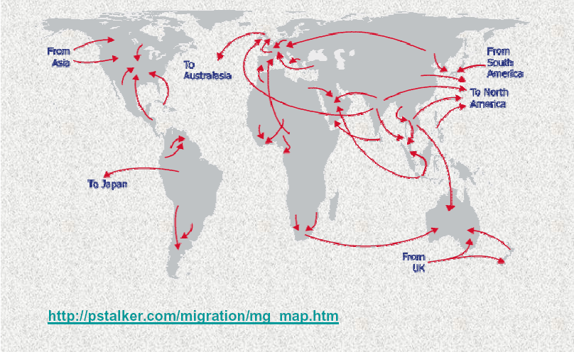
Migration Flows

Slide 56
NO MIGRATION NO BARRIERS WITHOUT VISA 1 WORLD Thank You!!!

