Slide 1
Chapter 2
Strowger Switching Systems

Slide 2
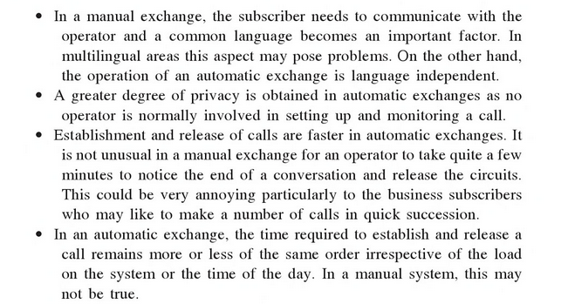
Automatic Switching System
Advantages:

Slide 3
Rotary Dial Telephone
A formal numbering plan or addressing scheme is required to identify the subscribers.
A mechanism to transmit the identity of the called subscriber to the exchange now required at the telephone set.
Two methods for this purpose:
i) Pulse dialing
ii) Multi frequency dialing

Slide 4
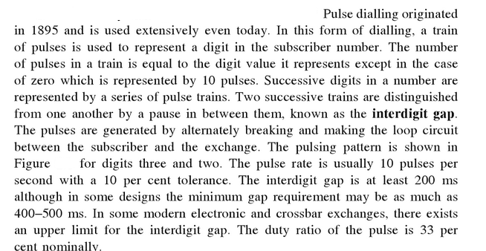
Pulse Dialing

Slide 5
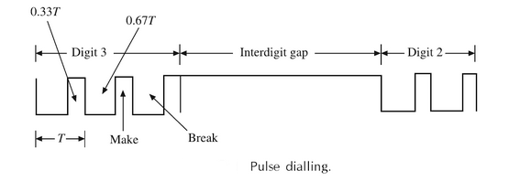

Slide 6
The following points have to be considered for the telephone set:
Since the pulses are produced by make and break of the subscriber loop, there is likelihood of sparking inside the telephone instrument.
The transmitter, receiver and the bell circuits of the telephone set may be damaged if the dialing pulses are passed through them.
The dialing habits of the users vary widely and hence all timing aspects should be independent of user action.

Slide 7
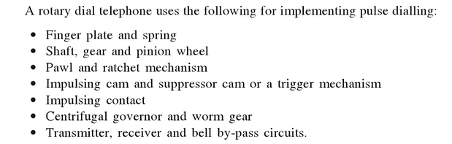
Rotary Dial Telephone

Slide 8
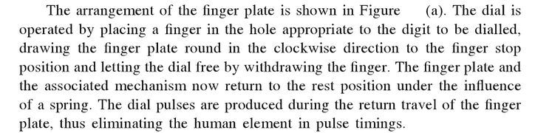
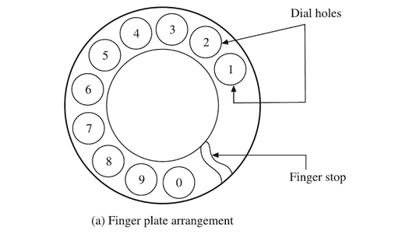

Slide 9
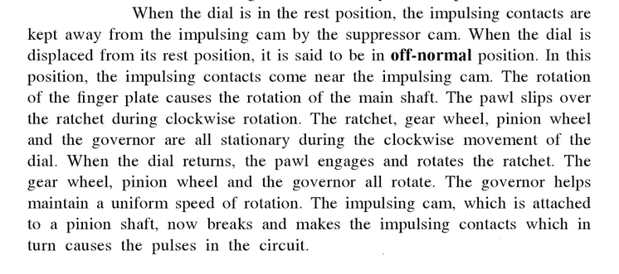
Parts and Mechanisn:

Slide 10
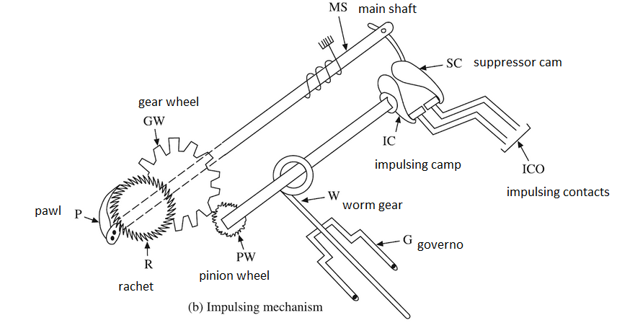

Slide 11
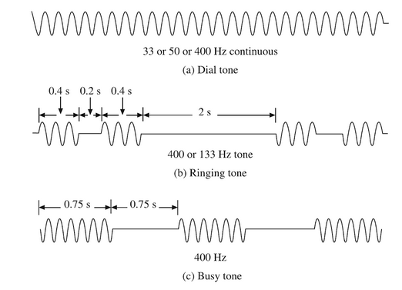
Signaling Tones:

Slide 12
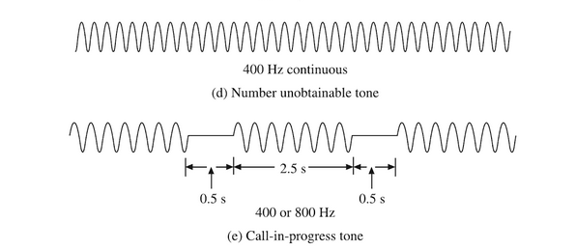
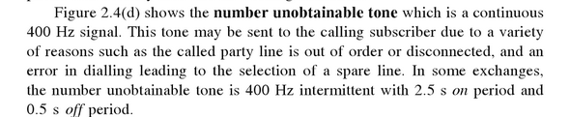

Slide 13
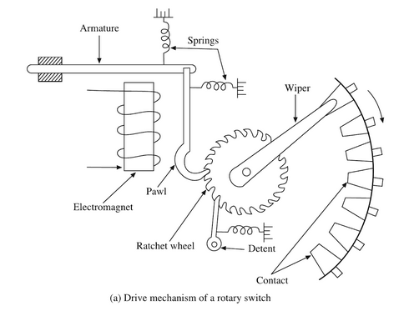
Strowger Switching Components:

Slide 14
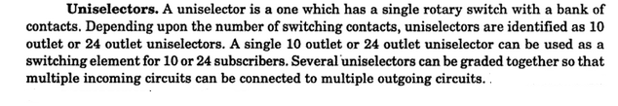
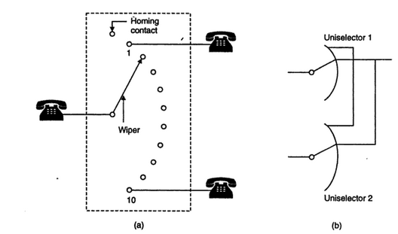
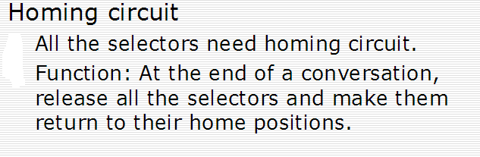
Uniselector

Slide 15
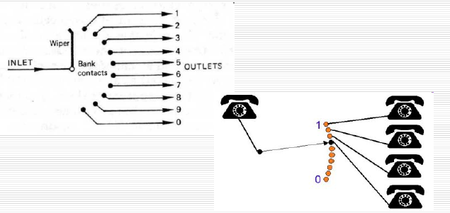

Slide 16
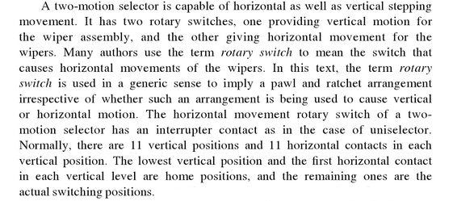
Two Motion Selectors

Slide 17
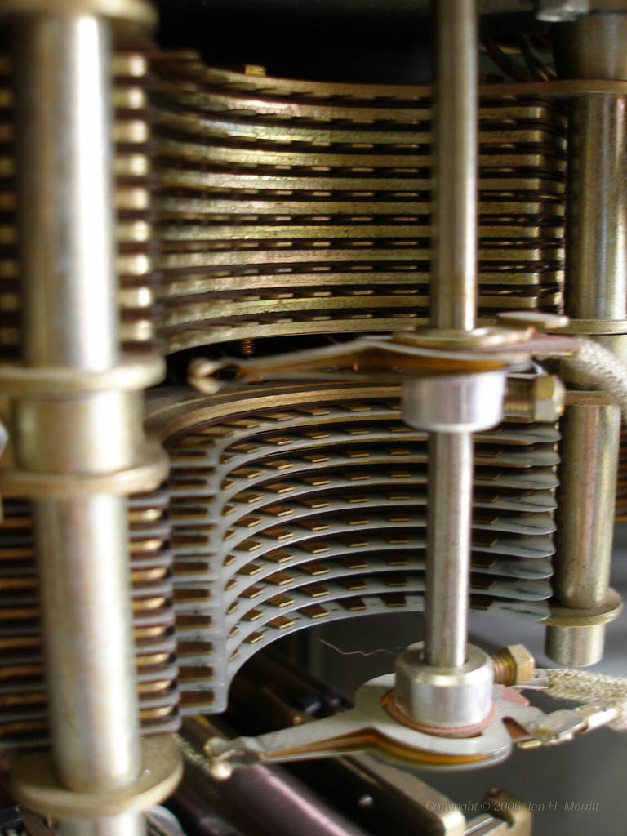

Slide 18
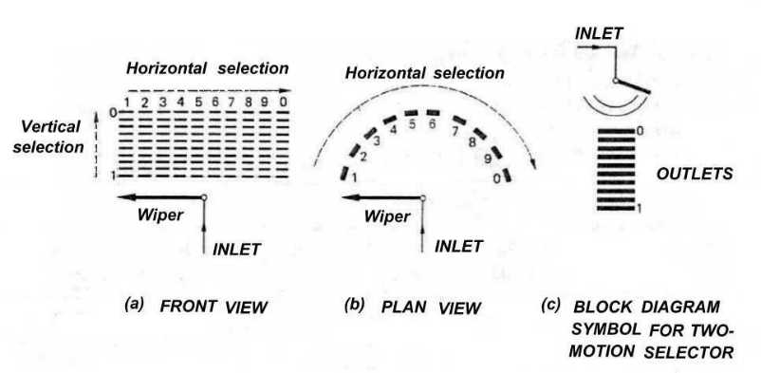

Slide 19
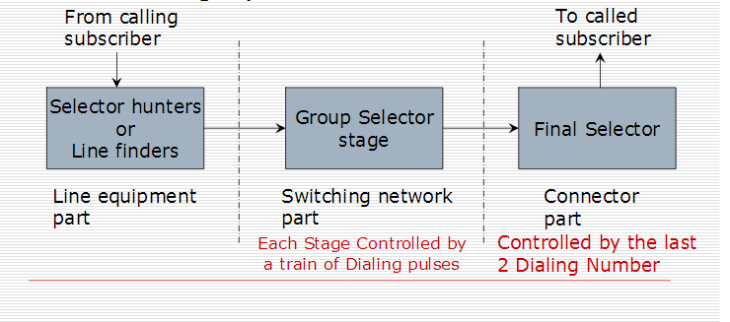
Step-by-Step Switching System

Slide 20
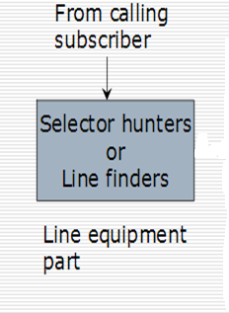
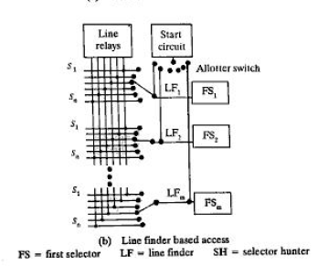
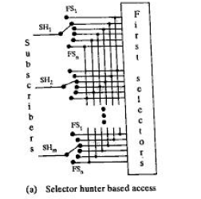

Slide 21
Selector Hunter Based Access
To find a free selector, alloter switch is used for connecting calling subscriber and selector line, selector hunter based access or line finder based access can be used. In selector hunter based access, when a subscriber lifts his handset, the interrupter mechanism in his selector hunter gets activated and the wiper steps to find free first selector. Once the free first selector is sensed, it is marked busy and the interrupter mechanism of selector hunter is disabled. Now the first selector sends the dial tone to the subscriber and then ready to receive dialled pulses from the calling subscriber. Thereafter, the first selector provides only electrical paths between calling subscriber and group selector.

Slide 22
Line Finder Based Access
In line finder based access approach, the seize is identified by interupt mechanism. Through the alloter switch, free line finder is identified. It gets activated and its wiper steps forward to reach the subscriber contact. Now the corresponding first selector sends the accept signal as dial tone. Thereafter, it acts as a simple electrical path between calling subscriber and group selector.

Slide 23
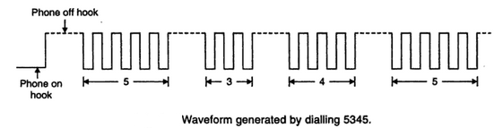
Call Set-up

Slide 24
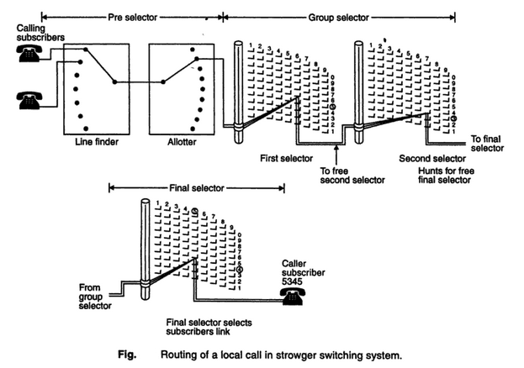

Slide 25
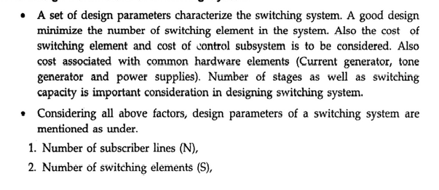
Design Parameters

Slide 26
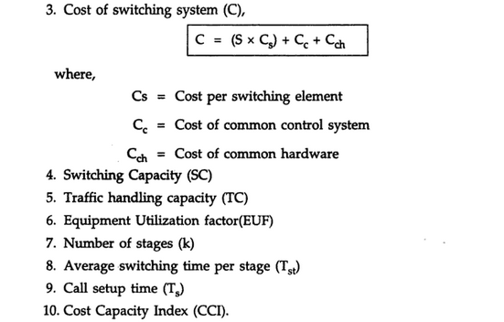

Slide 27
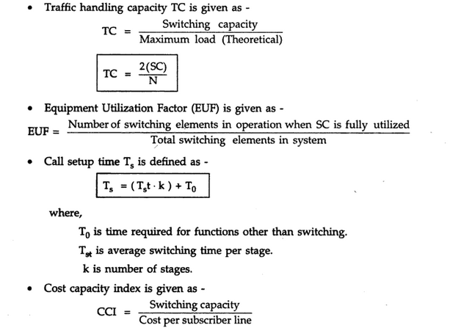


Slide 28
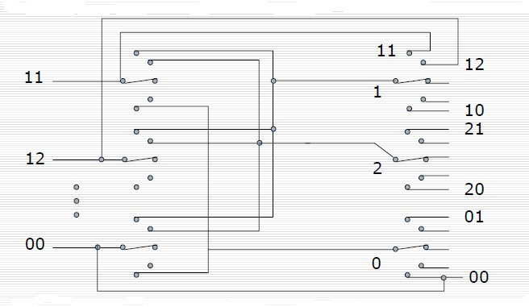
100-line Switching System

Slide 29
Total Number of Switching Elements, S=110
Switching Capacity, SC=10
Number of Switching stages, K=2
TC=(switching capacity)/(theoretical maximum load)
=(2SC)/N =0.2
EUF=(number of switching elements in operation when SC is fully utilized)/(total number of switching elements in the system) =0.18
C=110
CCI=9.09

Slide 30
Assignment
Design 2, Design 3, Design 4 and Design 5 for 100 line switching system.
1000 line Blocking Exchange.

