Slide 2
Sand blasting
the parts of dry process
for only in denim garments
physical process which creates localize abrasion
mechanical process,
where no need to use any chemical.
a water free process
sand blasting process is now isolated

Slide 3
Method of Sand Blasting
Sand Blasting,
Machine Sanding,
Hand sanding or hand brushing

Slide 4
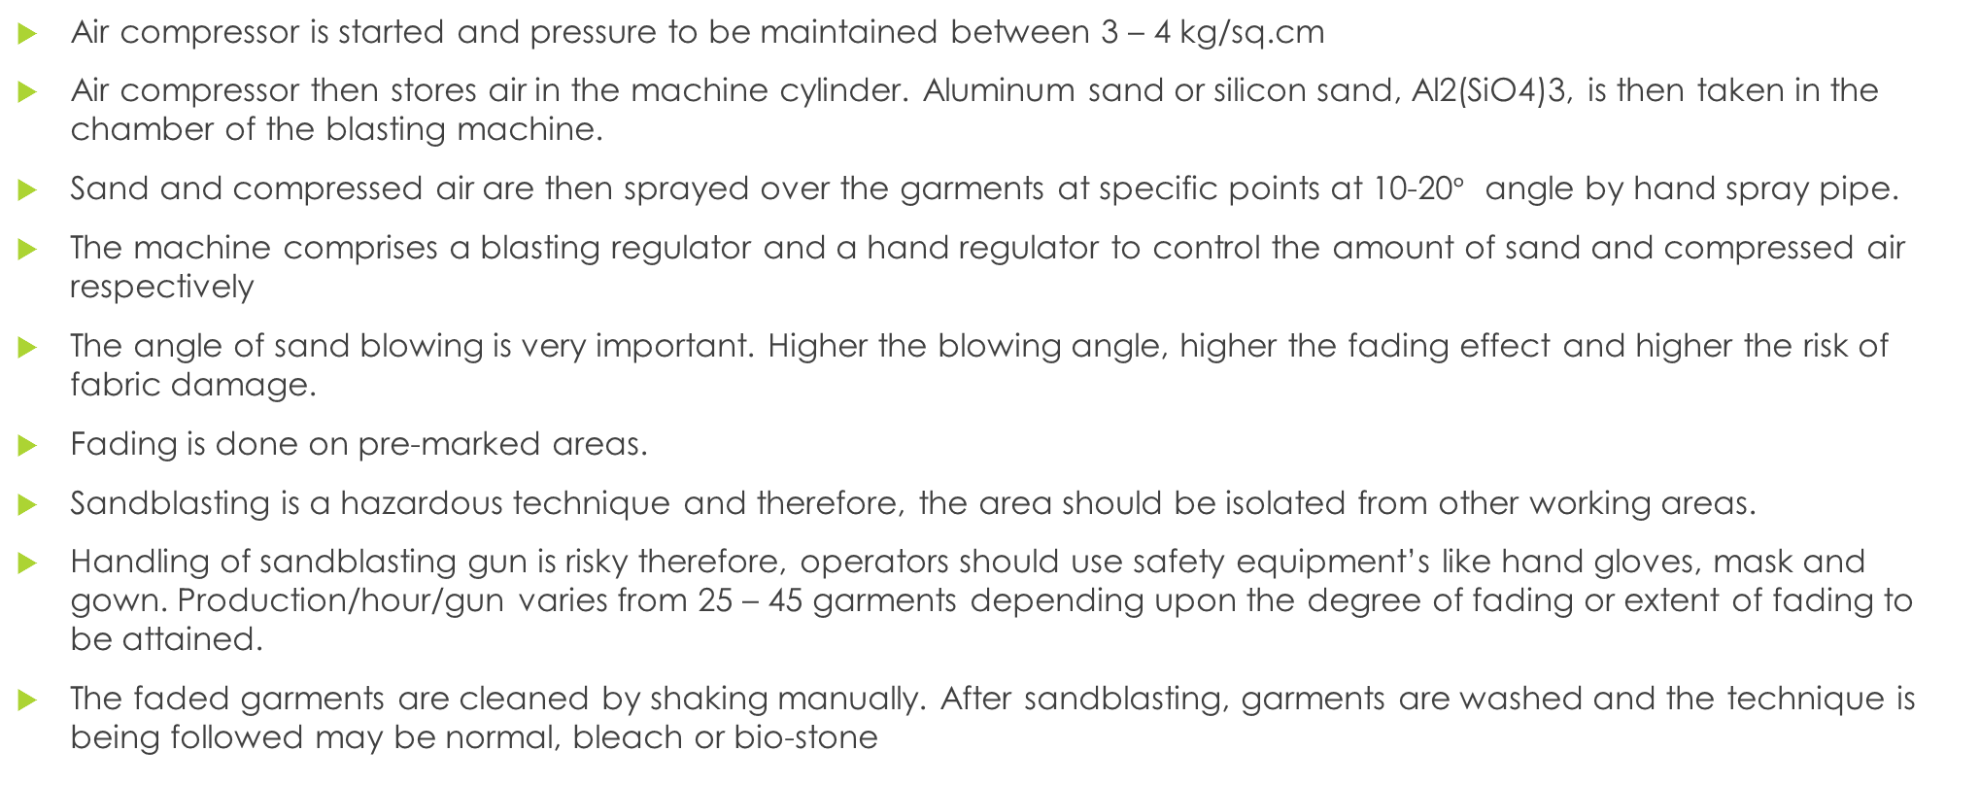
Procedure of Sand Blasting
Air compressor is started and pressure to be maintained between 3 – 4 kg/sq.cm
Air compressor then stores air in the machine cylinder. Aluminum sand or silicon sand, Al2(SiO4)3, is then taken in the chamber of the blasting machine.
Sand and compressed air are then sprayed over the garments at specific points at 10-20$°$ angle by hand spray pipe.
The machine comprises a blasting regulator and a hand regulator to control the amount of sand and compressed air respectively
The angle of sand blowing is very important. Higher the blowing angle, higher the fading effect and higher the risk of fabric damage.
Fading is done on pre-marked areas.
Sandblasting is a hazardous technique and therefore, the area should be isolated from other working areas.
Handling of sandblasting gun is risky therefore, operators should use safety equipment’s like hand gloves, mask and gown. Production/hour/gun varies from 25 – 45 garments depending upon the degree of fading or extent of fading to be attained.
The faded garments are cleaned by shaking manually. After sandblasting, garments are washed and the technique is being followed may be normal, bleach or bio-stone

Slide 5
Advantage of Sandblasting
Easy process
Less machinery
Wide applications
Perfect cleaning
It is a water-free process

Slide 6
: Disadvantage of Sandblasting
Air-borne diseases
Harm to naked skin

Slide 7
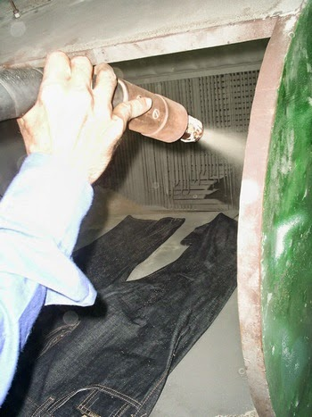
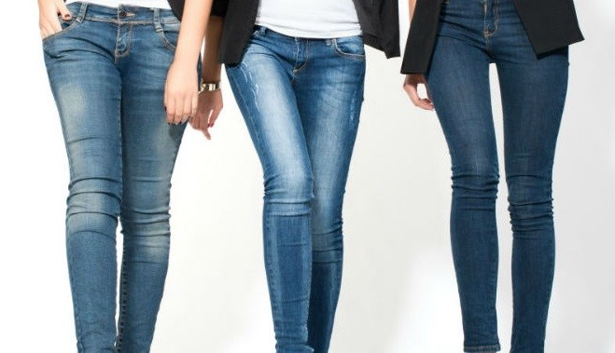
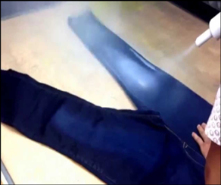

Slide 8
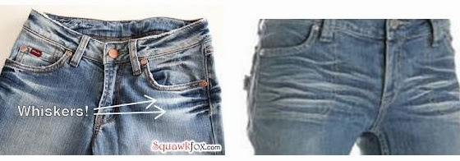
whisker
Is one of the most important designs of used look denim garments
The technique of artificially aging the look of denim

Slide 9
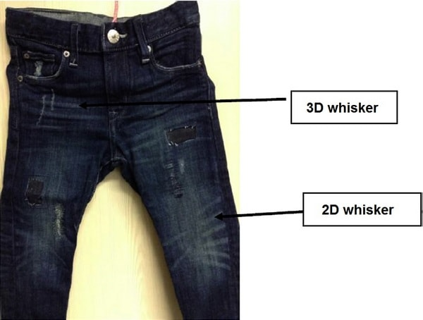
Types of whisker according to dimension
Two dimensional (2D)
Three dimensional (3D).

Slide 10
3D effects
The 3D whisker is an aesthetic 3D effect where resin (formaldehyde free) is used for achieving the 3D effect and a rigid look

Slide 11
Whisker types & process
By whiskering pattern
By Manual hand scrap.
By using laser Machine

Slide 12
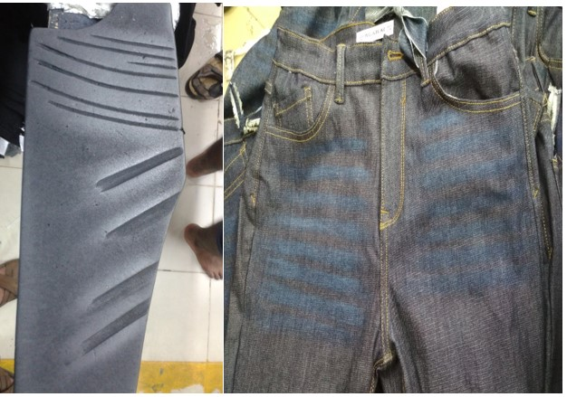
. By whiskering pattern
There is a pattern
According to the design
Abrasive paper is use to make the effect on the garments

Slide 13
. Manual Hand Scraping
Pattern
Emeri paper or abrasive paper
Chalk powder

Slide 14
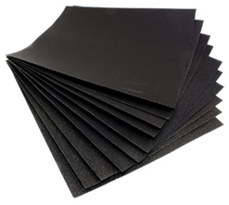
Abrasive paper grading:
P – 400 ( very rough surface for hard fabric )
P – 800 ( medium rough surface for medium hard fabric )
P – 1000 ( less rough surface for soft fabric )

Slide 15
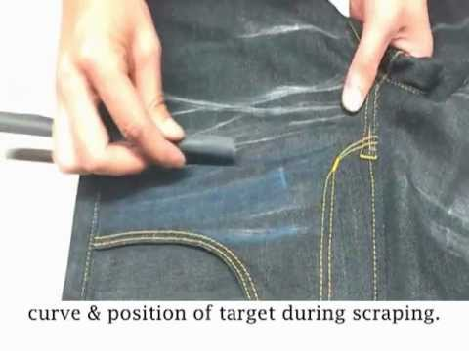
Manual Hand Scraping process
First the design is observed then draw the design with a chalk on the denim garments carefully
Scrape on the drawn line of the design by the abrasive paper thus the design is created.

Slide 16
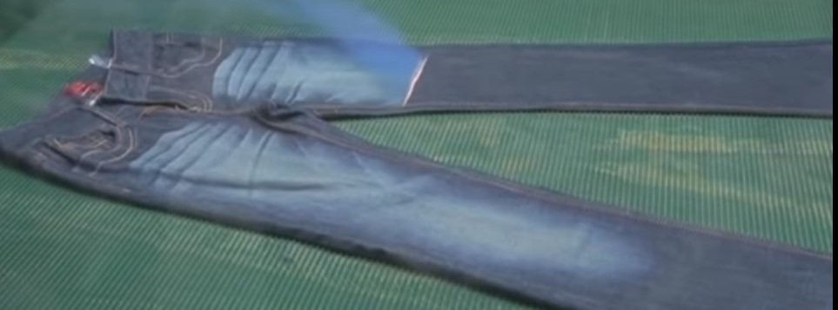
Using Laser Machine
First, the whiskering design is made by Photoshop or illustrator
Design is transferred to laser machine
The intensity of laser light is selected
Laser light is imposed on the denim garments to get the design
After the wash the burned indigo is removed and the whisker is visible

Slide 17
Type of whisker pattern
Wooden pattern
Rubber pattern

Slide 18
Step of making a whisker pattern
tracing paper on it which is transparent
draw the sketch
paper place it on the foam board
board cut it according to the whisker design that drawn previously on the paper.
scraping paper or silicon paper to make the desired shape on the pattern board

Slide 19
THANK YOU

