Slide 1
Standards
Something that is established by authority, custom or general consent as a model or example to be followed.
Something established for use as a rule or basis of comparison in measuring or judging capacity, quantity, content, extent, value, quality etc.
The type, model or example commonly or generally accepted adhered to; criterion set for usage or practice.
According to ISO, standards are documented agreements containing technical specifications or other precise criteria to be used consistently as rules, guidelines or definitions of characteristics to ensure that materials, products, processes and services are fit for their purpose.

Slide 2
Standards: Benefits
  Standards facilitate communication and prevent misunderstanding
  Standards make parts interchangeability possible and as a result mass production is possible
  Standards can be used in marketing strategy to promote purchase of products that meet nationally recognized requirements, especially, when conformance is backed by a certain program.
  Standards reduce cost and save money.

Slide 3
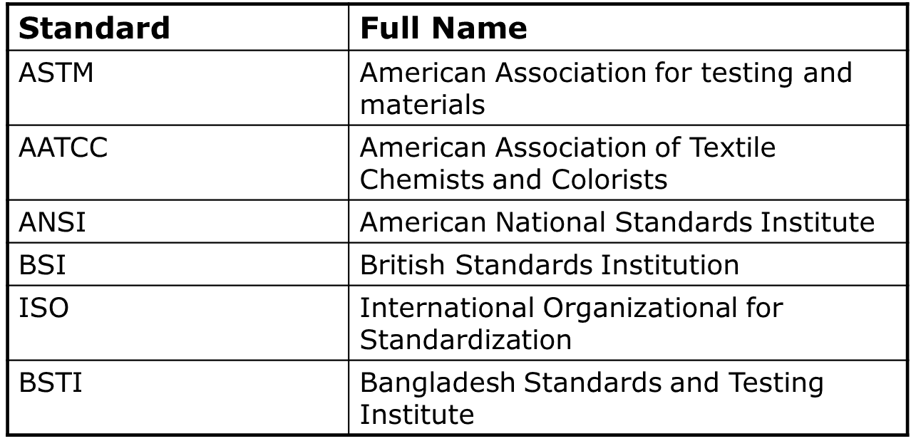
Standards
Sources of Standards:

Slide 4
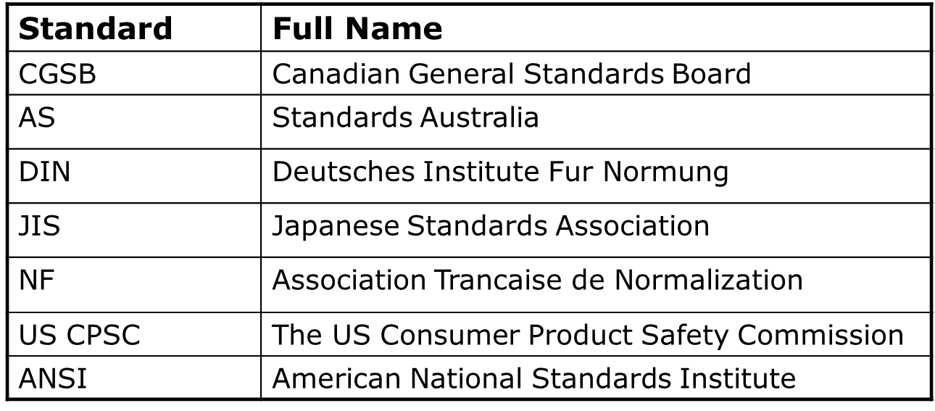
Standards
Sources of Standards:

Slide 5
Standards: ISO
  ISO is an independent, non-governmental international organization with a membership of 164 national standards bodies.
  Established in 1947 to promote development of standardization of related activities in the world.
  Mission is to facilitate the international exchange of goods and services and to develop cooperation in the sphere of intellectual, scientific, technological and economic activity
  ISO publishes various international agreements as international standards.
  ISO sets standards for many diversified field like information, textile, packaging, distribution of goods, energy production and utilization.

Slide 6
Management System Standards of ISO
ISO 9000: Quality Management System
ISO 14000: Environmental management systems
ISO 26000: Guidance on social responsibility
ISO 31000: Risk Management Principles and Guidelines

Slide 7
Standards: ISO 9000 Series - Quality Management
The ISO 9000 series is a sets of individual, but related, international standards on quality management and quality assurance. They are generic, not specific to any particular products. They can be used by manufacturing and service industries. They are:
ISO 9000: It is the first standard in the series and is entitled “Quality Management and Quality Assurance Standards-Guidelines for Selection and Use”.

Slide 8
ISO 9000 series
ISO 9001: Quality system model for quality assurance in design, development, production, Installation and servicing.
ISO 9002: Quality system model for quality assurance in production, Installation and servicing.
ISO 9003: Quality system model for quality assurance in final inspection and testing.
ISO 9004: Guidelines for quality management and quality system elements.

Slide 9
ISO14000 - International Environmental Standards
The ISO 14000 series, currently being developed by the International Organizational for Standardization (ISO), is a collection of voluntary standards that assists organizations to achieve environmental and financial gains through the implementation of effective environmental management.
The standards provide both a model for streamlining environmental management and guidelines to ensure environmental issues are considered within decision making practices

Slide 10
Standards: Environmental Management System (EMS)
An environmental Management System is a tool for managing the impacts of an Organization’s activities on the environment. It provides a structured approach to planning and implementing environment protection measures.
An EMS can be a powerful tool for organizations to improve their environmental performance and enhance their business efficiency.
An EMS is not prescriptive; rather it requires organizations to take an active role in examining their practices, and then determining how their impacts should be managed.
This approach encourages creative and relevant solutions from organization itself.

Slide 11
Benefits: EMS
Minimize environmental liabilities
Maximize the efficient use of resources
Reduce waste
Demonstrate a good corporate image
Build awareness of environmental concern among employees
Gain a better understanding of the environmental impacts of business activities
Increase profit, improving environmental performance through more efficient operations.

Slide 12
Standards: Steps towards ISO certification
Step-1. Management commitment
Step-2. Quality system requirement and quality policy manual
Step-3. Planning
Step-4. Training, Education and quality awareness.
Step-5. Implementation
Step-6. Auditing and Corrective action
Step-7. Certification.

Slide 13
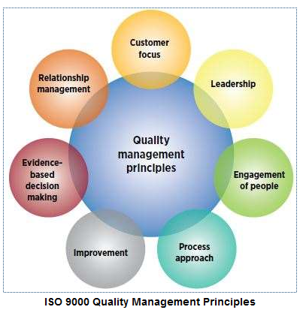
ISO: seven Quality Management Principles (QMPs)
ISO 9000, ISO 9001 and related ISO quality management standards are based on seven QMPs
QMP 1 – Customer focus
QMP 2 – Leadership
QMP 3 – Engagement of people
QMP 4 – Process approach
QMP 5 – Improvement
QMP 6 – Evidence-based decision making
QMP 7 – Relationship management

Slide 14
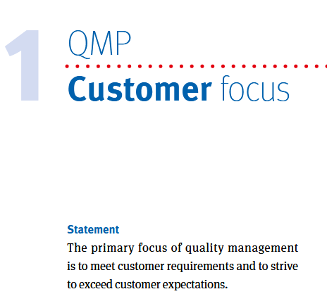
Statements on quality management principles:
QMP 1 – Customer focus

Slide 15
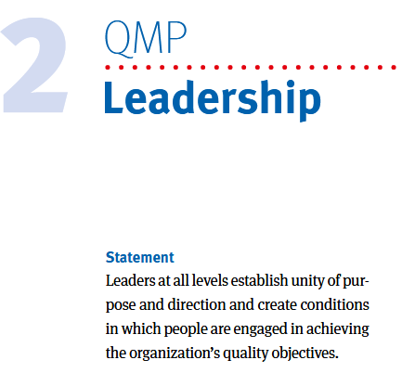
Statements on quality management principles
QMP 2 – Leadership

Slide 16
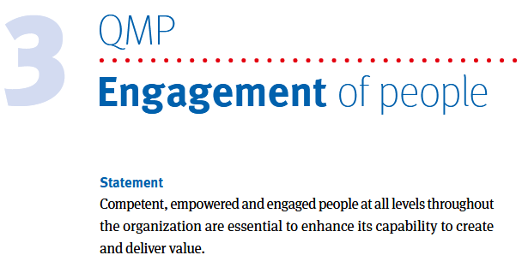
Statements on quality management principles
QMP 3 – Engagement of people

Slide 17
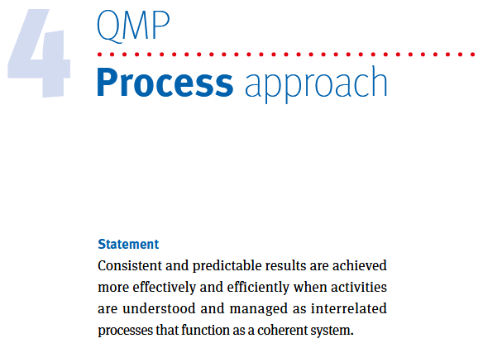
Statements on quality management principles
QMP 4 – Process approach

Slide 18
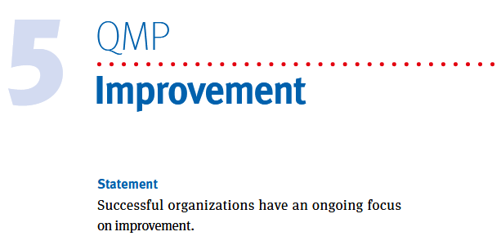
Statements on quality management principles
QMP 5 – Improvement

Slide 19
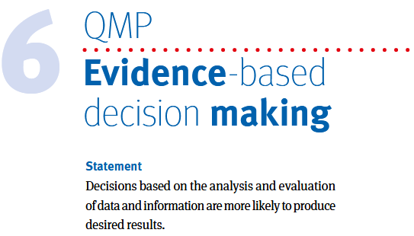
Statements on quality management principles
QMP 6 – Evidence-based decision making

Slide 20
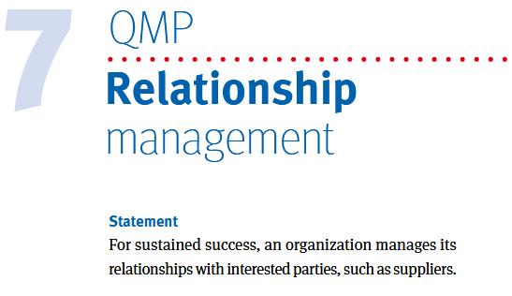
Statements on quality management principles
QMP 7 – Relationship management

