Slide 1
Quality Control
in
Yarn Manufacturing

Slide 2
Quality Assurance Steps in Spinning
▪ Setting of Norms
▪ Quality of incoming raw material
▪ Process Monitoring and Control
▪ Inspection of final product

Slide 3
Quality of incoming raw material
➢Test of raw cotton in terms of physical parameters
and accept if comparable with norms

Slide 4
Critical difference (CD)
Critical difference is a measure of the difference between two values that occur due to normal or unavoidable causes.
When the difference between two values exceed that of the critical difference, the two values are said to be statistically different.
Critical differences depends on:
i) CV%
ii) No of test.

Slide 5
Calculation of CD%
CD%(New)=CD% (table)√(N1/N2)
Here, N1=Number of test recommended in the table
N2= Number of test actually conducted
Table-1: No. of test and critical difference (%) for various fibre properties:
Fibre Property | No. of tests | CD(%)
2.5% span length | 4combs/sample | 4
Uniformity ratio | 4combs/sample | 5
Microniare value | 4plugs/sample | 6
Fibre strength | 10breaks/sample | 5
Trash content | 8 test/sample | 7

Slide 6
Calculation of CD%
Table-2: No. of test and critical difference (%) for various yarn properties:
Yarn Property | No. of tests | CD(%)
Lea count | 40 | 2
Strength | 40 | 4
Single yarn strength | 100 | 2.8
Evenness | 5 | 2.8

Slide 7
Problems
Problem-1. A mill wanted to purchase a cotton of 3.7 microns value to spin 50s count. The sample cotton received from a party was tested for micronaire and it was found to be 3.9 ( on the basis of 4 test).The mill is interested to know that whether the sample cotton conforms the mills requirements.
Problem-2. Mill C received 5 cotton samples from A & B. Their strength value were found to be 22 g/tex and 24 g/tex respectively (based on 5 tests). Which decision was taken by the mill?
Problem-3. Mill Z received yarn sample from gulshan spinning mill and karim spinning mill. Their strength was found 20 g/tex and 22 g/tex (Based on five tests). Which dicision will be taken by the mill?
SOLUTION

Slide 8
Quality of Fiber: Staple Length
Staple Length: The average length of a spinnable fiber is called Staple Length. Staple length is also most important fiber characteristics.
Rating on staple length
  Class Spun Length (mm)
  Extra long staple 33.0 and above
  Long staple 29.5 to 32.5
  Medium staple 25.0 to 29.0
  Short staple A 20.5 to 24.5
  Short staple B 20.0 and below

Slide 9
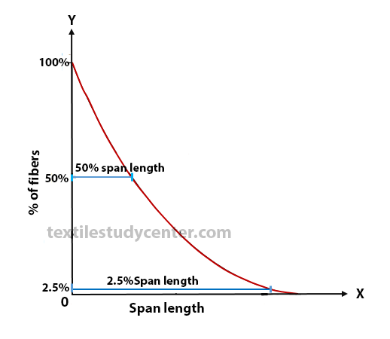
Quality of Fiber: Digital fibrograph

Slide 10
Quality of Fiber: Uniformity Ratio
2.5% spun length: 2.5% spun length is defined as the distance of 2.5% of the fibers extended from the clamp where they are caught at random along their length.
50% spun length: 50% spun length is defined as the distance of 50% of the fibers extended from the clamp where they are caught at random along their length.

Slide 11
Quality of Fiber: Uniformity Ratio
Definition
Rating
Uniformity ratio is defined as the ratio of 50% spun length to the 2.5% spun length expressed as a percentage
50% spun length
UR=-----------------------------------x100
2.5% spun length
This ratio is a measure of the length variability of the cotton.
Uniformity Ratio Grade
47 Good
45 Average
43 Poor

Slide 12
Quality of Fiber: Fiber Fineness
MIC : fiber weight in micrograms per inch. It indicates the maturity and fineness of fibers
Fiber fineness affects:
  Strength and irregularity of yarn
  Twist for maximum strength
  Drape and handling of fabric
Rating
MIC Description
Upto 3.1 Very fine
3.1-3.9 Fine
4.0-4.9 Medium
5.0-5.9 Slightly Coarse
6.0-above Coarse

Slide 13
Quality of Fiber: Fiber Strength
Fiber strength is measured by breaking the fibers held between clamp jaws. It’s reported as grams per tex, which is the force in grams required to break a bundle of fibers one tex unit in size. A tex unit is equal to the weight in grams of 1000 meters of fiber
Strength (g/tex) Description
Less than 21 Very weak
22-24 Weak
25-27 Medium
28-30 Strong
31-higher Very strong

Slide 14
Quality of fiber: Maturity coefficient (Mc)
The fiber maturity count is denoted by the percentages of the mature, half mature and immature fibers in a sample. It can be calculated using the formula,
Mc = (N + 0.6H + 0.4I)/100
where N - percentage of mature fibers.
H - Percentage half mature fibers
I - Percentage of immature fibers
For the chosen standard, N = 67% D or I = 7% and H = 26%.
So, Mc = ( 67 + 0.6(26) + 0.4(7) )/100 = 0.854

Slide 15
Quality of fiber: Maturity coefficient (Mc)
Based on the maturity coefficient, the cottons are classed into different groups as shown below:
Maturity Coefficient Rating
Below 0.60 Very Immature
0.60 to 0.70 Immature
0.71 to 0.80 Average Maturity
0.81-0.85 Good Maturity

Slide 16
Fibre Quality Index (FQI)
Different fiber characteristics are synthesized into a single index called Fiber quality index (FQI)
FQI = L * U *S / F
    Where, L= 50% spun length in mm
    S= Fiber bundle strength expressed in gm/tex
    F= fiber fineness (micronaire value)
    U= Uniformity Ratio

Slide 17
Calculation of FQI
Properties of a cotton is as follow
    50% Span length = 28 mm
    Uniformity Ratio = 0.47
    Micronaire value = 4.3
    Strength (gm/tex) = 22.5
  Find out the FQI of that cotton
L*U*S 28*0.47*22.5
FQI=-------------------- = --------------------------------= 296.1/4.3=68.86
F 4.3

Slide 18
Relation between CSP and FQI
MATHEMATICAL PROBLEMS WITH SOLUTION

Slide 19
Sliver, Roving and yarn faults
Coefficient of Variation CV%: The coefficient of variation CV is a well known value for the determination of the evenness of slivers, rovings and yarns.
• The Coefficient of Variation (CV) is the standard Deviation (SD) expressed as a percentage of the mean
CV % = (SD ÷ mean) x 100
• Each process in a spinning mill contributes a part to the evenness.

Slide 20
Yarn Faults
The undesirable and sometimes unavoidable defects that are found in yarn are known as yarn fault. It is impossible to produce fault-free yarn. So the spinners try to produce yarn with considerable limit of fault.
Faults found in yarn are:
Count variation
Unevenness & irregularity
Thick thin place and neps (Imperfection Index – IPI of yarn)
Hairiness
Lot mixing
Dead Fiber

Slide 21
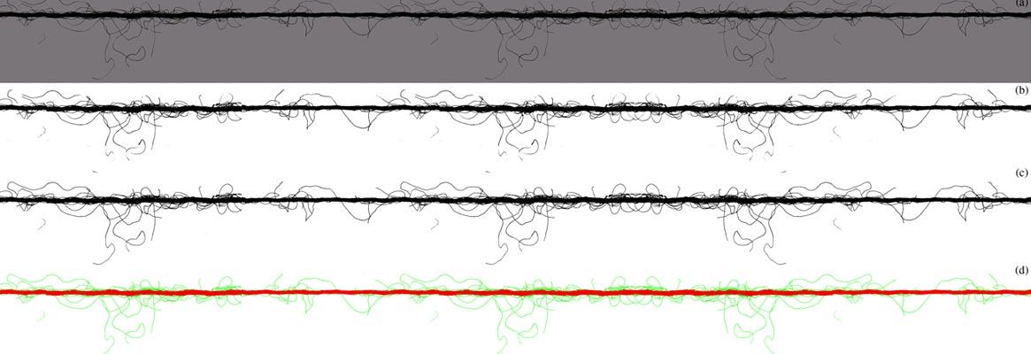
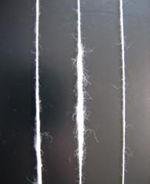
Types of Yarn Fault
Count variation: According to the textile institute, “ Count is the mathematical expression of fineness which expresses the length per unit weight of weight per unit length”. Practically ± 3 count variation is acceptable. Count can be measured by wrap reel and balance or using count measuring software (CMS).
Unevenness or irregularity: It is the mass variation per unit length. Cut length is taken generally 1cm. This fault is expressed as U% or CV%. Evenness tester is used to measure unevenness.

Slide 22

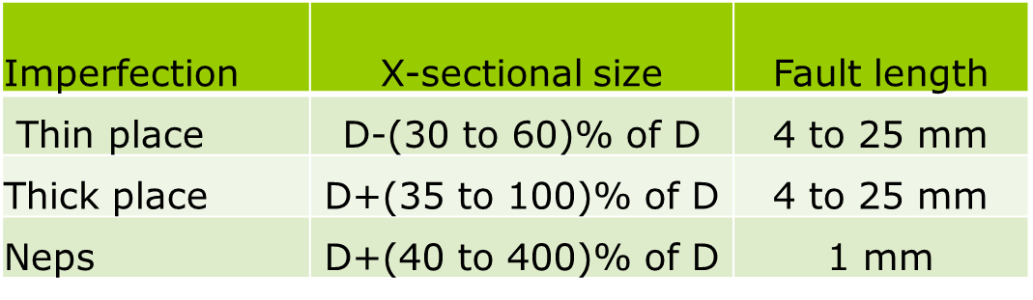
Types of Yarn Faults
Thick-thin paces and neps (IPI): These faults occur in yarn 10-5000 times per 1000m of yarn. Yarn spun from staple fibres contains ‘imperfection’ which can be subdivided into three groups. These three faults are normally measured in no. of faults per 1 km. These types of faults are determined during evenness testing with imperfection indicator.
Here, D= Dia of normal yarn

Slide 23
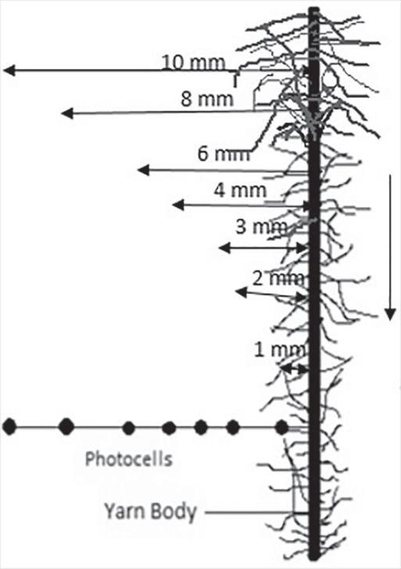
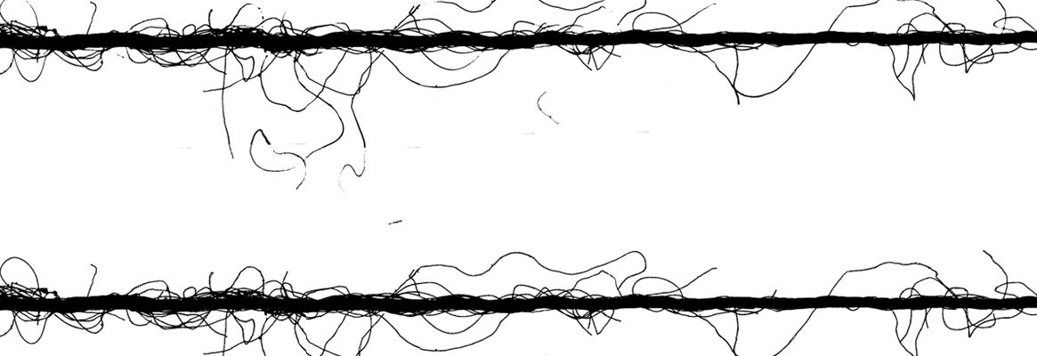
Types of Yarn Faults
Hairiness: Hairiness means the protruding fibres on yarn surface. It is the ratio of the total length of hair in any unit to the length observed in same unit. Generally it is measured as the ratio of total length of protruding fibres (in cm) per cm of yarn. The hairiness value is the ratio of two lengths; so it has no unit.
Lot mixing: Sometimes two lots can be mixed at the stage of sliver, roving, bobbin, cone and cartoon in spinning mill, as well as in the preparatory section weaving and knitting mill. This type of mixing causes several problems in subsequent process.

Slide 24
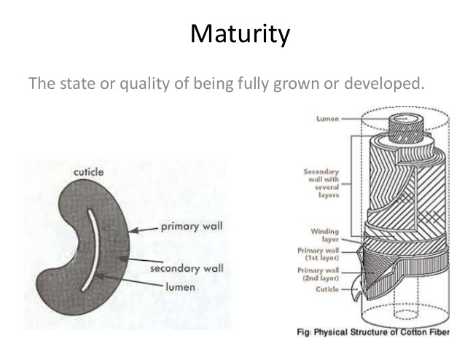
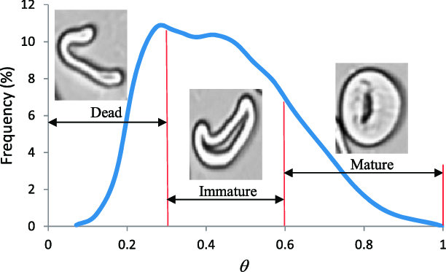
Types of Yarn Faults
Dead Fiber: Presence of dead fiber is a great problem for end users as dead fibers are not capable to absorb dyes, So they remain undyed/white after dyeing.

Slide 25
Causes of imperfection
Causes of thick & thin places:
      Short fibre content
      Improper draft
      Poor efficiency of carding & combing
      Twist variation
Causes of Neps:
      Immature fibre
      Improper ginning
      Improper carding speed & card setting
      Less efficiency of card
      Improper drafting speed

Slide 26
Factors Affecting Yarn Strength
1) Quality of Mixing:
Fibre Properties: Better length, strength & fineness of fibre gives better yarn strength.
Mixing Ratio: Proper mixing leads to higher & uniform yarn strength.
2) Quality of carding:
Mechanical condition of all carding surface
Waste control in carding action
Proper maintenance

Slide 27
Factors Affecting Yarn Strength
3) Quality of comber:
Level of comber waste.
Mechanical condition of comber.
4) Quality of drafting at ring frame:
Mechanical condition of the drafting system.
Total draft.
Break draft.
Types of drafting system

Slide 28
Factors Affecting Yarn Strength
5) Quality of twisting at ring frame:
Amount of appropriate twist.
Level of twist
Uniformity of twist
6) Other processing factor:
Atmospheric condition
Static electricity
Direction of feeding of fibre hooks.

Slide 29
Fibre testing equipment
Quality of the fibre is maintained through different lab test in the spinning. These are-
HVI (High Volume Instrument):
For fineness, color, trash, length & strength measurement.
AFIS (Advanced Fiber Information System): Sample weight taken for this test is 5 gm. Then this sample cotton is rolled up to 31 cm then it is inserted to the machine.
For neps, size of neps, fibre length, short fibre content, fineness, immature fibre content, no. and size of trash measurement.
Shirley Analyser: For trash content measurement.
In this testing the trash content (seeds, particles, leaves etc) in the fiber is measured.
Nep counter: For fibre length, neps, short fibre measurement.
Moisture Regain tester: For MR% testing.

Slide 30
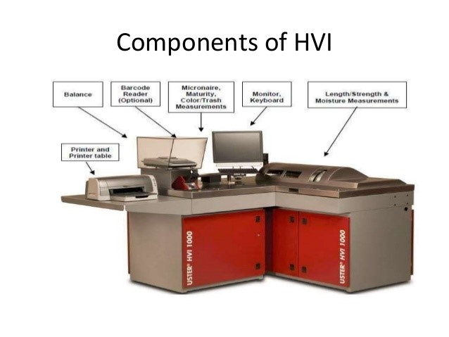
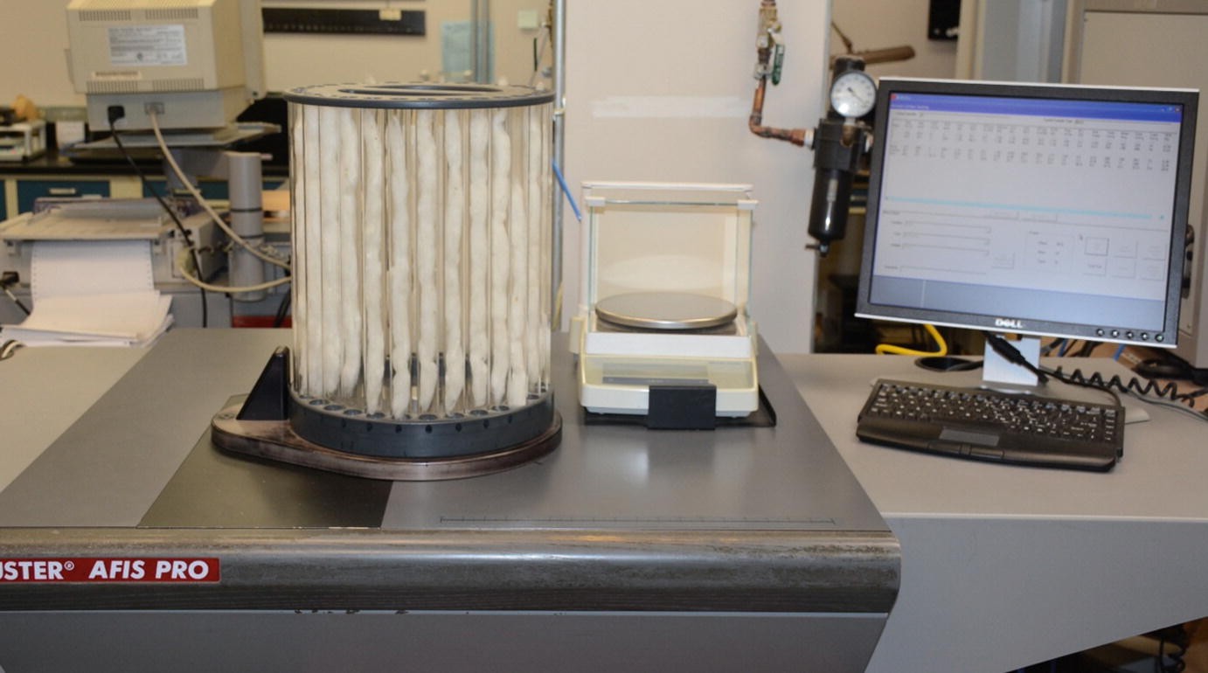
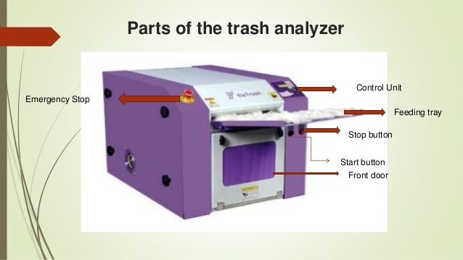
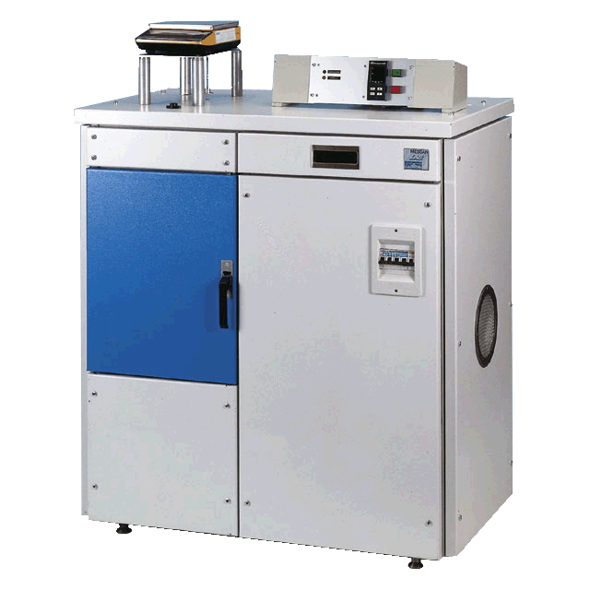

Slide 31
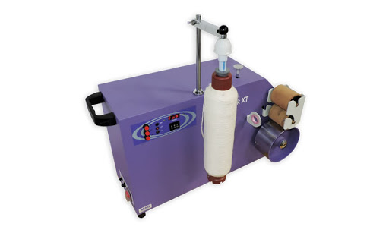
Lap, Sliver & Roving testing equipment
Lap length counter.
Balance, Scale, Wrap block: For testing sliver & roving.
Nep counting board.
Auto sorter: For sliver count testing.
Evenness tester.

Slide 32
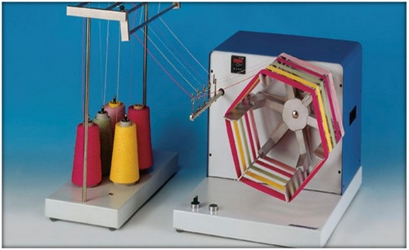
Yarn testing equipment
Wrap reel and balance: Yarn count testing
Auto sorter: For count & CV% analysis
Evenness tester: Yarn imperfection, U%, hairiness etc.
Uster classimate: Yarn fault analysis.
Yarn tension meter
Twist tester
Yarn strength tester
Software:
Bale Inventory and Analysis Software (BIAS): For bale management
CDS: For Automatic count measuring

Slide 33
