Slide 1
Quality Control
in
Fabric Manufacturing

Slide 2
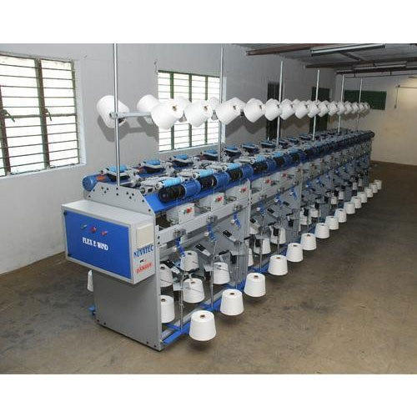
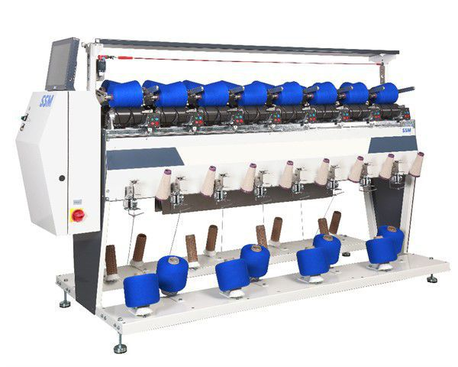
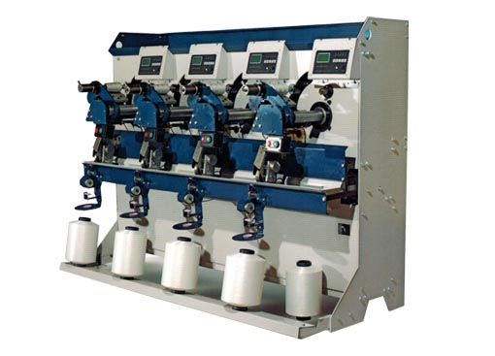
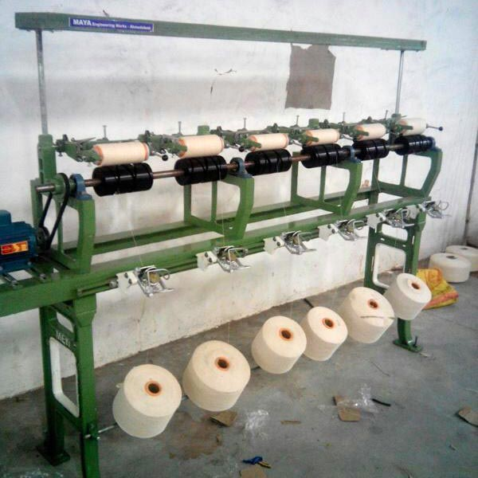
WINDING

Slide 3
Points to be maintained for quality winding
Appropriate winding tension
Free from different count mixing
Winding machine should be free from mechanical fault (Exap-Free from defective traversing motion, fault free yarn guide)
The knots & splices must have sufficient strength and stability.
Winding should be carried out at high speed in order to get high productivity. At high speed less time & auto coner will be required.

Slide 4
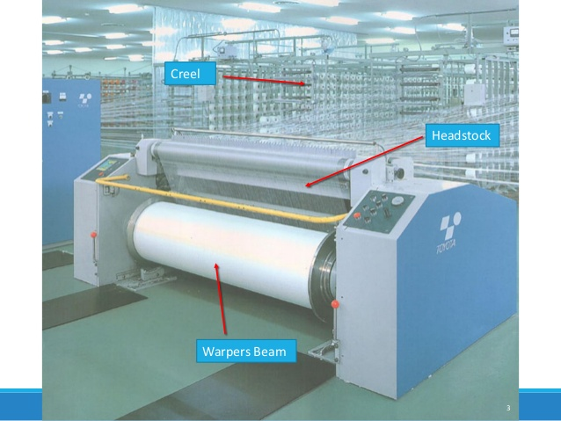
WARPING

Slide 5
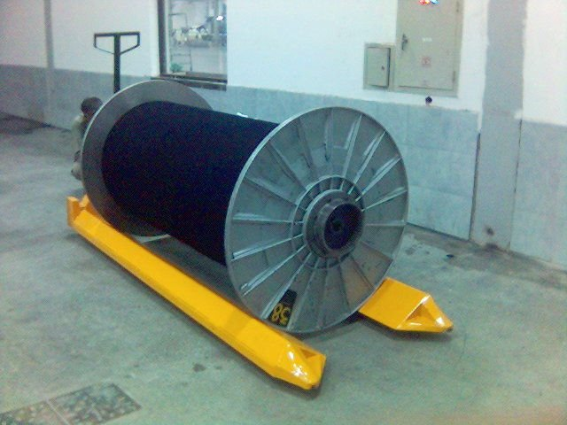
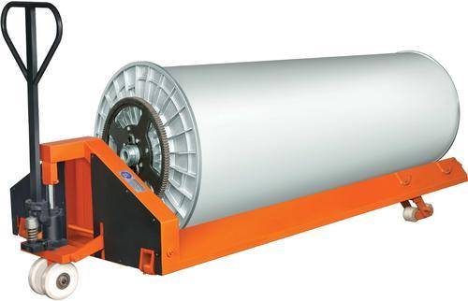
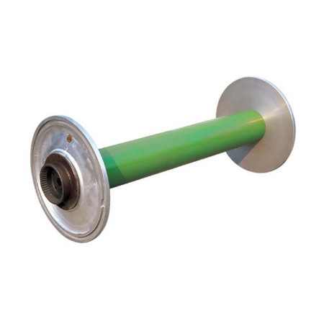
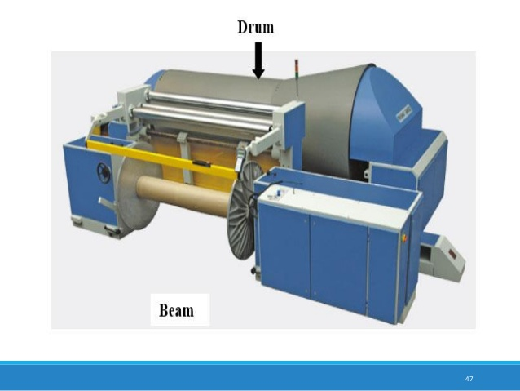

Slide 6
Factors affecting the quality of warping
Condition of the beam flange:
Problem: If the beam flange get damaged then unwinding at the two edges will not be satisfactory. There will also be problem in sizing and weaving. Beam flange get damaged due to improper handling and improper storage.
Solution: Empty bobbin should be checked on a regular basis and repairment should be done on a regular basis.
Stop motion:
Problem: Stop motion should be capable of stopping the machine immediately after any end break. Sometimes flying dust and tufts gets stuck in the stop motion so that the machine does not stop even after any end break.
Solution: Creel fans should work properly.
Beam barrel diameter: Smaller dia gives high unwinding tension during sizing, though it can accommodate more yarns.

Slide 7
Continued…
Condition of the driving drum: Driving drum is used to drive the warp beam by means of frictional force. In case of modern machines the warp beam is driven directly, however a drum is used to stop the rotating beam instantly. Any roughness of the drum is therefore dangerous for the safety of the yarn.
Length measuring motion: This device should work properly. Miss representation of the actual length may cause unnecessary wastage or shortage of yarn. The size% calculated from the length of the yarn. So a wrong length measuring will lead to incorrect estimation of the size%.
Density of the beam: In order to obtain satisfactory result the warp beam must be sufficiently compacted. The compactness should not be achieved by means of yarn tension rather it has to be achieved by means of creating pressure by drum.

Slide 8
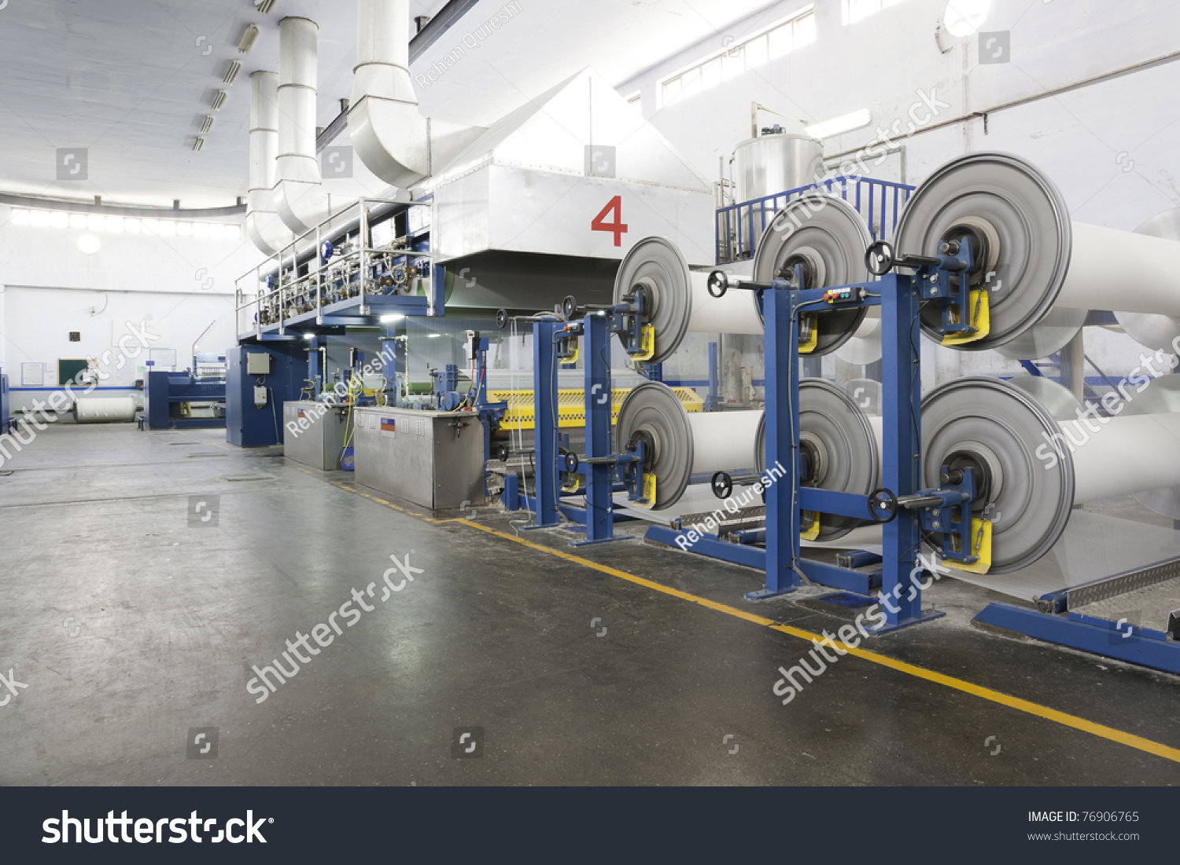
Factors influencing size pick up %/Sizing
Viscosity of the size paste in the size box
Squeezing pressure & condition of squeezing nip.
Yarn tension
Yarn twist
Speed of the sizing machine
Duration of immersion in the size paste
Level of size paste
Density of the warp
Dia of the yarns

Slide 9
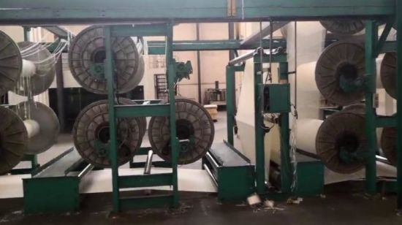
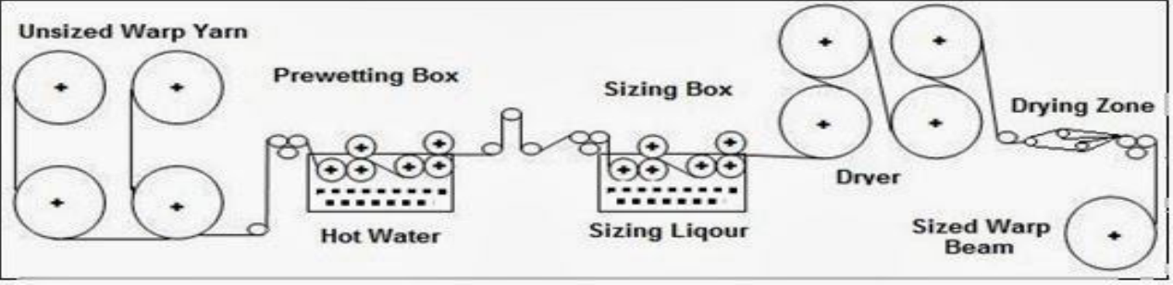
Factors influencing drying efficiency
Speed of sizing
No of ends in warp sheet (density)
Pick up % of size to be applied
Linear density of warp
Box concentration
Temperature of the drying cylinder
Area of contact around the cylinder

Slide 10
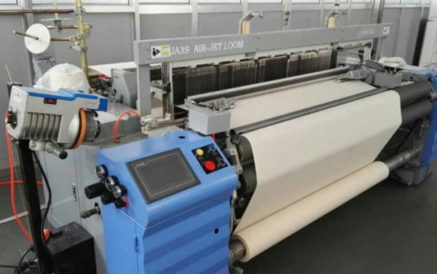
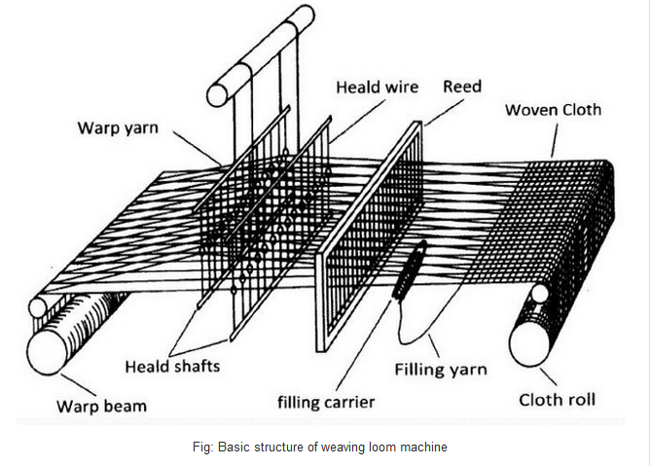
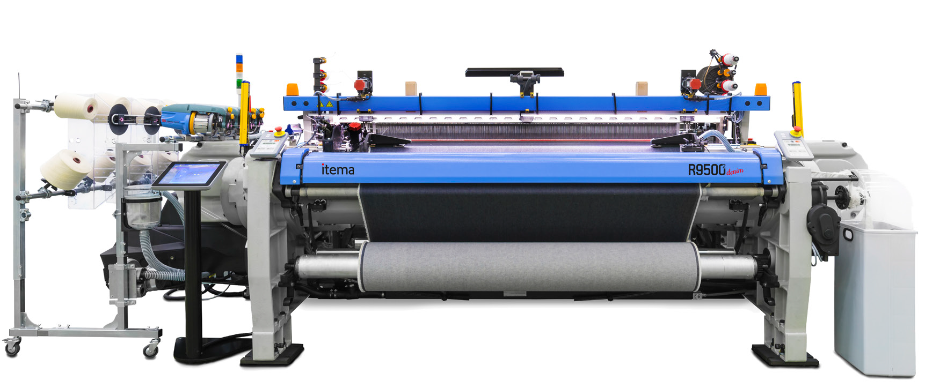
Weaving Loom

Slide 11
Defects in Grey Fabric: Woven
Hole 11. Double Pick
Broken End/warp 12. Bar(s)
Broken Picks/weft 13. Ball
Loose Warp 14. Oil Spot
Loose Weft 15. Tails Out
Double End 16. Slub
Tight End 17. Reed Mark
Float of Warp 18. Damaged Selvedge
Foreign Yarn
Miss Pick

Slide 12
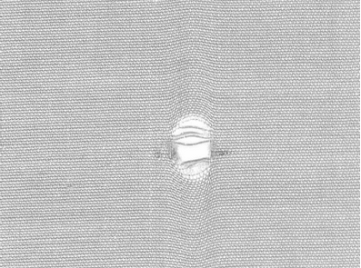
Woven Fabric Faults: Hole
A fabric imperfection in which one or several yarns are sufficiently damaged to create an opening

Slide 13
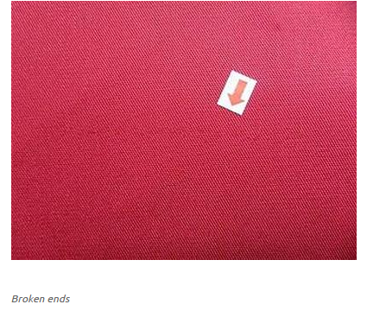
Woven Fabric Faults: Broken ends/warp
A defect in the woven fabrics caused by a warp yarn that was broken during weaving

Slide 14
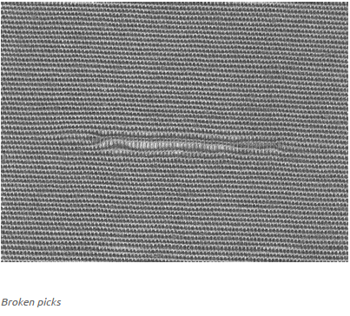
Woven Fabric Faults: Broken picks/weft
A filling yarn that is broken in the weaving of fabric

Slide 15
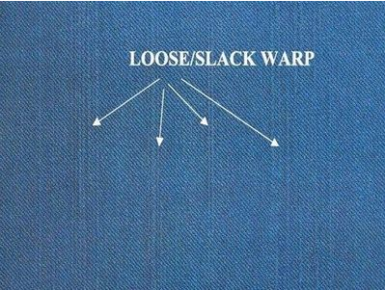
Woven Fabric Faults: Loose Warp
This type of fault is produced in woven fabrics when the tension of warp yarn is low

Slide 16
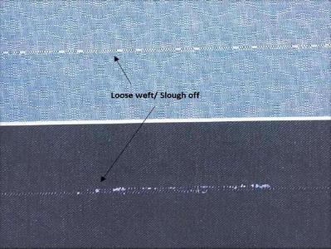
Woven Fabric Faults: Loose Weft or Snarl
It is produced in woven fabrics due to the looseness of filling yarn
        Loose Weft or Snarl

Slide 17
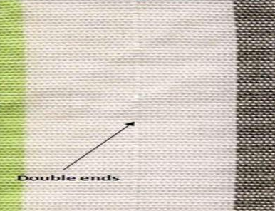
Woven Fabric Faults: Double End
This kind of fault is produced in woven fabrics when the two ends of warp sticks together after sizing
Double End

Slide 18
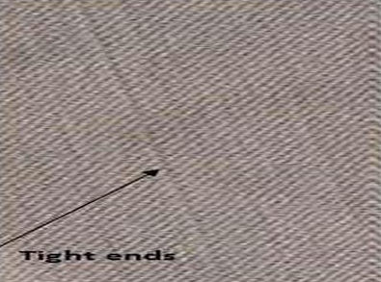
Woven Fabric Faults: Tight End
If the tension of warp yarn is more than the other ends present in the loom then this type of fault is produced in woven fabrics
Tight End

Slide 19
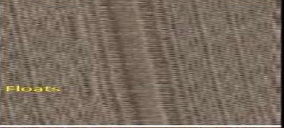
Woven Fabric Faults: Float of Warp
If cloth roller is pulled off intentionally or unintentionally then this kind of defect is produced in woven fabrics
Float of Warp

Slide 20
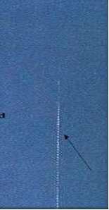
Woven Fabric Faults: Foreign Yarn
It is produced in woven fabric due to the wrong drawing of colored yarn
Foreign Yarn

Slide 21
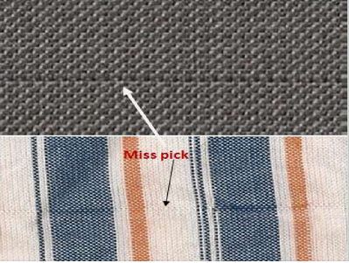
Woven Fabric Faults: Miss Pick
This kind of defect is produced in woven fabric when operator starts a stopped machine without picking the broken weft from the shade
Miss Pick

Slide 22
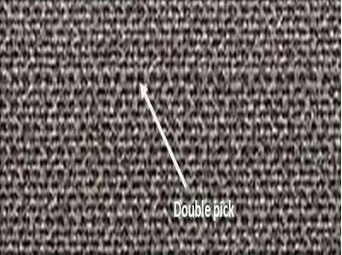
Woven Fabric Faults: Double Pick
It is produced in woven fabric when the two weft yarn stay together
Double Pick

Slide 23
Woven Fabric Faults: Bar
Bar: It is a band running across the full width of cloth due to difference in appearance from its adjacent surface. This term covers a number of specific defect as below:
  Pick bar: A bar due to difference in pick spacing. The causes of pick bars are faulty gearing in take-up motion.
  Starting mark: An isolated narrow marks along the pick. It is occurred due to restart of weaving after- a) Unweaving or Pulling back b) Prolonged loom stoppage.
  Tension bar/Shiner: A bar due to difference in weft tension.
  Weft bar: A bar due to difference in count, twist, luster, color or shade of adjacent groups of weft yarns

Slide 24
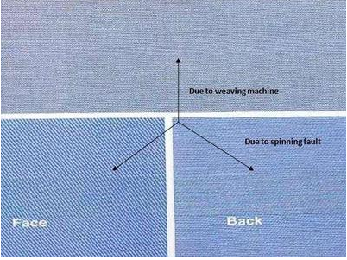
Woven Fabric Faults: Bar
Bar

Slide 25
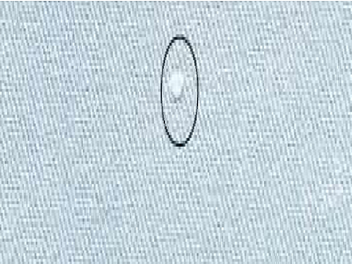
Woven Fabric Faults: Ball
If the warp is too much hairy then the reed will create ball in warp yarn in between reed and heald shaft. If the ball is small enough to pass through the dent of reed then those will form the ball in fabric
Ball

Slide 26
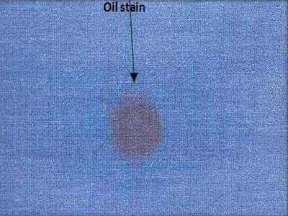
Woven Fabric Faults: Oils Spot
Discoloration on a local area of a substrate that may be resistant to remove by laundering. It may occur during spinning, weaving or finishing. It is also produced in woven fabric if too much oiling is done on the different parts of the loom
Oil Spot

Slide 27
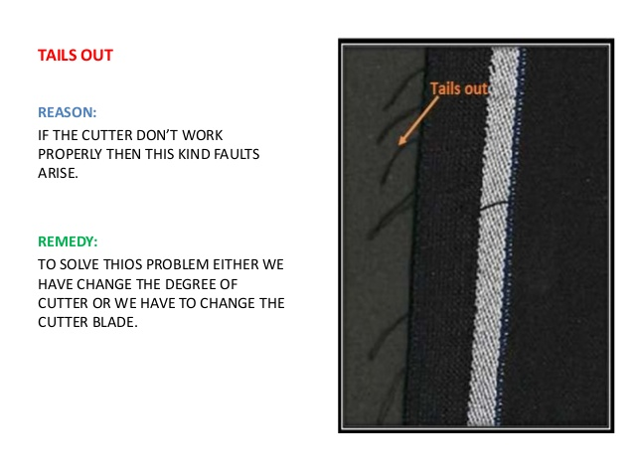
Woven Fabric Faults: Tails Out

Slide 28
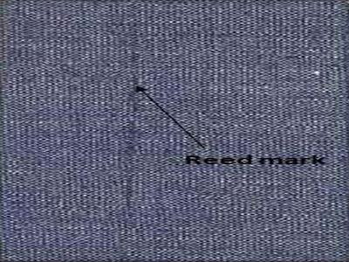
Woven Fabric Faults: Reed Mark
In woven fabric, a crack between the groups of warp ends either continuous or at intervals. It’s may be caused by the wrong drawing-in of the warp or damage to the reed wires.
Reed Mark

Slide 29
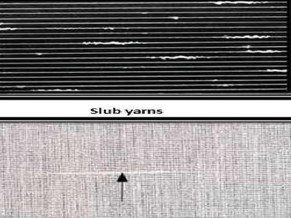
Woven Fabric Faults: Slub
If the yarn contains unexpected slub in it then those slub will be appeared in the fabric as a fault
Slub in fabric

Slide 30
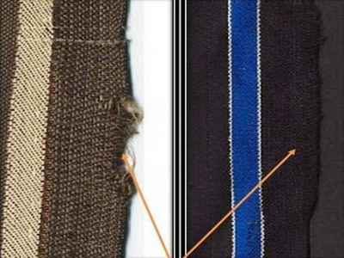
Woven Fabric Faults: Damaged Selvedge
Warp ends being set too far apart for the thickness of the yarn or in finished fabric.
Damaged Selvedge

Slide 31
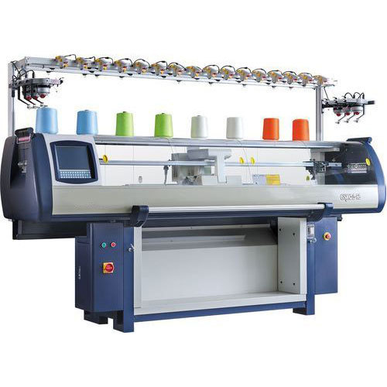
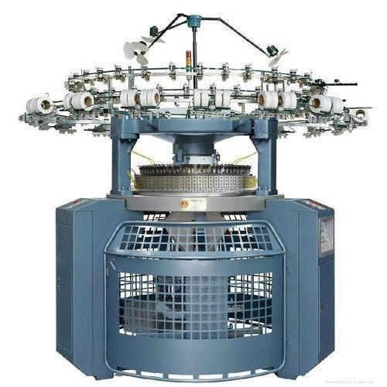
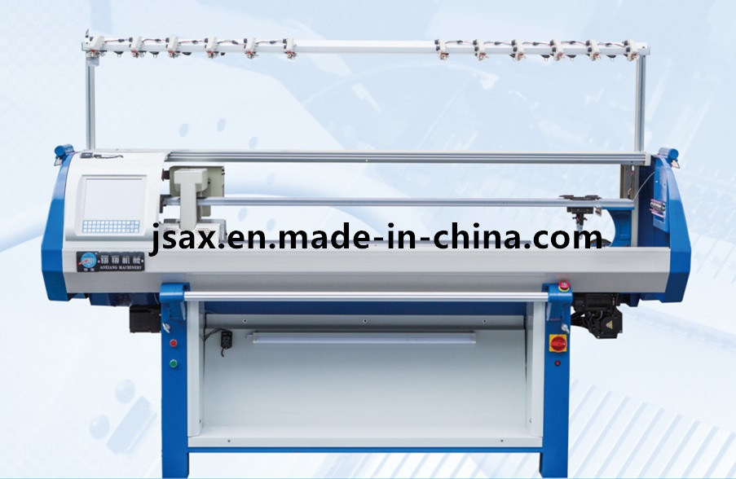
KNITTING

Slide 32
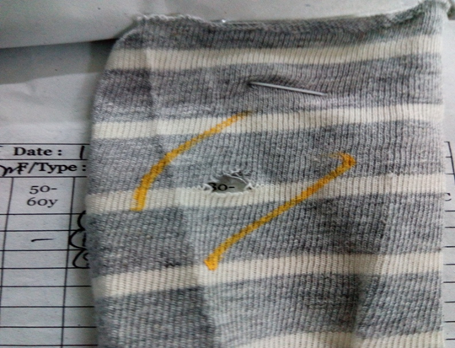
Hole: Holes of the same or different size which appear as defects in the Knitted fabrics.
Faults in Knit Grey fabric
Causes:
  High Yarn Tension
  Yarn Overfeed or Underfeed
  High Fabric Take Down
  Presence of defects like Slubs, and Knots etc.
Remedies:
  Ensure uniform yarn tension on all the feeders with a Tension Meter.
  Rate of yarn feed should be strictly regulated as per the required Stitch Length.
  The fabric tube should be just like a fully inflated balloon, not too tight or too slack.
  The yarn being used should have no imperfections like; Slubs, Naps & big knots etc.

Slide 33
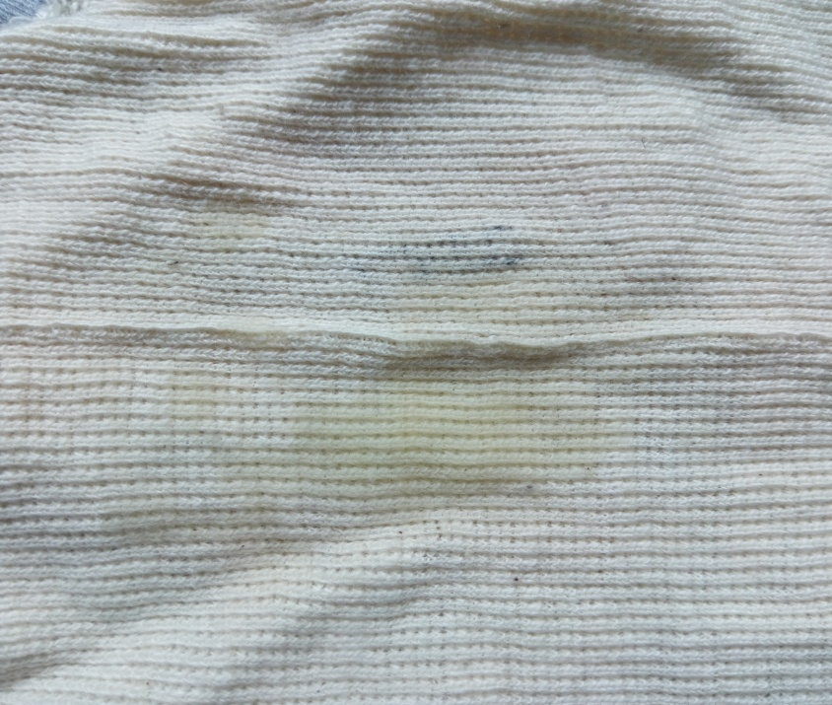
Oil spot:
Causes:
  Excessive oiling of the needle beds.
  Grease or oil stains from the unguarded moving machine part.
  Fabric touching the floors & other soiled places during transportation in the trolleys.
Remedies:
  Clean the grooves of the Cylinder & Dial of the machine thoroughly with petrol.
  Blow the grooves of the Cylinder Dial & Sinker ring with dry air after cleaning.
When lubricant or oil from knitting machine attached with the grey fabric it creates a spot on it and that is called oil spot.

Slide 34
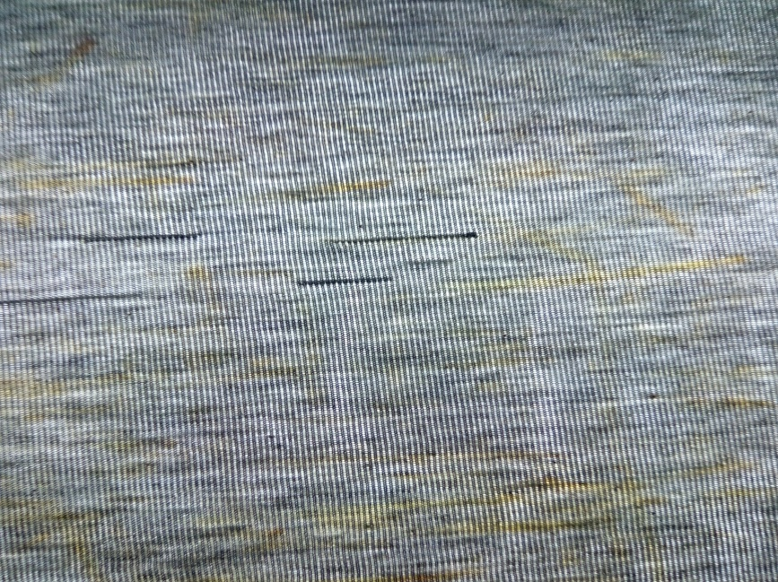
Fly:
Causes:
In knitting section too much lint is flying to and fro that are created from yarn due to low twist as well as yarn friction. This lint may adhere or attaches to the fabric surface tightly during knit fabric production.
Remedies:
Blowing air for cleaning and different parts after a certain period of time.
By cleaning the floor continuously.
By using ducting system for cleaning too much lint in the floor.
This fault is occur when the flying or projecting yarn get mixed with the yarn during knitting

Slide 35
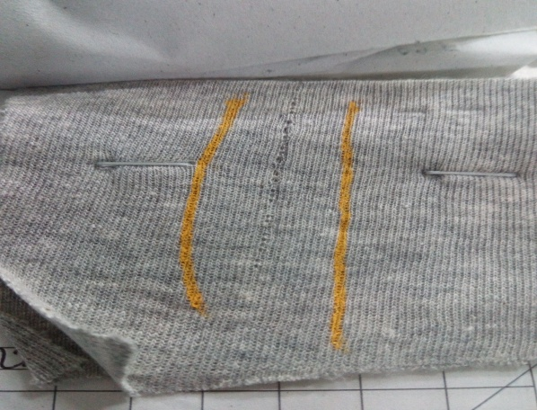
Needle Mark:
Causes:
High Yarn Tension
Bad Setting of the Yarn Feeders
Old & Worn out Needle set
Cylinder Grooves are too tight restricting needle movement
Breakage of hook or butt in needle.
Remedies:
Ensure uniform & the right Yarn tension on all the feeders.
Keep the recommended gap between the Yarn Feeders & the Needles.
Periodically change the complete set of needles.
Remove fly or blockage from groove.
Replace defective needle.
Defects caused by the broken needles show prominently as vertical lines parallel to the Wales. There are no loops formed in the Wale which has a broken needle

Slide 36
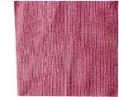
Pin Holes:
Causes:
  Due to break down or bend of latch, pin hole may come in the fabric
Remedies:
  Change the needle.
Tiny holes appears in the grey knit fabric is called pin holes

Slide 37
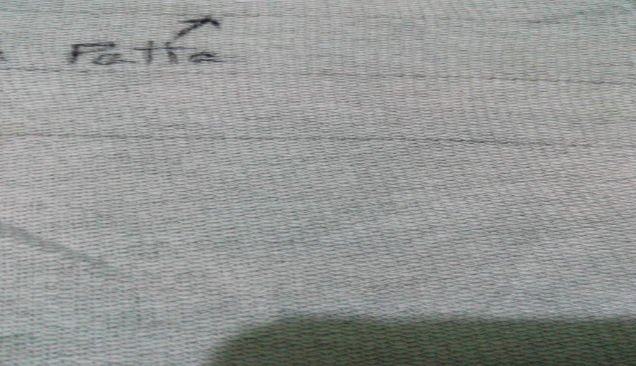
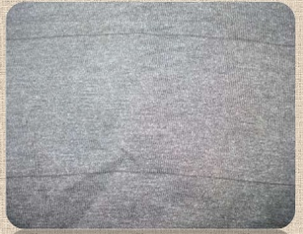
Barre/Patta:
Causes:
  Lot mixing of yarn
  Variation in package hardness
  Improper yarn tension
  Uneven dyed yarn
Remedies:
1. Flawless yarn
2. Proper machine setting
Thick or thin places visible in grey fabric in certain distance is called Barre or Patta.

Slide 38

Lycra out: This fault is occurred if the machine is not immediately after the breakage of lycra during production.
  Causes:
  Careless supervision
  Faulty auto stop motion
  Remedies:
  Proper maintenance of the knitting machine
  Conscious worker

Slide 39
Crease mark:
Crease mark is caused by-
  Yarn tension variation
  Lower GSM of fabric
  Faulty fabric take-up
Drop stitch:
Drop stitches are caused by-
  Defective needles
  Wrong setting of yarn feeder.
  Bad take up.
Sinker mark:
Sinker mark is caused by the defective sinker.

Slide 40
Faults in Knit Finished fabric
Oil Spot:
Causes:
Remedies:
Lubricant oil utilized in machine parts.
Unclean parts utilized.
Open hand dust.
Natural dust.
Should be utilized deformity free machine.
Lubricating ought to be utilized property.
Operator must be spotless and utilize hand gloves.
Proper support of machine.
Proper cleaning of machine.

