Slide 1
Quality Control
in
Wet Processing

Slide 2
Properties of raw materials for dyeing
Raw materials | Desired Properties
Grey Fabric | Free from stains Free from foreign matters and contamination Free from manufacturing defects
Cloth for dyeing | Good absorbing capacity Free from impurities Even whiteness Smooth surface
Dyestuff | Sufficient strength of required quality Good fastness properties Availability of data and shade card

Slide 3
Properties of raw materials for dyeing
Raw materials | Desired Properties
Chemicals and auxiliaries | Required purity Required strength and concentration Good efficiency Compatibility
Water | Softness, free from iron and metal salts Neutral pH Required ppm of water ingredients (TDS<300)

Slide 4
Qualities of dye house water
Standard | Permissible Concentration
Color | Colorless
Smell | Odorless
pH Value | Neutral (pH=7)
Water hardness | ‹ 5 degree dH
Dissolve solid | ‹ 1 mg/L
Solid deposit | ‹ 50 mg/L

Slide 5
Qualities of dye house water
Standard | Permissible Concentration
Organic Substance | ‹ 20 mg/L
Organic Salts | ‹ 500 mg/L
Iron | ‹ 0.1 mg/L
Copper | ‹ 0.005 mg/L
Nitrate | ‹ 50 mg/L
Nitrite | ‹ 5 mg/L

Slide 6
Estimation of Pre-Treatments: Scouring Effect
Estimation of Scouring:
1. Determination of weight loss%
2. Absorbency Test
          Immersion Test
          Drop Test/Spot Test
          Wicking Test

Slide 7
Estimation of Scouring Effect
1) Determination of weight loss%: The weight of un-scoured and scoured sample is taken at same MR% and from these figures weight loss% can be calculated from the following formula:
Weight before scouring – Weight after scouring
Weight loss%=………………………………………………………………………………………………………x100
Weight before scouring
The standard weight loss is (4-8)%
If it is 8% then we may say that the sample is well scoured, but if it is more than 8% then it is not acceptable as it indicates that the fibre damage has been taken place.
If it is less than 4%, it shows that the sample is not well scoured and there are some impurities still present in the sample.

Slide 8
Estimation of Scouring Effect
2) Absorbency test: 3 types-
Immersion test
Drop test/ Spot test
Wicking test
a. Immersion test: A sample is more absorbent when it is scoured. 1 cm×1 cm sample is placed on a water surface and time taken by it to be immersed is noted. The standard time is 5 second. It is up to 10 second. If it is greater than 10 second then it indicates that the scouring has not taken place properly.

Slide 9
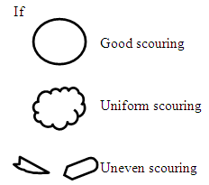
Estimation of Scouring Effect
b. Drop/Spot test: Colored solution of 0.1% direct dye (Red) is used. The solution is dropped on to the sample by pippet from 1-2 inch above and its absorbency is examined visually. The drop may have the following shapes:
Two things can be measured:
* The time taken in second to absorb one drop of solution is measured. Standard time is (0.5-0.8) sec; upto 1 sec is allowed.
* If the drop is circularly absorbed then we may say that the sample is uniformly scoured. If the drop is circular but has small area then the sample is uniformly scoured but not well scoured. If it is almost circular then it is uniformly scoured too. If not circular then it is not uniformly scoured.

Slide 10
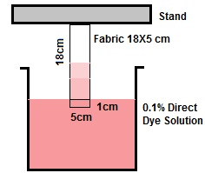
Estimation of Scouring Effect
C. Wicking test: A sample of 5 cm x 18 cm is taken and a mark is made at 1 cm from bottom. Then 1cm portion is immersed into 1% direct dye solution for 5 minutes and then the distance traveled by the colored solution above 1cm mark is noted. The acceptable range is (30-50) mm.
Fig: Wicking test

Slide 11
Estimation of Bleaching Effect
Measurement of reflectance by Leucometer:
The light reflectance capacity of a bleached fabric is higher than of unbleached fabric. Standard bleached fabric has a reflectance of (84-86)%. The reflectance can be sometimes increased to (90-95)%. But it is very risky and such high bleaching can be done in kier boiling and in a very high temperature of about (110-120) °C. Such high percentage of reflectance may be accompanied by strength loss.
It may be done by Computer Colour Matching System (CCMS), Reflectance (R%) from a mixture of Dyes or Pigments.
Whiteness/Leucometer Meter
Data color

Slide 12
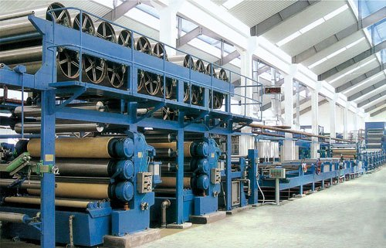
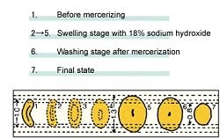
Estimation of Mercerizing Effect
Determination of Barium Activity Number (BAN):
This is the most effective test. Barium Activity Number is defined as the ration of the amount of Ba(OH)2 absorbed by mercerized sample to the amount of Ba(OH)2 absorbed by same amount of un-mercerized sample expressed as a percentage.
BAN=(Ba(OH)2 absorbed by mercerized sample/Ba(OH)2 absorbed by same amount of un-mercerized sample ) x 100
If the mercerization happens the result will be greater than 100 (usually 115-135 is acceptable).
Below 115 indicates poor mercerization has been taken place and it will result uneven dyeing. 127 indicates very high rate of mercerization. If the result is 100 then it indicates that no mercerization has happened.

Slide 13
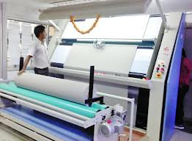
Quality Control of Finished Fabric: Inspection Machine

Slide 14
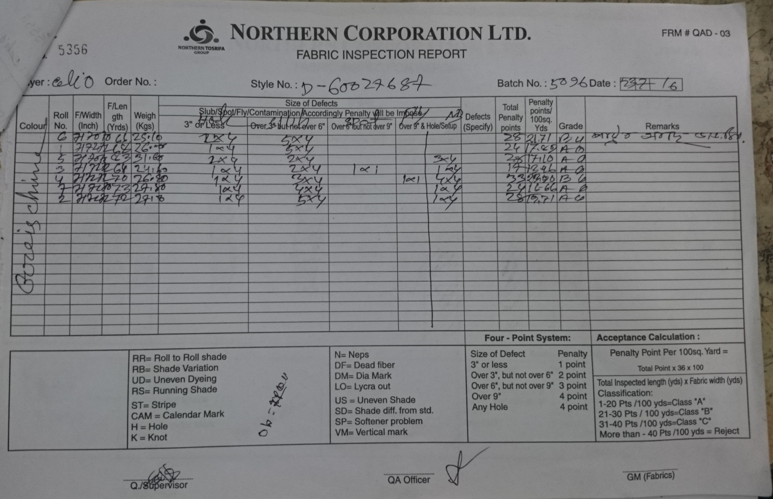

Slide 16

Faults in Knit Finished fabric: Softener Mark
Causes:
Softener not being uniformly dissolved in water
Remedies:
Scour the grey fabric thoroughly to remove all the impurities from the fabric before dying.
Ensure that the softener is uniformly dissolved in the water & doesn’t remain un-dissolved as lumps or suspension.
Use the right softener & the correct procedure for the application.
Maintain the correct pH value of the softener before application.
Visible stain in finished fabric due to softner

Slide 17
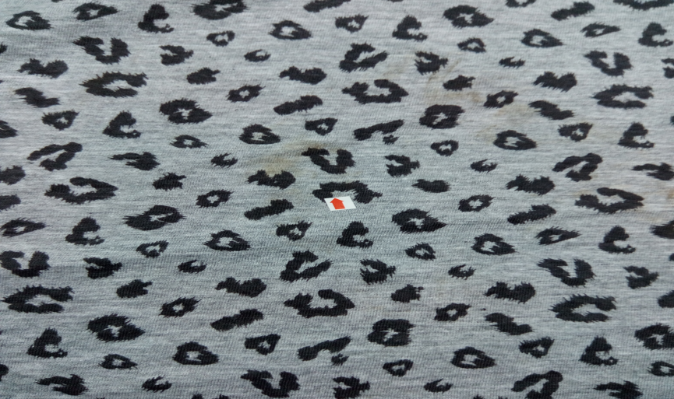
Faults in Knit Finished fabric: Dirty Spot
Causes:
Due to dirty finishing floor.
Unclean trolley of finishing floor.
Drop the footstep on fabric.
Remedies:
To keep clean the finishing floor.
Clean the trolley of finishing floor.
Sometime dirt from finishing floor or from trolley can be attached on the finished fabric which is appear as dirt spot.

Slide 18
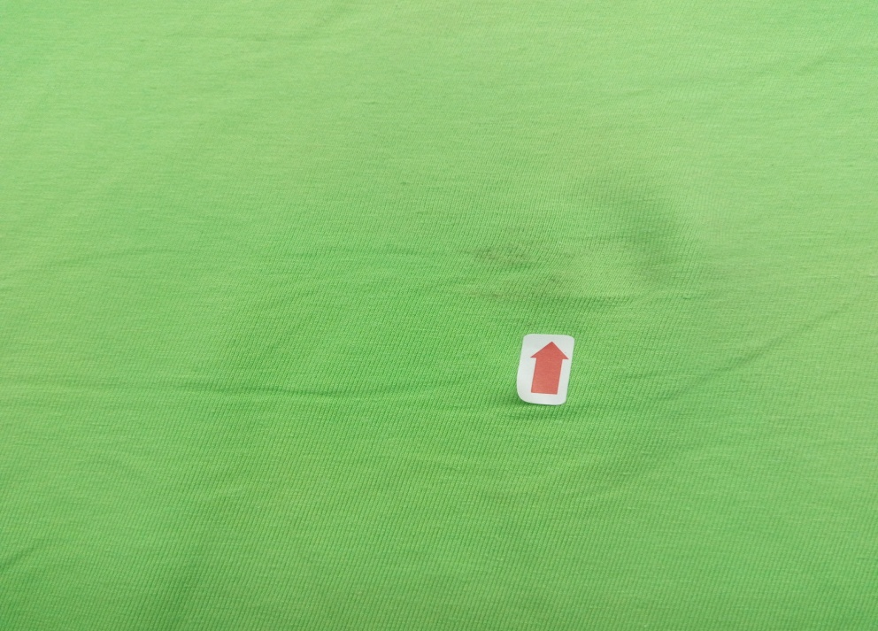
Faults in Knit Finished fabric: Color Spot
Causes:
Operator negligence.
Unwashed dyeing chamber.
Improper mixing of dyestuff.
Remedies:
Operator should be conscious.
Frequently wash out the dyeing chamber.
Proper mixing of dyestuff.
If the chamber of dyeing machine is not washed uniformly after one batch is dyed then some dye particles remain on the dye chamber which can attached with another batch of fabric when the fabric is insert on the machine chamber.

Slide 19
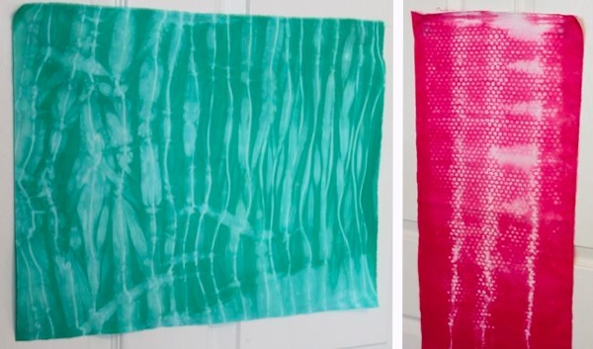
Faults in Knit Finished fabric: Color Fading
Causes:
Dyeing recipe i.e. the poor fixing of the dyes is a major cause of color fading.
Using the wrong combination of colors in a secondary or tertiary shade.
Use of strong detergents & the quality of water are also the common causes for color fading.
Prolonged exposure to strong light will also cause the colors to fade.
High label of acidity or alkalinity in the perspiration of individuals also causes color fading.
Remedies:
Use the correct dyeing recipe i.e. the appropriate labeling, fixing agents & the correct combination of dyes.
Follow the wash care instructions rigidly.
Use mild detergents & soft water for washing the garments.
Don’t soak the garments for more than 10- 15 minutes in the detergent prior to washing
Severe uneven dyeing

Slide 20
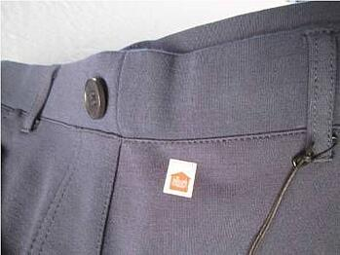
Faults in Knit Finished fabric: Shade Variation
Shade of one parts of fabric is different from the other areas.
Types:
Side to side shade variation
End to end shade variation
Batch to batch shade Variation

Slide 21
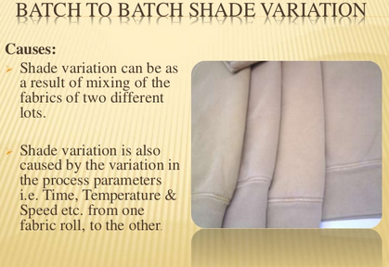

Shade Variation
Shade of one side of the roll/batch differs from the other side of the same roll/batch is called side to side shade variation.
One end of a roll/batch shows different shade with other end of the same roll/batch is called side to side shade variation.
Shade of one batch differ with others is called batch to batch shade variation.

Slide 22
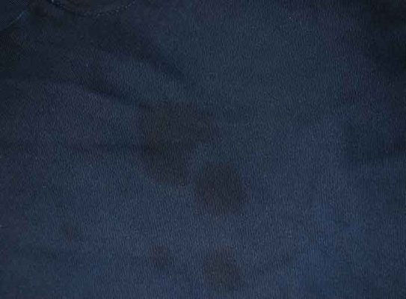
Faults in Knit Finished fabric: Oil Spot
Oil recolor with residue clung to surface which makes the stains increasingly visible
Causes:
Remedies:
Lubricant oil utilized in machine parts.
Unclean parts utilized.
Open hand dust.
Natural dust.
Should be utilized deformity free machine.
Lubricating ought to be utilized property.
Operator must be spotless and utilize hand gloves.
Proper support of machine.
Proper cleaning of machine.

Slide 23
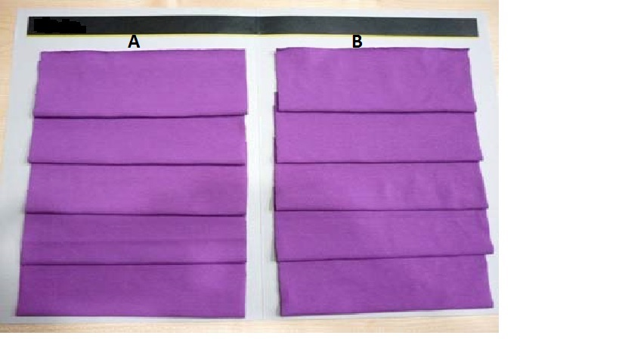
Causes of Shade Variation in Dyeing
Variation in fabric preparation
Difference in fibre strength
Difference in quality of dyes, chemicals and water
Variation in length of fabric in batch
Wrong formulation of dyeing recipe
Improper maintenance in dyeing operation
Selection of wrong dyeing parameters
Wrong measurement of materials

Slide 24
Fabric Inspection
Before the production of garments the quality of fabric should be inspected. When fabric received in store, at least it is needed to inspect 10% fabric. This inspection is done by point systems.
Some point system for fabric inspection are:
  4-point system
  6.5-point system
  10-point system
  Dallas point system

Slide 25
Fabric Inspection
4-point system
The 4-point system, also called the American Apparel Manufacturers Association (AAMA) point-grading system for determining fabric quality, is widely used by producers of apparel fabrics and by the department of defense in United States and is endorsed by the AAMA as well as ASQC (American Society for Quality Control).
The system in which the penalty point of a defect is maximum 4 is called 4-point system of quality control.

Slide 26
Fabric Inspection
Basic Principle: Defect point values should be counted in 100 square yards of fabric. If defect point values are 40 or less then it indicates first quality fabric. The grading range is given below:
Point | Grade
≤ 40 | A
Above 40-60 | B
Above 61-80 | C
Above 80 | Rejected

Slide 27
Fabric Inspection
Length of Defect | Point Allocated
Up to 3 inch | 1
Over 3 inch-Up to 6 inch | 2
Over 6 inch-Up to 9 inch | 3
Over 9 inch | 4
≤1 inch (Holes) | 2
Over 1 inch | 4
Procedure:
  Should select 10% fabric randomly from the fabric received quantity.
  The defects are located, marked and recorded on a frame.
  Fabric defect point values are taken based on the following:

Slide 28
Fabric Inspection
Calculation:
Point/ 100 yd = {(Total point scored in a roll x 3600)/ (Total yds inspected x Fabric width in inch)}
Exercise-1. A fabric roll of 1200 ydS long and 48 inch wide contains the following defects:
2 defects up to 3 inch
5 defects over 3 inch but up to 6 inch
1 defect over 6 inch but up to 9 inch
1 defect over 9 inch
Find out the grade of fabric based on 4-point system.

Slide 29
Consequences of fabric defects
The customer (garments manufacturer) may totally reject the defective fabric.
If the rate of defect is not very high in that case fabric is accepted with certain penalization in terms of either reduction of cost of the fabric or additional fabric is demanded by the buyer. This means that fabric defect may ultimately reduce the profitability of the concern entrepreneur.
The garment manufacturer will be in trouble in handling a defective fabric in the cutting table.
In spite of all preventive measures, garments are produced with fabric defects that result in ultimate rejection of the particular garment or even rejection of the whole lot.

