Slide 1
Quality Control in Garment Manufacturing
Areas to control quality in RMG factory
    A. Yarn Test in Composite Factory
    B. Sample Section
    C. Cutting Section
        C (a) Printing and
        C (b) Embroidery Section
    D. Accessories
    E. Sewing Section
        E (a) Washing
    F. Finishing Section
    G. Final Inspection of Garments

Slide 2
    A. Yarn Test in Composite Factory
Yarn is tested to evaluate the presence of
  a. dead fiber,
  b. contamination,
  c. patta,
  d. thick-thin place
  e. neps,
  f. slubs and
  g. hairiness

Slide 3
    A. Yarn Test in Composite Factory
Process:
  After receiving the yarn, factory knit/weave sample yardage
  Sample fabric is dyed in light coloured and dark coloured shade
  There are some yarn defects that are visible only in light colour and some are dark colour
  Defects are assessed with standards and decision is taken regarding further use of the yarn.

Slide 4
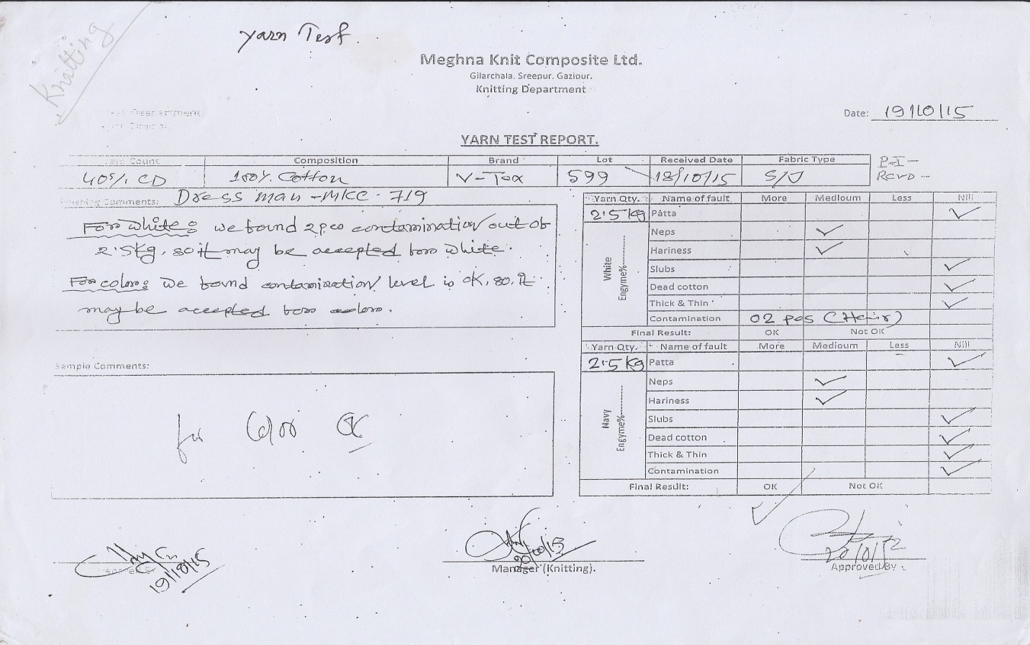
    A. Yarn Test in Composite Factory
Notes:
Yarn Test Report - Sample

Slide 5
    B. Sample Section : Comments of Buyer on Sample
Sample making is one of the main processes in garment manufacturing that plays vital role in attracting buyers and confirming the order
  Problems found in sample garments are usually
    Wrong Measurement
    Wrong Shaped Garment Parts
    Wrong Stitching
    Spot
    Rough Hand Feel
    Wrong Accessories

Slide 6
    B. Sample Section
Problems found in sample garments are usually
    Wrong Placket Size
    Wrong Collar
    Wrong Fabric/GSM

Slide 7
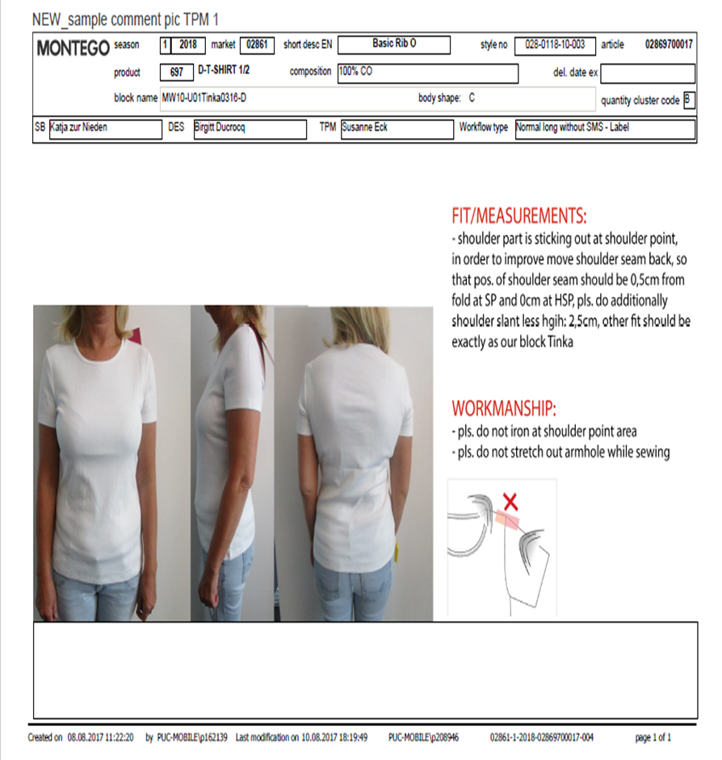
B. Sample Section
Comments on Sample: Format

Slide 8
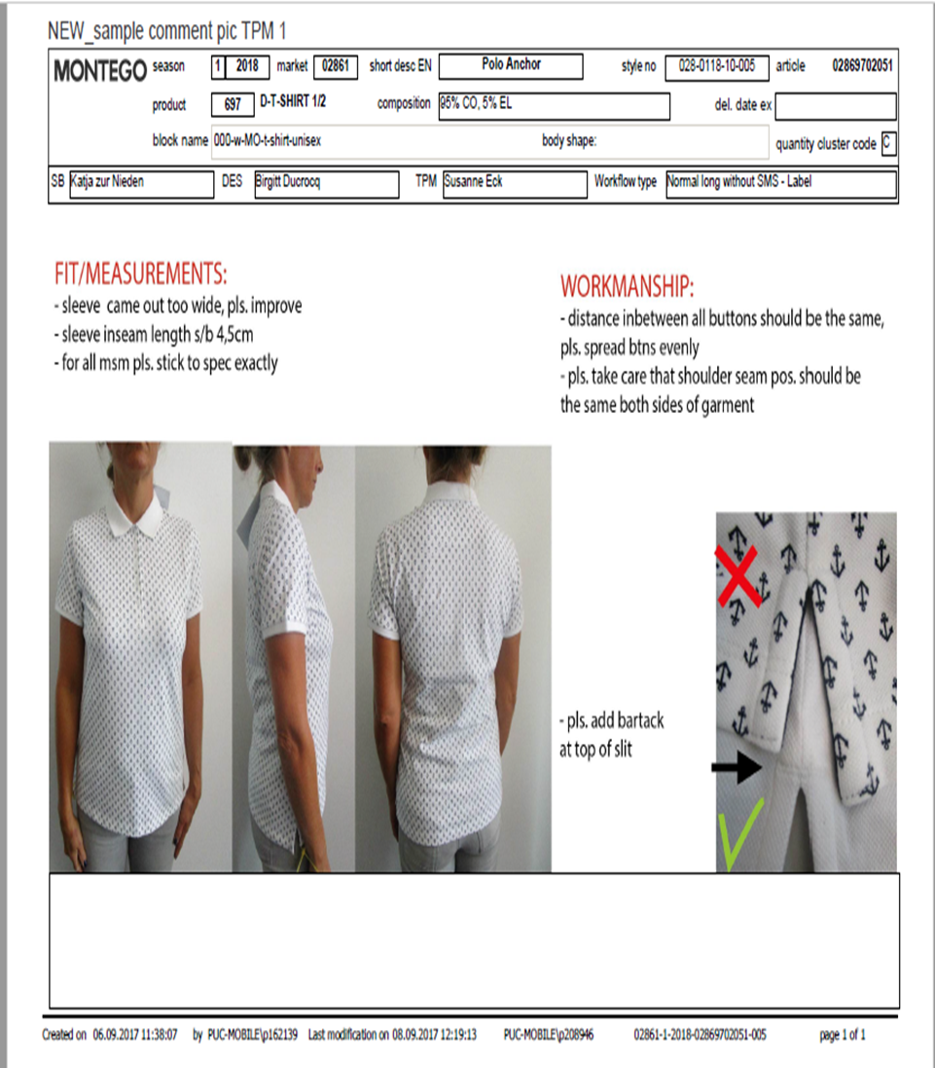
B. Sample Section
Comments on Sample: Format

Slide 9
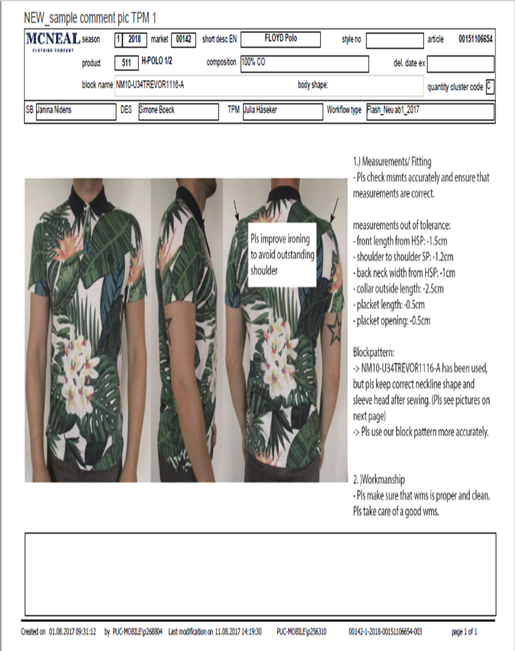
B. Sample Section
Comments on Sample: Format

Slide 10
B. Sample Section
Sample Garments Fail: Causes and Remedies
Wrong Measurement
    Measurement refers to the numerical data which is measured in different dimensions of a garment
Causes | Remedies
Less skill of the sample pattern maker | Have to improve the skill of pattern maker
Less skill of the sample cutting man | Have to improve the skill of sample cutting man
Less skill of the sample sewing person | Have to improve the skill of sample sewing person
Less skill of the sample man to understand the Measurement Sheet | Have to improve the skill of the sample man to understand the Measurement Sheet.

Slide 11
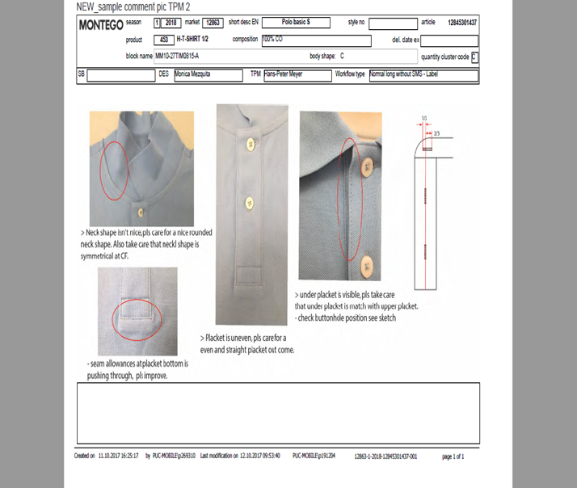
B. Sample Section
Comments on Sample: Measurement Defect

Slide 12
B. Sample Section
Sample Garments Fail: Causes and Remedies
Wrong Shaped garments Parts
    Garment Part Shape refers to the shape of different parts of a garment which is made by the help of pattern
Causes | Remedies
Less skill of the sample pattern maker | Have to improve the skill of pattern maker
Less skill of the sample sewing person | Have to improve the skill of sample sewing person
Not using modern sewing machine | Use State of the art sewing machine

Slide 13
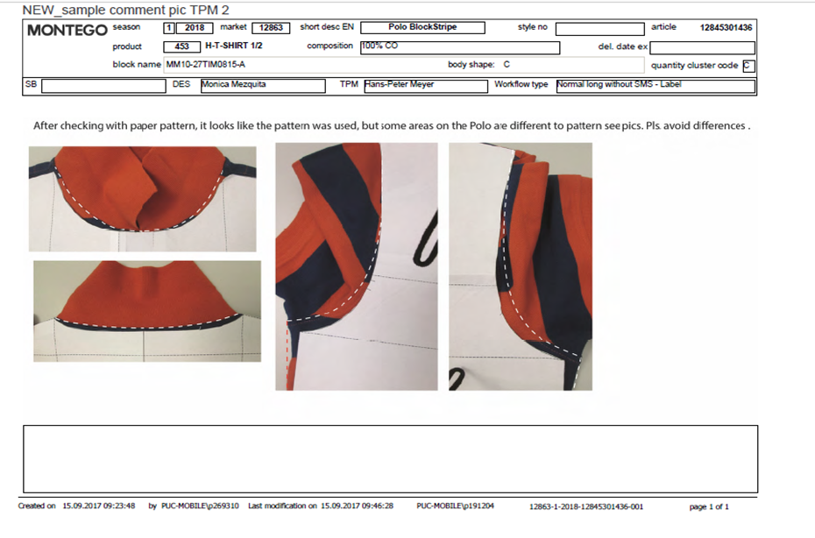
B. Sample Section
Sample Garments Fail: Photo
Wrong Shaped Garments Part

Slide 14
B. Sample Section
Sample Garments Fail: Causes and Remedies
Wrong Stitching
    Wrong stitching is done on the sample garment
Causes | Remedies
Less skill of the sample sewing person | Have to improve the skill of sample sewing person
Use of wrong size sewing thread | Good type of sewing thread should be used..
Sewing machine handled poorly | Sewing machine should be handled properly

Slide 15
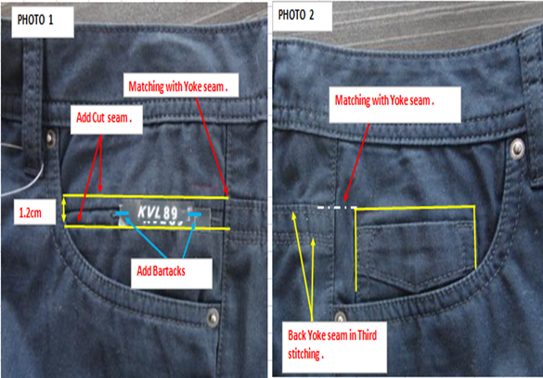
B. Sample Section
Sample Garments Fail: Photo
Wrong Stitching

Slide 16
B. Sample Section
Sample Garments Fail: Causes and Remedies
Print Spot
    Print Spot is a kind of problem which refers to have spot on print mark.
Causes | Remedies
Less skill of the sample printing person | Have to improve the skill of sample printing person
Inaccurate Art Work | Dyes & Chemicals should be prepared properly.
Inaccurate design | Art Work should be proper
 | Design should be accurate.

Slide 17
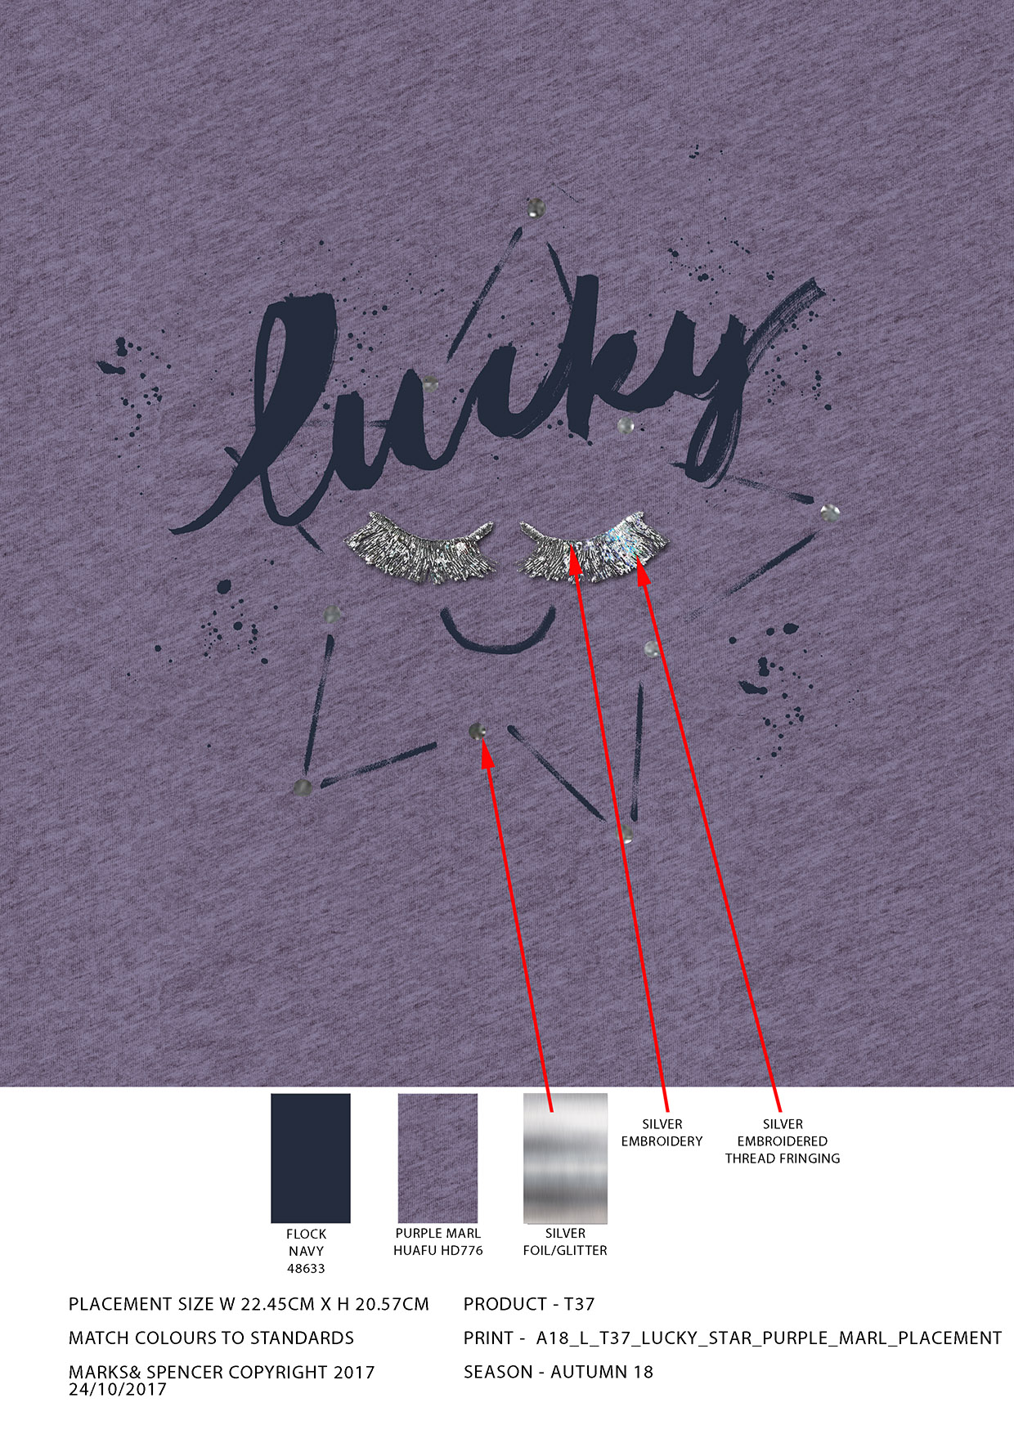
B. Sample Section
Sample Garments Fail: Photo
Print Spot

Slide 18
B. Sample Section
Sample Garments Fail: Causes and Remedies
Rough Hand feel
    It is a kind of property by which softness, smoothness and comfortiability of a garment can be assumed.
Causes | Remedies
Poor finishing | Finishing should be good.
Poor wash technique | Wash technique should be very good
Poor quality raw material usage. | Should be used good quality of raw material.

Slide 19
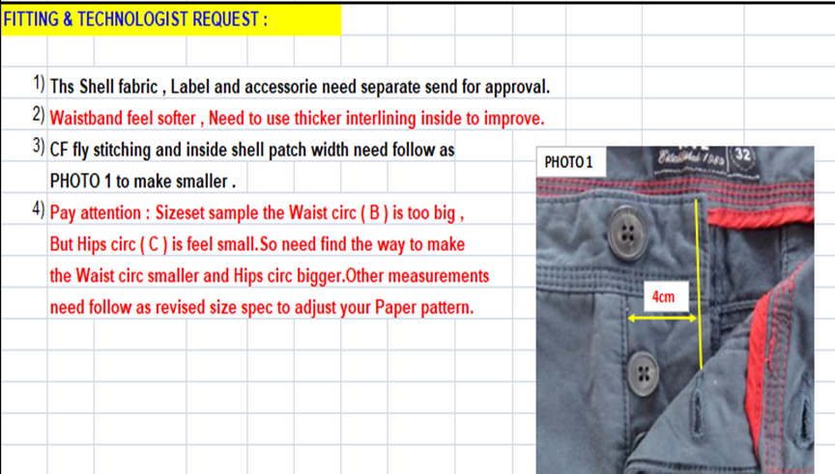
B. Sample Section
Sample Garments Fail: Photo
Rough Hand feel

Slide 20
B. Sample Section
Sample Garments Fail: Causes and Remedies
Accessories Problem
    Defective and wrong accessories may be used in the sample
Causes | Remedies
Usage of defective accessories | Use quality accessories
Usage of wrong accessories | Use appropriate accessories

Slide 21
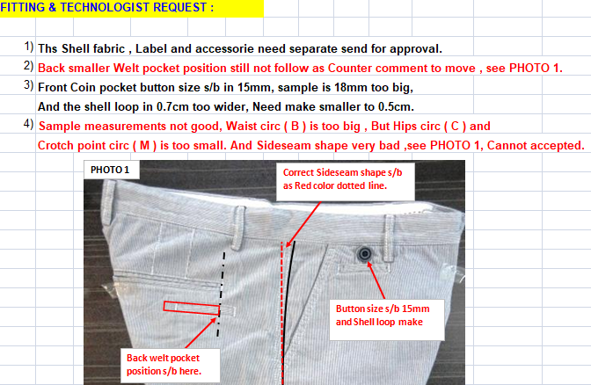
B. Sample Section
Sample Garments Fail: Photo
Accessories Problem

Slide 22
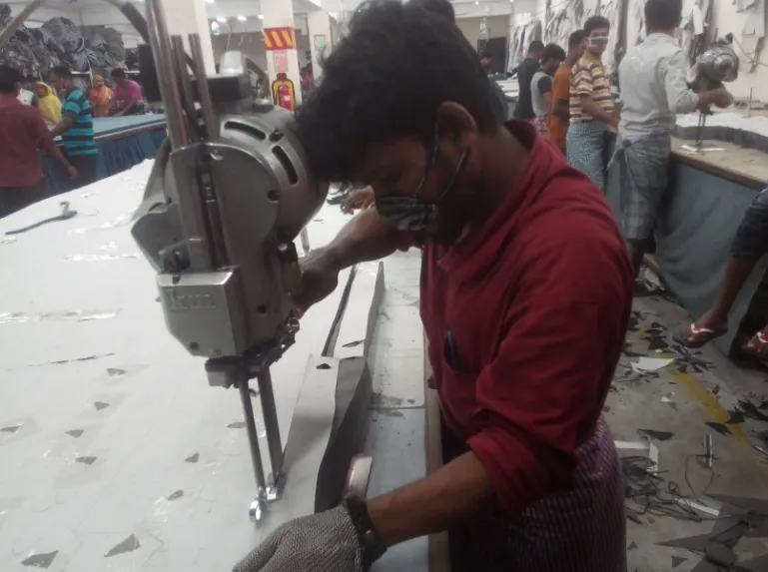
C. Cutting Section

Slide 23
C. Cutting Section
Quality control of cutting section mainly divided into four parts. Those are:
  a. Marker Inspection
  b. Spreading Control
  c. Cutting Quality control
  d. Piece Goods Inspection

Slide 24
C. Cutting Section
  a. Marker Inspection
  Marker Length
  Marker width
  Lay quantity
  Style/Lot
  Ratio
  The measure of all individual parts marked in marker

Slide 25
C. Cutting Section
  b. Spreading Control
  Cut numbers
  Ends
  Alignment
  Tension
  Counts
  Ply Height
  Fabric Fault

Slide 26
C. Cutting Section
  c. Cutting Quality Control
  Number of parts
  Miss cut
  Ragged cutting
  Notches
  Matching plies

Slide 27
C. Cutting Section
  d. Piece Goods Inspection
  100 % Cut panel is numbered and inspected to sort the defective ones.
      All the defects that are found in the grey and finished fabric is usually found in this inspection. Besides those defects, following defect may be found in the cut panels
        Wrong Numbering

Slide 28
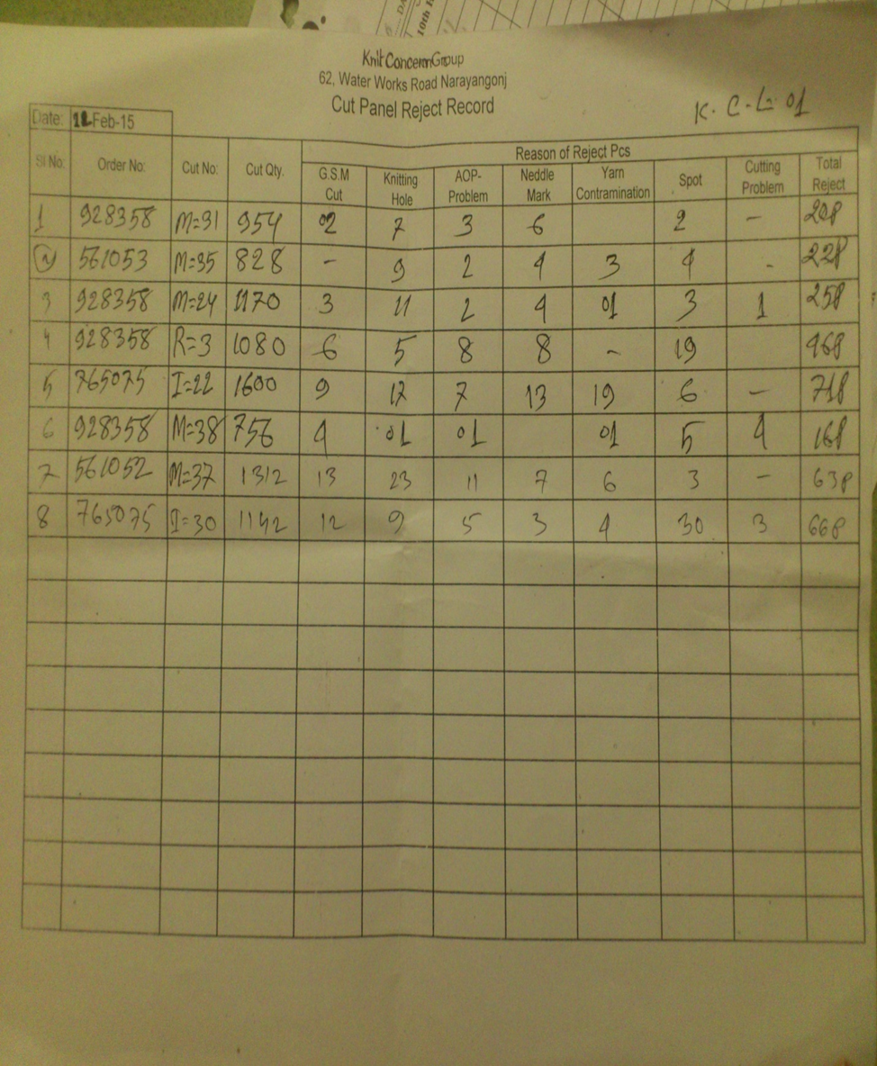
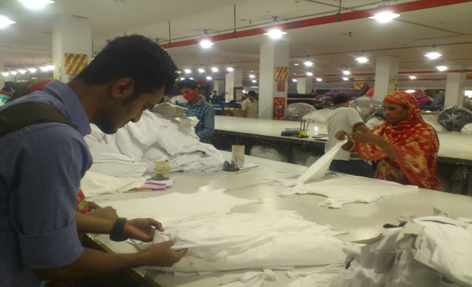
C. Cutting Section
Cut Panel Inspection: Format

Slide 29
        C (a) Printing
Defects that are usually found in printing are
  Crease mark
  Flushing/Wicking
  Stick-ins
  Color out
  Slanted printing
  Misplaced print
  Print stain
  Uneven shade
  White spots

Slide 30
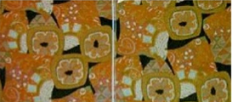
Defects in Printing
Crease Mark
Description
Photo
Crease marks appear where creases are caused by fabric fold during printing.

Slide 31
Defects in Printing
Flushing/Wicking
Description
Photo
when the printed area bleeds out into the unprinted area

Slide 32
Defects in Printing
Stick-ins:
Description
Photo
A stick-in occurs when a small fiber or piece of lint gets stuck in the screen opening
The result is a small unprinted circle in the design.

Slide 33
Defects in Printing
Color out:
Description
Photo
While printing, if the color paste runs low in the reservoir resulting in blank skips in the print pattern it is called as Color out

Slide 34
Defects in Printing
Slanted Print:
Description
Photo
If the print on the garment parts is bend in any direction is called slanted print

Slide 35
Defects in Printing
Misplaced print:
Description
Photo
If the print is not placed on the desired area is called misplaced print

Slide 36
Defects in Printing
Print stain:
Description
Photo
If print paste scattered in the areas that are not to be printed

Slide 37
Defects in Printing
Uneven Shade:
Description
Photo
Differences in the shade of the print area is known as uneven print of shade.

Slide 38
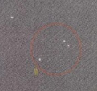
Defects in Printing
White spots:
Description
Photo
If any dust/dirt remain in the printing area may prevent penetration of print paste into the fabric known as white spots.

Slide 39
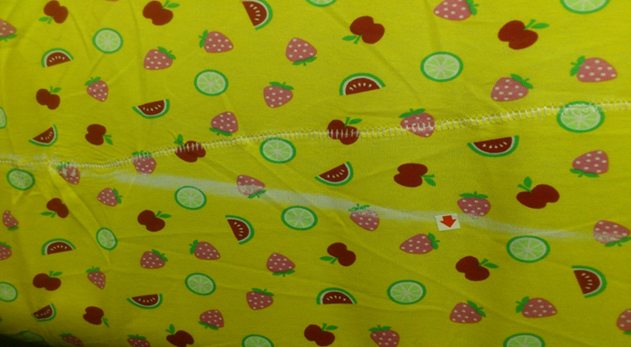
Defects in Printing
Mark on print:
Description
Photo
Any mark present in printed area

Slide 40
C (b) Embroidery Section
Defects that are usually found in Embroidery are
  Poor Registration
  Fabric Grin Through or Gapping
  Missed Trim
  Bunching at Corners
  Poor Stitch Balance
  Fabric Damage – Needle Holes
  Embroidery Too Thick
  Poor Coverage – Poor Stitch Density
  Poor Hooping

Slide 41
Defects in Embroidery Section
Poor Registration
Description
Photo
Where the stitches and design
elements do not line up correctly. The embroidery sewing process sews different colors at different times. If the fabric shifts while one color is being sewn, then poor registration will occur when the next color is sewn.
Sometimes it is difficult to tell the difference between poor registration, poor digitizing, and fabric “grin-through” or “gapping” due to thread “pull”

Slide 42
  Defects in Embroidery Section
  Fabric Grin Through or Gapping
Description
Photo
Where the fabric is seen through
the embroidery design either in the
middle of the pattern or on the edge

Slide 43
Defects in Embroidery Section
Untrimmed Embroidery
Description
Photo
Where threads are left on the embroidery pattern between images or lettering.

Slide 44
Defects in Embroidery Section
Bunching at Corners
Description
Photo
Where the corners of lettering or shapes are not sharp and crisp but are bunched up or distorted. Usually caused by too much thread in the corners due to poor digitizing

Slide 45
Defects in Embroidery Section
Poor Stitch Balance
Description
Photo
where white bobbin thread shows
on the topside of the embroidery. Ideally, the needle thread should be held on the underside of the seam, and not ever be pulled up to the topside

Slide 46
Defects in Embroidery Section
Fabric Damage – Needle Holes
Description
Photo
Where the fabric is damaged
around the corners of the embroidery.

Slide 47
Defects in Embroidery Section
Embroidery Too Thick
Description
Photo
Where the embroidery is too thick and uncomfortable.

Slide 48
Defects in Embroidery Section
Poor Stitch Density
Description
Photo
Where the stitch density is not
thick enough and one can see the fabric through the embroidery stitching

Slide 49
Defects in Embroidery Section
Poor Hooping
Description
Photo
Where the fabric around the embroidery looks distorted and does not lay flat.

Slide 50
D. Accessories
Important Rules for Accessories Inspection
  Both Quality and Quantity should be inspected
  10% accessories should be inspected, if any discrepancy is found, 100% accessories will be inspected
  If any critical defects found, lot will be rejected
  Hang tags and labels having barcodes printed on them must be checked properly by scanner
  All trims have to be checked using buyer approved light source: D65, TL84, UV, CWF, FA, and UL3500.
  After completing Brand labels inspection, its must keep in confirm area with lock and key. Key must be handle store in charge only

Slide 51
Button
Checking criteria of a button are
      Size (Ligne)
      Color
      Shade variation
      Broken/Cracked
      Holes
      Thickness
      Logo Position
      Missing logo
      Eveness

Slide 52
Zipper
Checking areas of a zipper are
  Does slider/runner slides smoothly
  Sharp teeth
  Stopper missing
  Loose stopper/teeth
  Zipper tape color
  Zipper tape faulty
  Wrong type of zipper
  Wrong material

Slide 53
Label
Checking areas of a Label are
  Color
  Shade Variation
  Shade
  Selvedge
  Length and width
  Letter missing
  Illegible letter
  Word / Space error

Slide 54
Label (Cont…..)
  Spelling mistake
  Wrong barcode
  Excess lettering alphabet
  Care symbol missing
  Wrong care symbol
  Printing blur / unclear/less distinct

Slide 55
E. Quality Control in sewing Section
Types of Inspection
  1. Pre-Production Check (PPC)
  2. Initial Production Check (IPC)
  3. During Production Check (Du-PRO)
  4. Final Random Inspection (FRI)

Slide 56
Types of Inspection
1. Pre-Production Check(PPC):
  This is done before production starts, Where the final verification of the raw material is done;
    Style, cut and workmanship of the garment or pre-production sample as per the customer requirements
    All types of accessories are checked – both quality and quantity

Slide 57
Types of Inspection
2. Initial Production Check(IPC):
  This is done at the start of production where a first batch (test production) of garments is inspected;
    To distinguish possible discrepancies/variation and to allow for the necessary corrections to be made for bulk production.
    The inspection in preliminary stage covering mainly style and general appearance, workmanship, measurements, quality of fabrics, components, weight, color and/or printing.

Slide 58
Types of Inspection
3. During Production Check(Du-Pro):
  This inspection is in fact the follow -up of the initial production check and is generally carried out a few days after the initial inspection;
    This inspection is carried out to be ensured that the garments are producing correctly
    To identify any changes of the production from the initial production

Slide 59
Types of Inspection
4. Final Random Inspection(FRI):
  This is carried out when the production of the total quantity of an order or partial delivery is completed;
    The AQL sampling inspection may be applied or another inspection system designed by the buyer
    The number of checked garments are determined by AQL chart which are randomly but proportionately selected

Slide 60
Organization for Inspection and Lab Test
Usually garments final inspection process and lab test is done by buyers or third party authority. Some third party authority’s name are:
SGS
TUV
ITS
REWE
ATI
AHL
SEGNET

Slide 61
E. Sewn Garments Inspection
Sewing is the major operation in garments. This operation is responsible for following defects:
      Open Seam
      Broken Stitch
      Un even Stitch
      Join Stitch
      Pleat
      Label Displacement
      Wrong Label
      Joint Stitch
      Needle Mark
      Part shading

Slide 62
E. Sewn Garments Inspection (Cont)
      Size mistake
      Dirty spot
      Oil mark
      Uncut thread
      Print mistake
      Twisting

Slide 63
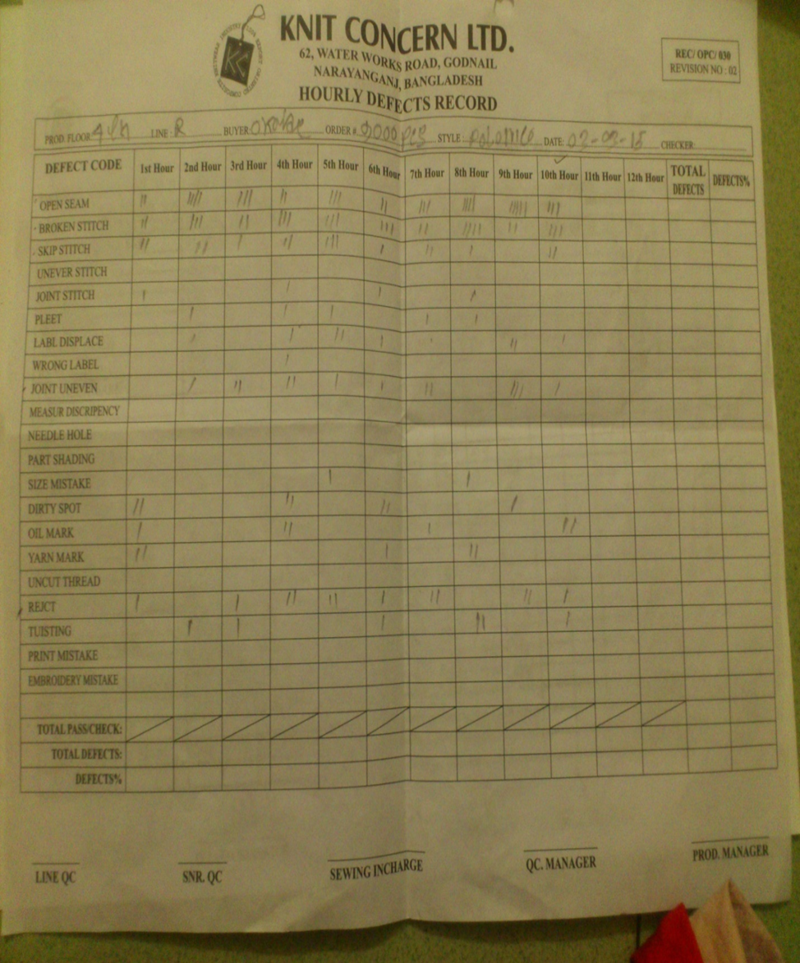
E. Sewn Garment Inspection: Format

Slide 64
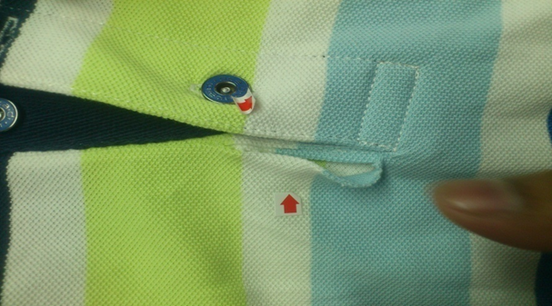
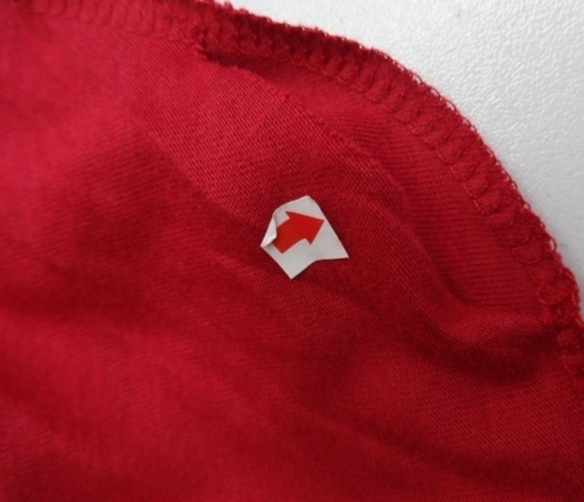
E. Sewing Defects: Causes and Remedies
Open Seam
    Some times stitch are out of the seam line and the seam are opened
Causes | Remedies
Incorrect needle to thread size relationship | Synchronized needle or thread size
Deflected or blunt needle point | Recommended needle size against specified article.
Needle vibrating or deflecting | Reset pressure foot.
Feed dog moves away | Tighten feed dog
Poor and variable control | Change the needle

Slide 65
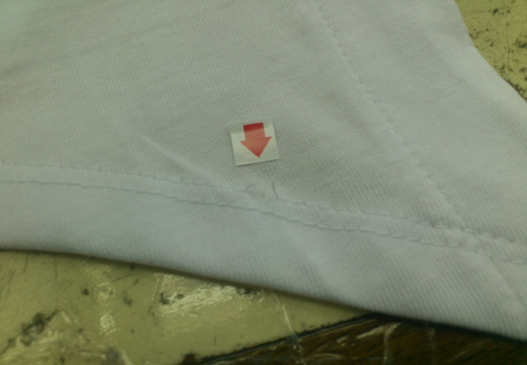
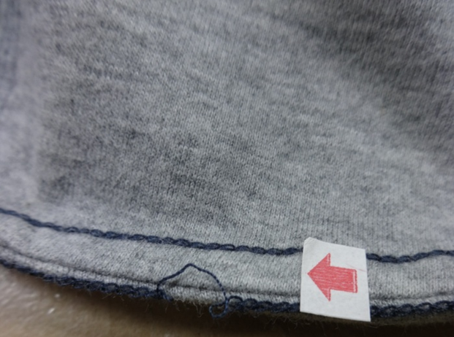
E. Sewing Defects: Causes and Remedies
Broken Stitch:
      When a stitch is broken in a seam line
Causes | Remedies
Thread trapped at the thread guide | Use stronger thread or adjust tension
Thread trapped at the base of cone | Use finer thread or coarser needle
Improper off winding from cone | Re guide the thread property
Sharp edge on throat plate hook point, needle guard, bobbin needle grove or eye | Increase thread guide and reduce disc tension
Excessive needle heat, grove or eye blocked with melted fabric. | Polish rough edges, replace needle use better quality

Slide 66
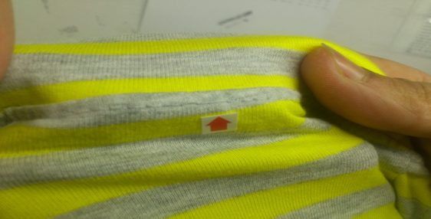
E. Sewing Defects: Causes and Remedies
Skip stitch:
      Failure of needle to enter bobbin loop is called skip stitch
Causes | Remedies
Failure of needle to enter loop in correct time | Check needle is inserted and aligned correctly
Needle deflection or blend needle | Synchronized needle and thread size
Thread loop failure due to incorrect needle size or thread size | Use recommended needle numbers against specified articles
Incorrect sewing tension in the needle | Re adjust the thread tension
Incorrect sewing tension in the needle | Re adjust pressure foot pressure

Slide 67
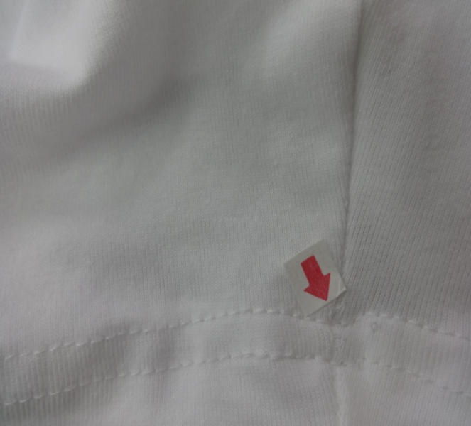
B. Sewing Defects: Causes and Remedies
Uneven Stitch
      When stiches do not maintain equal distance throughout the seam line
Causes | Remedies
Lack of care of the operator. | Be careful when operate.
Machine defect. | Regular maintenance of sewing machine.
Improper settings. | Setting should be check.

Slide 68
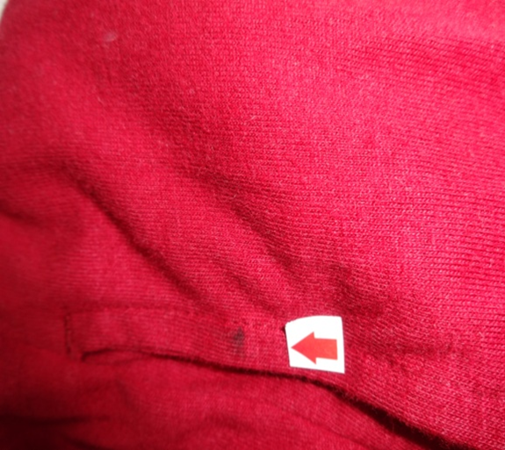
E. Sewing Defects: Causes and Remedies
Spot
      Different types of stain present in the garments
Causes | Remedies
Careless handling. | Operator should carefully when handling.
Unclean production place. | Working place should clean up before production.
Natural dust. | Precaution should be taken to avoid natural dust

Slide 69
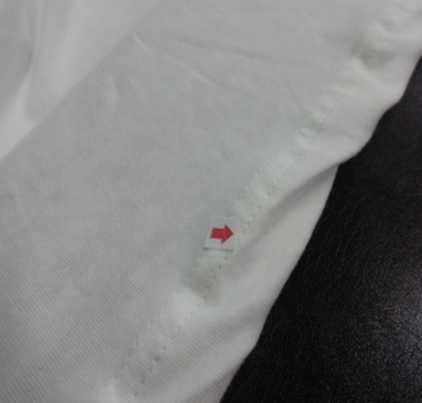
E. Sewing Defects: Causes and Remedies
Puckering
      Uneven gathering of fabric in seam line
Causes | Remedies
High tension thread. | Threads tension have to corrected
Fabric feeding problem. | Fabric feeding system should be controlled
Uneven pulling of back and front part of the garment | Feeding mechanism should be changed.

Slide 70
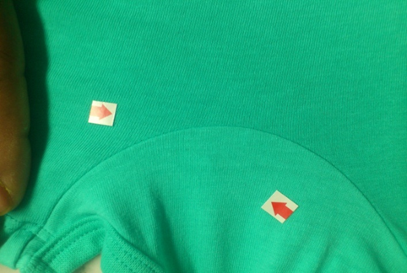
E. Sewing Defects: Causes and Remedies
Shade Variation
    When parts of a garments are different shades
Causes | Remedies
Wrong numbering after cutting | Ensure numbering is perfect
Use different shaded fabric | Try to use same shaded fabric
Cutting different shaded fabric together | Make shade band before cutting

Slide 71
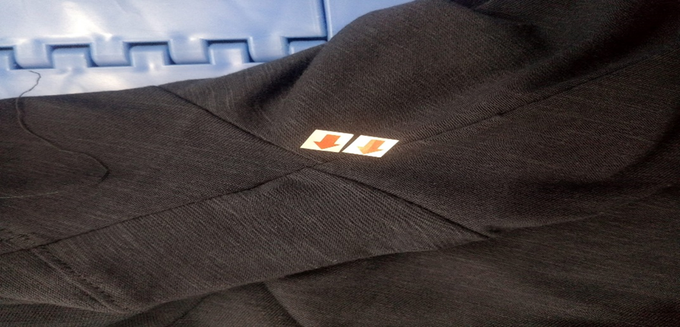
E. Sewing Defects: Causes and Remedies
Four point Up Down
If the all joint of the garments in sewing is not uniform

Slide 72
E (a) Washing Defects
Causes:
Sometime for the machine problem.
Operator negligence.
Incorrect cut mark.
Some operator not using guide
For operators unskilled.
Remedies:
Seam open and sewing again correctly.
If machine measurement problem, then solve it.
Operators must be careful.
Train up sewing operator for stitching incorrect seam.

Slide 73
E(a)Quality Control in Washing section
Wet Wash
Dry Wash

Slide 74
E(a)Quality Control in Washing section
Color Shade Variation
  Within Parts
  Within Garments
  Piece to Piece
Crease Marks
P.P Spot
Bleach spot
Stain
After Wash Hole
Damage
Dark Shade
Light Shade
Blue Shade

Slide 75
E(a)Washing faults: Color Shade Variation
Definition
Types
Garment are made by stitching number of fabric parts together. When shade variation is found in between garment parts, is called shade variation in garments. As mentioned above, garment making factory may receive fabric with varied shades of same color. If precaution is not taken in cutting department and sewing floor, fabric lot can mixed easily and as a result will garment with varied shade in between garment components.
Sometimes there appears to be a difference in the depth of shade between the roll to roll & from place to place in the same roll. The defect will show up clearly in the garments manufactured from such fabric.
Three types of shade variation occurs in washing of garments
Within parts shade variation
Within garments shade variation
Piece to piece shade variation

Slide 76
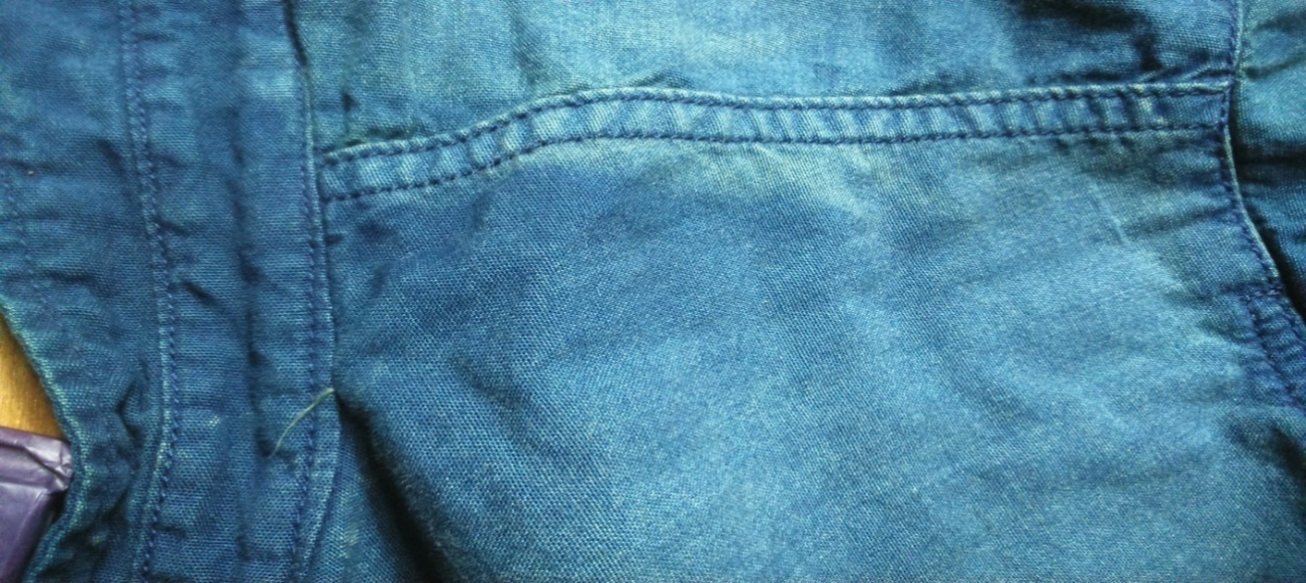
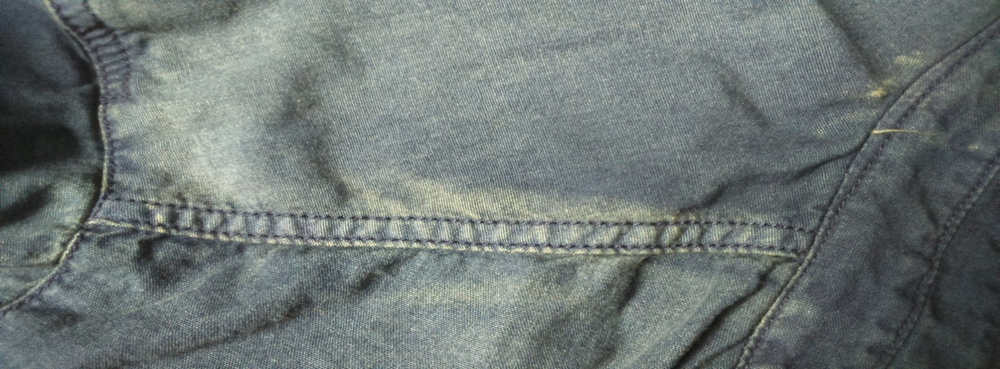

E(a)Washing faults: Color Shade Variation
Within Parts Shade Variation
Within Parts Shade Variation

Slide 77
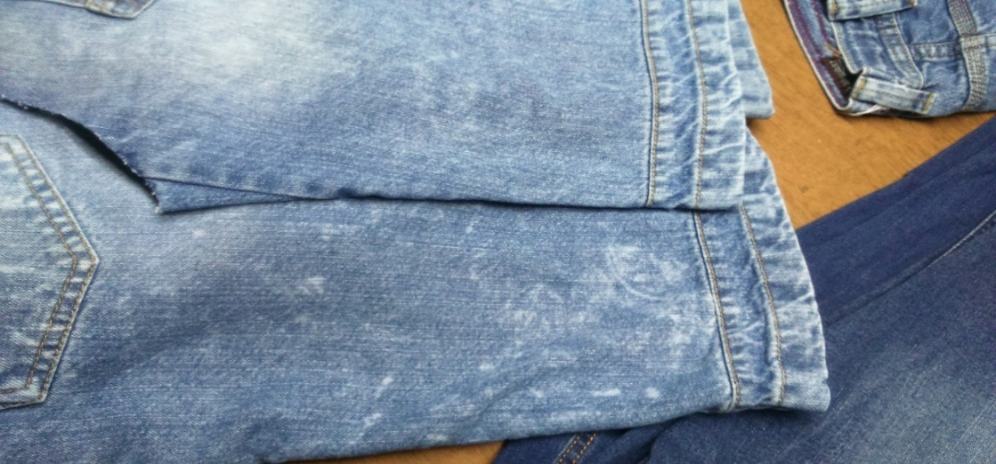


E(a)Washing faults: Color Shade Variation
Parts to parts Shade Variation

Slide 78
E(a)Washing faults: Color Shade Variation
Causes
Remedies
Shade variation can be as a result of mixing of the, fabrics of two different lots.
Shade variation is also caused, by the variation in the process parameters i.e. Time, Temperature& Speed etc. from one fabric roll, to the other.
Shade variation can appear to be, in fabrics with GSM variation, caused due to the uneven stretching, unequal fabric overfeed % etc.
Ensure that the grey fabric used for one shade is knitted/woven from the same lot of the yarn.
Ensure that the same process parameters (Width, Overfeed, Temperature & Machine Speed etc.) are used for each roll of a dye lot.

Slide 79
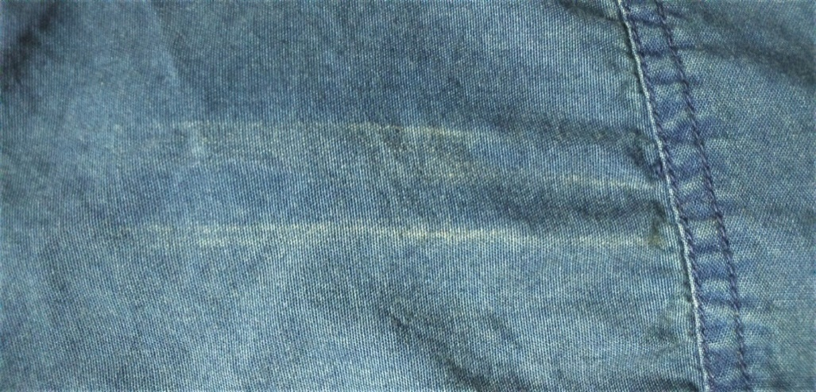
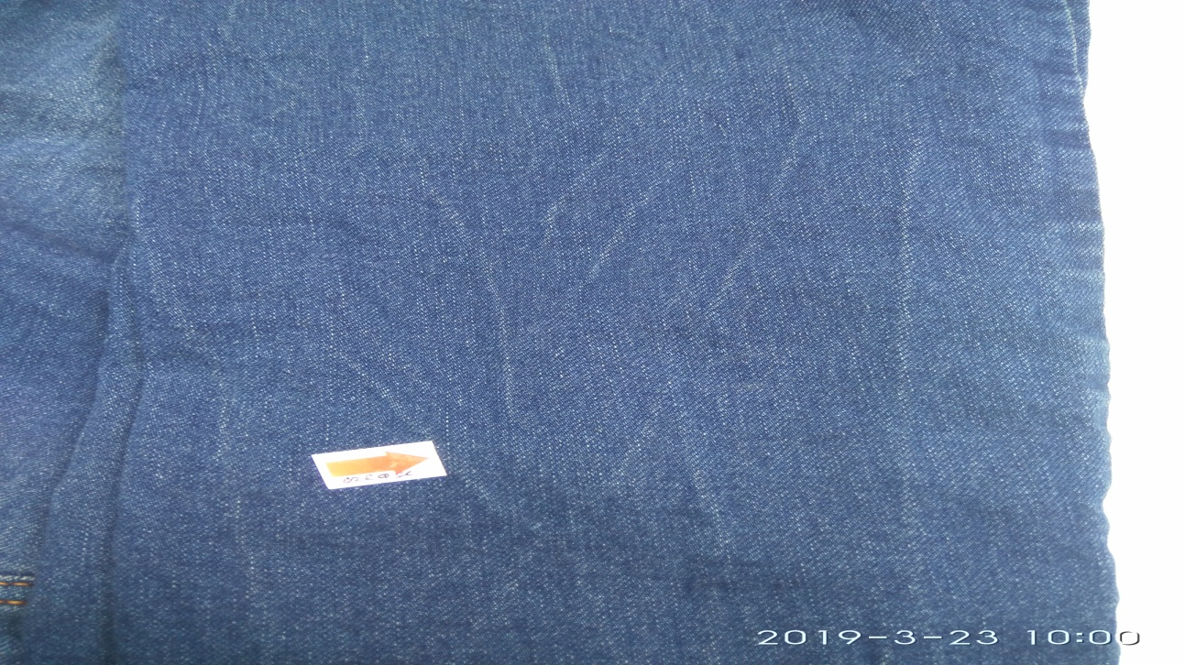
E(a)Washing Faults: Crease Mark
Crease marks appear in the woven fabric, as dark haphazard broken or continuous lines.
Causes:
Damp fabric moving at high speed in twisted form, in the Hydro extractor (Centrifuge)
Over loaded the garments on the washing Machine.
Remedies:
Use anti-Crease, during the Scouring & the Dyeing process.
The use of anti-Crease, swells the Cellulose & prevents the formation of Crease mark.
Spread the fabric in loose & open form & not in the rope form, in the Hydro Extractor.
Never Over loaded the garments in washings machine.
Crease Mark

Slide 80
E(a)Washing Faults: PP Spot
Potassium permanganate spray is done on jeans to take a bright effect on sand blast area. One important thing about potassium permanganate spray is, this is usually a sporting process to increase the effect of sand blast. Potassium permanganate solution is sprayed on blasted area of jeans garment with the help of normal spray gun. Sodium Metabisulphate is most commonly used neutralizer.
Potassium permanganate sprays concentrations ranges from .25 gm per liter to 15.00 grams per liter depending to required results and fabric types. Usually indigo died fabrics are treated with low concentrations whereas Black Sulfur Fabric requires high concentrations to treat with.
Cause:
Potassium permanganate sprays concentrations high range.
Operator skill not good
After spray keep over the other garments
Remedies
MixPotassium permanganate with water of ordered in low range
Good Operator Skill
After spray never keep over the garments

Slide 81
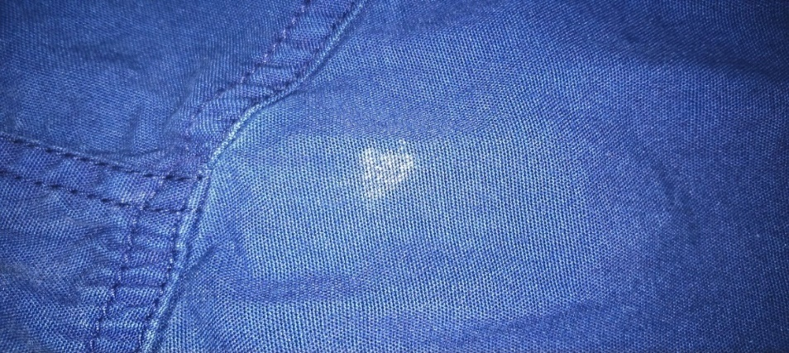
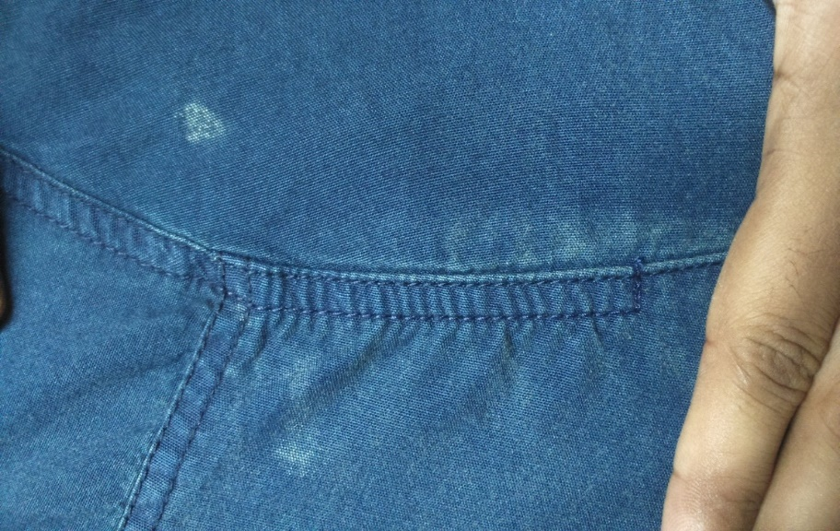
E(a)Washing Faults: PP Spot
Photo
Photo

Slide 82
E(a)Washing Faults: Bleach Spot
Oxygen-based or All-Fabric Bleach works more slowly than chlorine bleach and contains sodium perforate, sodium pre carbonate or hydrogen peroxide. It is safe for use on almost all washable fabrics and colors.
When this bleach is used in the wash, the chemical ingredient oxidizes to help remove soil and organic matter brightening the fabric and removing stains.
Bleach aids detergents in the removal of soil and stains. There are two types of bleach: chlorine bleach or sodium hypochlorite and oxygen bleach. Through a process of oxidation, bleach changes the soil into soluble particles to be washed away by detergents in the washing process. Bleach helps to whiten and brighten washable fabrics.
Causes:
If you use any type of acne or skin bleaching cream or washes, they can cause thediscoloration.
If any of these ring a bell, you should be able to change your habits and eliminate the Problem.
Do not use bleach directly.
Remedies:
Always check for color fastness first, following the instructions on the container, before using either type of bleach.
Add bleach to washer water, mixing well, before adding clothes.
Never mix bleach with ammonia which causes caustic fumes.
Read and follow care instructions and any warnings on the fabric care label regarding the use of bleach.
Do not use bleach on silk, acetate, wool, spandex, polypropylene foam, some flame retardant fabrics or rubber.
Repeated use of chlorine bleach can weaken cellulosic or cotton/ramie/linen fibers.

Slide 83

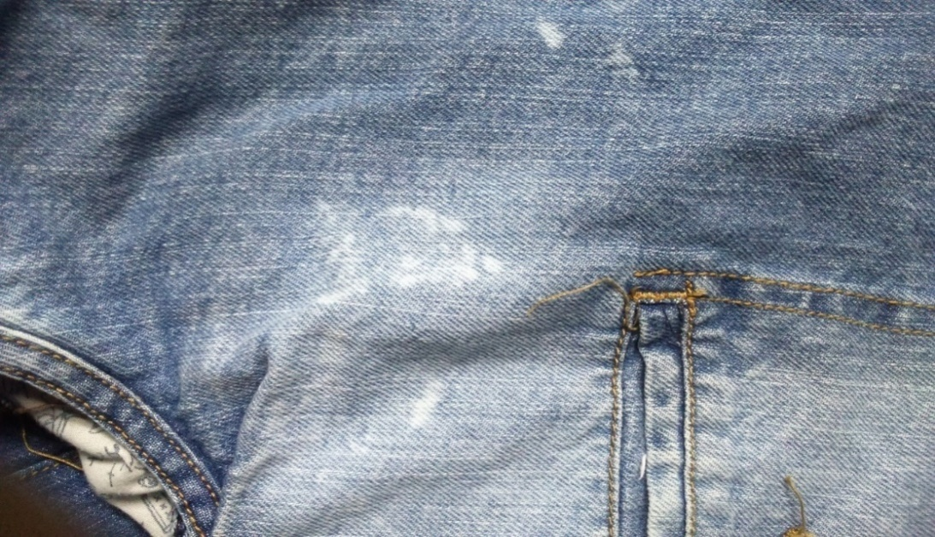
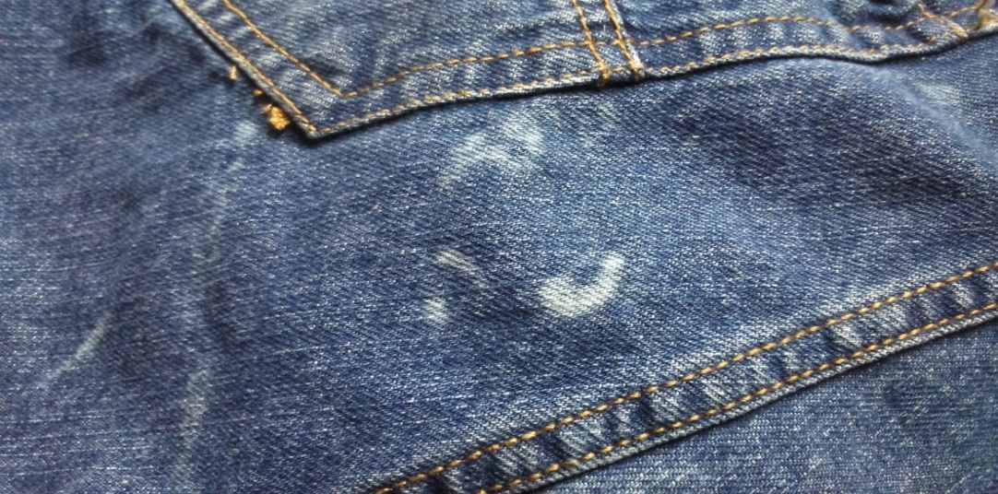
E(a)Washing Faults: Bleach Spot
Photo
Photo

Slide 84
E(a)Washing Faults: Stain
Different types of stain may added on the washing process and after wash
Cause:
Dirt in the fabric and after wash seen the mark
Storage problem.
Dirt in the yarn.
Remedies:
Very carefully storages
Check the garments before wash

Slide 85
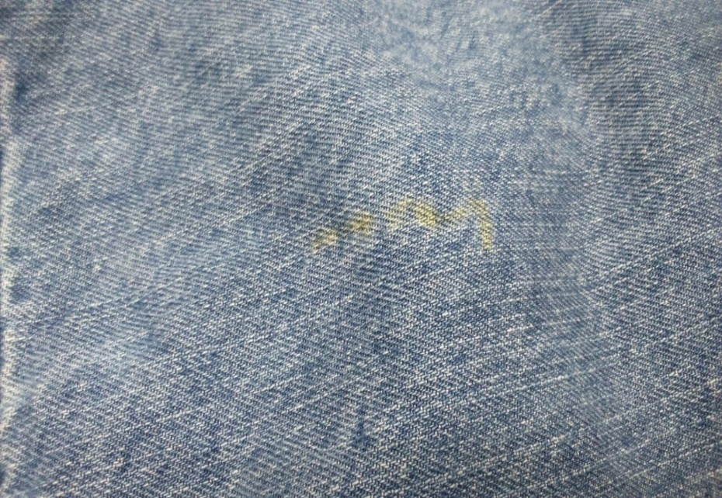
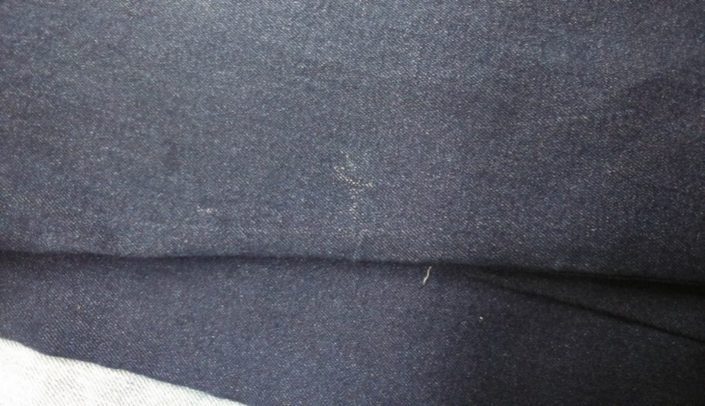
E(a)Washing Faults: Stain

Slide 86
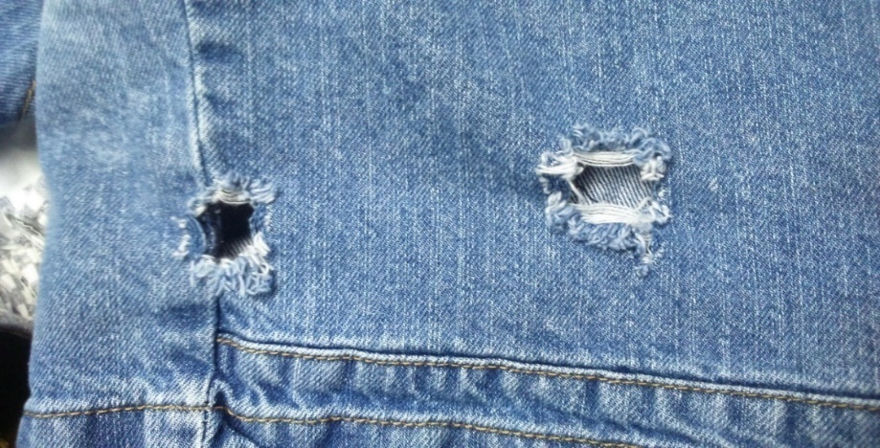
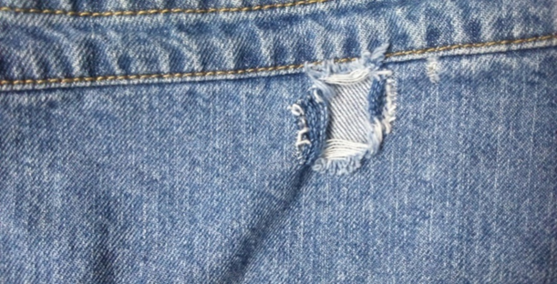
E(a)Washing Faults: After Wash Hole
After wash whole occurred by incorrect use of chemicals which can be found in woven garments.

Slide 87
E(a)Washing Faults: After Wash Hole
Causes
Remedies
The top reasons for holes rips and tears in from an automatic washing machine are:
Overloading
Poor quality clothing
Incorrect cycle or program use
Incorrect detergent use
If you are using too much chlorine bleach or not allowing the bleach to thoroughly mix with Water before putting in clothes, this will cause holes.
This not only affects cleaning but also can cause garments to get hooked on zippers, decorations and pulls on other clothing.
Take necessary steps to avoid overloading.
Check fabric quality very carefully during it can be stored.
Operating system can be done carefully by skilled full person to avoid this fault.
Detergent can play a vital role during washing. Excess use of detergent may harms for garments for that wash hole can found after washing. So, limited detergent can be used during washing. Here detergent quality may vary for the garments.

Slide 88
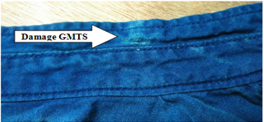
E(a)Causes and Remedies of Washing Faults
Damage: Damage of washed garments means any part of the garment destroyed due to various reasons. Damage is found mainly in heavy washed garments.
Causes: Amount of chemical and stone is higher, RPM of the machine is higher and cycle program is incorrect, Overloaded quantity in the machine
Remedies: Appropriate amount of chemical, stone should be used; Machine cycle and machine rpm should be accurate, Capacity of the washing machine should be respected.

Slide 89
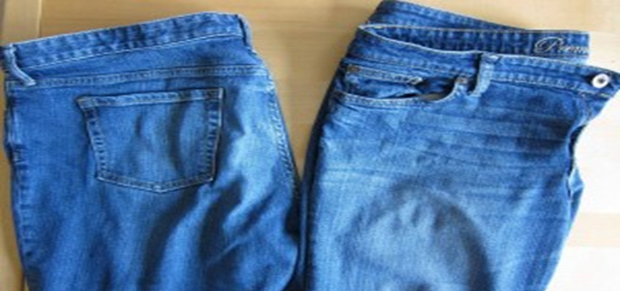
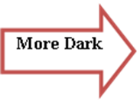
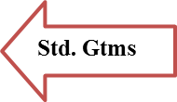
E(a)Washing Faults: Dark Shade
Dark Shade: When garments remain darker then its standard sample then it’s called light shade problem
Figure : Dark Shade Problem on Denim Washed Garments.
Causes: If the shade % is less than 1.5% then we consider this as dark shade. It cause if proper enzyme or bleaching process is not done.
Remedies: Enzyme process should do perfectly. And the rate of bleach will slightly increase then before.

Slide 90


E(a)Washing Faults: Light Shade
Light Shade: When garments become more lighter then it’s standard sample then it’s called light shade problem.
Causes: If the amount of bleach is higher or the timing of bleaching process is longer.
Remedies: On time of bleaching process the garments should check after time to time.

Slide 91
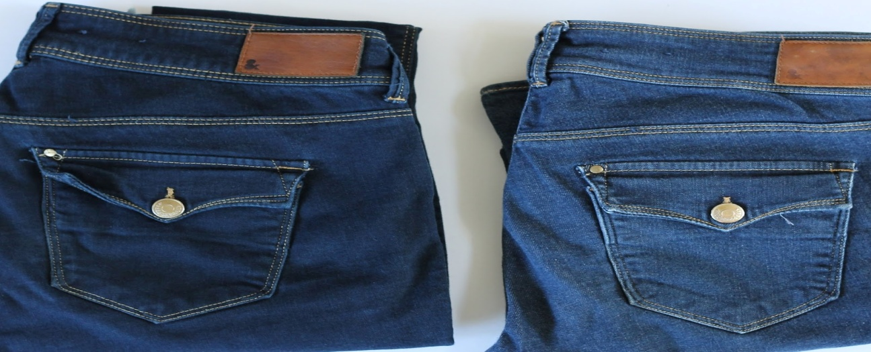


E(a)Washing Faults: Blue shade
Blue Shade: When garments remain or become bluer than standard then this problem is known as blue shade problem.
Causes: If standard mistake or any problem in recipe is occurred.
Remedies: Washing should done as per as standard & should apply the actual recipe.

Slide 92
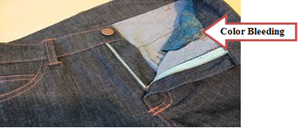
E(a)Washing Faults: Bleeding on Pocketing
Bleeding on Pocketing Fabric: When color of garment stained the pocketing fabric is known as ‘pocket bleeding’ or bleeding on pocketing fabric.
Causes: Less or no use of anti back staining chemical
Remedies: Proper use of anti back staining chemical

Slide 93
E(a)Causes and Remedies of Washing Faults
Dry Wash Faults:
  PP more: If PP Spray is applied more than the standard on garments.
Causes: Using more pp on the garments surface. If the concentration of pp is higher. Inactiveness of worker.
Remedies: PP should spray properly. Concentration should be accurate. Worker should be active on time of spraying.

Slide 94
E(a)Causes and Remedies of Washing Faults
Dry Wash Faults:
  PP less: If PP Spray is applied less than the standard on garments.
Causes: Using less pp on the garments surface. If the concentration of pp is lower. Inactiveness of worker.
Remedies: PP should spray properly. Concentration should be accurate. Worker should be active on time of spraying.

Slide 95
Causes & Remedies of PP More (4%)
If PP Spray is done more than the standard GMTS.
Causes: Using more pp on the garments surface. If the concentration of pp is higher. Inactiveness of worker.
Remedies: PP should spray properly. Concentration should be accurate. Worker should be active on time of spraying.
Causes & Remedies of PP Less (6%)
If PP Spray is done more than the standard GMTS.
Causes: Using less pp on the garments surface. If the concentration of pp is lower. Inactiveness of worker.
Remedies: PP should spray properly. Concentration should be accurate. Worker should be active on time of spraying.

Slide 96
F. Finishing Defects

Slide 97
Process Flow Chart of Garment Finishing:
Finishing input (style, color & size wise)
↓
Initial quality check
↓
Spot Removing
↓
Ironing/Pressing
↓
Inspection
↓
Hang tag
↓
Get up change
↓
Folding
↓
Poly
↓
Bar code (buyer wise sticker)
↓
Metal check
↓
Cartooning/Packaging
↓
Final inspection by buyer

Slide 98
F. Finishing Defects
Defects usually found in finishing section are
  Broken button
  Poor Ironing
  Wrong Hang tag
  Uncut thread
  Label Mistake
  Incorrect shape
  Wrong Polybag
  Incorrect packing
  Incorrect Packaging

Slide 99
PSI: Acceptable Quality Level (AQL)
Definition:
A statistical measurement of the maximum number of defective goods considered acceptable in a particular sample size.

Slide 100
The 3 general inspection levels
Level I
  Has this supplier passed most previous inspections? Do you feel confident in their products quality? Instead of doing no quality control, buyers can check less samples by opting for a level-I inspection.
  However, settling on this level by default, in order to spend less time/money on inspections, is very risky. The likelihood of finding quality problems is lower than generally recommended.
Level II
  It is the most widely used inspection level, to be used by default.

Slide 101
The 3 general inspection levels
Level III
  If a supplier recently had quality problems, this level is appropriate. More samples are inspected, and a batch of products will (most probably) be rejected if it is below the quality criteria defined by the buyer.
  Some buyers prefer level-III inspections for high-value products. It can also be interesting for small quantities, where the inspection would take only one day whatever the level chosen.

Slide 102
Defects
Visual defects are categorized as Critical, Major and Minor depending on the intensity and area of the defects.

Slide 103
Types of defects considered in AQL
Critical Defects: are those that render the product unsafe or hazardous for the end user or that contravene mandatory regulations.
Example:
Presence of insects, broken needle in the garment, etc.

Slide 104
Types of defects considered in AQL
Major defects: can result in the product’s failure, reducing marketability, usability.
Example:
Broken Stitch, Stain, etc.

Slide 105
Types of defects considered in AQL
Minor Defects: do not affect products marketability or usability but represents workmanship defects that make the product fall short of defined quality standard.
Example:
Minor stain, Puckering in small scale, etc.

Slide 106
Defect Zone
Visual defects are categorized as Major, Minor and Critical defects. In some cases, a major defect can be considered as minor based on the location of the defect in a garment. This location is called as zone. Zoning is done for fair evaluation of the garment during visual audit.
A garment can be divided up to 3 zones, like A, B and C.

Slide 107
Defect Zone
Most of the cases apparel buyers provide garment figures with marking zones in their quality manual. And provide a list of defects that fall under major or minor categories. In the following figure (source: Gap Inc.) a knitted top has been shown with zones A and B. At the front sleeves and upper front is considered as zone ‘A’ and lower front considered as zone ‘B’. On the back of the garment, under arms and back bottom is considered as zone ‘B’

Slide 108
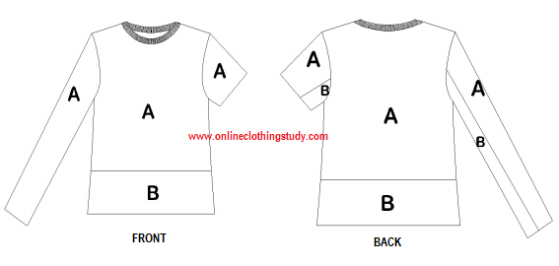
Defect Zone of T-Shirt

Slide 109
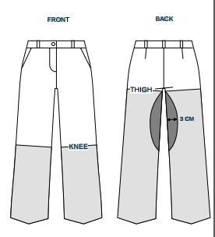
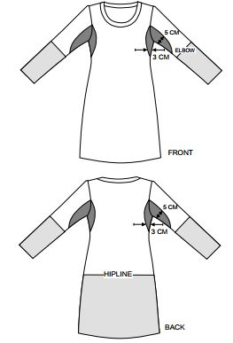
Pants and LS Ladies Dress

Slide 110
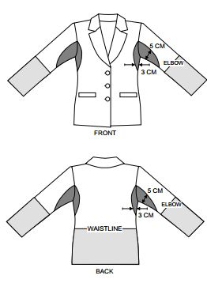

Blazer and Coat

Slide 111

AQL Chart

Slide 112
Checking areas in Inspection
Material Conformity
Style Conformity
Quantity Conformity
Workmanship (AQL)*
Measurement
Shade Conformity
Packing and Packaging Conformity

Slide 113
Selection of garment and carton
Buyers instruct about the required AQL
  Usually Major – 2.5
  Usually Minor – 4.0
  Usually Critical – zero tolerance
Cartons should be randomly selected
Numbers of carton to be selected = √n
All color and size should have the proportionate representation on the garments to be inspected
Measurement should cover all color and size that are to be inspected

Slide 114
Selection of Sample
Calculate the numbers of sample to be selected from different size, if order quantity=12000 pieces, numbers of color=1, Size wise quantity, S= 1500, M= 2500, L=4000, XL=2500 XXL= 1500.

Slide 115
List of Defects and their Categories (Fabric)
Sl# | Name of Defects | Critical | Major | Minor
01 | Presence of Broken Needle | x
02 | Presence of Insects in the Garments | x
03 | Hole (any Size) |  | x
04 | Needle Mark (Knitting) |  | x | x
05 | Sinker Mark |  | x | x
06 | Fly |  | x | x
07 | Starting Mark |  | x | x
08 | Patta /Barre Mark |  | x
09 | Lycra Out |  | x

Slide 116
List of Defects and their Categories (Fabric)
Sl# | Name of Defects | Critical | Major | Minor
10 | Warp Missing |  | x
11 | Slub |  | x | x
12 | Thick Yarn/Thin Yarn |  |  | x
13 | Knot |  | x | x
14 | End Out |  | x
15 | Crease Mark |  | x | x
16 | Stop Mark |  | x | x
17 | Missing Yarn |  | x
18 | Patch Mark |  | x | x

Slide 117
List of Defects and their Categories (Fabric)
Sl# | Name of Defects | Critical | Major | Minor
19 | Yarn Contamination |  | x | x

Slide 118
List of Defects and their Categories (Sewing)
Sl# | Name of Defects | Critical | Major | Minor
1 | Broken Stitch |  | x
2 | Puckering |  | x | x
3 | Poor Neck Shape |  | x | x
4 | Mismatch Stripe/Check |  | x | x
5 | Uncut Thread |  |  | x
6 | Skip Stitch |  | x
7 | Size Mistake |  | x
8 | Label Mistake |  | x
9 | Back Tape run off Stitch |  | x

Slide 119
List of Defects and their Categories (Sewing)
Sl# | Name of Defects | Critical | Major | Minor
10 | Uneven Body Hem |  | x | x
11 | Wrong placed Button/Up-Down |  | x | x
12 | Button Missing |  | x
13 | Incomplete Button Stitch |  | x
14 | Shade Variation between Parts |  | x | x
15 | Poor Shaped Pocket |  |  | x
16 | Raw Edge |  | x
17 | Uneven Width of Placket |  | x | x
18 | Slanted Pocket |  | x | x

Slide 120
List of Defects and their Categories (Sewing)
Sl# | Name of Defects | Critical | Major | Minor
19 | Slanted Pocket |  |  | x
20 | Slanted Zipper attachment |  |  | x
21 | Chalk mark |  |  | x
22 | Open Seam |  | x
23 | Thread not DTM |  |  | x
24 | Poor Neck Shape |  |  | x
25 | Uneven Sleeve Length |  | x
26 | Loose Stitch |  | x | x
27 | Blind Stitch Visible |  | x

Slide 121
List of Defects and their Categories (Sewing)
Sl# | Name of Defects | Critical | Major | Minor
8 | Uneven Stitch |  | x | x
29 | Button Hole Damaged |  | x
30 | Incomplete Button Hole Stitch |  | x
31 | Pleat |  | x | x
32 | Placing Mark |  |  | x
33 | Skipped Stitch |  | x

Slide 122
List of Defects and their Categories (Finishing)
Sl# | Name of Defects | Critical | Major | Minor
01 | Dirty Spot |  | x | x
02 | Oil Spot |  | x | x
03 | Hang Tag Missing |  | x
04 | Wrong Hang Tag |  | x
05 | Iron Mark |  | x | x
06 | Poor Iron |  |  | x
07 | Gum Mark of Interlining |  | x | x
08 | Loose Thread |  |  | x
09 | Wrong Hang Tag |  | x

Slide 123
List of Defects and their Categories (Miscellaneous)
Sl# | Name of Defects | Critical | Major | Minor
01 | Printing Spot |  | x | x
02 | Misplaced Print |  | x | x
03 | Slanted Print |  | x | x
04 | Incomplete Embroidery |  | x
05 | Misplaced Embroidery |  | x | x
06 | Presence of insects | x
07 | Presence of broken needle | x
08 | Sharp edge of Rivet | x

