Slide 1
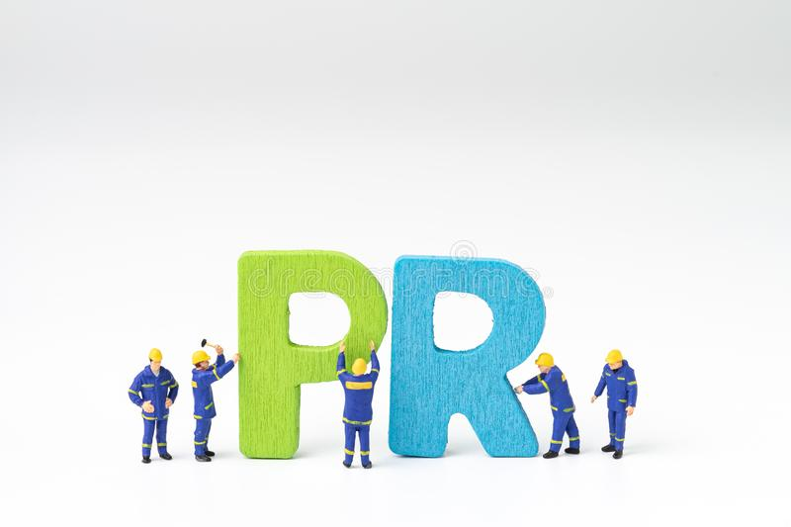
Welcome
To the Course
Public Relations(PR)
JMC 522

Slide 2
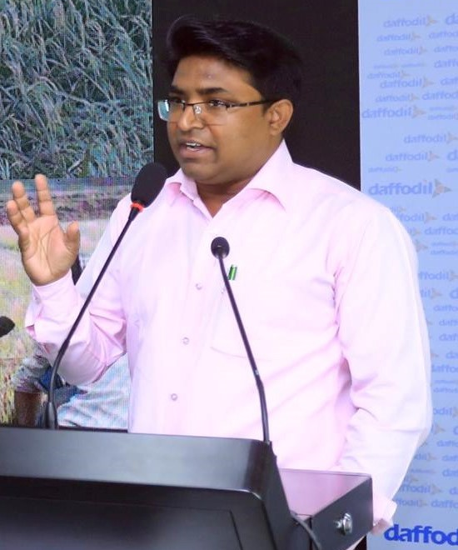
Dr. Sheikh Shafiul Islam
Associate Professor & Head
Department of Journalism and Mass Communication
Daffodil International University

Slide 3
Objective of the Course
To orient/enable the students with:
the established theories of Public Relations
the tools and techniques of PR
knowledge of designing a PR plan or strategy
Skills of producing innovative PR materials/tools
Ability to create image of a person or organization
Managerial capability to handle crisis

Slide 4
Careers in PR
Career in PR
Public Relations Officer
Media Relations Officer
Campaign Officer
Media Officer
Media Relations Officer
Client Relations Officer
Advocacy Officer
Brand Officer

Slide 5
Where?
* Government departments and organizations like ministries
* Non-government organizations like Bank, Insurance,
* Business agencies or corporate houses
* Donor agencies, national and local NGOs
* UN system agencies, World Bank, Asian Development Bank
* Ad agencies, event management and PR firms
* Any manufacturing companies
* Supplying companies/chains
* Any service and product oriented companies

Slide 6
Assessment Methods
Full marks of the course is 100 which is allocated as below:
Test Items | Marks
Attendance | 07
Quiz | 15
Assignment | 05
Presentation | 08
Midterm | 25
Final | 40
Full marks | 100

Slide 7
Grading system
Numerical Grade Letter Grade Grade Point Remarks
80% and above A + (Plus) 4.00 Outstanding
75% to less than 80% A (Regular) 3.75 Excellent
70% to less than 75% A – (Minus) 3.50 Very Good
65% to less than 70% B + (Plus) 3.25 Good
60% to less than 65% B 3.00 Satisfactory
55% to less than 60% B - (Minus) 2.75 Above Average
50% to less than 55% C + (Plus) 2.50 Average
45% to less than 50% C (Regular) 2.25 Below Average
40% to less than 45% D 2.00 Pass
Less than 40% F 0.00 Fail

Slide 8
Thank you very much

