Slide 1
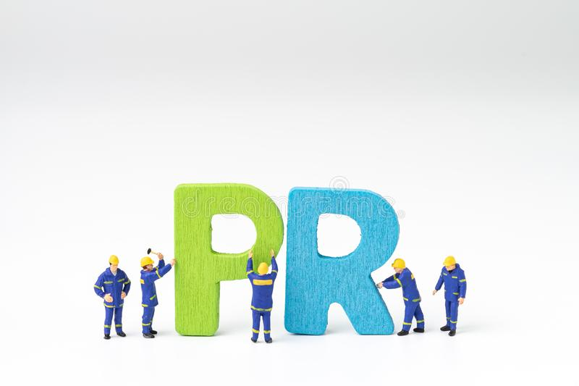
Welcome
To the Course
Public Relations(PR)
JMC 522

Slide 2
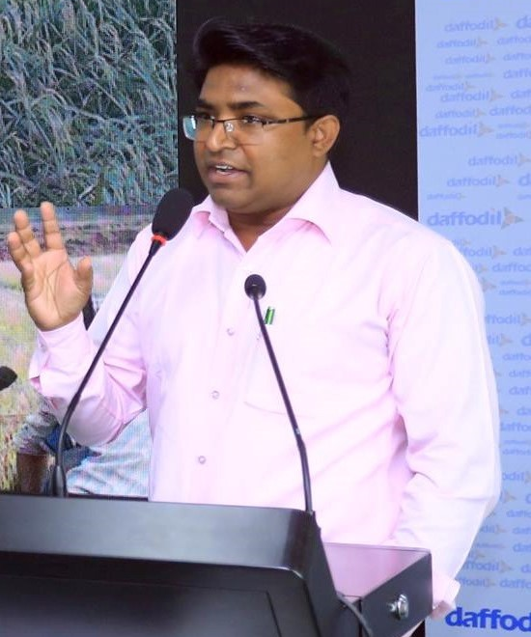
Dr. Sheikh Shafiul Islam
Associate Professor & Head
Department of Journalism and Mass Communication
Daffodil International University

Slide 3
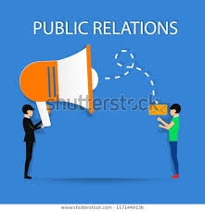
Definitions
“ Public relations is a strategic communication process that builds mutually beneficial relationships between organizations and their publics”.
PR can be defined as the practice of managing communication between an organization and its publics.

Slide 4
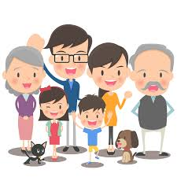
Definitions
John E. Marston said, “Public relations are the management function which evaluates public attitudes, identities the policies and procedures of an organization with the public interest and executes a programme of action and communication to earn public understanding and acceptance.”

Slide 5
Definitions
“A strategic management function that adds value to an organization by helping it to manage its reputation.” ---The Chartered Institute of public relations.
According to Edward Barney, “Public relations are the attempt by information, persuasion, adjustment, to engineer public support for an activity, a cause, movement or an institution.”

Slide 6
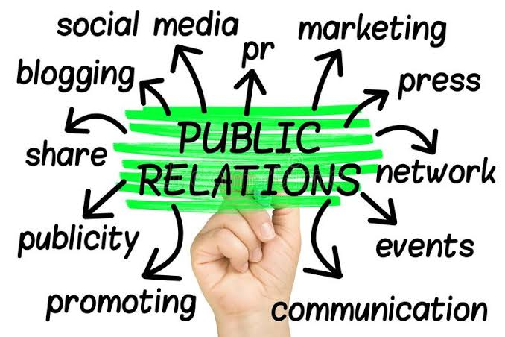
Tools & Platforms of PR

Slide 7
The Publics in PR

Slide 8
Key Role of PR Managing relationship with the public
Clients
Mass people
Customers
Stockholders
Suppliers
Employees

Slide 9
Major Functions of PR
The ultimate goal of the PR department/section is to create a positive image of an organization or person by proactively seeking and accommodating favourable opportunities in the media through the following means:
PR Functions
Disseminating press release
Planning campaign
Facilitating interviews
Organizing press conferences
Compiling helpful promotion info

Slide 10
What to learn ?
Subject knowledge
Computer skills
Soft skills, Language & Presentation

Slide 11
Thank you very much

