Slide 1

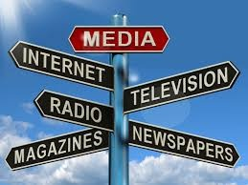
Human Communication

Slide 2
Presented By:
Dr. Sheikh Shafiul Islam
Associate Professor
Department of Journalism and Mass Communication
Daffodil International University
01704 320 110

Slide 3


Slide 4

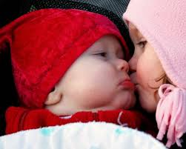


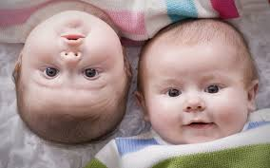

Slide 5
Human Communication
Definition:
“Communication is a process by which information is exchanged between individuals through a common system of symbols, signs or behavior.”
[Key Word: Process, Heraclitus, one can never step in the same river twice, Thomas wolf’s novel you can’t go home again]
“People can communicate on many levels, for many reasons, with many people, in many ways”
[70% active time: listening, speaking, reading, writing]

Slide 6


Concepts
The term `Communication’ derives from ‘communus’, a Latin Word. It means ‘commonness’. The word implies that through communication, commonness is created between two people or more. It involves sharing of an idea, thought, feeling or information with others, which includes thinking, dreaming, speaking, arguing and so on. It also denotes transformation of any information from one particular source to another

Slide 7
Concepts
Communication facilitates sharing of common experiences among different ‘selves’, the people. All people are not successful in every attempts of communication. This is why we need to learn to be successful communicators.
’Human Communication involves multidisciplinary knowledge and skills that makes it a complex process. We, however, in many cases forget to recognize how complex the communication is. To conceptualize the complex pattern of communication, we need to know the ways we communicate with people, the pattern of communication itself, the functions of human communication, and also some tips about how a person can be a successful communicator.

Slide 8
concepts
Communication is called ‘life-blood’ of an institution or an organization. Strong and effective communication is as helpful for building image, as the weak communication systems does reversely. Communication is the binding component of human beings which is fundamental for effective and intelligent existence on the earth.

